Slide 1
Topic 9: Wave phenomena - AHL 9.4 – Resolution
Topic 9.4 is an extension of Topic 4.
Essential idea: Resolution places an absolute limit on the extent to which an optical or other system can separate images of objects.
Nature of science: Improved technology: The Rayleigh criterion is the limit of resolution. Continuing advancement in technology such as large diameter dishes or lenses or the use of smaller wavelength lasers pushes the limits of what we can resolve.
Understandings:
• The size of a diffracting aperture
• The resolution of simple monochromatic two-source systems
Notes:
© 2015 By Timothy K. Lund

Slide 2
Topic 9: Wave phenomena - AHL 9.4 – Resolution
Applications and skills:
• Solving problems involving the Rayleigh criterion for light emitted by two sources diffracted at a single slit
• Resolvance of diffraction gratings
Guidance:
• Proof of the diffraction grating resolvance equation is not required
Data booklet reference:
• $=\frac{1.22λ}{b}$
• $R=\frac{λ}{Δλ}=mN$
Notes:
© 2015 By Timothy K. Lund

Slide 3
Topic 9: Wave phenomena - AHL 9.4 – Resolution
International-mindedness:
• Satellite use for commercial and political purposes is dictated by the resolution capabilities of the satellite
Theory of knowledge:
• The resolution limits set by Dawes and Rayleigh are capable of being surpassed by the construction of high quality telescopes. Are we capable of breaking other limits of scientific knowledge with our advancing technology?
Notes:
© 2015 By Timothy K. Lund

Slide 4
Topic 9: Wave phenomena - AHL 9.4 – Resolution
Utilization:
• An optical or other reception system must be able to resolve the intended images. This has implications for satellite transmissions, radio astronomy and many other applications in physics and technology (see Physics option C)
• Storage media such as compact discs (and their variants) and CCD sensors rely on resolution limits to store and reproduce media accurately
Notes:
© 2015 By Timothy K. Lund

Slide 5
Topic 9: Wave phenomena - AHL 9.4 – Resolution
Aims:
• Aim 3: this sub-topic helps bridge the gap between wave theory and real-life applications
• Aim 8: the need for communication between national communities via satellites raises the awareness of the social and economic implications of technology
Notes:
© 2015 By Timothy K. Lund

Slide 6
Topic 9: Wave phenomena - AHL 9.4 – Resolution
The resolution of monochromatic two-source systems
•Two distant objects that are close together will look like one object if they are far enough away.
EXAMPLE: Observe the animation of the headlights located about a meter apart on an approaching jeep. Describe qualitatively what you see.
SOLUTION:
•At first the two headlights appear to be one light source.
•The image begins to split as the vehicle approaches.
•Finally the two headlights are resolved.
central max
1st min
diffraction pattern of each source
Notes:
© 2015 By Timothy K. Lund

Slide 7
Topic 9: Wave phenomena - AHL 9.4 – Resolution
The resolution of monochromatic two-source systems
•The following example shows different degrees of resolution of the headlights of the last slide.
EXAMPLE: List NOT RESOLVED, JUST RESOLVED, RESOLVED, WELL-RESOLVED.
central max
A
A
B
B
C
C
E
1st min
D
E
D
F
F
Notes:
© 2015 By Timothy K. Lund

Slide 8
Topic 9: Wave phenomena - AHL 9.4 – Resolution
The resolution of monochromatic two-source systems
•Two sources are just resolved using an aperture if the following is true: the first minimum of the diffraction pattern of one of the sources falls on the central maximum of the diffraction pattern of the other source.
•This criterion yields the following two formulas for minimal angular separation:
•This definition is known as Rayleigh’s criterion.
central max
1st min
$$=\frac{λ}{b}$$
Rayleigh criterion for SQUARE apertures
(θ in rad)
b
b
$$=1.22\frac{λ}{b}$$
Rayleigh criterion for CIRCULAR apertures
(θ in rad)
b
Notes:
© 2015 By Timothy K. Lund

Slide 9
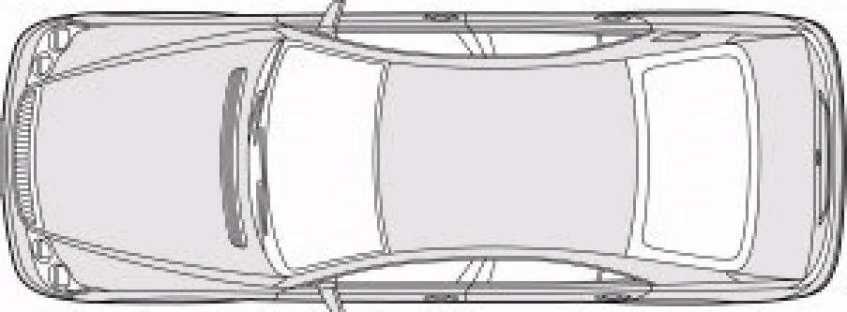
Topic 9: Wave phenomena - AHL 9.4 – Resolution
The resolution of monochromatic two-source systems
$$=\frac{λ}{b}$$
Rayleigh criterion for SQUARE apertures
(θ in rad)
b
b
$$=1.22\frac{λ}{b}$$
Rayleigh criterion for CIRCULAR apertures
(θ in rad)
b
PRACTICE: A car’s headlights (λ = 530 nm) are 0.75 m apart. At what maximum distance can they just be resolved by the human eye (diameter = 2.5 mm)?
SOLUTION: Use $=1.22\frac{λ}{b}$since pupil is circular.
$=1.22\frac{λ}{b}$= $\frac{1.22\left(530×{10}^{−9}\right)}{0.0025}= 2.5864×{10}^{−4}$ rad.
From the sketch $=\frac{0.75}{D}$ so $D=\frac{0.75}{θ}=\frac{0.75}{2.5864×{10}^{−4}}=2.9$km.
D
θ
0.75 m
Notes:
© 2015 By Timothy K. Lund

Slide 10
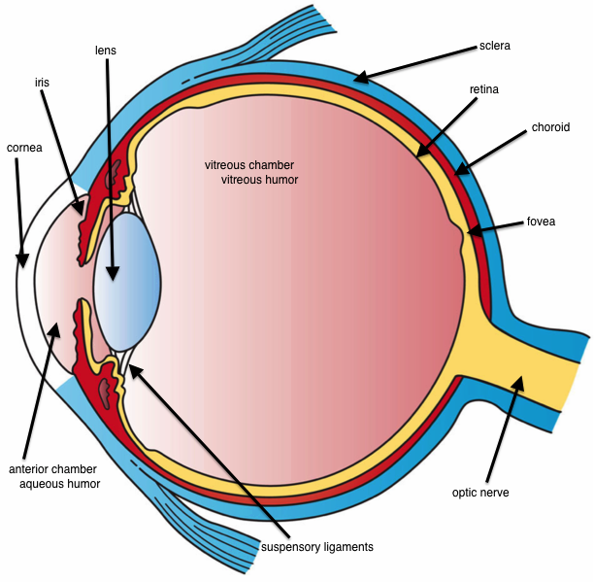
Notes:
© 2015 By Timothy K. Lund

Slide 11
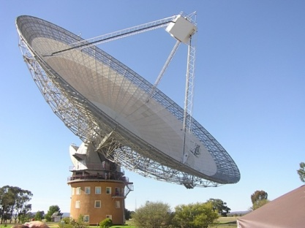
Topic 9: Wave phenomena - AHL 9.4 – Resolution
The resolution of monochromatic two-source systems
PRACTICE: A 68-meter diameter radio telescope is receiving radio signals of 2.0 GHz from two stars that are 75 light years (ly) away and separated by 0.045 ly.
(a) Can the telescope resolve the images of the two stars?
SOLUTION:
$=\frac{c}{f}=\frac{3.00×{10}^{8}}{2.0×{10}^{9}} = 0.15$m.
•For the telescope
$=1.22\frac{λ}{b}=\frac{1.22\left(0.15\right)}{68} = 0.0027$rad.
•For the stars
$ =\frac{0.045}{75} = 0.00060 rad$.
NO. The angular separation of the stars is too small for the telescope to resolve.
θ
0.045
75
FYI: We usually cancel the units (in this case light years). Don’t convert prematurely!
Notes:
© 2015 By Timothy K. Lund

Slide 12
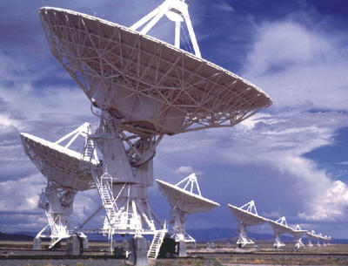
Topic 9: Wave phenomena - AHL 9.4 – Resolution
The resolution of monochromatic two-source systems
PRACTICE: A 68-meter diameter radio telescope is receiving radio signals of 2.0 GHz from two stars that are 75 light years (ly) away and separated by 0.045 ly.
(b) If another identical radio telescope is located 350 m away and it can be used in concert with the first one to create a single telescope having an effective diameter of 350 m, can the pair resolve the two stars?
SOLUTION: We need $ ≤\frac{0.045}{75}=0.00060$rad.
$=\frac{c}{f}=\frac{3.00×{10}^{8}}{2.0×{10}^{9}} = 0.15 \text{m}$ (as before).
For the new telescope
$=1.22\frac{λ}{b}=\frac{1.22\left(0.15\right)}{350}=0.000523$rad.
YES.
FYI: Radio telescopes are commonly grouped together in what are called radio arrays.
Notes:
© 2015 By Timothy K. Lund

Slide 13
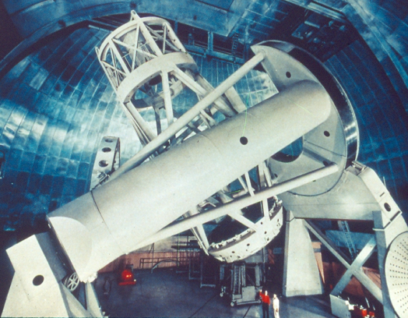
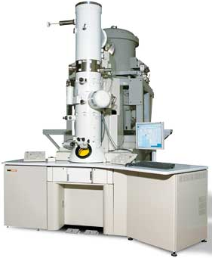
Topic 9: Wave phenomena - AHL 9.4 – Resolution
The resolution of monochromatic two-source systems
$$=1.22\frac{λ}{b}$$
Rayleigh criterion for CIRCULAR apertures
(θ in rad)
b
PRACTICE: List two ways to increase the resolution (decrease θ) of an optical device.
SOLUTION:
•Method 1: Increase b, the diameter.
Thus, the 200-inch telescope on Mt. Palomar will have a better resolution than a 2-inch diameter home-sized telescope.
•Method 2: Decrease the wavelength λ.
Thus, an electron microscope has better resolution than an optical microscope.
Notes:
© 2015 By Timothy K. Lund

Slide 14
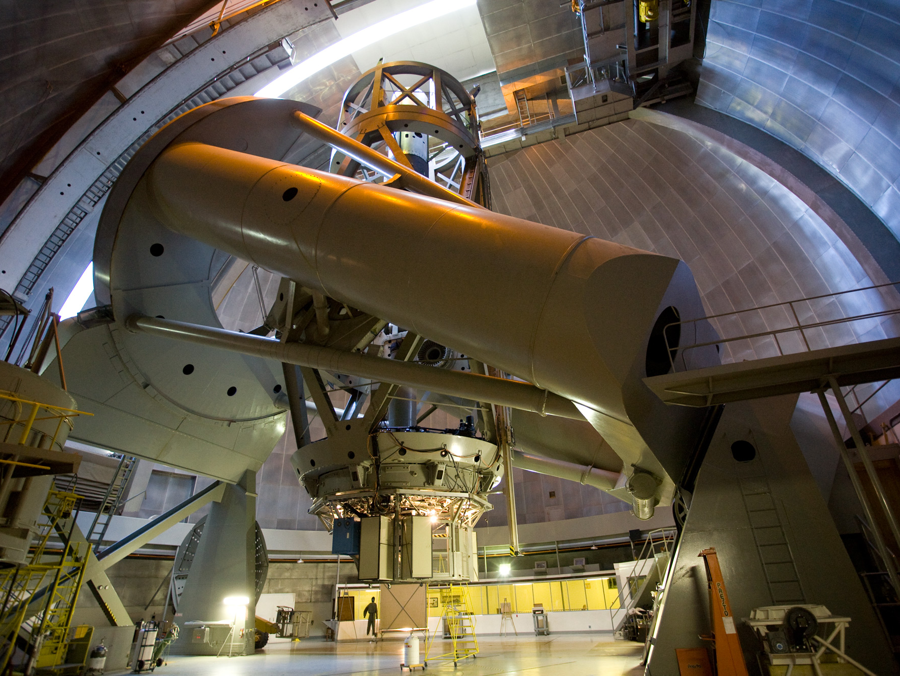
Palomar Observatory – 200 inch detector
Notes:
© 2015 By Timothy K. Lund

Slide 15
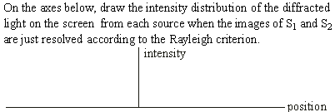
Topic 9: Wave phenomena - AHL 9.4 – Resolution
The resolution of monochromatic two-source systems
•FYI. The single slit is our aperture.
•Note that the peak of one matches the 1st minimum of the other.
Notes:
© 2006 By Timothy K. Lund

Slide 16
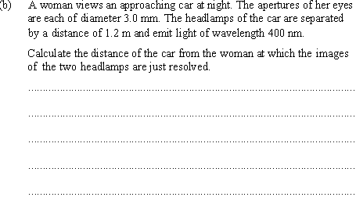
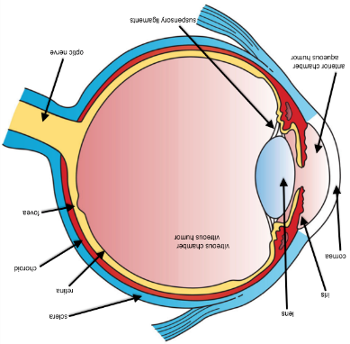
Topic 9: Wave phenomena - AHL 9.4 – Resolution
The resolution of monochromatic two-source systems
$$=1.22\frac{λ}{b}$$
•For the woman’s round pupils:
$=1.22\left(\frac{400×{10}^{−9}}{0.003}\right) = 1.6×{10}^{−4}$rad.
θ = 0.00016
1.2
D
$$=0.00016=\frac{1.2}{D}$$
•We want D:
$D=\frac{1.2}{0.00016}=7500$ m ($7.5$ km).
Notes:
© 2006 By Timothy K. Lund

Slide 17
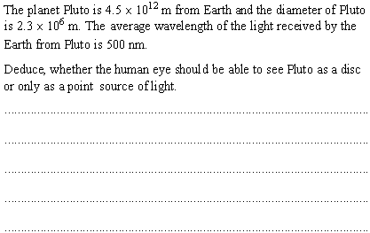
Topic 9: Wave phenomena - AHL 9.4 – Resolution
The resolution of monochromatic two-source systems
•Pluto’s angular separation at the equator is
$=\frac{2.3×106}{4.5×1012}= 5.1×{10}^{−7}$rad.
•For an eye to see this angular separation:
$=1.22\frac{λ}{b}$ and so $b=1.22\frac{λ}{θ}=1.22\frac{500×{10}^{−9}}{5.1×{10}^{−7}}= 1.2 \text{m}$
•This eye diameter is way too big.
•Thus the human eye will perceive Pluto only as a point source of light.
Notes:
© 2006 By Timothy K. Lund

Slide 18
Topic 9: Wave phenomena - AHL 9.4 – Resolution
The resolution of monochromatic two-source systems
•Use $=1.22\frac{λ}{b}$ ( or $θ=\frac{λ}{b}$ since we are looking only for the ORDER ):
$=1.22\frac{0.06}{120} = 6×{10}^{−4}$rad.
$=\frac{0.06}{120} = 5×{10}^{−4}$rad.
Notes:
© 2006 By Timothy K. Lund

Slide 19
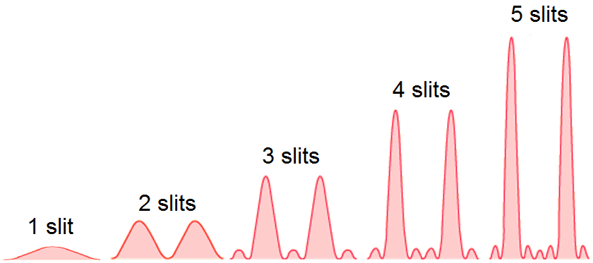
Topic 9: Wave phenomena - AHL 9.4 – Resolution
Resolvance of diffraction gratings
•Consider the intensity patterns for multiple-slit interference.
•Two pattern characteristics are apparent:
The more slits, the higher the intensity of the primary maxima.
The more slits, the narrower the primary maxima.
Notes:
© 2015 By Timothy K. Lund

Slide 20
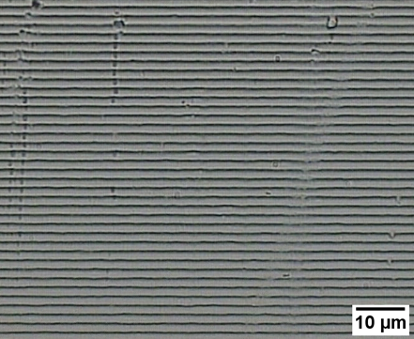
Topic 9: Wave phenomena - AHL 9.4 – Resolution
Resolvance of diffraction gratings
•If we think of a diffraction grating as having hundreds of slits, we can imagine that the widths of the primary maxima are very small, indeed.
•And using the Rayleigh criterion on these primary maxima, we see that the resolution for a grating will be proportional to the number of lines.
•The resolvance R of a diffraction grating is defined as the ratio of the average λ of two wavelengths to their difference Δλ. Thus
$$R =\frac{λ}{Δλ}$$
resolvance of a diffraction grating
FYI: Resolvance is essentially a measure of how well a diffraction grating can separate two wavelengths.
Notes:
© 2015 By Timothy K. Lund

Slide 21
Topic 9: Wave phenomena - AHL 9.4 – Resolution
Resolvance of diffraction gratings
•As we pointed out on the previous slide, grating resolution is proportional to N, the total lines illuminated by the incident beam of light.
•Observing the diffraction pattern for white light, we see that a natural consequence of diffraction is the spreading out of the pattern for higher orders. This amounts to a natural separation of wavelengths that increases with order.
•Without proof, we state that the resolvance R for each order of diffraction m is given by R = Nm, where N is the total number of slits illuminated by the beam. (In light of the above points this should be reasonable.)
m = 2
m = 1
m = 0
m = 1
m = 2
$$R =\frac{λ}{Δλ}=Nm$$
resolvance of a diffraction grating
Notes:
© 2015 By Timothy K. Lund

Slide 22
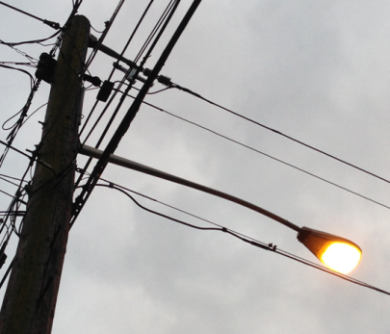
Topic 9: Wave phenomena - AHL 9.4 – Resolution
Resolvance of diffraction gratings
$$R =\frac{λ}{Δλ}=Nm$$
resolvance of a diffraction grating
EXAMPLE: Two lines of the sodium emission spectrum are visible, having wavelengths of 589.0 nm and 589.6 nm. A diffraction grating is illuminated with a beam of this light having a width of 0.2500 mm.
What is the resolvance of this grating?
SOLUTION:
$=\frac{589.0+589.6}{2} = 589.3$ nm. Thus
$R=\frac{λ}{Δλ}=\frac{589.3}{589.6–589.0} = 982.2$.
Notes:
© 2015 By Timothy K. Lund

Slide 23
Topic 9: Wave phenomena - AHL 9.4 – Resolution
Resolvance of diffraction gratings
$$R =\frac{λ}{Δλ}=Nm$$
resolvance of a diffraction grating
EXAMPLE: Two lines of the sodium emission spectrum are visible, having wavelengths of 589.0 nm and 589.6 nm. A diffraction grating is illuminated with a beam of this light having a width of 0.2500 mm.
(b) Find the minimum number of lines under the beam needed for the resolvance of the order 2 spectrum.
SOLUTION: Use $R=Nm$where $m=2$ and $R=982.2$.
$N=\frac{R}{m}=\frac{982.2}{2} = 491.1$.
Notes:
© 2015 By Timothy K. Lund

Slide 24
Topic 9: Wave phenomena - AHL 9.4 – Resolution
Resolvance of diffraction gratings
$$R =\frac{λ}{Δλ}=Nm$$
resolvance of a diffraction grating
EXAMPLE: Two lines of the sodium emission spectrum are visible, having wavelengths of 589.0 nm and 589.6 nm. A diffraction grating is illuminated with a beam of this light having a width of 0.2500 mm.
(c) Find the minimum number of lines per mm needed in this particular diffraction grating.
SOLUTION:
Lines per mm $=\frac{491.1 lines}{0.2500 mm} = 1964\frac{lines}{mm}$.
Notes:
© 2015 By Timothy K. Lund

Slide 25
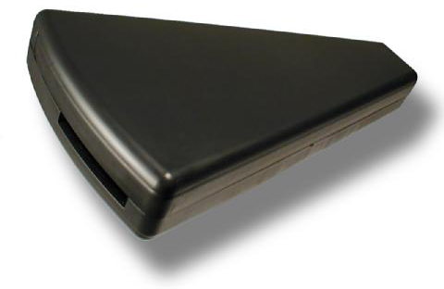
Topic 9: Wave phenomena - AHL 9.4 – Resolution
Resolvance of diffraction gratings
PRACTICE:
A beam of light having an average wavelength of 550.0 nm is incident on a 1.50-cm wide diffraction grating having 500. lines per mm. Calculate the smallest difference in wavelength that can be resolved in the third order and find the resolvance of the grating.
SOLUTION:
•Use $\frac{λ}{Δλ}=Nm$ where $m=3$and $=550.0$nm
•N is the number of lines in the incident beam. Thus
$N=\left(500\frac{lines}{mm}\right)\left(15.0 mm\right)=7500 lines$.
•From $\frac{λ}{Δλ}=Nm$ we get
$Δλ=\frac{λ}{Nm}=\frac{550.0 nm}{\left(7500\right)\left(3\right)} = 0.02444$nm.
•From R = Nm we get
$R=Nm=(7500)(3)=22500$.
Notes:
© 2015 By Timothy K. Lund

Slide 26
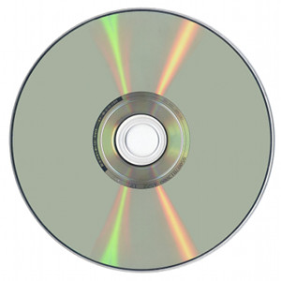
Topic 9: Wave phenomena - AHL 9.4 – Resolution
Resolvance of diffraction gratings
PRACTICE:
CDs and DVDs consist of very tiny pits and peaks that represent zeros and ones (binary). These pits are detected by laser light. Explain why DVDs can hold more information than CDs.
SOLUTION:
•With the advent of lasers having higher frequencies, smaller pits can be resolved.
•A DVD player must have a laser of higher frequency (smaller wavelength) than a CD player.
light pickup (laser)
1 0 1 0 0 1 0 1 1 0 1 1 1 0 0 1 0 1 1
DIGITAL INFORMATION STORAGE
motion of “groove”
Notes:
© 2015 By Timothy K. Lund

Slide 27
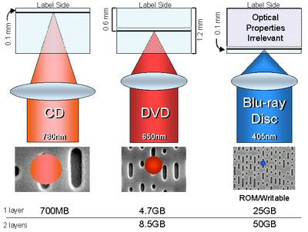
Topic 9: Wave phenomena - AHL 9.4 – Resolution
Resolvance of diffraction gratings
EXAMPLE:
Here is a comparison of the different laser frequencies and wavelengths used today.
Notes:
© 2015 By Timothy K. Lund

