Slide 1
Topic 9: Wave phenomena - AHL 9.3 – Interference
Topic 9.3 is an extension of Topic 4.4.
Essential idea: Interference patterns from multiple slits and thin films produce accurately repeatable patterns.
Nature of science: (1) Curiosity: Observed patterns of iridescence in animals, such as the shimmer of peacock feathers, led scientists to develop the theory of thin film interference. (2) Serendipity: The first laboratory production of thin films was accidental.
Notes:
© 2015 By Timothy K. Lund

Slide 2
Topic 9: Wave phenomena - AHL 9.3 – Interference
Understandings:
• Young’s double-slit experiment
• Modulation of two-slit interference pattern by one-slit diffraction effect
• Multiple slit and diffraction grating interference patterns
• Thin film interference
Notes:
© 2015 By Timothy K. Lund

Slide 3
Topic 9: Wave phenomena - AHL 9.3 – Interference
Applications and skills:
• Qualitatively describing two-slit interference patterns, including modulation by one-slit diffraction effect
• Investigating Young’s double-slit experimentally
• Sketching and interpreting intensity graphs of double-slit interference patterns
• Solving problems involving the diffraction grating equation
• Describing conditions necessary for constructive and destructive interference from thin films, including phase change at interface and effect of refractive index
• Solving problems involving interference from thin films
Notes:
© 2015 By Timothy K. Lund

Slide 4
Topic 9: Wave phenomena - AHL 9.3 – Interference
Guidance:
• Students should be introduced to interference patterns from a variety of coherent sources such as (but not limited to) electromagnetic waves, sound and simulated demonstrations
• Diffraction grating patterns are restricted to those formed at normal incidence
• The treatment of thin film interference is confined to parallel-sided films at normal incidence
• The constructive interference and destructive interference formulae listed below and in the data booklet apply to specific cases of phase changes at interfaces and are not generally true
Notes:
© 2015 By Timothy K. Lund

Slide 5
Topic 9: Wave phenomena - AHL 9.3 – Interference
Data booklet reference:
• nλ = d sin θ
• Constructive interference: 2dn = (m + ½)λ
• Destructive interference: 2dn = mλ
Theory of knowledge:
• Most two-slit interference descriptions can be made without reference to the one-slit modulation effect. To what level can scientists ignore parts of a model for simplicity and clarity?
Utilization:
• Compact discs are a commercial example of the use of diffraction gratings
• Thin films are used to produce anti-reflection coatings
Notes:
© 2015 By Timothy K. Lund

Slide 6
Topic 9: Wave phenomena - AHL 9.3 – Interference
Aims:
• Aim 4: two scientific concepts (diffraction and interference) come together in this sub-topic, allowing students to analyze and synthesize a wider range of scientific information
• Aim 6: experiments could include (but are not limited to): observing the use of diffraction gratings in spectroscopes; analysis of thin soap films; sound wave and microwave interference pattern analysis
• Aim 9: the ray approach to the description of thin film interference is only an approximation. Students should recognize the limitations of such a visualization
Notes:
© 2015 By Timothy K. Lund

Slide 7
Topic 9: Wave phenomena - AHL 9.3 – Interference
Double-slit interference - review
PRACTICE: Two apertures in a sea wall produce two diffraction patterns as shown in the animation.
(a) Which letter represents a maximum displacement above equilibrium? __
(b) Which letter represents a maximum displacement below equilibrium? __
(c) Which letter represents a minimum displacement from equilibrium? __
•Crest-crest = max high. Trough-trough = max low.
•Crest-trough = minimum displacement.
C (crest-crest)
A
B (trough-trough)
B
C
D
A (crest-trough)
Notes:
© 2015 By Timothy K. Lund

Slide 8
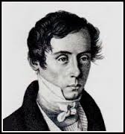
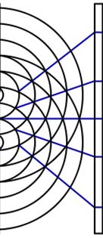
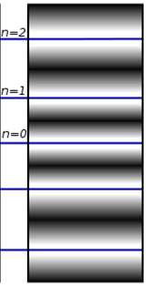
Topic 9: Wave phenomena - AHL 9.3 – Interference
Double-slit interference - review
•Double-slit interference with light waves was explored by Thomas Young in 1801.
•The following formula, as you may recall from Topic 4.4, relates wavelength λ, slit separation d, and distance D to screen, to the separation s of the maxima:
λ
s
d
monochromatic light
D
$$s=\frac{λD}{d}$$
Young’s double-slit experiment
Notes:
© 2015 By Timothy K. Lund

Slide 9
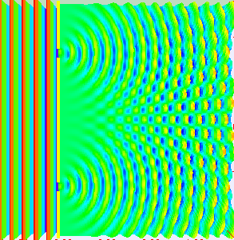
Topic 9: Wave phenomena - AHL 9.3 – Interference
Double-slit interference - review
•This animation of water waves shows single-slit diffraction and two-slit interference over a large field.
•Where two crests or two troughs meet there is constructive interference.
•Where a crest meets a trough there is destructive interference.
s
"Doubleslit3Dspectrum" by Lookang many thanks to Fu-Kwun Hwang and author of Easy Java Simulation - Francisco Esquembre - Own work. Licensed under CC BY-SA 3.0 via Wikimedia Commons -
Notes:
© 2015 By Timothy K. Lund

Slide 10
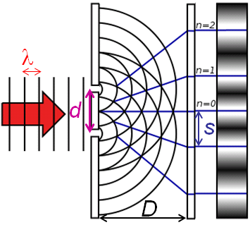
Topic 9: Wave phenomena - AHL 9.3 – Interference
Double-slit interference - review
EXAMPLE: Coherent light having a wavelength of 675 nm is incident on an opaque card having two vertical slits separated by 1.25 mm. A screen is located 4.50 m away from the card. What is the distance between the central maximum and the first maximum?
SOLUTION: Use $s=\frac{λD}{d}$.
•λ = 675×10 ⁻⁹ m, D = 4.50 m, and d = 1.25×10 ⁻³ m.
•Thus
$s =\frac{λD}{d}$
$=\frac{\left(675×{10}^{−9}\right)\left(4.50\right)}{1.25×{10}^{−3}}= 0.00243$m.
Notes:
© 2015 By Timothy K. Lund

Slide 11
Topic 9: Wave phenomena - AHL 9.3 – Interference
Double-slit interference – intensity
•Because each slit in two-slit interference also acts like a single slit, likewise introduced in Topic 4, the ________________________________.
•The bottom image shows the double-slit pattern. Note the regular separation s but the varying intensity.
•The top image shows the interference pattern if one of the two slits is blocked. In fact, ___________________ ____________________________________________.
single-slit intensity
double-slit intensity
Notes:
© 2015 By Timothy K. Lund

Slide 12
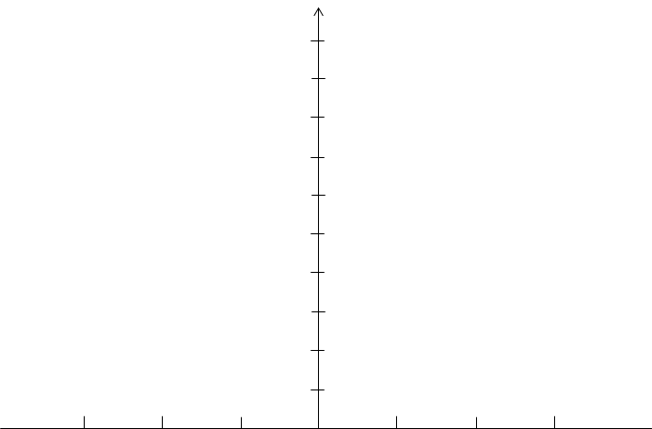
Topic 9: Wave phenomena - AHL 9.3 – Interference
Double-slit interference – intensity
•If the double-slit intensity were not modulated by the single-slit effect, it would look like this:
•Because of single- slit constructive and destructive interference, the actual double-slit intensity pattern looks like this:
single-slit envelope
single-slit intensity
double-slit intensity
Notes:
© 2015 By Timothy K. Lund

Slide 13
Topic 9: Wave phenomena - AHL 9.3 – Interference
Double-slit interference – intensity
•Incidentally, the overall ________________ intensity of the _________________________________________ ____________________________________ there are two sources, rather than one.
•It turns out that if N is the number of slits, and I₁ is the intensity of the single-slit central maximum, then
I₁
single-slit intensity I₁
4I₁
double-slit intensity I₂ = 2²I₁ = 4I₁
intensity of central maximum for N slits
Notes:
© 2015 By Timothy K. Lund

Slide 14
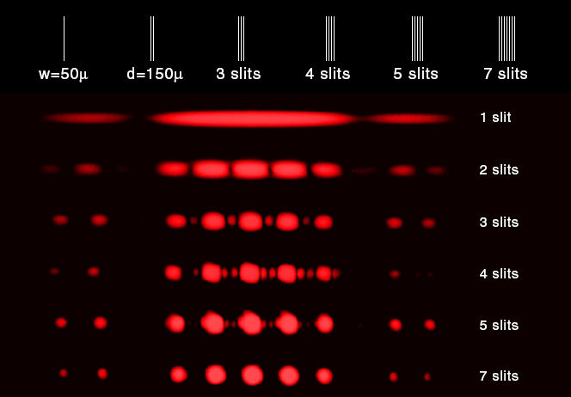
Topic 9: Wave phenomena - AHL 9.3 – Interference
The single-slit envelope still applies.
Multiple-slit interference
•The separation between maxima $s=\frac{λD}{d}$that we calculated for two-slit interference shows the location of the single-slit envelope peaks for multiple slits separated by d, as illustrated:
primary maxima
s
s
s
s
secondary maxima
Notes:
© 2015 By Timothy K. Lund

Slide 15
Topic 9: Wave phenomena - AHL 9.3 – Interference
1 slit
Multiple-slit interference
•The intensities for 1, 2, 3, 4 and 5 equally-spaced slits are shown here, for part of the central maximum envelope.
•Note the ____________ ____________________ ____________________ ____________________.
•Also observe that the ____________________ _______________. More light gets through.
I₂
2 slits
(9/4)I₂
s
s
3 slits
(16/4)I₂
4 slits
(25/4)I₂
primary maxima
secondary maxima
5 slits
Notes:
© 2015 By Timothy K. Lund

Slide 16
Topic 9: Wave phenomena - AHL 9.3 – Interference
Multiple-slit interference
EXAMPLE: A light having a wavelength of λ = 675×10 ⁻⁹ m is projected onto four vertical slits equally spaced at 16.875 μm between slits. The slit widths are all 6.75 μm. The resulting diffraction pattern is projected on a wall that is 5.00 m away from the slits.
(a) Find the separation between the bright points in the pattern.
SOLUTION: Use $s =\frac{λD}{d}$
Notes:
© 2015 By Timothy K. Lund

Slide 17
Topic 9: Wave phenomena - AHL 9.3 – Interference
Multiple-slit interference
EXAMPLE: A light having a wavelength of λ = 675×10 ⁻⁹ m is projected onto four vertical slits equally spaced at 16.875 μm between slits. The slit widths are all 6.75 μm. The resulting diffraction pattern is projected on a wall that is 5.00 m away from the slits.
(b) Determine the width of the brightest central region of the overall pattern.
SOLUTION: Use $=\frac{λ}{b}$.
Notes:
© 2015 By Timothy K. Lund

Slide 18
Topic 9: Wave phenomena - AHL 9.3 – Interference
Multiple-slit interference
EXAMPLE: A light having a wavelength of λ = 675×10 ⁻⁹ m is projected onto four vertical slits equally spaced at 16.875 μm between slits. The slit widths are all 6.75 μm. The resulting diffraction pattern is projected on a wall that is 5.00 m away from the slits.
(c) Approximately how many bright points will fit in this central region?
SOLUTION:
Notes:
© 2015 By Timothy K. Lund

Slide 19
Topic 9: Wave phenomena - AHL 9.3 – Interference
Multiple-slit interference
EXAMPLE: A light having a wavelength of λ = 675×10 ⁻⁹ m is projected onto four vertical slits equally spaced at 16.875 μm between slits. The slit widths are all 6.75 μm. The resulting diffraction pattern is projected on a wall that is 5.00 m away from the slits.
(d) Sketch the pattern’s intensity in the region of the central maximum.
SOLUTION:
•Because we have four slits, there will be two small maximas between each large one. All will be constrained to fit within the single-slit envelope.
Notes:
© 2015 By Timothy K. Lund

Slide 20
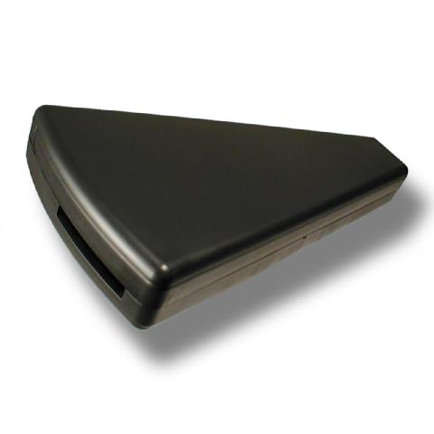
Topic 9: Wave phenomena - AHL 9.3 – Interference
The diffraction grating
•___________________________________________.
continuous spectrum
light source
absorption spectrum
light source
cool gas X
emission spectrum
hot gas X
compare…
Same fingerprint!
Notes:
© 2015 By Timothy K. Lund

Slide 21
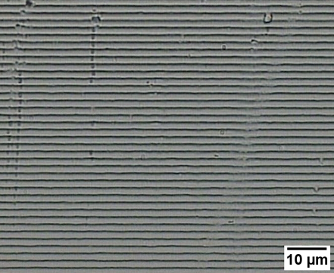
Topic 9: Wave phenomena - AHL 9.3 – Interference
The diffraction grating
•A typical ___________________________________ __________________________________________________________________________________________________________________________________.
•_____________________ ______________________ _____________ producing interference maxima at angles θ given by
where n is the order of the maxima. n = 0 is the central maximum, n = 1 is on either side of the central maximum, etc.
n = 2
n = 1
n = 0
d is the distance between the lines
n = 1
diffraction grating maxima locations
n = 2
Notes:
© 2015 By Timothy K. Lund

Slide 22
Topic 9: Wave phenomena - AHL 9.3 – Interference
The diffraction grating
EXAMPLE: A diffraction grating that has 750 lines per millimeter is illuminated by a monochromatic light which is normal to the grating. A third-order maximum is observed at an angle of 56° to the straight-through direction. Determine the wavelength of the light.
SOLUTION: Use $nλ=d\sin{θ}$, with n = 3 and θ = 56°.
•d must be calculated:
n = 3
n = 2
n = 1
n = 0
n = 1
n = 2
n = 3
Notes:
© 2015 By Timothy K. Lund

Slide 23
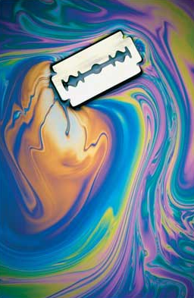
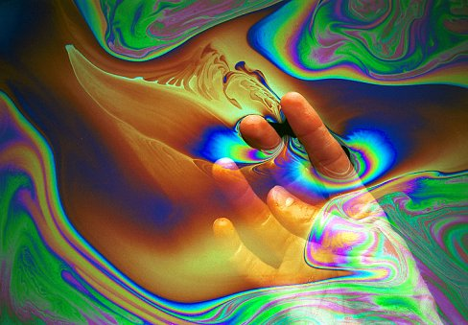
Topic 9: Wave phenomena - AHL 9.3 – Interference
Thin film interference
•Soap bubbles and gasoline spills on water, and iridescence in insects and feathers, are all examples of __________________________.
Notes:
© 2015 By Timothy K. Lund

Slide 24
Note that v is less in the heavy rope than it is in the light rope.
Topic 9: Wave phenomena - AHL 9.3 – Interference
Thin film interference
•Before we can understand how this interference works we need to review how waves are reflected at the boundary of a heavy rope and a light rope. A single pulse is sent from left to right, as shown.
•Note that the reflection is _____________ and the transmission is also _____________.
•Note that the reflection is ____________________ and the transmission is still ______________.
Notes:
© 2015 By Timothy K. Lund

Slide 25
Know these three properties so you can solve any kind of thin film interference problem.
Topic 9: Wave phenomena - AHL 9.3 – Interference
Thin film interference
•We can remark on the following three properties:
If a wave __________________________________ _________________________________________.
If a wave __________________________________ ________________________________________________
In any case, the wave is ______________________ _________________________________________.
before
after
before
after
Notes:
© 2015 By Timothy K. Lund

Slide 26
Topic 9: Wave phenomena - AHL 9.3 – Interference
Thin film interference
•Consider a ____________ of thickness d made of a transparent medium having an index of refraction n.
•Light having a wavelength λ is ______________________________. We show it at a slight angle so that you can see reflection and refraction clearly…
•At the ______________________________________ ____________________________________.
•At _________________________________________ ________________________.
Notes:
© 2015 By Timothy K. Lund

Slide 27
Topic 9: Wave phenomena - AHL 9.3 – Interference
φ +π
φ
Thin film interference
•The speed of light in air is $c$, and the speed of light in the medium is $v=\frac{c}{n}$which is always less than c.
•At the _____________the reflected ray is __________ ____________ with the incident ray. (See the ropes…)
•Inside the film the ____________________________ with the incident ray.
•At the ______________________the reflected ray is ________________with the incident wave.
•At the __________________ the __________ of the ___________________________ during transmission.
φ
φ
φ
Notes:
© 2015 By Timothy K. Lund

Slide 28
Topic 9: Wave phenomena - AHL 9.3 – Interference
φ +π
φ
Thin film interference
•The _________ the light travels __________________. The angle of incidence is actually 0° and has been exaggerated.
•The speed of light in the medium is $\frac{c}{n}$.
•From $speed=\frac{distance}{time}$we see that inside the medium the time for a typical crest to make it through the medium is
$time=\frac{distance}{speed} =$
•But outside the medium a crest travels m wavelengths λ in
$time=\frac{distance}{speed}=$
φ
φ
φ
Notes:
© 2015 By Timothy K. Lund

Slide 29
Topic 9: Wave phenomena - AHL 9.3 – Interference
φ +π
φ
Thin film interference
•Because the light in Ray A and Ray B are __________________ ___________, when the two rays rejoin at the top surface, they will __________________ ______________ if their transit times are equal:
$time=$
•Similarly, it can be deduced that the rejoining rays will ____________________ if the following relation holds:
$time=$
φ
A
B
φ
φ
thin film destructive interference
thin film constructive interference
Notes:
© 2015 By Timothy K. Lund

Slide 30
Topic 9: Wave phenomena - AHL 9.3 – Interference
Thin film interference
•These formulas were derived assuming the observer was on the same side as the light source.
•These formulas were derived assuming that only one of the rays was reflected π out of phase.
•If both rays are π out of phase, reverse the formulas.
PRACTICE: Predict what you will see if you view the film from the side away from the source.
SOLUTION:
same side
away side
Notes:
© 2015 By Timothy K. Lund

Slide 31
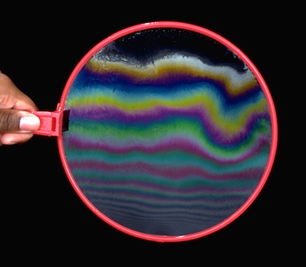
Topic 9: Wave phenomena - AHL 9.3 – Interference
Thin film interference
EXAMPLE: Explain why thin-film interference in a vertical soap bubble looks like this.
SOLUTION:
Notes:
© 2015 By Timothy K. Lund

Slide 32
Topic 9: Wave phenomena - AHL 9.3 – Interference
Thin film interference
PRACTICE: A film of oil having a refractive index of 1.40 floats on a puddle of rain water having a refractive index of 1.33. The puddle is illuminated by sunlight. When viewed at near-normal incidence a particular region of the oil film has an orange color, corresponding to a wavelength of 575 nm.
(a) Explain how the refractive indices of the air, oil, and water all play a part in producing this orange color.
SOLUTION:
Notes:
© 2015 By Timothy K. Lund

Slide 33
Topic 9: Wave phenomena - AHL 9.3 – Interference
Thin film interference
PRACTICE: Continued...
(b) Calculate the possible thicknesses of the film in the orange region.
SOLUTION:
Notes:
© 2015 By Timothy K. Lund

Slide 34
Topic 9: Wave phenomena - AHL 9.3 – Interference
Thin film interference
PRACTICE: A film of oil having a refractive index of 1.40 floats on a puddle of rain water having a refractive index of 1.33. The puddle is illuminated by sunlight. When viewed at near-normal incidence a particular region of the oil film has an orange color, corresponding to a wavelength of 575 nm.
(c) Calculate the minimum thickness of the film in the orange region.
SOLUTION:
Notes:
© 2015 By Timothy K. Lund

Slide 35
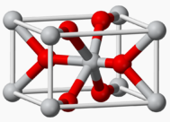
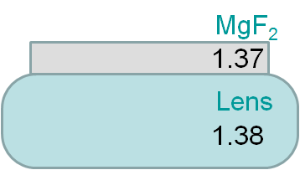
Topic 9: Wave phenomena - AHL 9.3 – Interference
Thin film interference – non-reflective coatings
EXAMPLE: Magnesium fluoride MgF₂ has n = 1.37. If applied in a thin layer over an optical lens made of glass having n = 1.38, what thickness should it be so that light having a wavelength of 528 nm is not reflected from the lens?
SOLUTION:
Notes:
© 2015 By Timothy K. Lund

