Slide 1
Topic 9: Wave phenomena - AHL
9.1 – Simple harmonic motion
Topic 9.1 is an extension of Topic 4.1. The new material begins on slide 12 and ends on slide 32, then 42 to 46. The rest is review.
Essential idea: The solution of the harmonic oscillator can be framed around the variation of kinetic and potential energy in the system.
Nature of science: Insights: The equation for simple harmonic motion (SHM) can be solved analytically and numerically. Physicists use such solutions to help them to visualize the behavior of the oscillator. The use of the equations is very powerful as any oscillation can be described in terms of a combination of harmonic oscillators. Numerical modeling of oscillators is important in the design of electrical circuits.
Notes:
© 2015 By Timothy K. Lund

Slide 2
Topic 9: Wave phenomena - AHL
9.1 – Simple harmonic motion
Understandings:
• The defining equation of SHM
• Energy changes
Applications and skills:
• Solving problems involving acceleration, velocity and displacement during simple harmonic motion, both graphically and algebraically
• Describing the interchange of kinetic and potential energy during simple harmonic motion
• Solving problems involving energy transfer during simple harmonic motion, both graphically and algebraically
Notes:
© 2015 By Timothy K. Lund

Slide 3
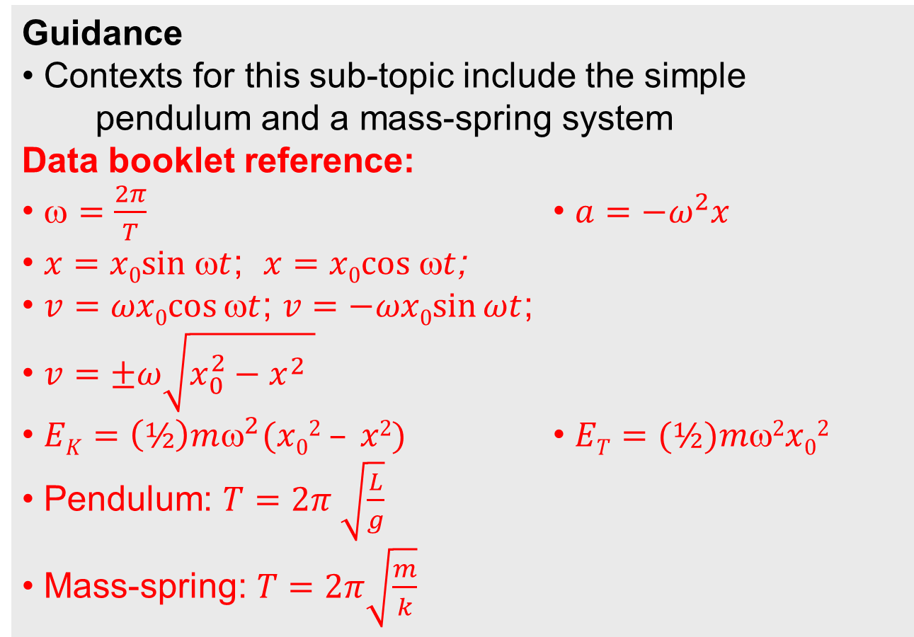
Topic 9: Wave phenomena - AHL
9.1 – Simple harmonic motion
Guidance
• Contexts for this sub-topic include the simple pendulum and a mass-spring system
Data booklet reference:
• $=\frac{2π}{T}$ • $a=−ω^{2}x$
• $x=x0sin t$; $x=x0cos t$;
• $v=ωx0cos⁡t$; $v=−ωx0sin⁡ωt$;
• $v=±ω\sqrt{x_{0}^{2}−x^{2} }$
• $EK=\left(½\right)mω^{2}(x02 – x2)$ • $ET=(½)m2x02$
• Pendulum: $T=2π \sqrt{\frac{L}{g}}$
• Mass-spring: $T=2π\sqrt{\frac{m}{k}}$
Notes:
© 2015 By Timothy K. Lund

Slide 4
Topic 9: Wave phenomena - AHL
9.1 – Simple harmonic motion
Utilization:
• Fourier analysis allows us to describe all periodic oscillations in terms of simple harmonic oscillators. The mathematics of simple harmonic motion is crucial to any areas of science and technology where oscillations occur.
• The interchange of energies in oscillation is important in electrical phenomena
• Quadratic functions (see Mathematics HL sub-topic 2.6; Mathematics SL sub-topic 2.4; Mathematical studies SL sub-topic 6.3)
• Trigonometric functions (see Mathematics SL sub-topic 3.4)
Notes:
© 2015 By Timothy K. Lund

Slide 5
Topic 9: Wave phenomena - AHL
9.1 – Simple harmonic motion
Aims:
• Aim 4: students can use this topic to develop their ability to synthesize complex and diverse scientific information
• Aim 6: experiments could include (but are not limited to): investigation of simple or torsional pendulums; measuring the vibrations of a tuning fork; further extensions of the experiments conducted in sub-topic 4.1.
Notes:
© 2015 By Timothy K. Lund

Slide 6
Topic 9: Wave phenomena - AHL
9.1 – Simple harmonic motion
Aims:
• Aim 6: By using the force law, a student can, with iteration, determine the behavior of an object under simple harmonic motion. The iterative approach (numerical solution), with given initial conditions, applies basic uniform acceleration equations in successive small time increments. At each increment, final values become the following initial conditions.
• Aim 7: the observation of simple harmonic motion and the variables affected can be easily followed in computer simulations
Notes:
© 2015 By Timothy K. Lund

Slide 7
Topic 9: Wave phenomena - AHL
9.1 – Simple harmonic motion
Examples of oscillation
•Oscillations are vibrations which repeat themselves.
EXAMPLE: They can be driven externally, like a pendulum in a gravitational field.
EXAMPLE: They can be driven internally, like a mass on a spring.
v = 0
v = 0
v = v_{max}
FYI
•In all oscillations v = 0 at the extremes and v = v_{max} in the middle of the motion.
v = v_{max}
v = 0
v = 0
x
Notes:
© 2015 By Timothy K. Lund

Slide 8

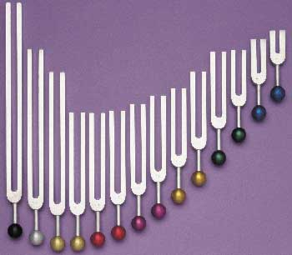
Topic 9: Wave phenomena - AHL
9.1 – Simple harmonic motion
Examples of oscillation
•Oscillations are vibrations which repeat themselves.
EXAMPLE: They can be very rapid vibrations such as in a plucked guitar string or a tuning fork.
Notes:
© 2015 By Timothy K. Lund

Slide 9

Topic 9: Wave phenomena - AHL
9.1 – Simple harmonic motion
equilibrium
Describing oscillation
•Consider a mass on a spring that is displaced 4 meters to the right and then released.
•We call the maximum displacement x₀ the amplitude. In this example x₀ = 4 m.
•We call the point of zero displacement the equilibrium position.
•The period T (measured in s) is the time it takes for the mass to make one complete oscillation or cycle.
•For this particular oscillation, the period T is about 24 seconds (per cycle).
x
x₀
x₀
Notes:
© 2015 By Timothy K. Lund

Slide 10



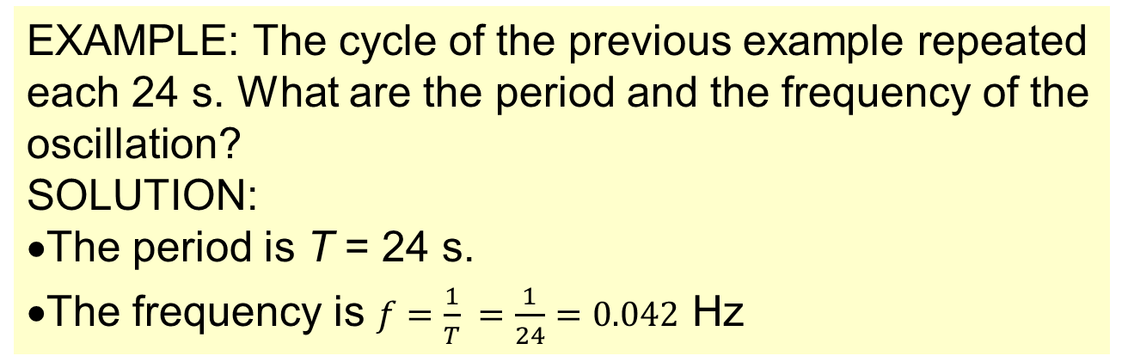
Topic 4: Waves
4.1 – Oscillations
Time period and frequency
•The frequency f (measured in Hz or $\frac{cycles}{s}$) is defined as how many cycles (oscillations, repetitions) occur each second.
•Since period T is seconds per cycle, frequency must be $\frac{1}{T}$.
$$f=\frac{1}{T}$$
$$T=\frac{1}{f}$$
relation between T and f
EXAMPLE: The cycle of the previous example repeated each 24 s. What are the period and the frequency of the oscillation?
SOLUTION:
•The period is T = 24 s.
•The frequency is $f=\frac{1}{T} =\frac{1}{24}=0.042$ Hz
Notes:
© 2006 By Timothy K. Lund

Slide 11
Topic 9: Wave phenomena - AHL
9.1 – Simple harmonic motion
Describing oscillation
•We can pull the mass to the right and then release it to begin its motion:
•Or we could push it to the left and release it:
•The resulting motion would have the same values for T and f.
•However, the resulting motion will have a phase difference of half a cycle.
start stretched
x
The two motions are half a cycle out of phase.
start compressed
x
Notes:
© 2015 By Timothy K. Lund

Slide 12
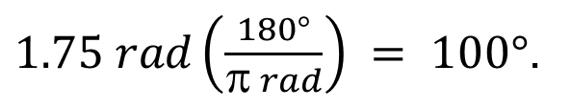
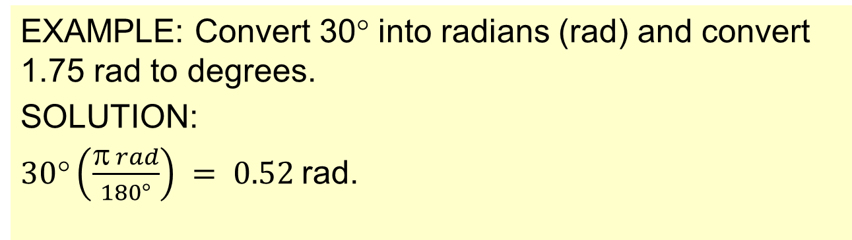

Topic 9: Wave phenomena - AHL
9.1 – Simple harmonic motion
Angular speed ω
•We say that the angular speed ω of the object is
$=\frac{θ}{t}$
•In Topic 9 we must learn about an alternate and more natural method of measuring angles besides degrees.
•They are called radians.
π rad = 180° = ½ rev
radian-degree-revolution conversions
2π rad = 360° = 1 rev
EXAMPLE: Convert 30° into radians (rad) and convert 1.75 rad to degrees.
SOLUTION:
$30°\left(\frac{π rad}{180°}\right) = 0.52$rad.
$1.75 rad\left(\frac{180°}{π rad}\right) = 100°$.
Notes:
© 2015 By Timothy K. Lund

Slide 13
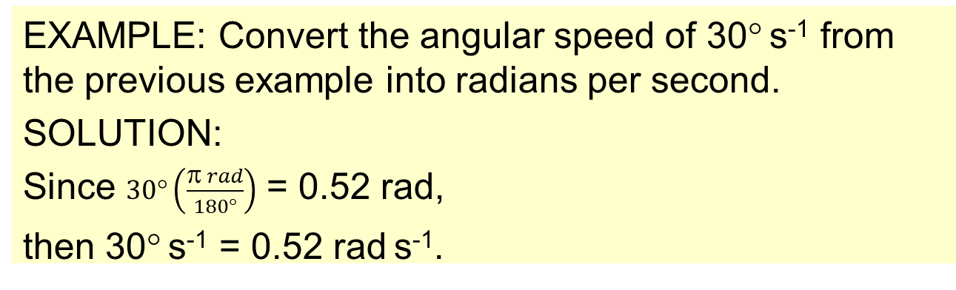
Topic 9: Wave phenomena - AHL
9.1 – Simple harmonic motion
Angular speed ω
•Angular speed will not be measured in degrees per second in Topic 9. It will be measured in radians per second.
π rad = 180° = ½ rev
radian-degree-revolution conversions
2π rad = 360° = 1 rev
EXAMPLE: Convert the angular speed of 30° s⁻¹ from the previous example into radians per second.
SOLUTION:
Since $30°\left(\frac{π rad}{180°}\right)$ = 0.52 rad,
then 30° s⁻¹ = 0.52 rad s⁻¹.
v₀
x₀
FYI
•Angular speed is also called angular frequency.
Notes:
© 2015 By Timothy K. Lund

Slide 14

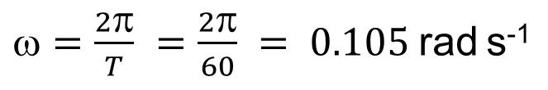

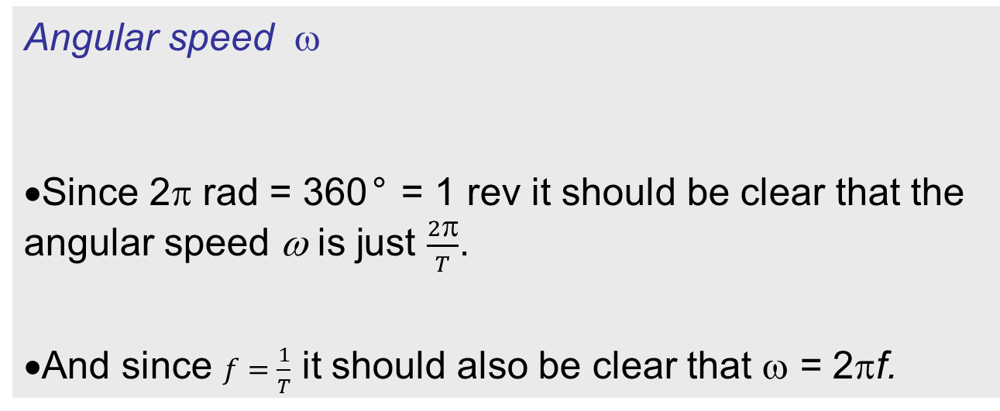
Topic 9: Wave phenomena - AHL
9.1 – Simple harmonic motion
Angular speed ω
•Since 2π rad = 360° = 1 rev it should be clear that the angular speed ω is just $\frac{2π}{T}$.
•And since $f=\frac{1}{T}$ it should also be clear that ω = 2πf.
π rad = 180° = 1/2 rev
radian-degree-revolution conversions
2π rad = 360° = 1 rev
$$=\frac{2π}{T}=\frac{θ}{t} = 2πf$$
relation between ω, T and f
EXAMPLE: Find the angular frequency (angular speed) of the second hand on a clock.
SOLUTION: •Since the second hand turns through one circle each 60 s, it has an angular speed
$=\frac{2π}{T} =\frac{2π}{60} = 0.105$rad s⁻¹
Notes:
© 2015 By Timothy K. Lund

Slide 15

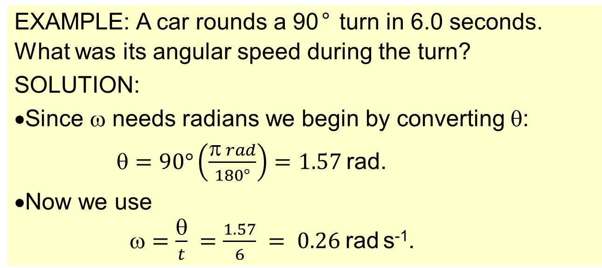
Topic 9: Wave phenomena - AHL
9.1 – Simple harmonic motion
Angular speed ω
π rad = 180° = 1/2 rev
radian-degree-revolution conversions
2π rad = 360° = 1 rev
$$=\frac{2π}{T} =\frac{θ}{t} = 2πf$$
relation between ω, T and f
EXAMPLE: A car rounds a 90° turn in 6.0 seconds. What was its angular speed during the turn?
SOLUTION:
•Since ω needs radians we begin by converting θ:
$=90°\left(\frac{π rad}{180°}\right)=1.57$rad.
•Now we use
$=\frac{θ}{t} =\frac{1.57}{6} = 0.26$rad s⁻¹.
Notes:
© 2015 By Timothy K. Lund

Slide 16

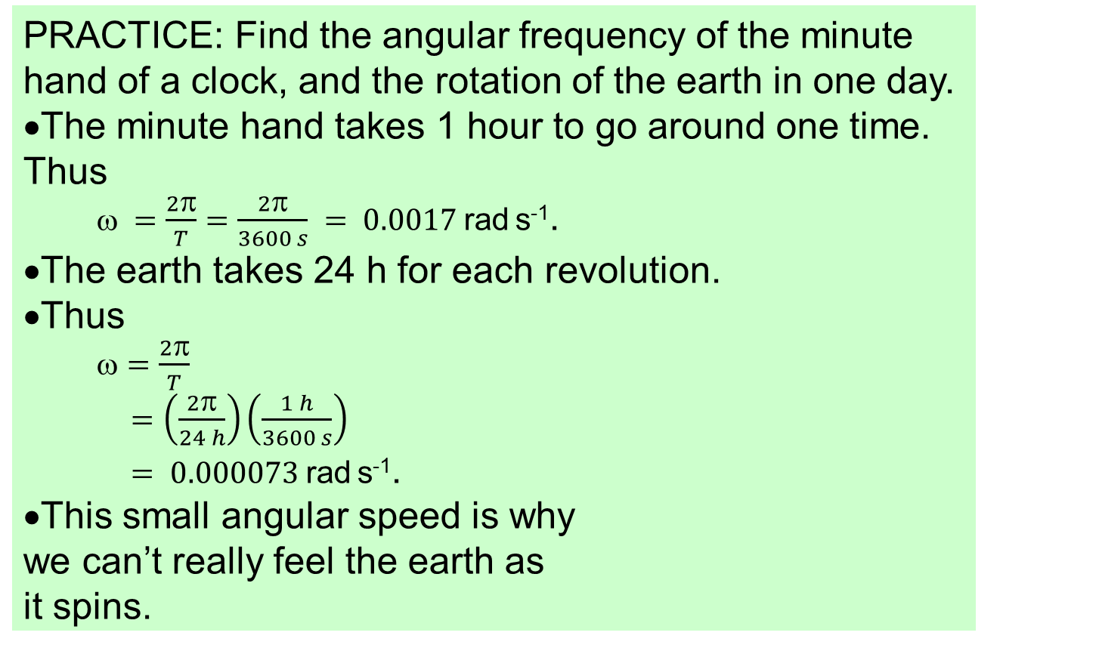
Topic 9: Wave phenomena - AHL
9.1 – Simple harmonic motion
Angular speed ω
PRACTICE: Find the angular frequency of the minute hand of a clock, and the rotation of the earth in one day.
•The minute hand takes 1 hour to go around one time. Thus
$ =\frac{2π}{T}=\frac{2π}{3600 s} = 0.0017$rad s⁻¹.
•The earth takes 24 h for each revolution.
•Thus
$=\frac{2π}{T}$
$=\left(\frac{2π}{24 h}\right)\left(\frac{1 h}{3600 s}\right)$
$= 0.000073$rad s⁻¹.
•This small angular speed is why we can’t really feel the earth as it spins.
Notes:
© 2015 By Timothy K. Lund

Slide 17
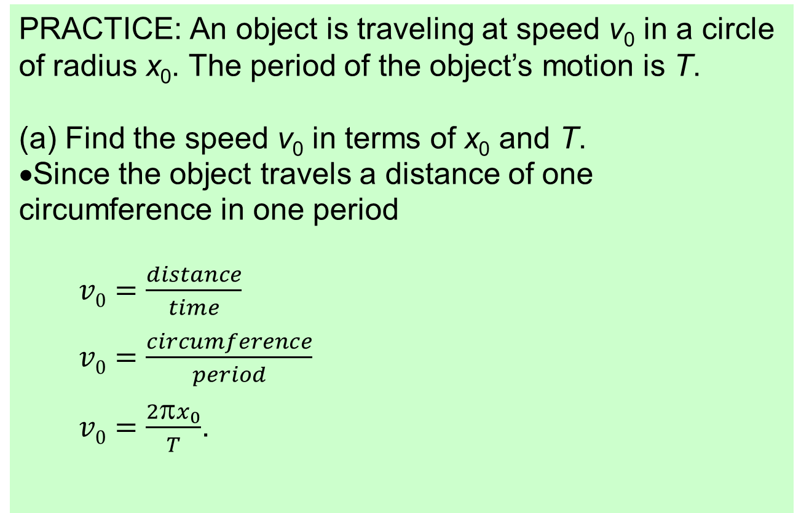
Topic 9: Wave phenomena - AHL
9.1 – Simple harmonic motion
Angular speed ω
PRACTICE: An object is traveling at speed v₀ in a circle of radius x₀. The period of the object’s motion is T.
(a) Find the speed v₀ in terms of x₀ and T.
•Since the object travels a distance of one circumference in one period
$v0=\frac{distance}{time}$
$v0=\frac{circumference}{period}$
$v0=\frac{2πx_{0}}{T}$.
v₀
x₀
Notes:
© 2015 By Timothy K. Lund

Slide 18
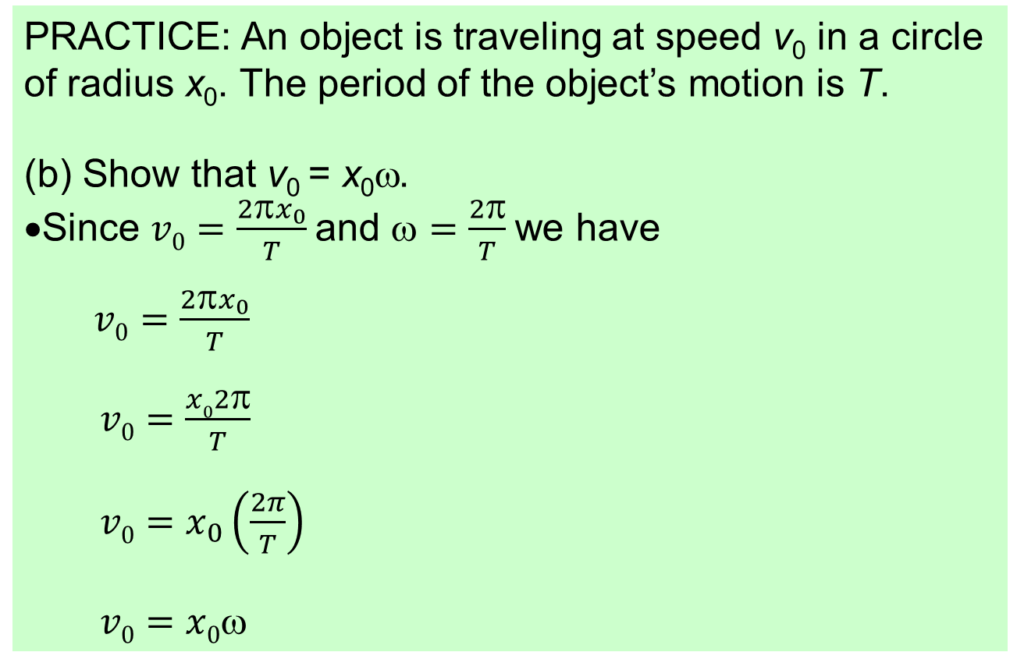
Topic 9: Wave phenomena - AHL
9.1 – Simple harmonic motion
Angular speed ω
PRACTICE: An object is traveling at speed v₀ in a circle of radius x₀. The period of the object’s motion is T.
(b) Show that v₀ = x₀ω.
•Since $v0=\frac{2πx_{0}}{T}$and $=\frac{2π}{T}$we have
$v0=\frac{2πx_{0}}{T}$
$v0=\frac{x02π}{T}$
$v0=x_{0}\left(\frac{2π}{T}\right)$
$v0=x0$
v₀
x₀
Notes:
© 2015 By Timothy K. Lund

Slide 19
Topic 9: Wave phenomena - AHL
9.1 – Simple harmonic motion
The defining equation of SHM: a = -ω²x
•Consider a rotating disk that has a ball glued onto its edge. We project a strong light to produce a shadow of the ball’s motion on a screen.
•Like the mass in the mass-spring system, the ball behaves the same at the arrows:
-x₀
0
x₀
x
ω
ω
ω
ω
ω
ω
ω
ω
ω
ω
ω
ω
ω
x
x₀
x₀
x₀
x₀
x₀
x₀
x₀
x₀
x₀
x₀
x₀
x₀
x₀
Notes:
© 2015 By Timothy K. Lund

Slide 20
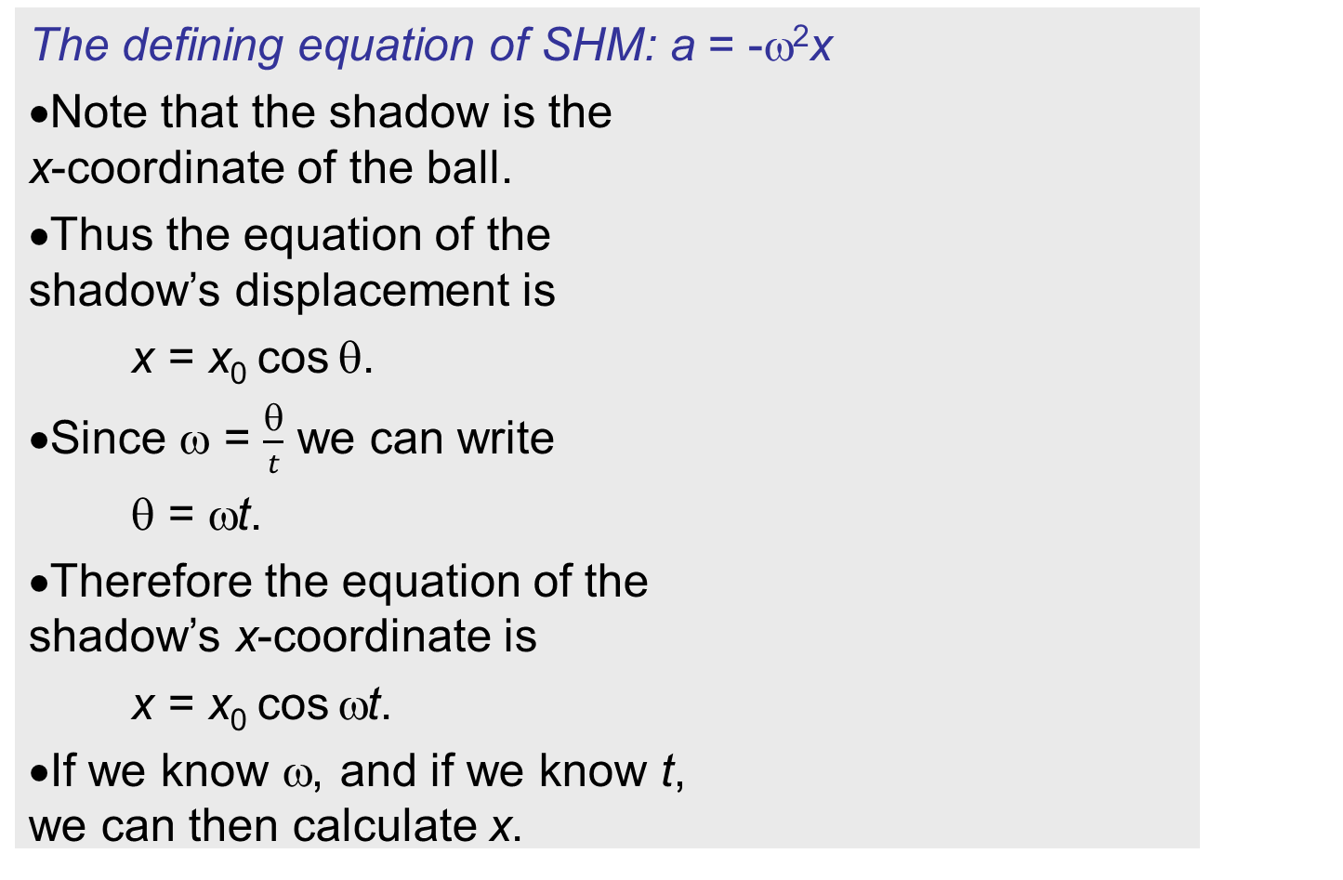
Topic 9: Wave phenomena - AHL
9.1 – Simple harmonic motion
The defining equation of SHM: a = -ω²x
•Note that the shadow is the x-coordinate of the ball.
•Thus the equation of the shadow’s displacement is
x = x₀ cos θ.
•Since ω = $\frac{θ}{t}$ we can write
θ = ωt.
•Therefore the equation of the shadow’s x-coordinate is
x = x₀ cos ωt.
•If we know ω, and if we know t, we can then calculate x.
-x₀
0
x₀
x
v₀
v₀
θ
x₀
x₀
x
x = x₀ cos θ
Notes:
© 2015 By Timothy K. Lund

Slide 21
Topic 9: Wave phenomena - AHL
9.1 – Simple harmonic motion
The defining equation of SHM: a = -ω²x
On page 355 in your textbook, there is an explanation of how the following formulas are obtained. You do not need to know how to get these formula, and if you don’t know calculus yet, you won’t understand how they were obtained. How they were obtained is not important. Only the results will be important for us in this course:
a = -ω²x
a = -x₀ω² cos ωt
Notes:
© 2015 By Timothy K. Lund

Slide 22
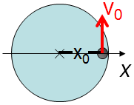
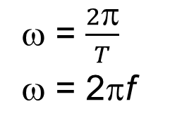
Topic 9: Wave phenomena - AHL
9.1 – Simple harmonic motion
The defining equation of SHM: a = -ω²x
•Let’s put all of our equations in a box – there are quite a few!
•We say a particle is undergoing simple harmonic motion (SHM) if it’s acceleration is of the form a = -ω²x.
•The Data Booklet has the highlighted formulas.
x = x₀ cos ωt
ω = $\frac{2π}{T}$
ω = 2πf
Set 1 - equations of simple harmonic motion
v = - x₀ω sin ωt
a = -x₀ω² cos ωt
v₀ = x₀ω
a = -ω²x
x₀ is the maximum displacement
v₀ is the maximum speed
This equation set works only for a mass which begins at x = +x₀ and is released from rest at t = 0 s.
Notes:
© 2015 By Timothy K. Lund

Slide 23
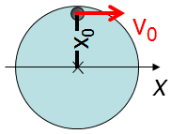
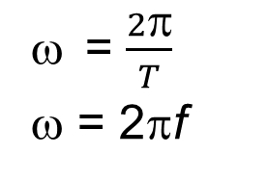
Topic 9: Wave phenomena - AHL
9.1 – Simple harmonic motion
The defining equation of SHM: a = -ω²x
•Without deriving the other set in the Data Booklet, here they are:
•This last set is derived by observing the shadow from a light at the left, beginning as shown:
•Data Booklet has highlighted formulas.
x = x₀ sin ωt
= $\frac{2π}{T}$
ω = 2πf
Set 2 - equations of simple harmonic motion
v = x₀ω cos ωt
a = -x₀ω² sin ωt
v₀ = x₀ω
a = -ω²x
x₀ is the maximum displacement
v₀ is the maximum speed
This equation set works only for a mass which begins at x = 0 and is given a positive velocity v₀ at t = 0 s.
Notes:
© 2015 By Timothy K. Lund

Slide 24
Topic 9: Wave phenomena - AHL
9.1 – Simple harmonic motion
The defining equation of SHM: a = -ω²x
•From Set 1: x = x₀ cos ωt, v = -x₀ sin ωt and v₀ = x₀ω:
•Begin by squaring each equation from Set 1:
x² = x₀² cos² ωt,
v² = (- x₀ω sin ωt)² = x₀² ω² sin² ωt.
•Now sin² ωt + cos² ωt = 1 yields sin² ωt = 1 – cos² ωt
so that v² = x₀²ω²(1 – cos² ωt) or
v² = ω²(x₀² – x₀² cos² ωt).
•Then v² = ω²(x₀² – x²), which becomes
v = ±ω x₀² – x²
relation between x and v
Notes:
© 2015 By Timothy K. Lund

Slide 25
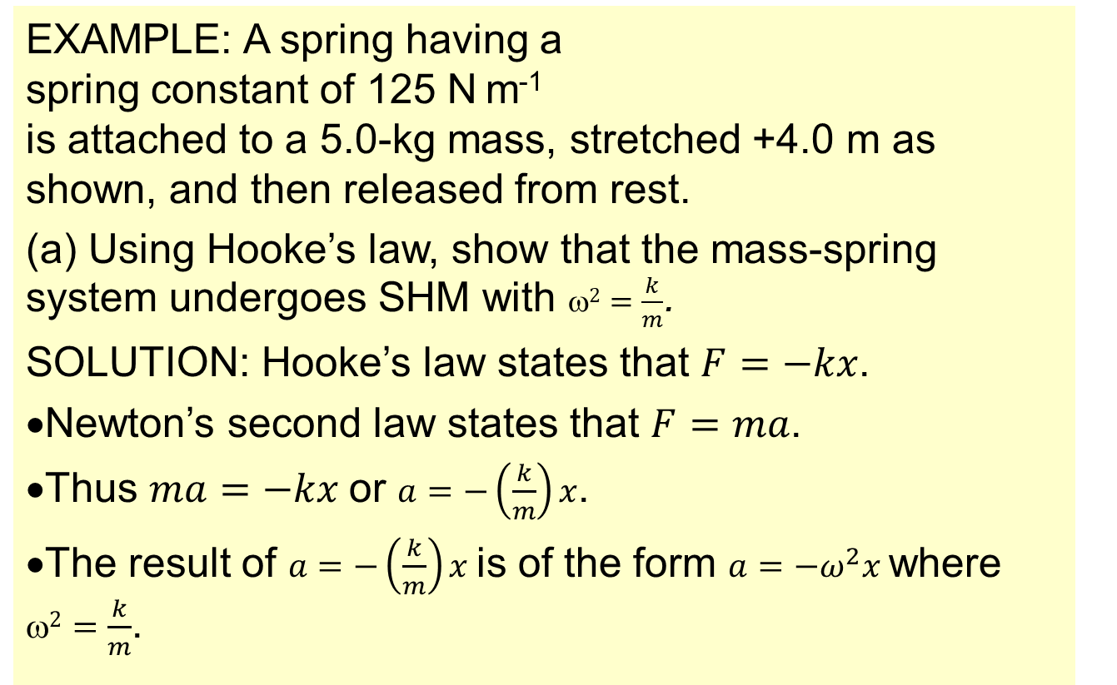
Topic 9: Wave phenomena - AHL
9.1 – Simple harmonic motion
Solving SHM problems
EXAMPLE: A spring having a spring constant of 125 N m⁻¹ is attached to a 5.0-kg mass, stretched +4.0 m as shown, and then released from rest.
(a) Using Hooke’s law, show that the mass-spring system undergoes SHM with $2=\frac{k}{m}$.
SOLUTION: Hooke’s law states that $F=−kx$.
•Newton’s second law states that $F=ma$.
•Thus $ma=−kx$or $a=−\left(\frac{k}{m}\right)x$.
•The result of $a=−\left(\frac{k}{m}\right)x$is of the form $a=−ω^{2}x$where $2=\frac{k}{m}$.
x
•Therefore, the mass-spring system is in SHM
Notes:
© 2015 By Timothy K. Lund

Slide 26
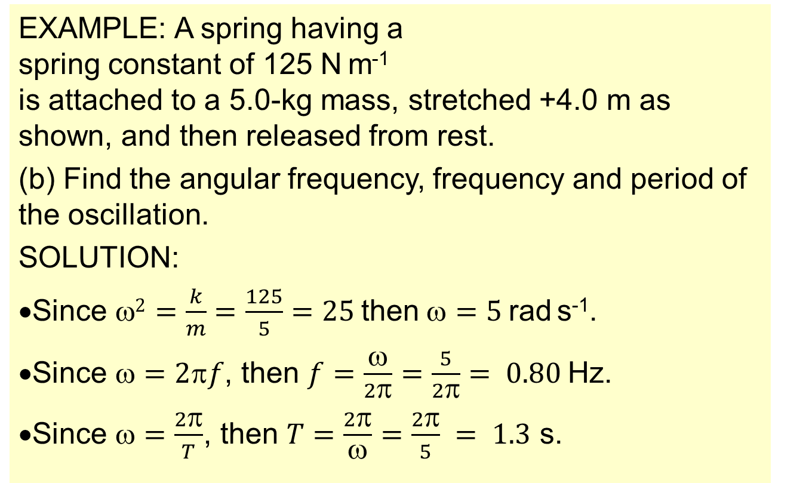
Topic 9: Wave phenomena - AHL
9.1 – Simple harmonic motion
Solving SHM problems
EXAMPLE: A spring having a spring constant of 125 N m⁻¹ is attached to a 5.0-kg mass, stretched +4.0 m as shown, and then released from rest.
(b) Find the angular frequency, frequency and period of the oscillation.
SOLUTION:
•Since $2=\frac{k}{m}=\frac{125}{5}=25$then$=5$rad s⁻¹.
•Since $=2f$, then $f=\frac{ω}{2π}=\frac{5}{2π}= 0.80$Hz.
•Since $=\frac{2π}{T}$, then $T=\frac{2π}{ω}=\frac{2π}{5} = 1.3$ s.
x
Notes:
© 2015 By Timothy K. Lund

Slide 27
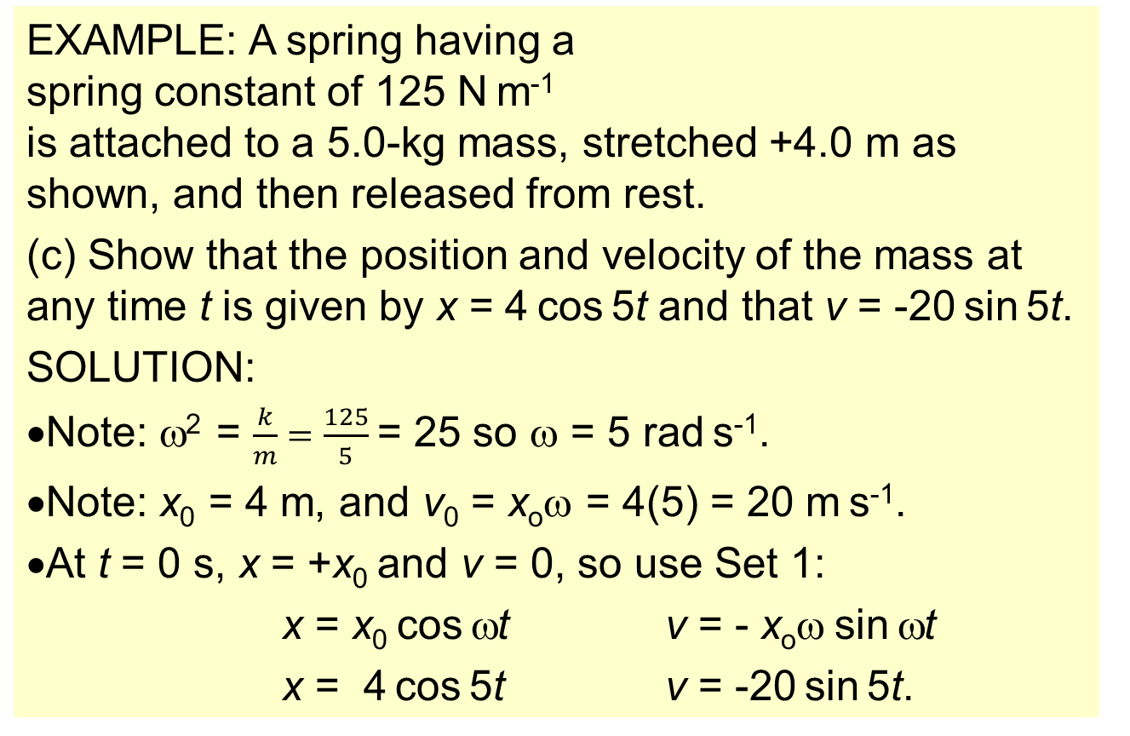
Topic 9: Wave phenomena - AHL
9.1 – Simple harmonic motion
Solving SHM problems
EXAMPLE: A spring having a spring constant of 125 N m⁻¹ is attached to a 5.0-kg mass, stretched +4.0 m as shown, and then released from rest.
(c) Show that the position and velocity of the mass at any time t is given by x = 4 cos 5t and that v = -20 sin 5t.
SOLUTION:
•Note: ω² = $\frac{k}{m}=\frac{125}{5}$= 25 so ω = 5 rad s⁻¹.
•Note: x₀ = 4 m, and v₀ = x_{o}ω = 4(5) = 20 m s⁻¹.
•At t = 0 s, x = +x₀ and v = 0, so use Set 1:
x = x₀ cos ωt v = - x_{o}ω sin ωt
x = 4 cos 5t v = -20 sin 5t.
x
Notes:
© 2015 By Timothy K. Lund

Slide 28
Topic 9: Wave phenomena - AHL
9.1 – Simple harmonic motion
Solving SHM problems
EXAMPLE: A spring having a spring constant of 125 N m⁻¹ is attached to a 5.0-kg mass, stretched +4.0 m as shown, and then released from rest.
(d) Find the position, the velocity, and the acceleration of the mass at t = 0.75 s. Then find the maximum kinetic energy of the system.
SOLUTION:
•x = 4 cos 5t = 4 cos (5×0.75) = 4 cos 3.75 = -3.3 m.
•v = -20 sin 5t = -20 sin (5×0.75) = +11 m s⁻¹.
•a = -ω²x = -(5)²(-3.3) = 83 m s⁻².
•E_{K,max} = ½mv₀² = ½(5)(20)² = 1000 J.
x
Notes:
© 2015 By Timothy K. Lund

Slide 29


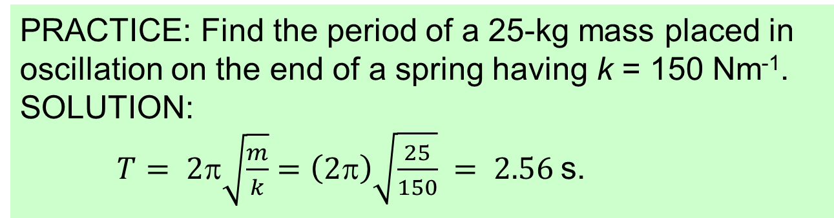
Topic 9: Wave phenomena - AHL
9.1 – Simple harmonic motion
The period of a mass-spring system
•Because for a mass-spring system $^{2}=\frac{k}{m}$and because for any system $=\frac{2π}{T}$we can write
$T =\frac{2π}{ω} =\left(2π\right)÷\sqrt{\frac{k}{m}}$ $= 2π\sqrt{\frac{m}{k}}$
x
$$T= 2π\sqrt{\frac{m}{k}}$$
Period of a mass-spring system
PRACTICE: Find the period of a 25-kg mass placed in oscillation on the end of a spring having k = 150 Nm⁻¹.
SOLUTION:
$T= 2π\sqrt{\frac{m}{k}}=\left(2π\right)\sqrt{\frac{25}{150}} = 2.56$s.
Notes:
© 2015 By Timothy K. Lund

Slide 30

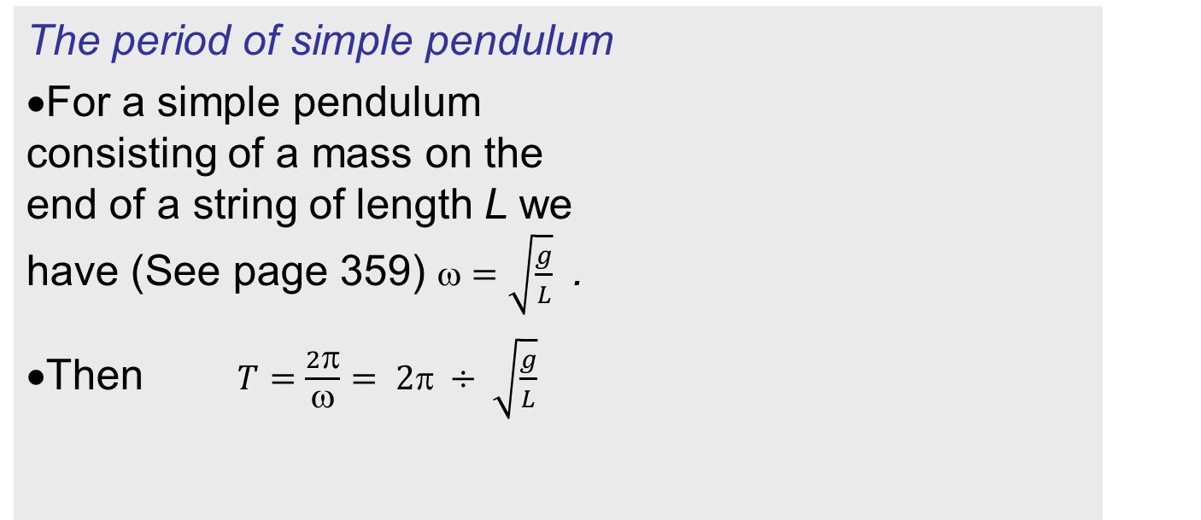

Topic 9: Wave phenomena - AHL
9.1 – Simple harmonic motion
The period of simple pendulum
•For a simple pendulum consisting of a mass on the end of a string of length L we have (See page 359) $=\sqrt{\frac{g}{L}}$ .
•Then $T=\frac{2π}{ω}= 2π ÷ \sqrt{\frac{g}{L}}$
L
$$T = 2π\sqrt{\frac{L}{g}}$$
period of a simple pendulum
PRACTICE: Find the period of a 25-kg mass placed in oscillation on the end of a 1.75-meter long string.
SOLUTION:
$T=2π\sqrt{\frac{L}{g}}=(2π)\sqrt{\frac{1.75}{9.8}} = 2.7$s.
Notes:
© 2015 By Timothy K. Lund

Slide 31
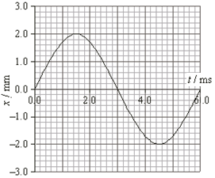
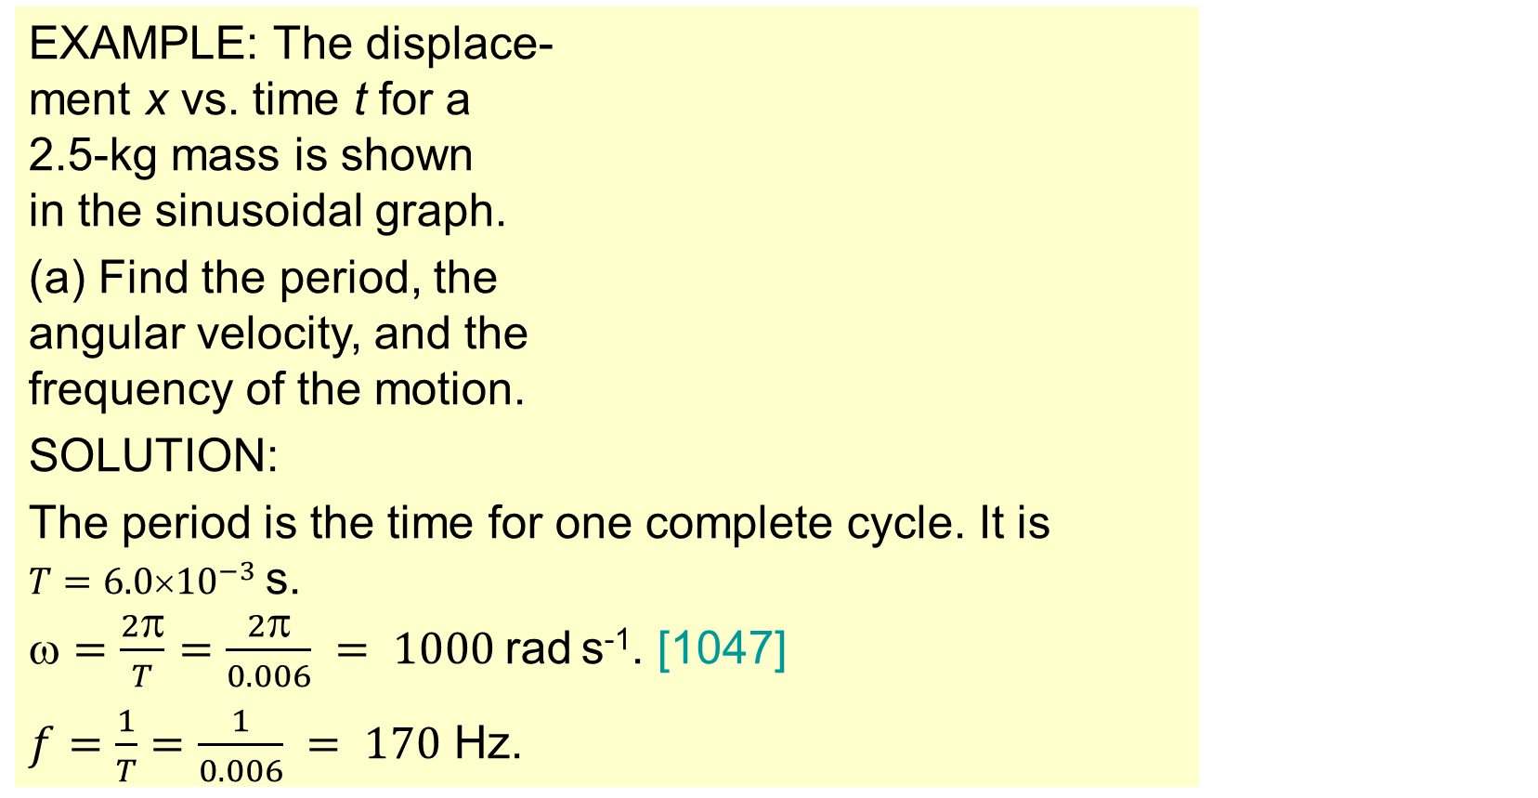
Topic 9: Wave phenomena - AHL
9.1 – Simple harmonic motion
Solving SHM problems graphically and by calculation
EXAMPLE: The displace- ment x vs. time t for a 2.5-kg mass is shown in the sinusoidal graph.
(a) Find the period, the angular velocity, and the frequency of the motion.
SOLUTION:
The period is the time for one complete cycle. It is $T=6.0{10}^{−3}$s.
$=\frac{2π}{T}=\frac{2π}{0.006} = 1000$rad s⁻¹. [1047]
$f=\frac{1}{T}=\frac{1}{0.006} = 170$ Hz.
Notes:
© 2015 By Timothy K. Lund

Slide 32
Topic 9: Wave phenomena - AHL
9.1 – Simple harmonic motion
Solving SHM problems graphically and by calculation
EXAMPLE: The displace- ment x vs. time t for a 2.5-kg mass is shown in the sinusoidal graph.
(b) Find the velocity and acceleration of the mass at t = 3.4 ms.
SOLUTION:
•From the graph x = -0.8×10⁻³ m at t = 3.4 ms.
•From the graph x₀ = 2.0×10⁻³ m. Thus
v = ±ω (x₀² - x²) = -1047 (0.002² - 0.0008²) = -1.9 m s⁻¹.
•Finally a = -ω²x = -(1047²)(-0.0008) = +880 m s⁻².
Why is v negative?
Because the slope is!
Notes:
© 2015 By Timothy K. Lund

Slide 33
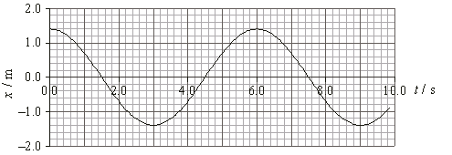
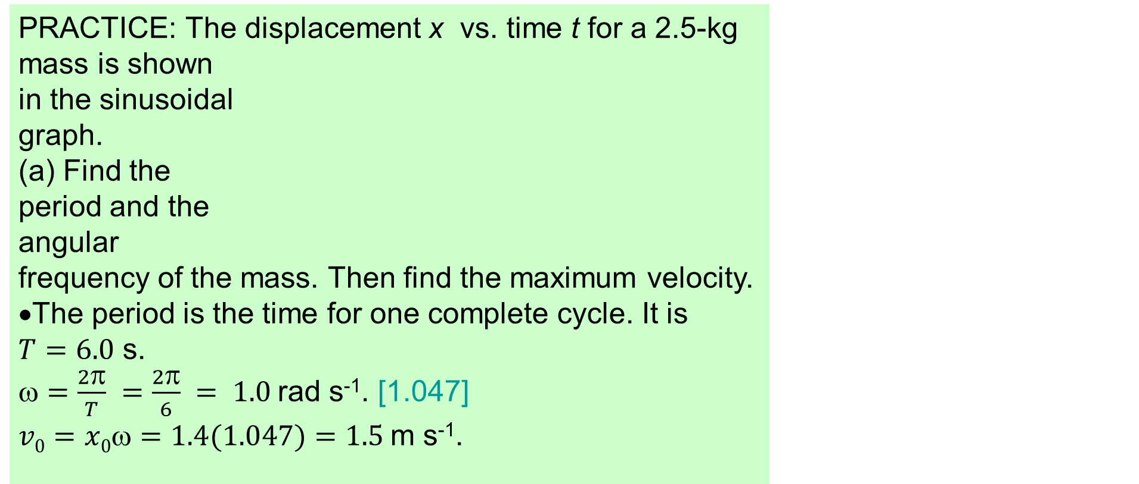
Topic 9: Wave phenomena - AHL
9.1 – Simple harmonic motion
Solving SHM problems graphically and by calculation
PRACTICE: The displacement x vs. time t for a 2.5-kg mass is shown in the sinusoidal graph.
(a) Find the period and the angular frequency of the mass. Then find the maximum velocity.
•The period is the time for one complete cycle. It is $T=6.0$ s.
$=\frac{2π}{T} =\frac{2π}{6} = 1.0$rad s⁻¹. [1.047]
$v0=x0=1.4(1.047)=1.5$m s⁻¹.
Notes:
© 2015 By Timothy K. Lund

Slide 34
Topic 9: Wave phenomena - AHL
9.1 – Simple harmonic motion
Solving SHM problems graphically and by calculation
PRACTICE: The displacement x vs. time t for a 2.5-kg mass is shown in the sinusoidal graph.
(b) Find the force acting on the mass at t = 3 s. Then find it’s velocity at that instant.
•Use F = ma where m = 2.5 kg.
•At t = 3 s we see that x = -1.4 m.
•Then a = -ω²x = -(1.047²)(-1.4) = 1.5 m s⁻².
•Then F = ma = 2.5(1.5) = 3.8 N.
•Because the slope is zero, so is the velocity.
Notes:
© 2015 By Timothy K. Lund

Slide 35
Topic 9: Wave phenomena - AHL
9.1 – Simple harmonic motion
Energy changes during SHM
•Consider the pendulum to the right which is placed in position and held there.
•Let the green rectangle represent the potential energy of the system.
•Let the red rectangle represent the kinetic energy of the system.
•Because there is no motion yet, there is no kinetic energy. But if we release it, the kinetic energy will grow as the potential energy diminishes.
•A continuous exchange between E_{K} and E_{P} occurs.
Notes:
© 2015 By Timothy K. Lund

Slide 36
Topic 9: Wave phenomena - AHL
9.1 – Simple harmonic motion
Energy changes during SHM
•Consider the mass-spring system shown here. The mass is pulled to the right and held in place.
•Let the green rectangle represent the potential energy of the system.
•Let the red rectangle represent the kinetic energy of the system.
•A continuous exchange between E_{K} and E_{P} occurs.
•Note that the sum of E_{K} and E_{P} is constant.
x
FYI
•If friction and drag are both zero E_{T} = CONST.
E_{K} + E_{P} = E_{T} = CONST
relation between E_{K} and E_{P}
Notes:
© 2015 By Timothy K. Lund

Slide 37
Topic 9: Wave phenomena - AHL
9.1 – Simple harmonic motion
Energy changes during SHM
•If we plot both kinetic energy and potential energy vs. time for either system we would get the following graph:
E_{K} + E_{P} = E_{T} = CONST
relation between E_{K} and E_{P}
Energy
time
x
Notes:
© 2015 By Timothy K. Lund

Slide 38
Topic 9: Wave phenomena - AHL
9.1 – Simple harmonic motion
Energy changes during SHM
•Recall the relation between v and x that we derived in the last section: v = ±ω (x₀² – x²).
•Then v² = ω²(x₀² – x²)
½mv² = ½mω²(x₀² – x²)
E_{K} = ½mω²(x₀² – x²).
•Recall that v_{max} = v₀ = ωx₀ so that we have
E_{K,max} = ½mv_{max}² = ½mω²x₀².
•These last two are in the Data Booklet.
E_{K} + E_{P} = E_{T} = CONST
relation between E_{K} and E_{P}
E_{K} = ½mω²(x₀² – x²)
relation between E_{K} and x
E_{K,max} = ½mω²x₀²
relation E_{K,max} and x₀
Notes:
© 2015 By Timothy K. Lund

Slide 39
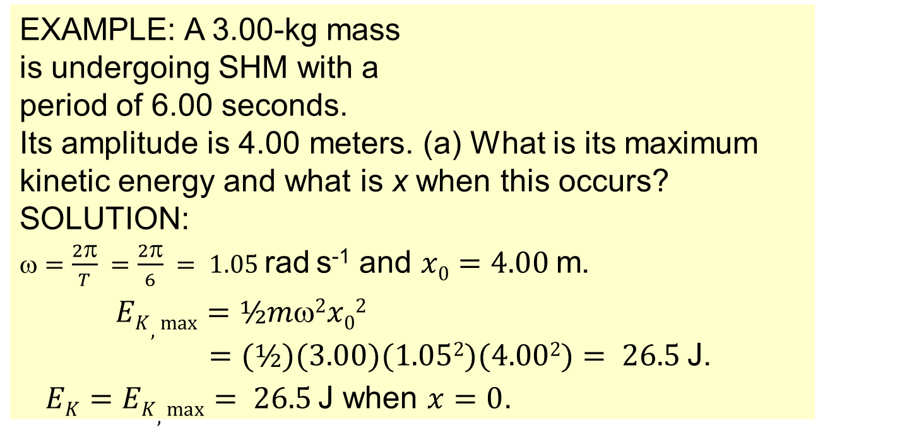
Topic 9: Wave phenomena - AHL
9.1 – Simple harmonic motion
Energy changes during SHM
E_{K} + E_{P} = E_{T} = CONST
relation between E_{K} and E_{P}
E_{K,max} = ½mω²x₀²
relation E_{K,max} and x₀
EXAMPLE: A 3.00-kg mass is undergoing SHM with a period of 6.00 seconds. Its amplitude is 4.00 meters. (a) What is its maximum kinetic energy and what is x when this occurs?
SOLUTION:
$=\frac{2π}{T} =\frac{2π}{6} = 1.05$rad s⁻¹ and $x0=4.00$m.
$EK,max⁡=½m2x02$
$=(½)(3.00)(1.052)(4.002)= 26.5$J.
$EK=EK,max= 26.5$J when $x=0$.
x
Notes:
© 2015 By Timothy K. Lund

Slide 40
Topic 9: Wave phenomena - AHL
9.1 – Simple harmonic motion
Energy changes during SHM
E_{K} + E_{P} = E_{T} = CONST
relation between E_{K} and E_{P}
E_{K,max} = ½mω²x₀²
relation E_{K,max} and x₀
EXAMPLE: A 3.00-kg mass is undergoing SHM with a period of 6.00 seconds. Its amplitude is 4.00 meters. (b) What is its potential energy when the kinetic energy is maximum and what is the total energy of the system?
SOLUTION:
•E_{K} = E_{K,max} when x = 0. Thus E_{P} = 0.
•From E_{K} + E_{P} = E_{T} = CONST we have
26.5 + 0 = E_{T} = 26.5 J.
x
Notes:
© 2015 By Timothy K. Lund

Slide 41
Topic 9: Wave phenomena - AHL
9.1 – Simple harmonic motion
Energy changes during SHM
E_{K} + E_{P} = E_{T} = CONST
relation between E_{K} and E_{P}
E_{K,max} = ½mω²x₀²
relation E_{K,max} and x₀
EXAMPLE: A 3.00-kg mass is undergoing SHM with a period of 6.00 seconds. Its amplitude is 4.00 meters. (c) What is its potential energy when the kinetic energy is 15.0 J?
SOLUTION:
•Since E_{T} = 26.5 J then
•From E_{K} + E_{P} = 26.5 = CONST so we have
15.0 + E_{P} = 26.5 J
E_{P} = 11.5 J.
x
Notes:
© 2015 By Timothy K. Lund

Slide 42
Topic 9: Wave phenomena - AHL
9.1 – Simple harmonic motion
Energy changes during SHM
•Since E_{P} = 0 when E_{K} = E_{K,max} we have
E_{K} + E_{P} = E_{T}
E_{K,max} + 0 = E_{T}
•From E_{K} = ½mω²(x₀² – x²) we get
E_{K} = ½mω²x₀² – ½mω²x²
E_{K} = E_{T} – ½mω²x²
E_{T} = E_{K} + ½mω²x²
E_{K} + E_{P} = E_{T} = CONST
relation between E_{K} and E_{P}
E_{K} = ½mω²(x₀² – x²)
relation E_{K} and x
E_{K,max} = ½mω²x₀²
relation E_{K,max} and x₀
E_{T} = ½mω²x₀²
relation between E_{T} and x₀
E_{P} = ½mω²x²
potential energy E_{P}
Notes:
© 2015 By Timothy K. Lund

Slide 43
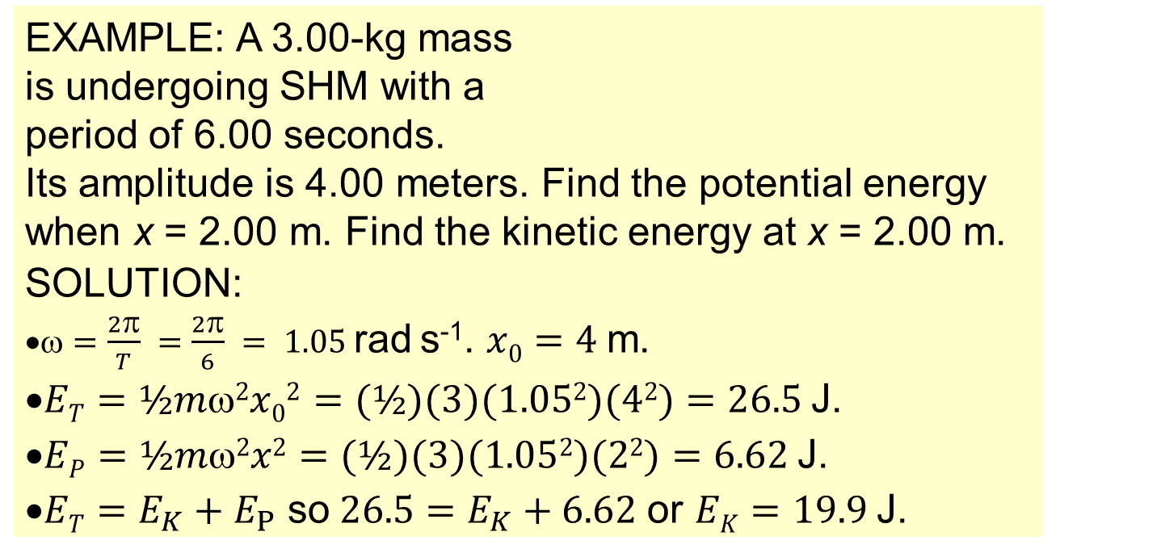
Topic 9: Wave phenomena - AHL
9.1 – Simple harmonic motion
Energy changes during SHM
E_{T} = ½mω²x₀²
relation between E_{T} and x₀
E_{P} = ½mω²x²
potential energy E_{P}
EXAMPLE: A 3.00-kg mass is undergoing SHM with a period of 6.00 seconds. Its amplitude is 4.00 meters. Find the potential energy when x = 2.00 m. Find the kinetic energy at x = 2.00 m.
SOLUTION:
$•ω=\frac{2π}{T} =\frac{2π}{6} = 1.05$rad s⁻¹. $x0=4$m.
•$ET=½m2x02=(½)(3)(1.052)(42)=26.5$J.
•$EP=½m2x2=(½)(3)(1.052)(22)=6.62$J.
•$ET=E_{K}+E_{P}$ so$26.5=E_{K}+6.62$ or $EK=19.9$J.
x
Notes:
© 2015 By Timothy K. Lund

Slide 44
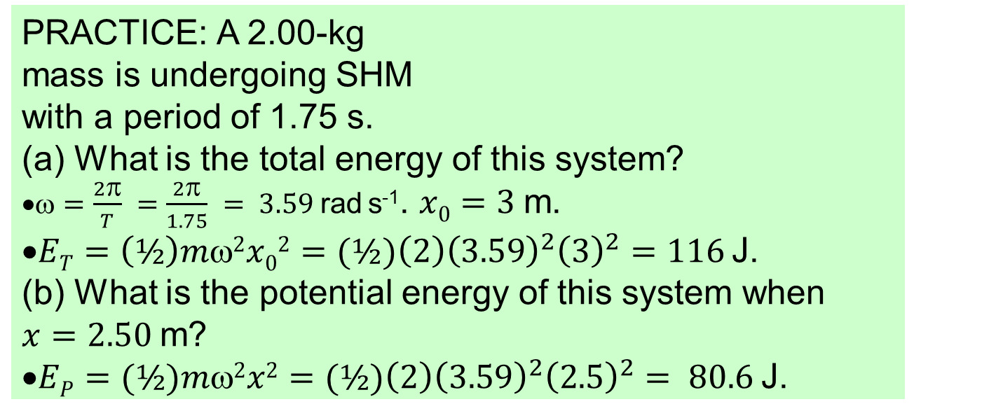
Topic 9: Wave phenomena - AHL
9.1 – Simple harmonic motion
Energy changes during SHM
PRACTICE: A 2.00-kg mass is undergoing SHM with a period of 1.75 s.
What is the total energy of this system?
$•ω=\frac{2π}{T} =\frac{2π}{1.75} = 3.59$rad s⁻¹. $x0=3$m.
•$ET=\left(½\right)mω2x02=(½)\left(2\right){\left(3.59\right)}^{2}{\left(3\right)}^{2}=116$J.
(b) What is the potential energy of this system when $x=2.50$m?
•$EP=(½)mω2x2=(½)\left(2\right){\left(3.59\right)}^{2}{\left(2.5\right)}^{2}= 80.6$J.
x
FYI
•All of these problems assume the friction is zero.
•The potential energy formula is not on the Data Booklet.
Notes:
© 2015 By Timothy K. Lund

Slide 45
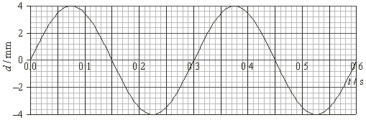
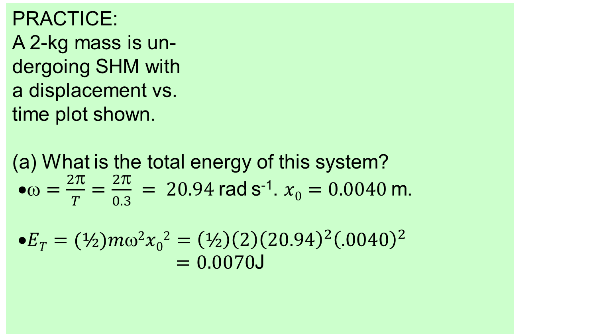
Topic 9: Wave phenomena - AHL
9.1 – Simple harmonic motion
Energy changes during SHM
PRACTICE: A 2-kg mass is un- dergoing SHM with a displacement vs. time plot shown.
What is the total energy of this system?
$•ω=\frac{2π}{T}=\frac{2π}{0.3} = 20.94$rad s⁻¹. $x0=0.0040$m.
•$ET=(½)mω2x02=\left(½\right)\left(2\right){\left(20.94\right)}^{2}{\left(.0040\right)}^{2}$
$=0.0070$J
Notes:
© 2015 By Timothy K. Lund

Slide 46
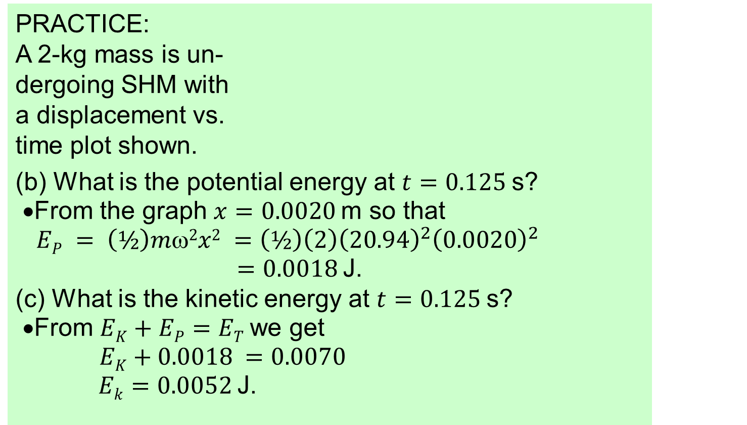
Topic 9: Wave phenomena - AHL
9.1 – Simple harmonic motion
Energy changes during SHM
PRACTICE: A 2-kg mass is un- dergoing SHM with a displacement vs. time plot shown.
(b) What is the potential energy at $t=0.125$s?
•From the graph $x=0.0020$m so that
$EP = \left(½\right)mω2x2 =\left(½\right)\left(2\right){\left(20.94\right)}^{2}{\left(0.0020\right)}^{2}$
$=0.0018$J.
(c) What is the kinetic energy at $t=0.125$s?
•From $EK+EP=ET$we get
$EK+0.0018 =0.0070$
$Ek=0.0052$J.
Notes:
© 2015 By Timothy K. Lund

Slide 47
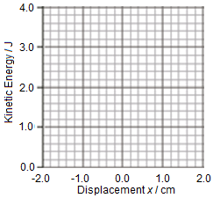
Topic 9: Wave phenomena - AHL
9.1 – Simple harmonic motion
Sketching and interpreting graphs of SHM
EXAMPLE: The kinetic energy vs. displacement for a system undergoing SHM is shown in the graph. The system consists of a 0.125-kg mass on a spring.
(a) Determine the maximum velocity of the mass.
SOLUTION:
•When E_{K} is maximum, so is v.
Thus 4.0 = (½)mv_{MAX}² so that
4.0 = (½)(0.125)v_{MAX}²
→ v_{MAX} = 8.0 ms⁻¹.
x
-2.0
0.0
2.0
Notes:
© 2015 By Timothy K. Lund

Slide 48
Topic 9: Wave phenomena - AHL
9.1 – Simple harmonic motion
Sketching and interpreting graphs of SHM
EXAMPLE: The kinetic energy vs. displacement for a system undergoing SHM is shown in the graph. The system consists of a 0.125-kg mass on a spring.
(b) Sketch E_{P} and determine the total energy of the system.
SOLUTION:
•Since E_{K} + E_{P} = E_{T} = CONST, and since E_{P} = 0 when E_{K} = E_{K,MAX}, it must be that E_{T} = E_{K,MAX} = 4.0 J.
•Thus E_{P} will be an “inverted” E_{K}.
E_{T}
E_{K}
E_{P}
x
-2.0
0.0
2.0
Notes:
© 2015 By Timothy K. Lund

Slide 49
Topic 9: Wave phenomena - AHL
9.1 – Simple harmonic motion
Sketching and interpreting graphs of SHM
EXAMPLE: The kinetic energy vs. displacement for a system undergoing SHM is shown in the graph. The system consists of a 0.125-kg mass on a spring.
(c) Determine the spring constant k of the spring.
SOLUTION: Use E_{P} = (½)kx².
•E_{K} = 0 at x = x_{MAX} = 2.0 cm.
Thus E_{K} + E_{P} = E_{T} = CONST
→ E_{T} = 0 + (½)kx_{MAX}² so that
4.0 = (½)k 0.020² → k = 20000 Nm⁻¹.
x
-2.0
0.0
2.0
Notes:
© 2015 By Timothy K. Lund

Slide 50
Topic 9: Wave phenomena - AHL
9.1 – Simple harmonic motion
Sketching and interpreting graphs of SHM
EXAMPLE: The kinetic energy vs. displacement for a system undergoing SHM is shown in the graph. The system consists of a 0.125-kg mass on a spring.
(c) Determine the acceleration of the mass at x = 1.0 cm.
SOLUTION: Use F = -kx.
•Thus F = -20000(0.01)
= -200 N.
•From F = ma we get -200 = 0.125a
→ a = -1600 ms⁻².
x
-2.0
0.0
2.0
Notes:
© 2015 By Timothy K. Lund

Slide 51
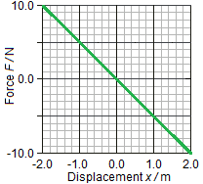
Topic 9: Wave phenomena - AHL
9.1 – Simple harmonic motion
Sketching and interpreting graphs of SHM
EXAMPLE: A 4.0-kg mass is placed on a spring’s end and displaced 2.0 m to the right.
The spring force F vs. its displacement x from equilibrium is shown in the graph.
(a) How do you know that the mass is undergoing SHM?
SOLUTION: In SHM, a ∝ -x.
•Since F = ma, F ∝ -x also.
•The graph shows that F ∝ -x. Thus we have SHM.
x
-2.0
0.0
2.0
Notes:
© 2015 By Timothy K. Lund

Slide 52
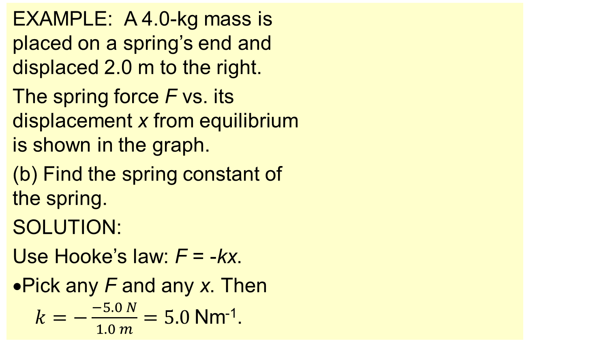
Topic 9: Wave phenomena - AHL
9.1 – Simple harmonic motion
Sketching and interpreting graphs of SHM
EXAMPLE: A 4.0-kg mass is placed on a spring’s end and displaced 2.0 m to the right.
The spring force F vs. its displacement x from equilibrium is shown in the graph.
(b) Find the spring constant of the spring.
SOLUTION:
Use Hooke’s law: F = -kx.
•Pick any F and any x. Then
$k=−\frac{−5.0 N}{1.0 m}=5.0$Nm⁻¹.
F = -5.0 N
x = 1.0 m
x
-2.0
0.0
2.0
Notes:
© 2015 By Timothy K. Lund

Slide 53
Topic 9: Wave phenomena - AHL
9.1 – Simple harmonic motion
Sketching and interpreting graphs of SHM
EXAMPLE: A 4.0-kg mass is placed on a spring’s end and displaced 2.0 m to the right.
The spring force F vs. its displacement x from equilibrium is shown in the graph.
(c) Find the total energy of the system.
SOLUTION:
Use E_{T} = (½)kx_{MAX}². Then
E_{T} = (½)kx_{MAX}²
= (½)(5.0)(2.0)² = 10. J.
x
-2.0
0.0
2.0
Notes:
© 2015 By Timothy K. Lund

Slide 54
Topic 9: Wave phenomena - AHL
9.1 – Simple harmonic motion
Sketching and interpreting graphs of SHM
EXAMPLE: A 4.0-kg mass is placed on a spring’s end and displaced 2.0 m to the right.
The spring force F vs. its displacement x from equilibrium is shown in the graph.
(d) Find the maximum speed of the mass.
SOLUTION:
Use E_{T} = (½)mv_{max}²
10. = (½)(4.0)(v_{max})²
v_{MAX} = 2.2 ms⁻¹.
x
-2.0
0.0
2.0
Notes:
© 2015 By Timothy K. Lund

Slide 55
Topic 9: Wave phenomena - AHL
9.1 – Simple harmonic motion
Sketching and interpreting graphs of SHM
EXAMPLE: A 4.0-kg mass is placed on a spring’s end and displaced 2.0 m to the right.
The spring force F vs. its displacement x from equilibrium is shown in the graph.
(e) Find the speed of the mass when its displacement is 1.0 m.
SOLUTION:
Use E_{T} = (½)mv ² + (½)kx ².
10. = (½)(4)v ² + (½)(5)1²
v = 1.9 ms⁻¹.
x
-2.0
0.0
2.0
Notes:
© 2015 By Timothy K. Lund

Slide 56
Topic 9: Wave phenomena - AHL
9.1 – Simple harmonic motion
Superposition revisited
EXAMPLE: Fourier series are examples of the superposition principle. You can create any waveform by summing up SHM waves!
y
5
y = Σ y_{n}
1
5π
1
2
y₅ = - sin 5ωt
n=1
1
4
0
t
T
2T
1
4
-
1
2
1
3π
-
y₃ = - sin 3ωt
1
4π
y₄ = - sin 4ωt
1
2π
y₂ = - sin 2ωt
1
1π
y₁ = - sin ωt
Notes:
© 2006 By Timothy K. Lund

