Slide 1
Topic 6: Circular motion and gravitation
6.2 – Newton’s law of gravitation
Essential idea: The Newtonian idea of gravitational force acting between two spherical bodies and the laws of mechanics create a model that can be used to calculate the motion of planets.
Nature of science: Laws: Newton’s law of gravitation and the laws of mechanics are the foundation for deterministic classical physics. These can be used to make predictions but do not explain why the observed phenomena exist.
Notes:
© 2006 By Timothy K. Lund

Slide 2
Topic 6: Circular motion and gravitation
6.2 – Newton’s law of gravitation
Understandings:
• Newton’s law of gravitation
• Gravitational field strength
Applications and skills:
• Describing the relationship between gravitational force and centripetal force
• Applying Newton’s law of gravitation to the motion of an object in circular orbit around a point mass
• Solving problems involving gravitational force, gravitational field strength, orbital speed and orbital period
• Determining the resultant gravitational field strength due to two bodies
Notes:
© 2006 By Timothy K. Lund

Slide 3
Topic 6: Circular motion and gravitation
6.2 – Newton’s law of gravitation
Guidance:
• Newton’s law of gravitation should be extended to spherical masses of uniform density by assuming that their mass is concentrated at their centre
• Gravitational field strength at a point is the force per unit mass experienced by a small point mass at that point
• Calculations of the resultant gravitational field strength due to two bodies will be restricted to points along the straight line joining the bodies
Notes:
© 2006 By Timothy K. Lund

Slide 4
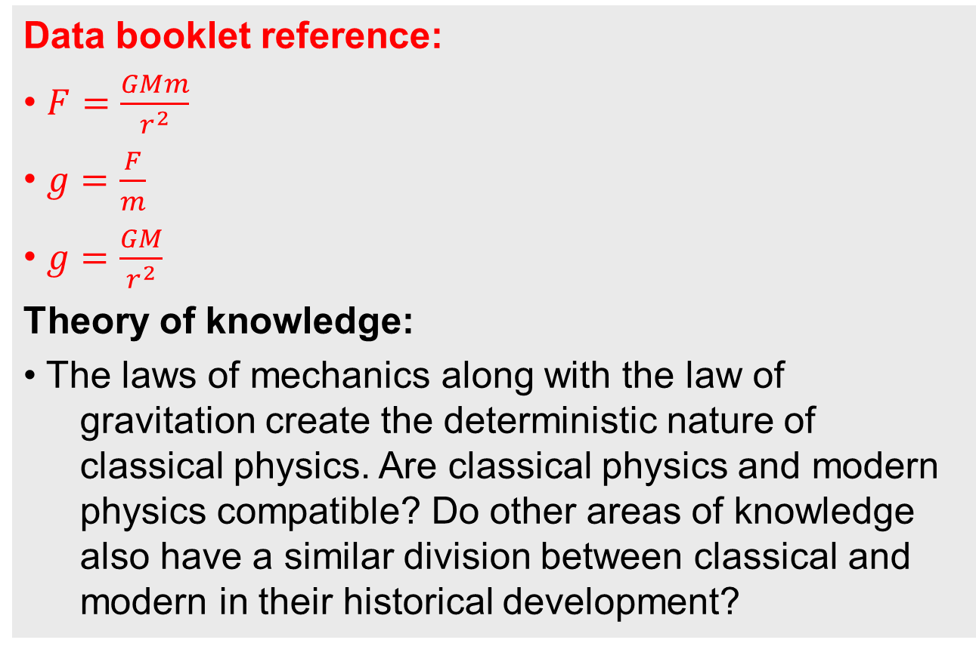
Topic 6: Circular motion and gravitation
6.2 – Newton’s law of gravitation
Data booklet reference:
• $F=\frac{GMm}{r^{2}}$
• $g=\frac{F}{m}$
• $g=\frac{GM}{r^{2}}$
Theory of knowledge:
• The laws of mechanics along with the law of gravitation create the deterministic nature of classical physics. Are classical physics and modern physics compatible? Do other areas of knowledge also have a similar division between classical and modern in their historical development?
Notes:
© 2006 By Timothy K. Lund

Slide 5
Topic 6: Circular motion and gravitation
6.2 – Newton’s law of gravitation
Utilization:
• The law of gravitation is essential in describing the motion of satellites, planets, moons and entire galaxies
• Comparison to Coulomb’s law (see Physics sub-topic 5.1)
Aims:
• Aim 4: the theory of gravitation when combined and synthesized with the rest of the laws of mechanics allows detailed predictions about the future position and motion of planets
Notes:
© 2006 By Timothy K. Lund

Slide 6
Topic 6: Circular motion and gravitation
6.2 – Newton’s law of gravitation
Newton’s law of gravitation
•The ______________________is the weakest of the four fundamental forces, as the following visual shows:
ELECTRO-WEAK
ELECTROMAGNETIC
GRAVITY
STRONG
WEAK
+
+
nuclear
force
light, heat, charge and magnets
radioactivity
freefall, orbits
Notes:
© 2006 By Timothy K. Lund

Slide 7
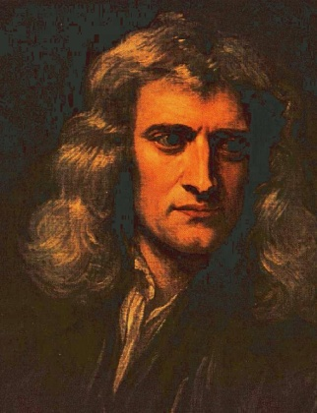
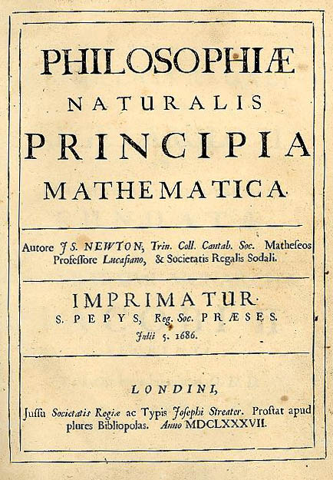
Topic 6: Circular motion and gravitation
6.2 – Newton’s law of gravitation
Newton’s law of gravitation
•In 1687 ___________published what has been called by some the greatest scientific discovery of all time – his _________________________.
•The law states that the ___________________ _____________________________________________________________________________________________________________________________
•The actual value of __, the ______________________ _____________, was not known until Henry Cavendish conducted a tricky experiment in 1798 to find it.
Universal law of gravitation
Notes:
© 2006 By Timothy K. Lund

Slide 8
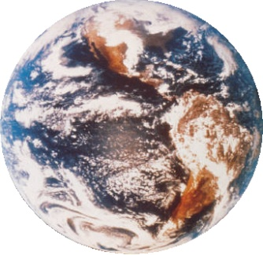
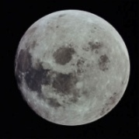
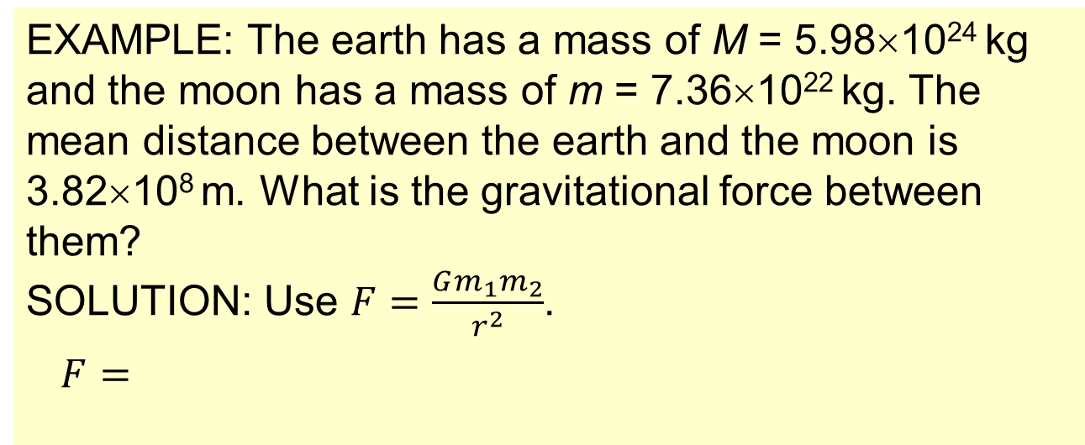
Topic 6: Circular motion and gravitation
6.2 – Newton’s law of gravitation
Solving problems involving gravitational force
•Be very clear that __ is the ______________________ _____________ of the masses.
FYI
•The radius of each mass is immaterial.
m₁
m₂
F₁₂
F₂₁
EXAMPLE: The earth has a mass of M = 5.98×10²⁴ kg and the moon has a mass of m = 7.36×10²² kg. The mean distance between the earth and the moon is 3.82×10⁸ m. What is the gravitational force between them?
SOLUTION: Use $F=\frac{Gm_{1}m_{2}}{r^{2}}$.
$F=$
Notes:
© 2006 By Timothy K. Lund

Slide 9
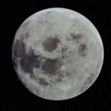
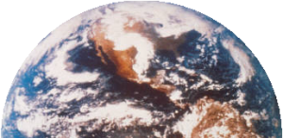
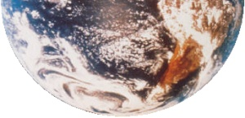
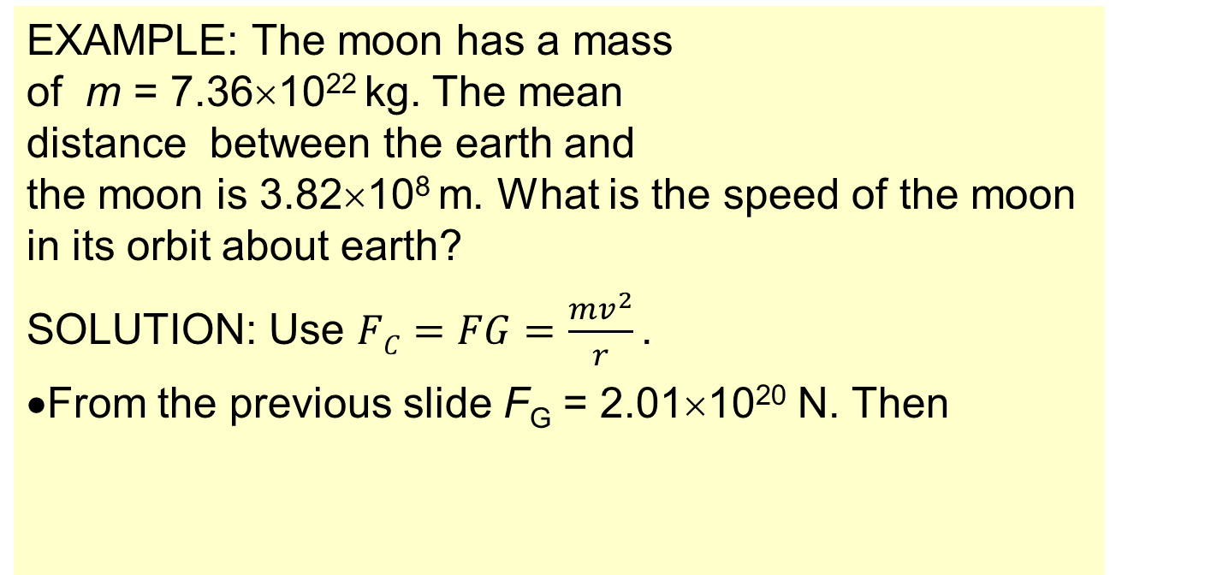
Topic 6: Circular motion and gravitation
6.2 – Newton’s law of gravitation
Solving problems involving gravitational force
EXAMPLE: The moon has a mass of m = 7.36×10²² kg. The mean distance between the earth and the moon is 3.82×10⁸ m. What is the speed of the moon in its orbit about earth?
SOLUTION: Use $FC=FG=\frac{mv^{2}}{r}$ .
•From the previous slide F_{G} = 2.01×10²⁰ N. Then
FYI • ___________________, the gravitational force is the centripetal force. Thus _________.
Notes:
© 2006 By Timothy K. Lund

Slide 10
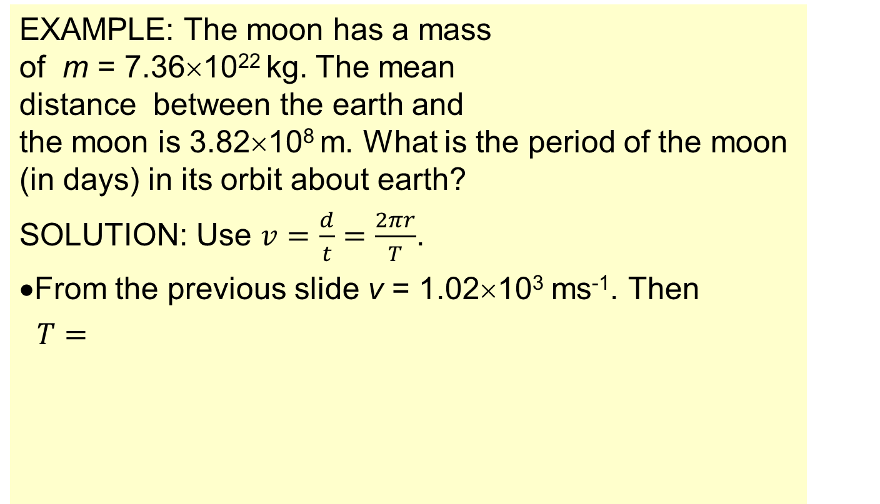
Topic 6: Circular motion and gravitation
6.2 – Newton’s law of gravitation
Solving problems involving gravitational force
EXAMPLE: The moon has a mass of m = 7.36×10²² kg. The mean distance between the earth and the moon is 3.82×10⁸ m. What is the period of the moon (in days) in its orbit about earth?
SOLUTION: Use $v=\frac{d}{t}=\frac{2πr}{T}$.
•From the previous slide v = 1.02×10³ ms⁻¹. Then
$T=$
Notes:
© 2006 By Timothy K. Lund

Slide 11
Topic 6: Circular motion and gravitation
6.2 – Newton’s law of gravitation
Gravitational field strength
•Suppose a mass m is located a distance r from a another mass M.
•The _______________________ g is the __________ _______________________________________. Thus
The units are __________________________.
Note that from Newton’s second law, F = ma, we see that a _______________________________________.
Note further that weight has the formula F = mg, and that the g in this formula is none other than the gravitational field strength!
___________________________________________.
gravitational field strength
Notes:
© 2006 By Timothy K. Lund

Slide 12

Topic 6: Circular motion and gravitation
6.2 – Newton’s law of gravitation
Solving problems involving gravitational field strength
•Suppose a mass m is located on the surface of a planet of radius R. We know that it’s weight is $F=mg$.
•But from the law of universal gravitation, the weight of m is equal to its attraction to the planet’s mass M and equals $F=\frac{GMm}{R^{2}}$. Thus $mg=\frac{GMm}{R^{2}}$.
This same derivation works for any r.
gravitational field strength at surface of a planet of mass M and radius R
gravitational field strength at distance r from center of a planet of mass M
Notes:
© 2006 By Timothy K. Lund

Slide 13
Topic 6: Circular motion and gravitation
6.2 – Newton’s law of gravitation
Solving problems involving gravitational field strength
PRACTICE: The mass of the earth is M = 5.98×10²⁴ kg and the radius of the earth is R = 6.37×10⁶ m. Find the gravitational field strength at the surface of the earth, and at a distance of one earth radius above its surface.
SOLUTION:
Notes:
© 2006 By Timothy K. Lund

Slide 14
Topic 6: Circular motion and gravitation
6.2 – Newton’s law of gravitation
Solving problems involving gravitational field strength
PRACTICE: A 525-kg satellite is launched from the earth’s surface to a height of one earth radius above the surface. What is its weight (a) at the surface, and (b) at altitude?
SOLUTION: Use information from the previous slide:
Notes:
© 2006 By Timothy K. Lund

Slide 15
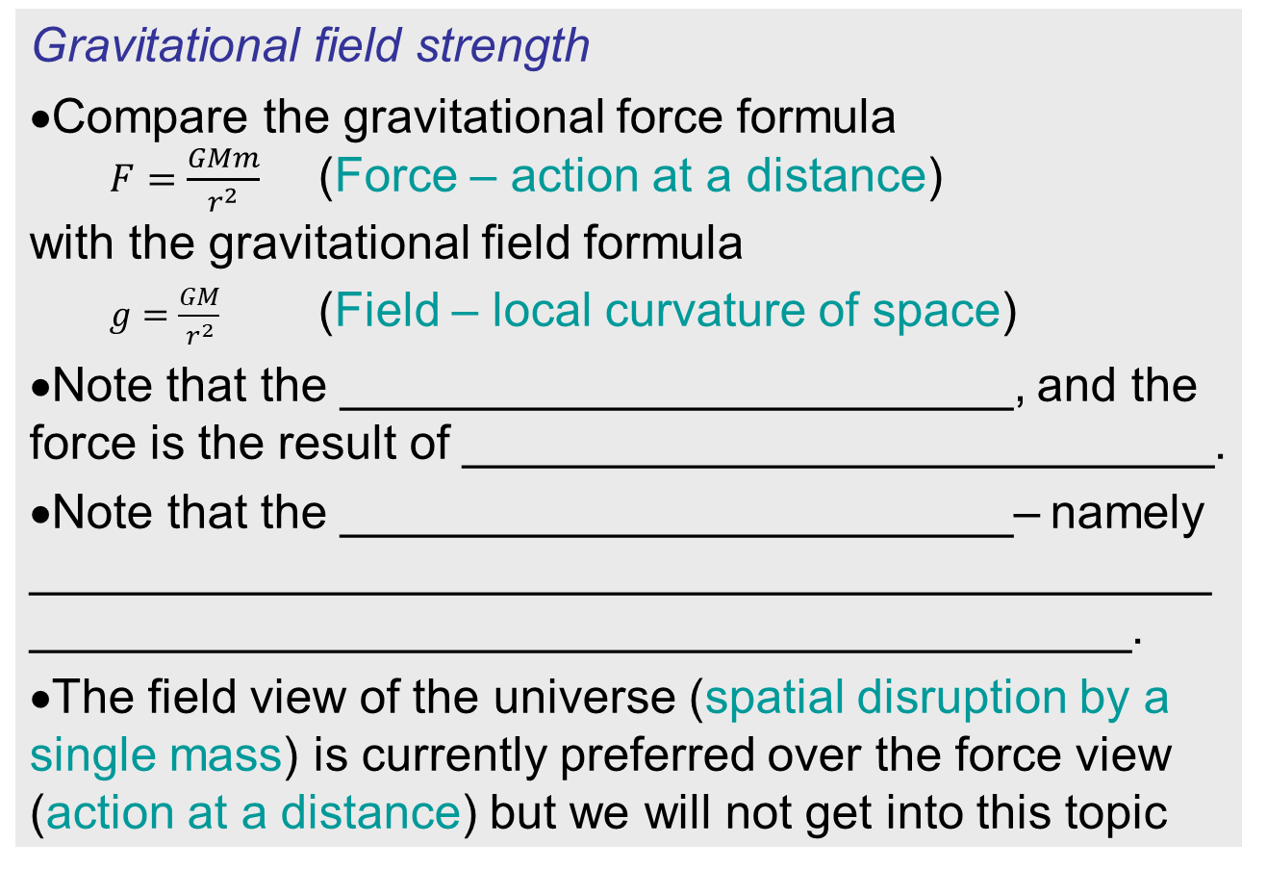
Topic 6: Circular motion and gravitation
6.2 – Newton’s law of gravitation
Gravitational field strength
•Compare the gravitational force formula
$F=\frac{GMm}{r^{2}}$ (Force – action at a distance)
with the gravitational field formula
$g=\frac{GM}{r^{2}}$ (Field – local curvature of space)
•Note that the _________________________, and the force is the result of ____________________________.
Note that the _________________________– namely _____________________________________________________________________________________.
The field view of the universe (spatial disruption by a single mass) is currently preferred over the force view (action at a distance) but we will not get into this topic
Notes:
© 2006 By Timothy K. Lund

Slide 16
Topic 6: Circular motion and gravitation
6.2 – Newton’s law of gravitation
Gravitational field strength
•Consider the gravitational field of
the sun. If we consider the field lines
to represent gravitational field strength,
our sketch of the gravitational field is
vastly simplified:
•In fact, we don’t even have to draw the sun – the arrows are sufficient to denote its presence.
•To simplify field drawings even more, we take the convention of drawing “field lines” as a single arrow.
Notes:
© 2006 By Timothy K. Lund

Slide 17
Topic 6: Circular motion and gravitation
6.2 – Newton’s law of gravitation
Gravitational field strength
•In the first sketch the ________________ at a point is determined by the _________ _________________________________.
•The second sketch has single arrows, so how do we know how strong the field is at a particular point in the vicinity of a mass?
•We simply look at the ____________ of the field lines. ________________________ _____________________________.
•In the red region the field lines are closer together than in the green region.
•Thus the red field is stronger than the green field.
SUN
SUN
Notes:
© 2006 By Timothy K. Lund

Slide 18



Topic 6: Circular motion and gravitation
6.2 – Newton’s law of gravitation
Solving problems involving gravitational field strength
PRACTICE: Sketch the gravitational field about the earth (a) as viewed from far away, and (b) as viewed “locally” (at the surface).
SOLUTION:
(a)
(b)
or
FYI
•Note that the ________________________________ _______________________________________.
Notes:
© 2006 By Timothy K. Lund

Slide 19
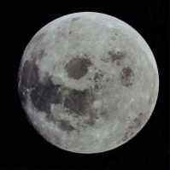
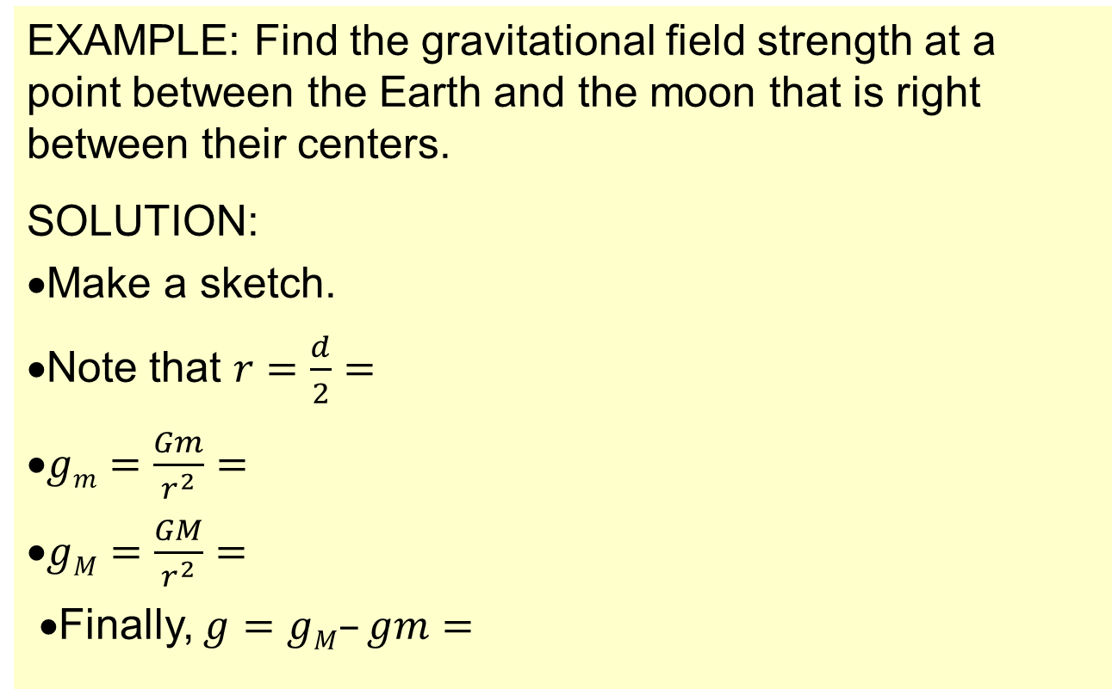
Topic 6: Circular motion and gravitation
6.2 – Newton’s law of gravitation
Solving problems involving gravitational field strength
EXAMPLE: Find the gravitational field strength at a point between the Earth and the moon that is right between their centers.
SOLUTION:
•Make a sketch.
•Note that $r=\frac{d}{2}=$
•$gm=\frac{Gm}{r^{2}}=$
•$gM=\frac{GM}{r^{2}}=$
•Finally, $g=gM–gm=$
M = 5.98×10²⁴ kg
m = 7.36×10²² kg
g_{m}
g_{M}
d = 3.82×10⁸ m
Notes:
© 2006 By Timothy K. Lund

Slide 20
Topic 6: Circular motion and gravitation
6.2 – Newton’s law of gravitation
Solving problems involving gravitational field strength
PRACTICE: Jupiter’s gravitational field strength at its surface is 25 N kg⁻¹ while its radius is 7.1×10⁷ m.
(a) Derive an expression for the gravitational field strength at the surface of a planet in terms of its mass M and radius R and the gravitational constant G.
SOLUTION: This is for a general planet…
(a)
Notes:
© 2006 By Timothy K. Lund

Slide 21
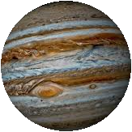
Topic 6: Circular motion and gravitation
6.2 – Newton’s law of gravitation
Solving problems involving gravitational field strength
PRACTICE: Jupiter’s gravitational field strength at its surface is 25 N kg⁻¹ while its radius is 7.1×10⁷ m.
(b) Using the given information and the formula you just derived deduce Jupiter’s mass.
(c) Find the weight of a 65-kg man on Jupiter.
SOLUTION:
Notes:
© 2006 By Timothy K. Lund

Slide 22
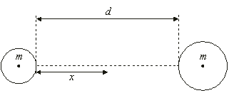
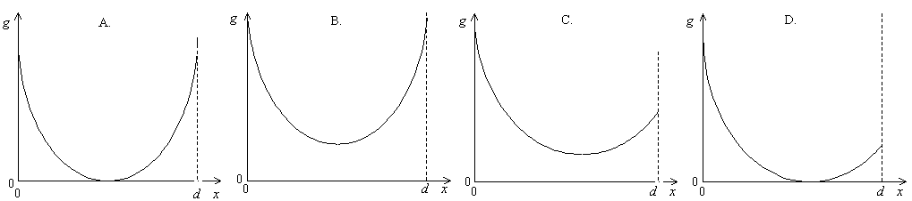
Topic 6: Circular motion and gravitation
6.2 – Newton’s law of gravitation
Solving problems involving gravitational field strength
PRACTICE: Two spheres of equal mass and different radii are held a distance d apart. The gravitational field strength is measured on the line joining the two masses at position x which varies. Which graph shows the variation of g with x correctly?
Notes:
© 2006 By Timothy K. Lund

Slide 23
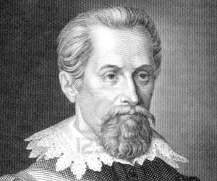
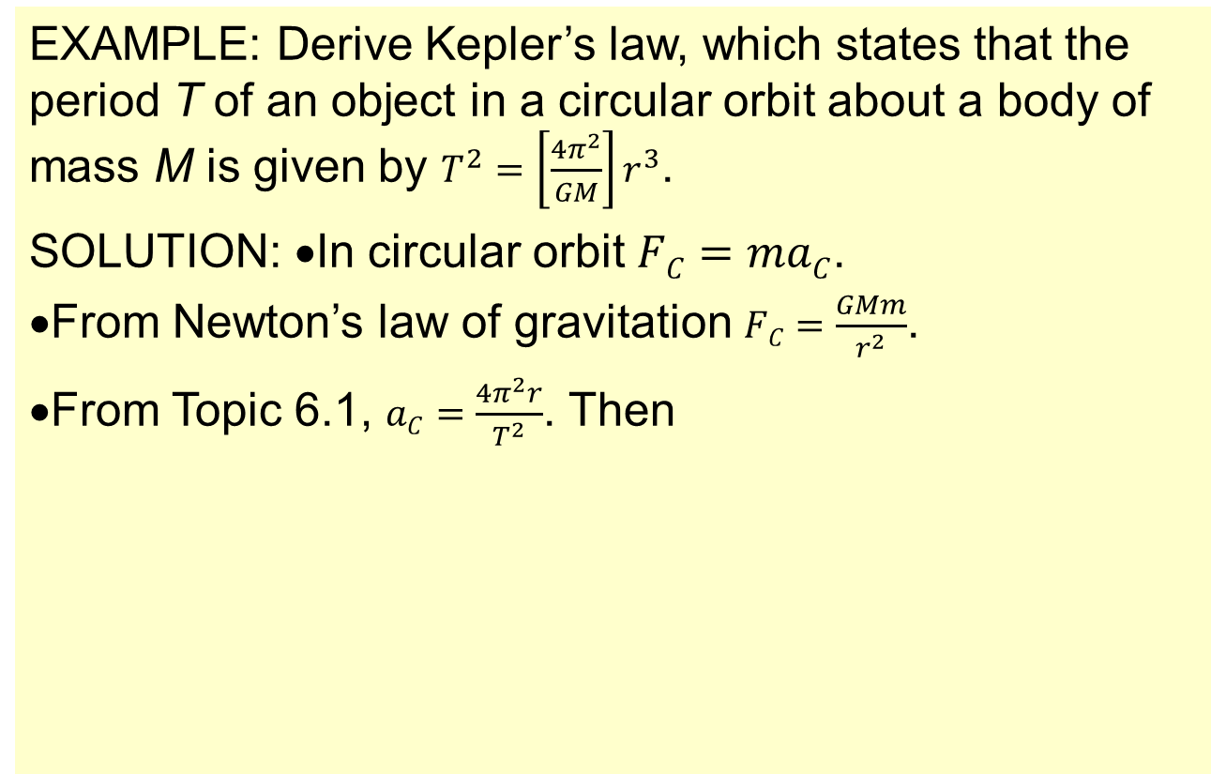
Topic 6: Circular motion and gravitation
6.2 – Newton’s law of gravitation
Solving problems involving orbital period
EXAMPLE: Derive Kepler’s law, which states that the period T of an object in a circular orbit about a body of mass M is given by $T^{2}=\left[\frac{4π^{2}}{GM}\right]r^{3}$.
SOLUTION: •In circular orbit $FC=maC$.
•From Newton’s law of gravitation $FC=\frac{GMm}{r^{2}}$.
•From Topic 6.1, $aC=\frac{4π^{2}r}{T^{2}}$. Then
Notes:
© 2006 By Timothy K. Lund

Slide 24

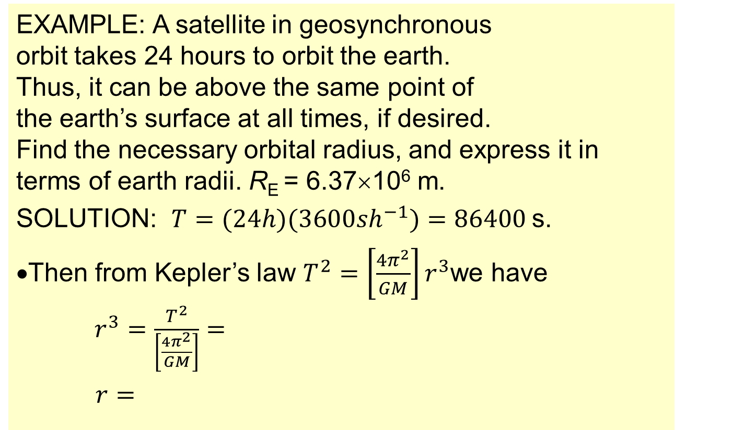
Topic 6: Circular motion and gravitation
6.2 – Newton’s law of gravitation
Solving problems involving orbital period
EXAMPLE: A satellite in geosynchronous orbit takes 24 hours to orbit the earth. Thus, it can be above the same point of the earth’s surface at all times, if desired. Find the necessary orbital radius, and express it in terms of earth radii. R_{E} = 6.37×10⁶ m.
SOLUTION: $T=(24h)(3600sh^{−1})=86400$s.
•Then from Kepler’s law $T^{2}=\left[\frac{4π^{2}}{GM}\right]r^{3}$we have
$r^{3}=\frac{T^{2}}{\left[\frac{4π^{2}}{GM}\right]}=$
$r=$
Notes:
© 2006 By Timothy K. Lund

Slide 25

Topic 6: Circular motion and gravitation
6.2 – Newton’s law of gravitation
Solving problems involving orbital period
Kepler’s third law
FYI • Kepler’s third law originally said that _______________________ ____________________________________________ – and nothing at all about what the constant of proportionality was. Newton’s law of gravitation was needed for that!
Notes:
© 2006 By Timothy K. Lund

Slide 26


Topic 6: Circular motion and gravitation
6.2 – Newton’s law of gravitation
Solving problems involving orbital period
$$T^{2}=\left[\frac{4π^{2}}{GM}\right]r^{3}$$
Kepler’s third law
Notes:
© 2006 By Timothy K. Lund

Slide 27


Topic 6: Circular motion and gravitation
6.2 – Newton’s law of gravitation
Solving problems involving orbital period
$$T^{2}=\left[\frac{4π^{2}}{GM}\right]r^{3}$$
Kepler’s third law
Notes:
© 2006 By Timothy K. Lund

Slide 28


Topic 6: Circular motion and gravitation
6.2 – Newton’s law of gravitation
Solving problems involving gravitational field
•Consider Dobson inside an elevator which is not moving…
•If he drops a ball, it will accelerate downward at 9.8 ms⁻² as expected.
PRACTICE: If the elevator is accelerating upward at 2 ms⁻², what will Dobson observe the dropped ball’s acceleration to be?
SOLUTION:
•Since the elevator is accelerating upward at 2 ms⁻² to meet the ball that is accelerating downward at 9.8 ms⁻², Dobson would observe an acceleration of __________.
•If the elevator were accelerating downward at 2, he would observe an acceleration of _______.
Notes:
© 2006 By Timothy K. Lund

Slide 29
Topic 6: Circular motion and gravitation
6.2 – Newton’s law of gravitation
Solving problems involving gravitational field
PRACTICE: If the elevator were to accelerate downward at 9.8 ms⁻², what would Dobson observe the dropped ball’s acceleration to be?
SOLUTION:
•He would observe the acceleration of the ball to be zero!
•He would think that the ball was _______________.
FYI
•_________________________, obviously. It is merely accelerating at the same rate as Dobson!
•How could you get Dobson to accelerate downward at 9.8 ms⁻²?
Notes:
© 2006 By Timothy K. Lund

Slide 30
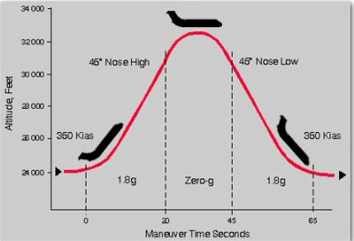
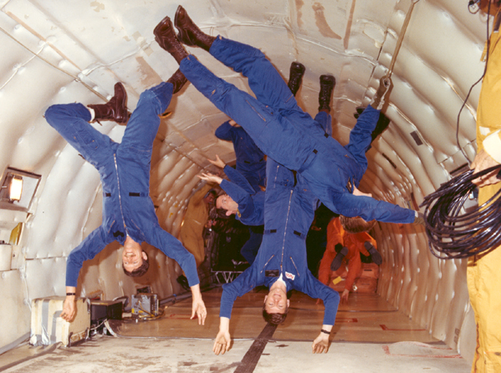
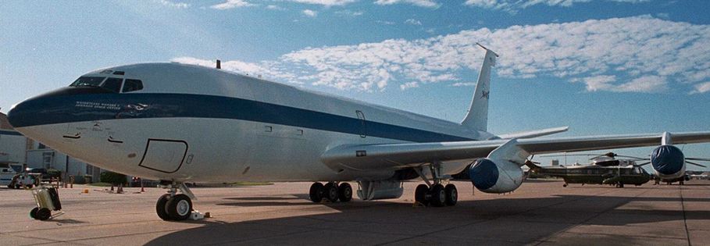
The “Vomit Comet”
Notes:
© 2006 By Timothy K. Lund

Slide 31
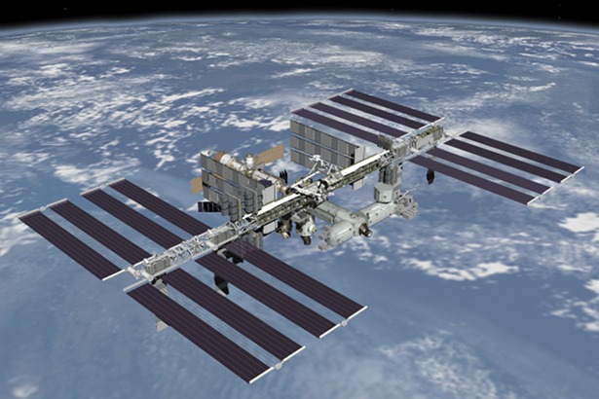
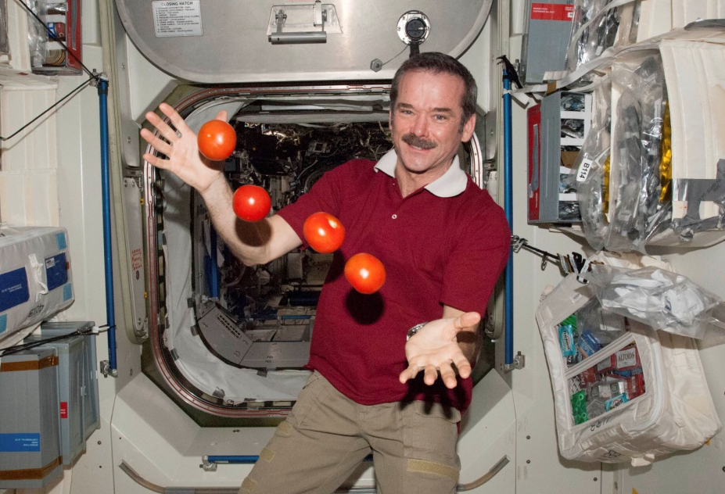
Topic 6: Circular motion and gravitation
6.2 – Newton’s law of gravitation
Solving problems involving gravitational field
PRACTICE: We have all seen astronauts experiencing “weightlessness.” Explain why it only appears that they are weightless.
SOLUTION:
International Space Station
Notes:
© 2006 By Timothy K. Lund

Slide 32
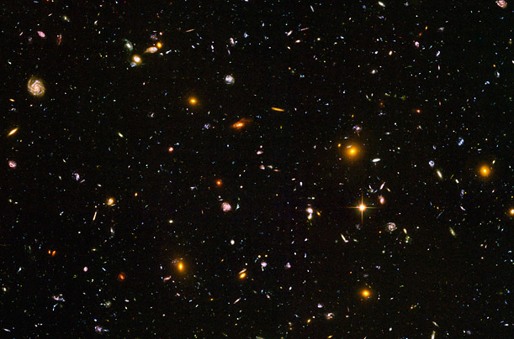
Topic 6: Circular motion and gravitation
6.2 – Newton’s law of gravitation
Solving problems involving gravitational field
PRACTICE: Discuss the concept of weightlessness in _______________.
SOLUTION: Only in deep space – which is defined to be far, far away from all masses – will a mass be truly weightless.
________________________________________________________________________________________________________________________________
Notes:
© 2006 By Timothy K. Lund

Slide 33

Topic 6: Circular motion and gravitation
6.2 – Newton’s law of gravitation
Solving problems involving gravitational field
Notes:
© 2006 By Timothy K. Lund

Slide 34

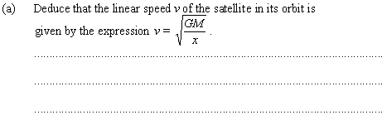
Topic 6: Circular motion and gravitation
6.2 – Newton’s law of gravitation
Solving problems involving gravitational field
x
R
Notes:
© 2006 By Timothy K. Lund

Slide 35
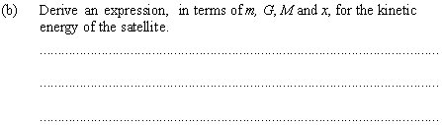
Topic 6: Circular motion and gravitation
6.2 – Newton’s law of gravitation
Solving problems involving gravitational field
x
R
Notes:
© 2006 By Timothy K. Lund

Slide 36
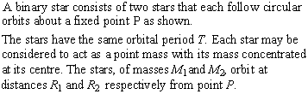

Topic 6: Circular motion and gravitation
6.2 – Newton’s law of gravitation
Solving problems involving gravitational force
R₂
R₁
M₁
M₂
P
Notes:
© 2006 By Timothy K. Lund

Slide 37
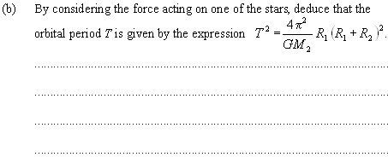
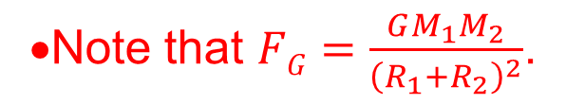
Topic 6: Circular motion and gravitation
6.2 – Newton’s law of gravitation
•Note that $FG=\frac{GM_{1}M_{2}}{{\left(R_{1}+R_{2}\right)}^{2}}$.
Solving problems involving gravitational force
R₂
R₁
M₁
M₂
P
Notes:
© 2006 By Timothy K. Lund

Slide 38
Topic 6: Circular motion and gravitation
6.2 – Newton’s law of gravitation
Solving problems involving gravitational force
R₂
R₁
M₁
M₂
P
Notes:
© 2006 By Timothy K. Lund

Slide 39
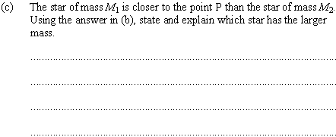
Topic 6: Circular motion and gravitation
6.2 – Newton’s law of gravitation
Solving problems involving gravitational force
R₂
R₁
M₁
M₂
P
Notes:
© 2006 By Timothy K. Lund

Slide 40
Topic 6: Circular motion and gravitation
6.2 – Newton’s law of gravitation
Solving problems involving gravitational force
R₂
R₁
M₁
M₂
P
Notes:
© 2006 By Timothy K. Lund

