Slide 1
Topic 6: Circular motion and gravitation
6.1 – Circular motion
Essential idea:
A force applied perpendicular to a body’s displacement can result in its circular motion.
Nature of science:
Observable universe: Observations and subsequent deductions led to the realization that the force must act radially inwards in all cases of circular motion.
Notes:
© 2006 By Timothy K. Lund

Slide 2
Topic 6: Circular motion and gravitation
6.1 – Circular motion
Understandings:
• Period, frequency, angular displacement and angular velocity
• Centripetal force
• Centripetal acceleration
Notes:
2
© 2006 By Timothy K. Lund

Slide 3
Topic 6: Circular motion and gravitation
6.1 – Circular motion
Applications and skills:
• Identifying the forces providing the centripetal forces such as tension, friction, gravitational, electrical, or magnetic
• Solving problems involving centripetal force, centripetal acceleration, period, frequency, angular displacement, linear speed and angular velocity
• Qualitatively and quantitatively describing examples of circular motion including cases of vertical and horizontal circular motion
Notes:
3
© 2006 By Timothy K. Lund

Slide 4
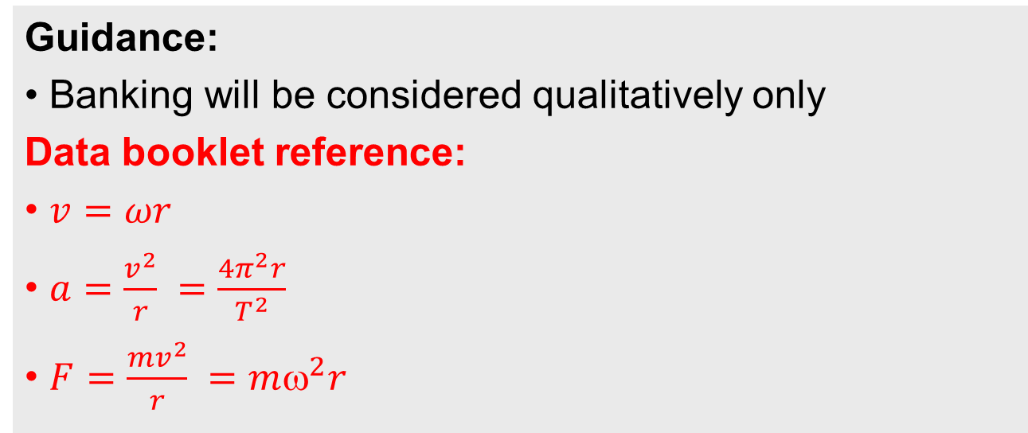
Topic 6: Circular motion and gravitation
6.1 – Circular motion
Guidance:
• Banking will be considered qualitatively only
Data booklet reference:
• $v=ωr$
• $a=\frac{v^{2}}{r} =\frac{4π^{2}r}{T^{2}}$
• $F=\frac{mv^{2}}{r} =mω^{2}r$
Notes:
4
© 2006 By Timothy K. Lund

Slide 5
Topic 6: Circular motion and gravitation
6.1 – Circular motion
International-mindedness:
• International collaboration is needed in establishing effective rocket launch sites to benefit space programs
Theory of knowledge:
• Foucault’s pendulum gives a simple observable proof of the rotation of the earth, which is largely unobservable. How can we have knowledge of things that are unobservable?
Notes:
5
© 2006 By Timothy K. Lund

Slide 6
Topic 6: Circular motion and gravitation
6.1 – Circular motion
Utilization:
• Motion of charged particles in magnetic fields (see Physics sub-topic 5.4)
• Mass spectrometry (see Chemistry sub-topics 2.1 and 11.3)
• Playground and amusement park rides often use the principles of circular motion in their design
Notes:
6
© 2006 By Timothy K. Lund

Slide 7
Topic 6: Circular motion and gravitation
6.1 – Circular motion
Aims:
• Aim 6: experiments could include (but are not limited to): mass on a string; observation and quantification of loop-the-loop experiences; friction of a mass on a turntable
• Aim 7: technology has allowed for more accurate and precise measurements of circular motion, including data loggers for force measurements and video analysis of objects moving in circular motion
Notes:
7
© 2006 By Timothy K. Lund

Slide 8
Topic 6: Circular motion and gravitation
6.1 – Circular motion
Centripetal force and acceleration
•A particle is said to be in uniform circular motion if it travels in a circle (or arc) with constant speed v.
•Observe that the velocity vector is always tangent to the circle.
•Note that the magnitude of the velocity vector is NOT changing.
•Note that the direction of the velocity vector IS changing.
•Thus, there is an acceleration, even though the speed is not changing!
v red
r blue
y
v
r
x
Notes:
© 2006 By Timothy K. Lund

Slide 9

Topic 6: Circular motion and gravitation
6.1 – Circular motion
Centripetal force and acceleration
•To find the direction of the acceleration ($a=\frac{Δv}{Δt}$) we observe two nearby snapshots of the particle:
•The direction of the acceleration is gotten from Δv = v₂ – v₁ = v₂ + (-v₁):
•The direction of the acceleration is toward the center of the circle - you must be able to sketch this.
v red
r blue
v₂
y
v₂
v₂
v₁
-v₁
v₁
v₁
-v₁
Δv
Δv
x
FYI
•Centripetal means center-seeking.
Notes:
© 2006 By Timothy K. Lund

Slide 10
Topic 6: Circular motion and gravitation
6.1 – Circular motion
Centripetal force and acceleration
•How does centripetal acceleration a_{c} depend on r and v ?
•To explore this we define the centripetal force F_{c}:
•Picture yourself as the passenger in a car that is rounding a left turn:
•The sharper the turn, the harder you and your door push against each other.
(Small r = big F_{c}.)
The faster the turn, the harder you and your door push against each other.
(Big v = big F_{c}.)
F_{c} = ma_{c}
centripetal force
F_{c}
Notes:
© 2006 By Timothy K. Lund

Slide 11
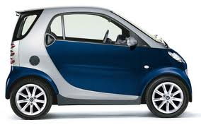


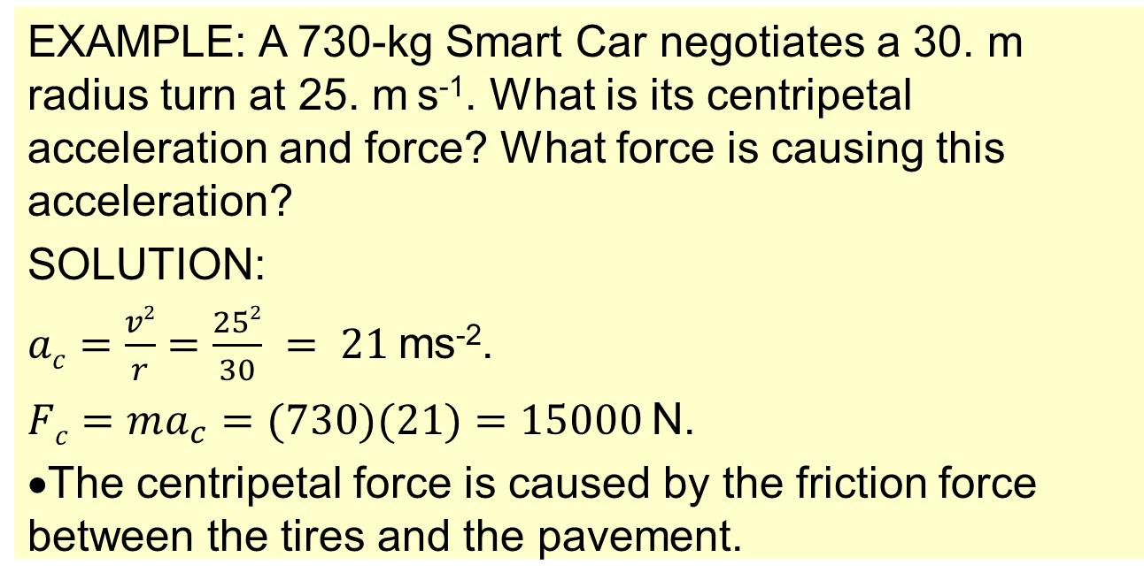
Topic 6: Circular motion and gravitation
6.1 – Circular motion
Solving centripetal acceleration and force problems
$$Fc=ma_{c}$$
centripetal force
$$ac=\frac{v2}{r}$$
centripetal acceleration
EXAMPLE: A 730-kg Smart Car negotiates a 30. m radius turn at 25. m s⁻¹. What is its centripetal acceleration and force? What force is causing this acceleration?
SOLUTION:
$ac=\frac{v2}{r}=\frac{252}{30} = 21$ms⁻².
$Fc=ma_{c}=(730)(21)=15000$N.
The centripetal force is caused by the friction force between the tires and the pavement.
Notes:
© 2006 By Timothy K. Lund

Slide 12

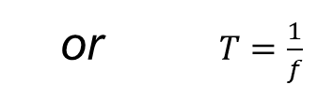

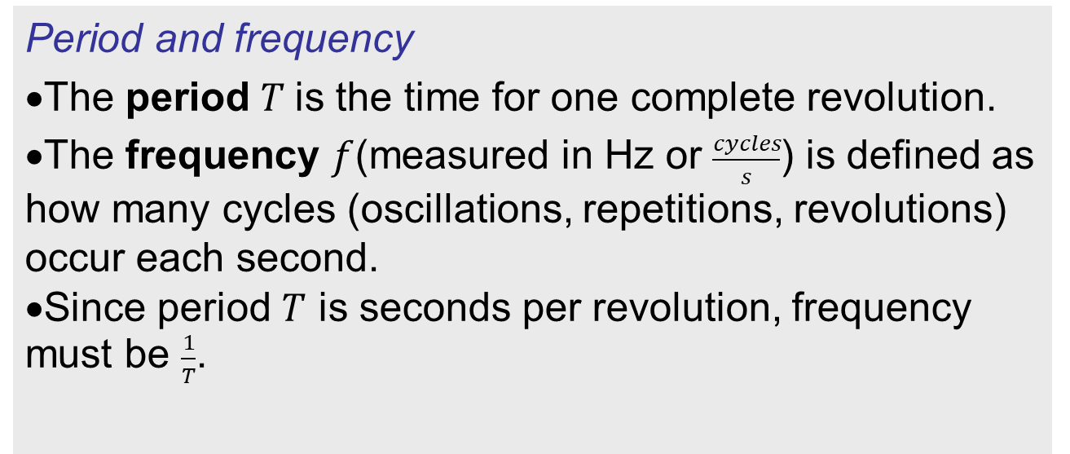
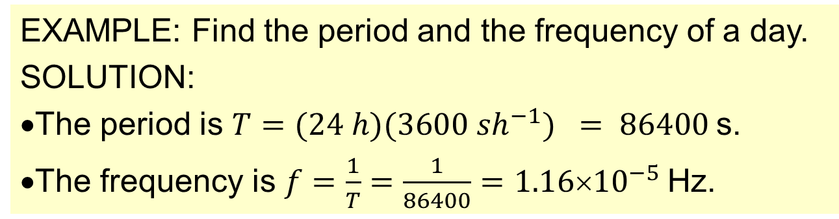
Topic 6: Circular motion and gravitation
6.1 – Circular motion
Period and frequency
•The period $T$is the time for one complete revolution.
•The frequency $f$(measured in Hz or $\frac{cycles}{s}$) is defined as how many cycles (oscillations, repetitions, revolutions) occur each second.
•Since period $T$ is seconds per revolution, frequency must be $\frac{1}{T}$.
$$f=\frac{1}{T}$$
or $T=\frac{1}{f}$
relation between T and f
EXAMPLE: Find the period and the frequency of a day.
SOLUTION:
•The period is $T=(24 h)(3600 sh^{−1}) = 86400$s.
•The frequency is $f=\frac{1}{T}=\frac{1}{86400}=1.16×{10}^{−5}$Hz.
Notes:
© 2006 By Timothy K. Lund

Slide 13
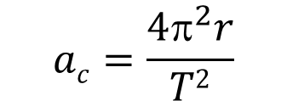
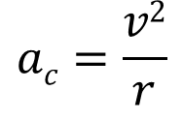
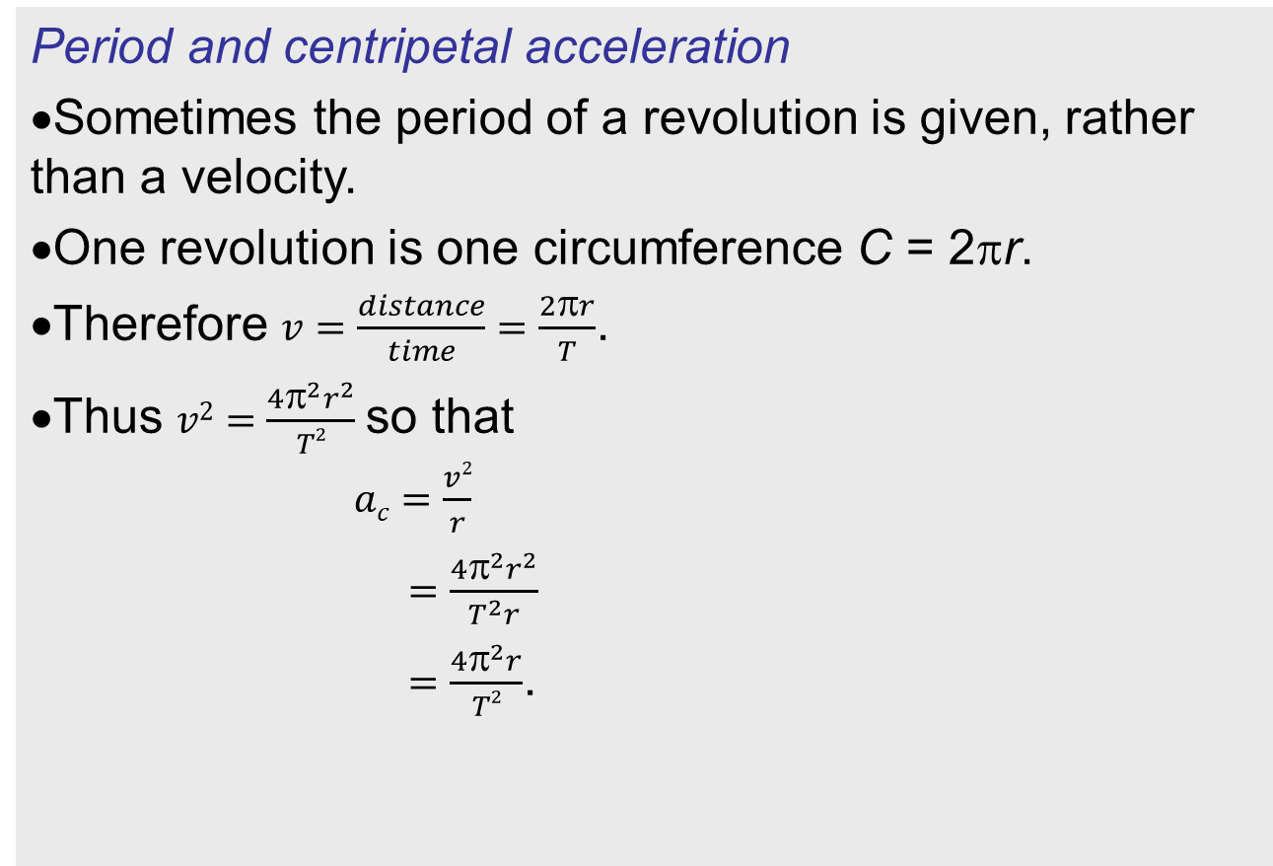
Topic 6: Circular motion and gravitation
6.1 – Circular motion
Period and centripetal acceleration
•Sometimes the period of a revolution is given, rather than a velocity.
•One revolution is one circumference C = 2πr.
•Therefore $v=\frac{distance}{time}=\frac{2πr}{T}$.
•Thus $v2=\frac{4π^{2}r^{2}}{T2}$so that
$ac=\frac{v2}{r}$
$=\frac{4π^{2}r^{2}}{T^{2}r}$
$=\frac{4π^{2}r}{T2}$.
$$ac=\frac{v2}{r}$$
$$ac=\frac{4π^{2}r}{T2}$$
centripetal acceleration
Notes:
© 2006 By Timothy K. Lund

Slide 14
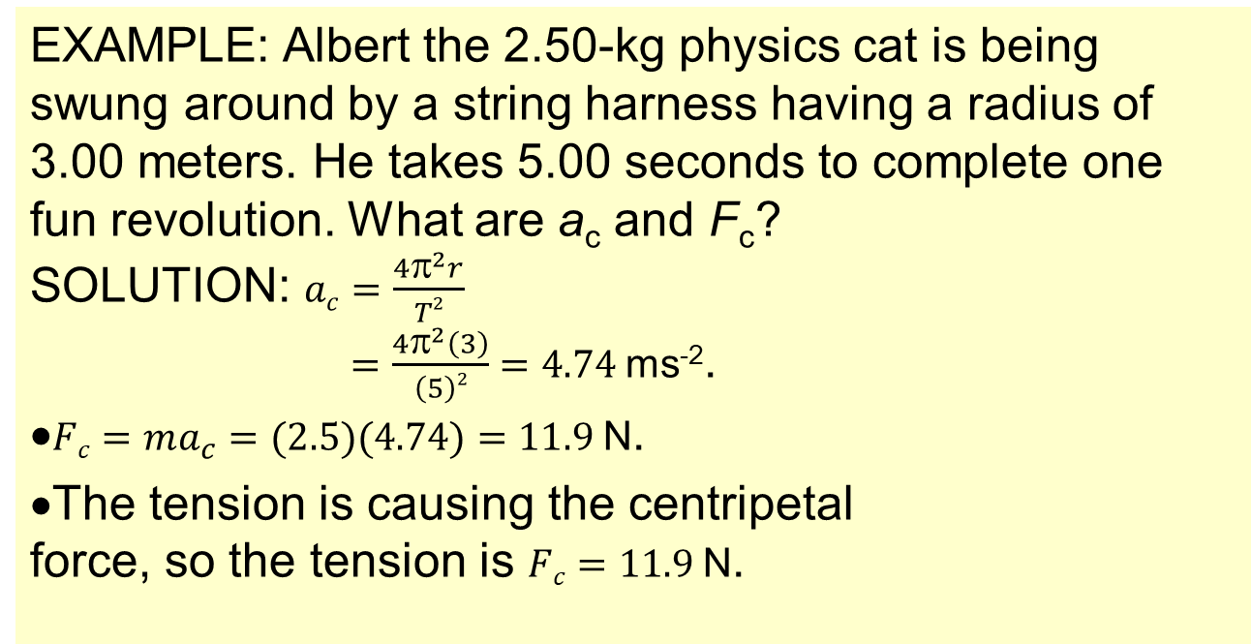
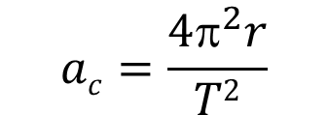
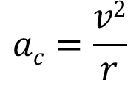
Topic 6: Circular motion and gravitation
6.1 – Circular motion
Solving centripetal acceleration and force problems
$$ac=\frac{v2}{r}$$
$$ac=\frac{4π^{2}r}{T2}$$
centripetal acceleration
EXAMPLE: Albert the 2.50-kg physics cat is being swung around by a string harness having a radius of 3.00 meters. He takes 5.00 seconds to complete one fun revolution. What are a_{c} and F_{c}?
SOLUTION: $ac=\frac{4π^{2}r}{T2}$
$=\frac{4π^{2}\left(3\right)}{\left(5\right)2}=4.74$ms⁻².
•$Fc=ma_{c}=(2.5)(4.74)=11.9$N.
•The tension is causing the centripetal force, so the tension is $Fc=11.9$N.
Albert the Physics Cat
Notes:
© 2006 By Timothy K. Lund

Slide 15
Topic 6: Circular motion and gravitation
6.1 – Circular motion
Angular displacement and arc length
•Consider the rotating arm which has 6 paint cans along its radius.
•Each can has a spout that is opened for exactly a quarter of a revolution.
•We call θ the angular displacement.
•All 6 color trails represent the same angular displacements of 90˚.
•Each color traces out a different displacement s.
•We call s the arc length.
•All 6 color trails represent different arc lengths.
θ
s
s
s
s
s
Notes:
© 2006 By Timothy K. Lund

Slide 16
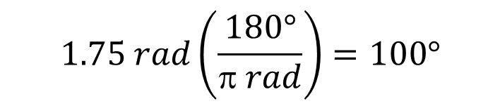
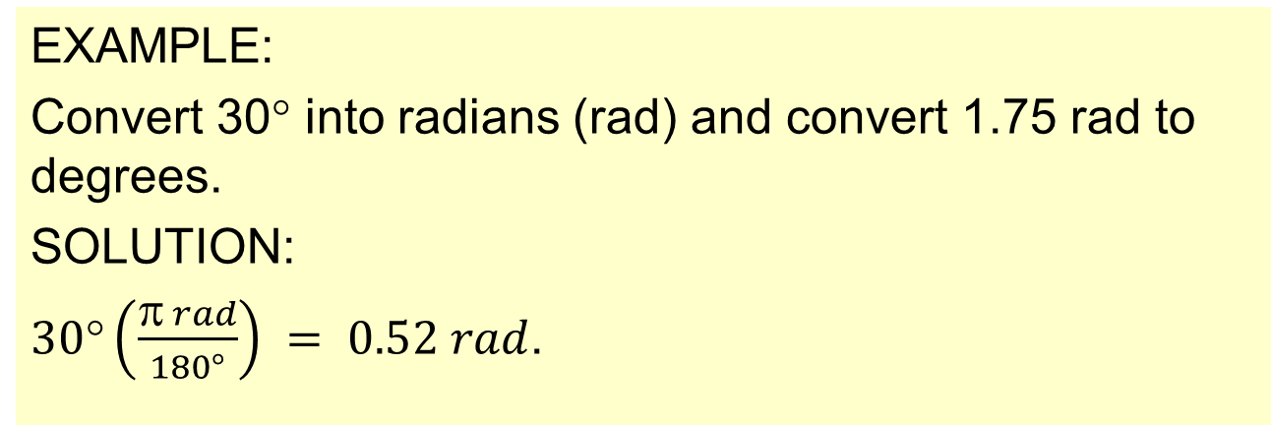
Topic 6: Circular motion and gravitation
6.1 – Circular motion
Angular displacement and arc length
•At this point it is useful to define a new way to measure angles – called radians.
•Looking at the above conversions we see that there are 2π rad in 360˚.
π rad = 180° = ½ rev
radian-degree-revolution conversions
2π rad = 360° = 1 rev
EXAMPLE:
Convert 30° into radians (rad) and convert 1.75 rad to degrees.
SOLUTION:
$30°\left(\frac{π rad}{180°}\right) = 0.52 rad$.
$$1.75 rad\left(\frac{180°}{π rad}\right)=100°$$
Notes:
© 2006 By Timothy K. Lund

Slide 17
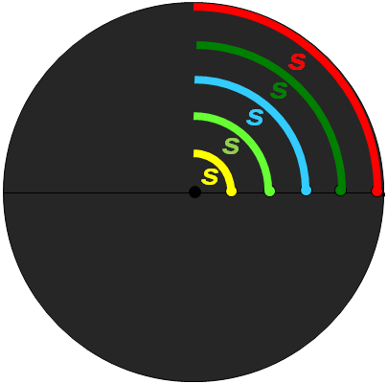

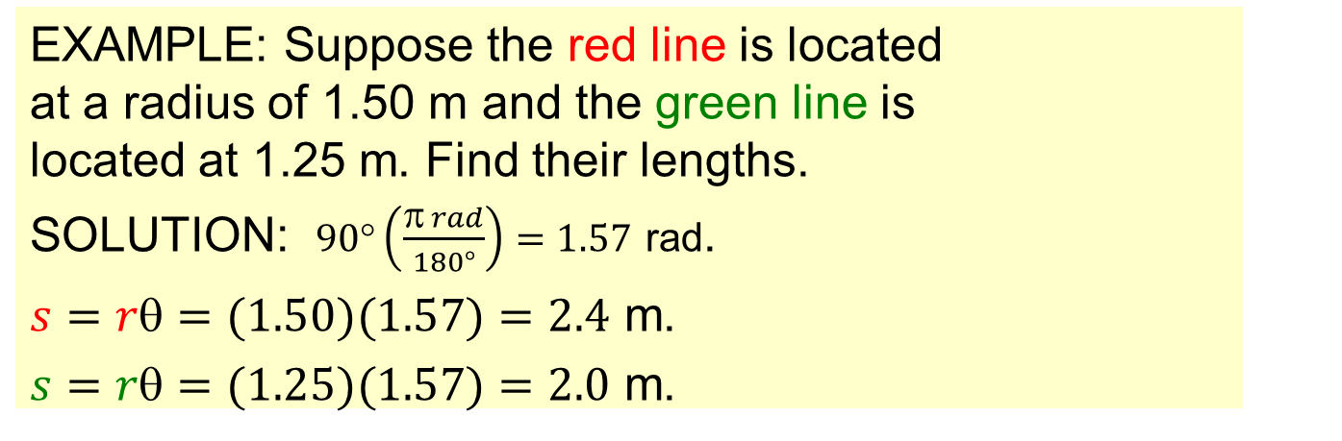
Topic 6: Circular motion and gravitation
6.1 – Circular motion
Angular displacement and arc length
•The relationship between angular displacement θ and arc length s is
where r is the radius.
π rad = 180° = ½ rev
radian-degree-revolution conversions
2π rad = 360° = 1 rev
$$s = r$$
θ in radians
relation between s and θ
EXAMPLE: Suppose the red line is located at a radius of 1.50 m and the green line is located at 1.25 m. Find their lengths.
SOLUTION: $90°\left(\frac{π rad}{180°}\right)=1.57$ rad.
$s=r=(1.50)(1.57)=2.4$ m.
$s=r=(1.25)(1.57)=2.0$ m.
Notes:
© 2006 By Timothy K. Lund

Slide 18



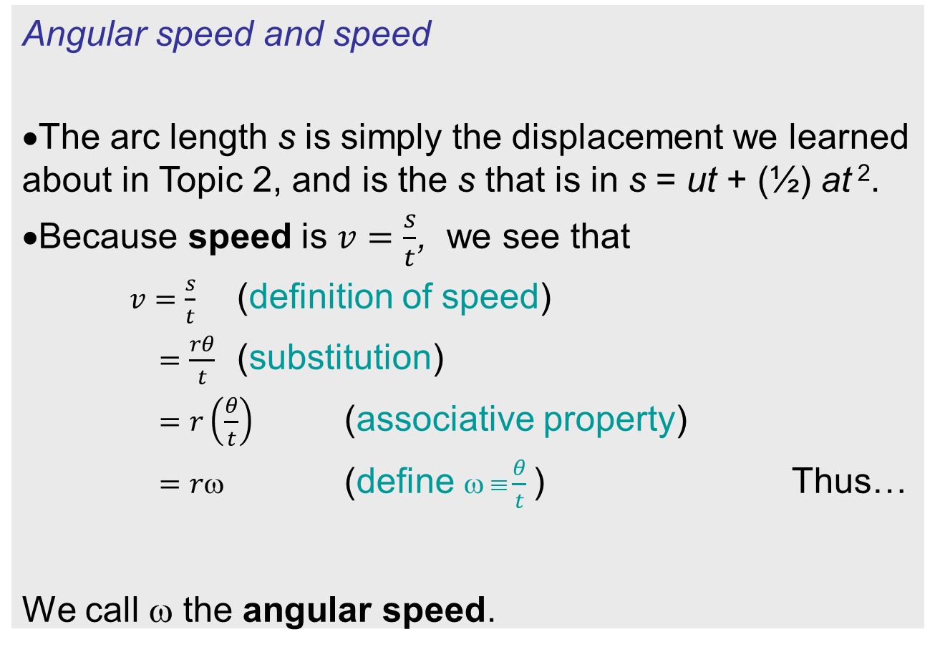
Topic 6: Circular motion and gravitation
6.1 – Circular motion
Angular speed and speed
•The arc length s is simply the displacement we learned about in Topic 2, and is the s that is in s = ut + (½) at ².
•Because speed is $v=\frac{s}{t}$, we see that
$v=\frac{s}{t}$ (definition of speed)
$=\frac{rθ}{t}$ (substitution)
$=r\left(\frac{θ}{t}\right)$ (associative property)
$=r$ (define $ ≡\frac{θ}{t}$) Thus…
We call ω the angular speed.
$$s=r$$
θ in radians
relation between s and θ
$$v=r$$
$=\frac{θ}{t}$(rad s⁻¹)
relation between v and ω
Notes:
© 2006 By Timothy K. Lund

Slide 19


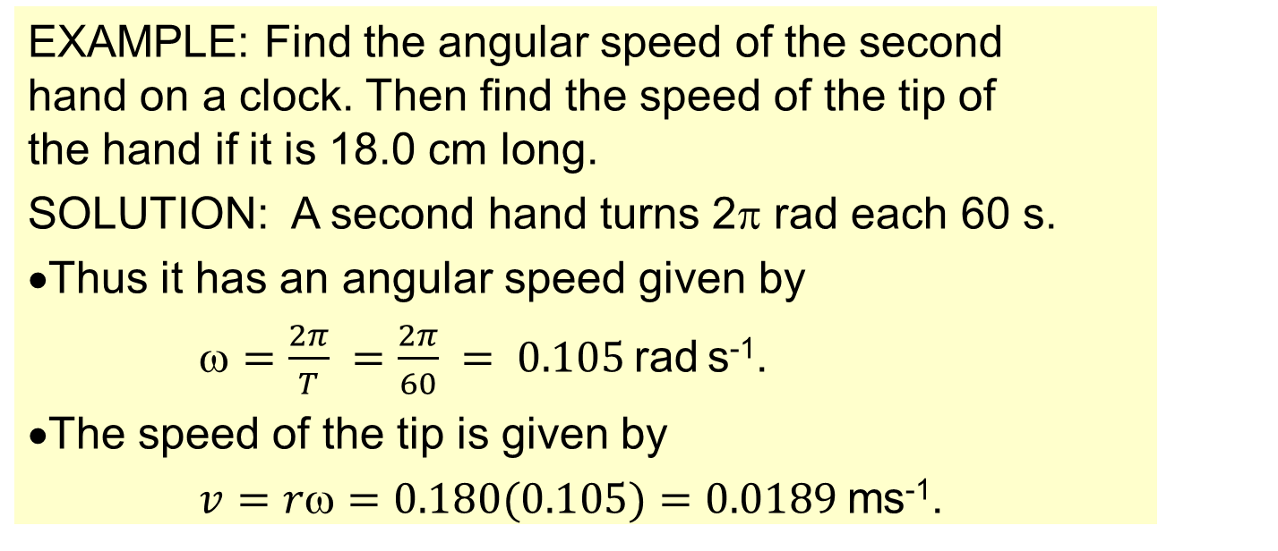

Topic 6: Circular motion and gravitation
6.1 – Circular motion
Angular speed and speed
$$v=r$$
$=\frac{θ}{t}$(rad s⁻¹)
relation between v and ω
EXAMPLE: Find the angular speed of the second hand on a clock. Then find the speed of the tip of the hand if it is 18.0 cm long.
SOLUTION: A second hand turns 2π rad each 60 s.
•Thus it has an angular speed given by
$=\frac{2π}{T} =\frac{2π}{60} = 0.105$rad s⁻¹.
•The speed of the tip is given by
$v=r=0.180(0.105)=0.0189$ms⁻¹.
FYI •Speed depends on length or position but angular speed does not.
Notes:
© 2006 By Timothy K. Lund

Slide 20

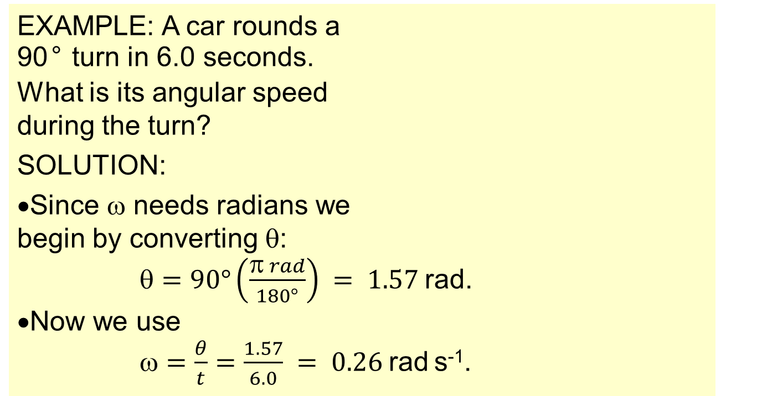
Topic 6: Circular motion and gravitation
6.1 – Circular motion
Angular speed and speed
$$v=r$$
$=\frac{θ}{t}$(rad s⁻¹)
relation between v and ω
EXAMPLE: A car rounds a 90° turn in 6.0 seconds. What is its angular speed during the turn?
SOLUTION:
•Since ω needs radians we begin by converting θ:
$=90°\left(\frac{π rad}{180°}\right) = 1.57$rad.
•Now we use
$=\frac{θ}{t}=\frac{1.57}{6.0} = 0.26$rad s⁻¹.
Notes:
© 2006 By Timothy K. Lund

Slide 21
Topic 6: Circular motion and gravitation
6.1 – Circular motion
Banking
•The car is able to round the curve because of the friction between tire and pavement.
•The friction always points to the center of the circle.
•So, how does a plane follow a circular trajectory?
•There is no sideways friction force that the plane can use because there is no solid friction between the air and the plane.
Notes:
© 2006 By Timothy K. Lund

Slide 22
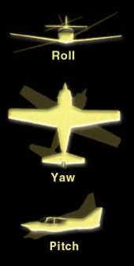
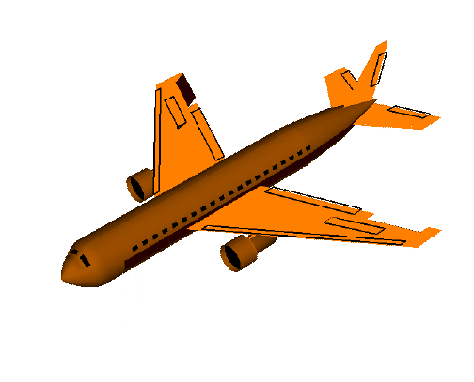
Topic 6: Circular motion and gravitation
6.1 – Circular motion
Banking
•Using control surfaces on the tail and the main wings, planes can execute three types of maneuver:
ROLL – Ailerons act in opposing directions
YAW – Tail rudder turns left or right
PITCH – Ailerons and horizontal stabilizer act together
FYI
•It is the ROLL maneuver that gives a plane a centripetal force as we will see on the next slide.
Notes:
© 2006 By Timothy K. Lund

Slide 23
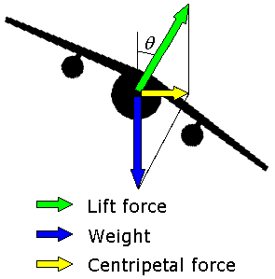
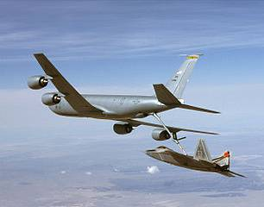
Topic 6: Circular motion and gravitation
6.1 – Circular motion
Banking
•As the plane banks (rolls), the lift vector begins to have a horizontal component.
•The centripetal force causes the plane to begin traveling in a horizontal circle.
Notes:
© 2006 By Timothy K. Lund

Slide 24
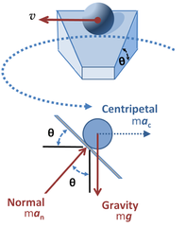
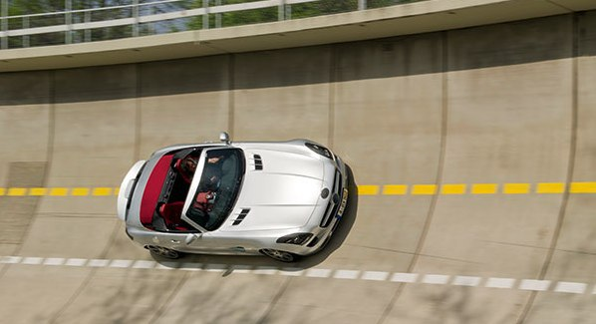
Topic 6: Circular motion and gravitation
6.1 – Circular motion
Banking
•Even though cars use friction, roads are banked so that the need for friction is reduced.
•Instead of a component of the LIFT force providing a centripetal force, a component of the NORMAL force does so.
R
FYI •A banked curve can be designed so that a car can make the turn even if it is perfectly frictionless!
F_{C}
W
Notes:
© 2006 By Timothy K. Lund

Slide 25
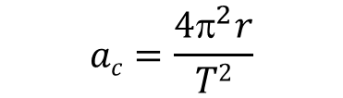
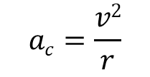





Topic 6: Circular motion and gravitation
6.1 – Circular motion
Angular speed and centripetal acceleration
•Sometimes the angular speed of an object in circular motion is given, rather than its velocity.
•From $v=r$we get $v^{2}=r^{2}^{2}$.
•From $ac=\frac{v^{2}}{r}$we get
$ac=\frac{r^{2}ω^{2}}{r}$
$ac=r^{2}$.
•Putting it all together we have
$$ac=\frac{v2}{r}$$
$$Fc=\frac{mv^{2}}{r}$$
a_{c} and F_{c} (all three forms)
$$ac=\frac{4π^{2}r}{T2}$$
$$Fc=\frac{4π^{2}mr}{T^{2}}$$
$$ac=r^{2}$$
$$Fc=m^{2}r$$
Notes:
© 2006 By Timothy K. Lund

Slide 26
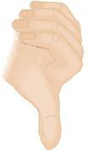

Topic 6: Circular motion and gravitation
6.1 – Circular motion
Angular velocity
•As speed with a direction is called velocity, angular speed with a direction is called angular velocity.
•To assign a direction to a rotation we use a right hand rule as follows:
Rest the heel of your right hand on the rotating object.
Make sure your fingers are curled in the direction of rotation.
Your extended thumb points in the direction of the angular velocity.
$$=\frac{2π}{T}=2πf=\frac{θ}{t}$$
relation between ω, T and f
v
r
ω
FYI •Angular velocity always points perpendicular to the plane of motion!
Notes:
© 2006 By Timothy K. Lund

Slide 27
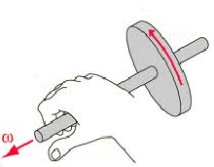
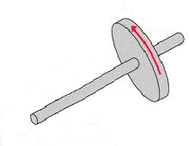
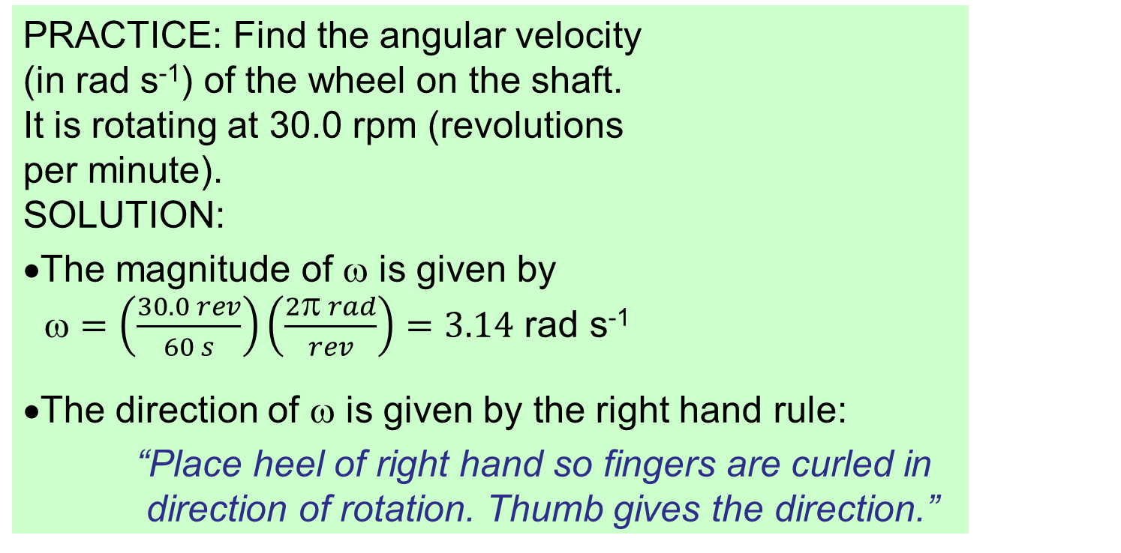
Topic 6: Circular motion and gravitation
6.1 – Circular motion
Angular velocity
$$=\frac{2π}{T}=2πf=\frac{θ}{t}$$
relation between ω, T and f
PRACTICE: Find the angular velocity (in rad s⁻¹) of the wheel on the shaft. It is rotating at 30.0 rpm (revolutions per minute).
SOLUTION:
•The magnitude of ω is given by
$=\left(\frac{30.0 rev}{60 s}\right)\left(\frac{2π rad}{rev}\right)=3.14$ rad s⁻¹
•The direction of ω is given by the right hand rule:
“Place heel of right hand so fingers are curled in direction of rotation. Thumb gives the direction.”
Notes:
© 2006 By Timothy K. Lund

Slide 28

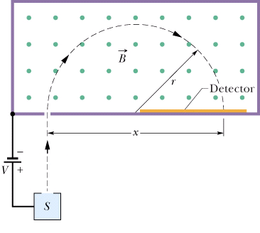
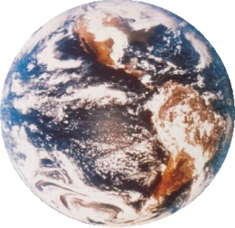
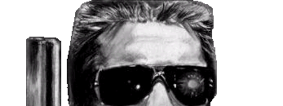

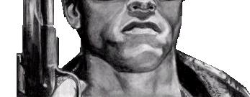
Topic 6: Circular motion and gravitation
6.1 – Circular motion
Identifying the forces providing centripetal forces
PRACTICE:
Identify at least five forces that are centripetal in nature:
SOLUTION:
•The tension force (Albert the physics cat and Arnold).
•The friction force (the race car making the turn).
•The gravitational force (the baseball and the earth).
•The electric force (an electron orbiting a nucleus).
•The magnetic force (a moving charge in a B-field).
Notes:
© 2006 By Timothy K. Lund

Slide 29

Topic 6: Circular motion and gravitation
6.1 – Circular motion
Solving centripetal acceleration and force problems
PRACTICE: Dobson is watching a 16-pound bowling ball being swung around at 50 m/s by Arnold. If the string is cut at the instant the ball is next to the ice cream, what will the ball do?
(a) It will follow path A and strike Dobson's ice cream.
(b) It will fly outward along curve path B.
(c) It will fly tangent to the original circular path along C.
A
C
B
Notes:
© 2006 By Timothy K. Lund

Slide 30
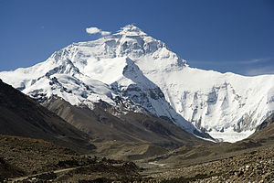


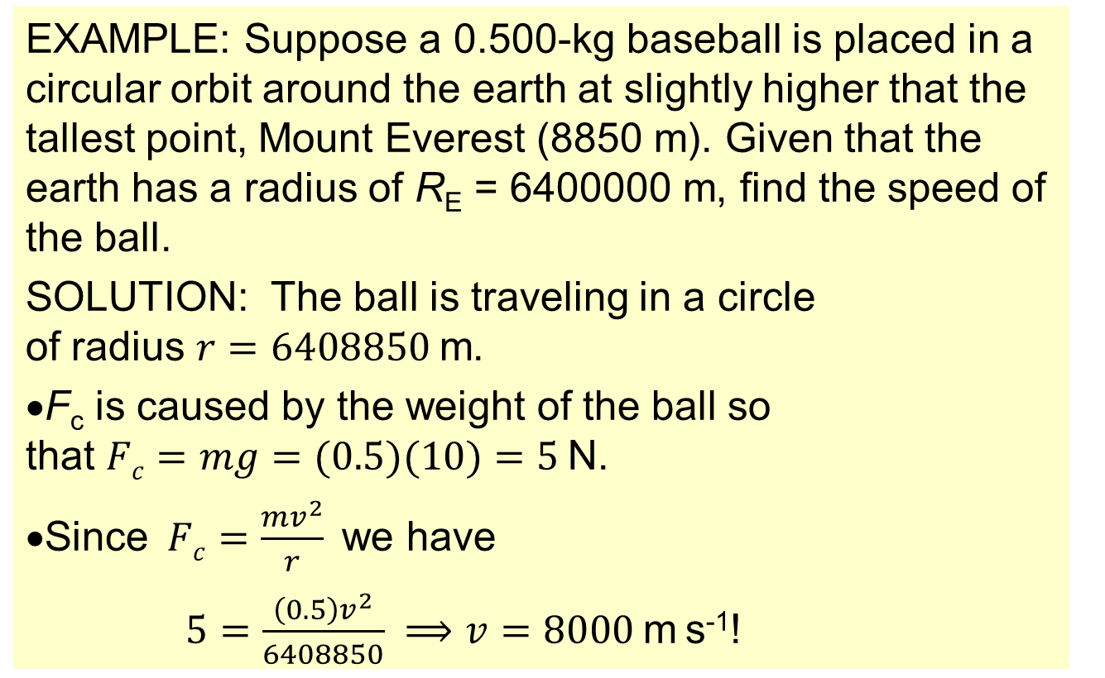
Topic 6: Circular motion and gravitation
6.1 – Circular motion
Solving centripetal acceleration and force problems
EXAMPLE: Suppose a 0.500-kg baseball is placed in a circular orbit around the earth at slightly higher that the tallest point, Mount Everest (8850 m). Given that the earth has a radius of R_{E} = 6400000 m, find the speed of the ball.
SOLUTION: The ball is traveling in a circle of radius $r=6408850$m.
•F_{c} is caused by the weight of the ball so that $Fc=mg=(0.5)(10)=5$N.
•Since $Fc=\frac{mv^{2}}{r}$we have
$5=\frac{\left(0.5\right)v^{2}}{6408850} ⟹v=8000$m s⁻¹!
Notes:
© 2006 By Timothy K. Lund

Slide 31
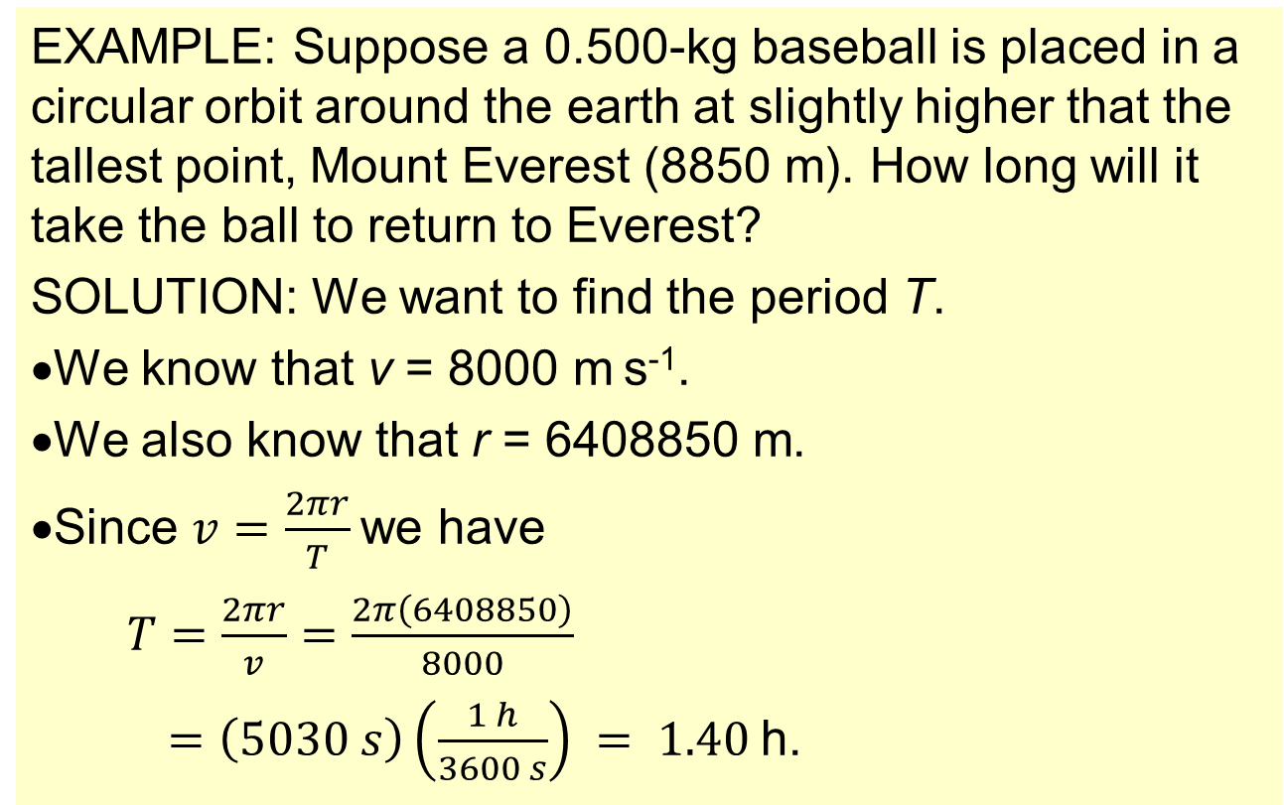
Topic 6: Circular motion and gravitation
6.1 – Circular motion
Solving centripetal acceleration and force problems
EXAMPLE: Suppose a 0.500-kg baseball is placed in a circular orbit around the earth at slightly higher that the tallest point, Mount Everest (8850 m). How long will it take the ball to return to Everest?
SOLUTION: We want to find the period T.
•We know that v = 8000 m s⁻¹.
•We also know that r = 6408850 m.
•Since $v=\frac{2πr}{T}$we have
$T=\frac{2πr}{v}=\frac{2π\left(6408850\right)}{8000}$
$=\left(5030 s\right)\left(\frac{1 h}{3600 s}\right) = 1.40$h.
Notes:
© 2006 By Timothy K. Lund

Slide 32

Topic 6: Circular motion and gravitation
6.1 – Circular motion
Solving centripetal acceleration and force problems
EXAMPLE: Explain how an object can remain in orbit yet always be falling.
SOLUTION:
•Throw the ball at progressively larger speeds.
•In all instances the force of gravity will draw the ball toward the center of the earth.
•When the ball is finally thrown at a great enough speed, the curvature of the ball’s path will match the curvature of the earth’s surface.
•The ball is effectively falling around the earth!
Notes:
© 2006 By Timothy K. Lund

Slide 33
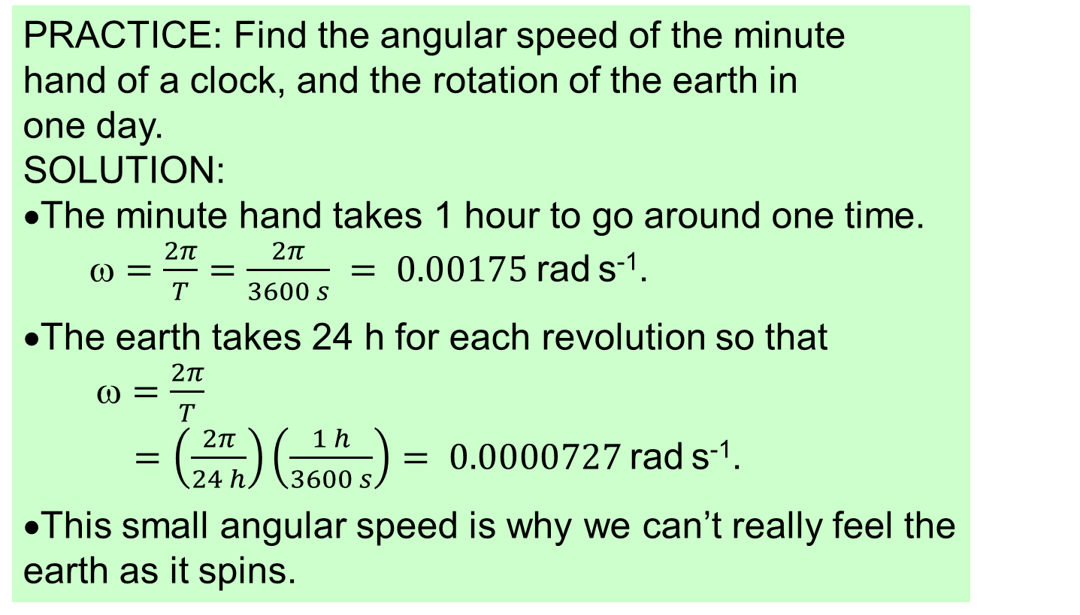
Topic 6: Circular motion and gravitation
6.1 – Circular motion
Solving centripetal acceleration and force problems
PRACTICE: Find the angular speed of the minute hand of a clock, and the rotation of the earth in one day.
SOLUTION:
•The minute hand takes 1 hour to go around one time. $=\frac{2π}{T}=\frac{2π}{3600 s} = 0.00175$rad s⁻¹.
•The earth takes 24 h for each revolution so that
$=\frac{2π}{T}$
$=\left(\frac{2π}{24 h}\right)\left(\frac{1 h}{3600 s}\right)= 0.0000727$rad s⁻¹.
•This small angular speed is why we can’t really feel the earth as it spins.
Notes:
© 2006 By Timothy K. Lund

Slide 34
Topic 6: Circular motion and gravitation
6.1 – Circular motion
Solving centripetal acceleration and force problems
90˚
ω
EXAMPLE: Find the apparent weight of someone standing on an equatorial scale if his weight is 882 N at the north pole.
SOLUTION: Recall that ω = 0.0000727 rad s⁻¹ anywhere on the earth.
•The blue arcs represent the lines of latitude.
•The white line R represents the earth’s radius.
•The yellow line r represents the radius of the circle a point at a latitude of θ follows.
•Note that r = R cos θ, and that at the equator, θ = 0˚ and at the pole, θ = 90˚.
r
R
θ
0˚
θ
Notes:
© 2006 By Timothy K. Lund

Slide 35
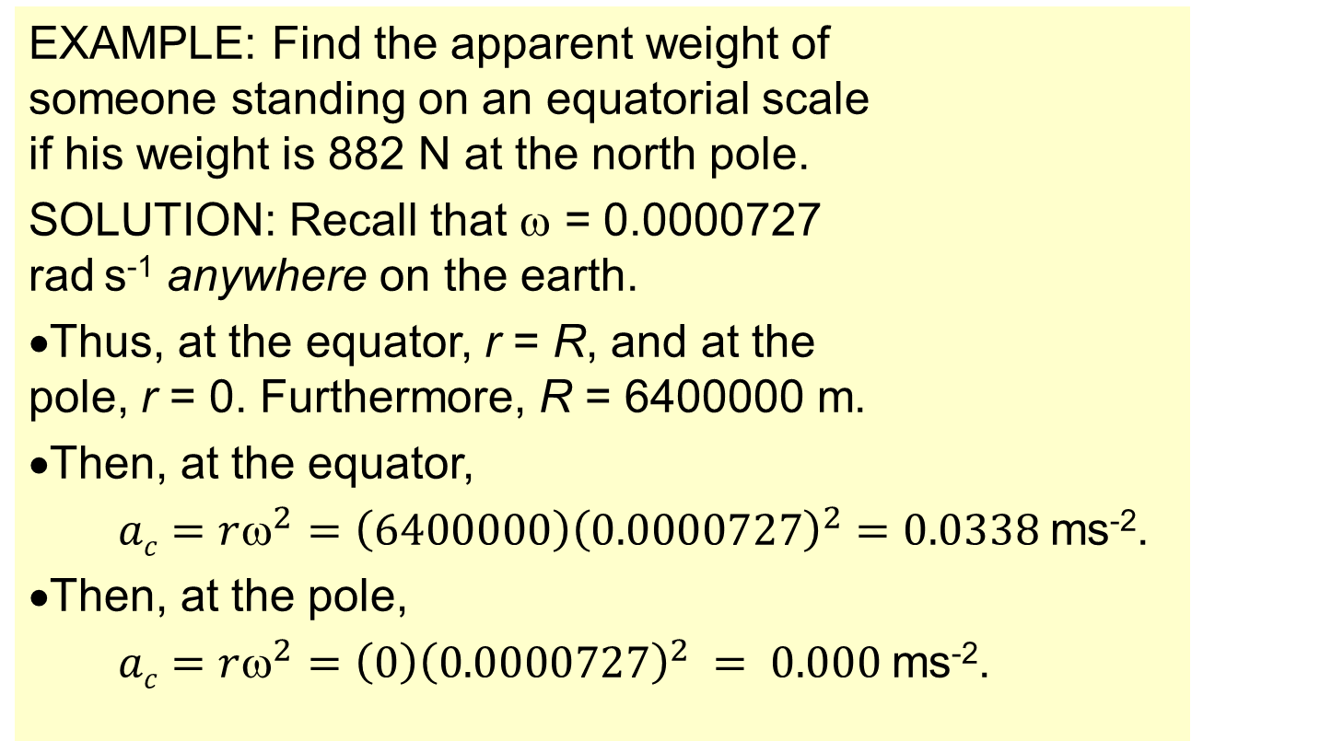
Topic 6: Circular motion and gravitation
6.1 – Circular motion
Solving centripetal acceleration and force problems
ω
EXAMPLE: Find the apparent weight of someone standing on an equatorial scale if his weight is 882 N at the north pole.
SOLUTION: Recall that ω = 0.0000727 rad s⁻¹ anywhere on the earth.
•Thus, at the equator, r = R, and at the pole, r = 0. Furthermore, R = 6400000 m.
•Then, at the equator,
$ac=rω^{2}=\left(6400000\right){\left(0.0000727\right)}^{2}=0.0338$ms⁻².
•Then, at the pole,
$ac=rω^{2}=\left(0\right){\left(0.0000727\right)}^{2} = 0.000$ms⁻².
r
R
θ
θ
Notes:
© 2006 By Timothy K. Lund

Slide 36
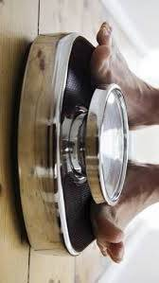
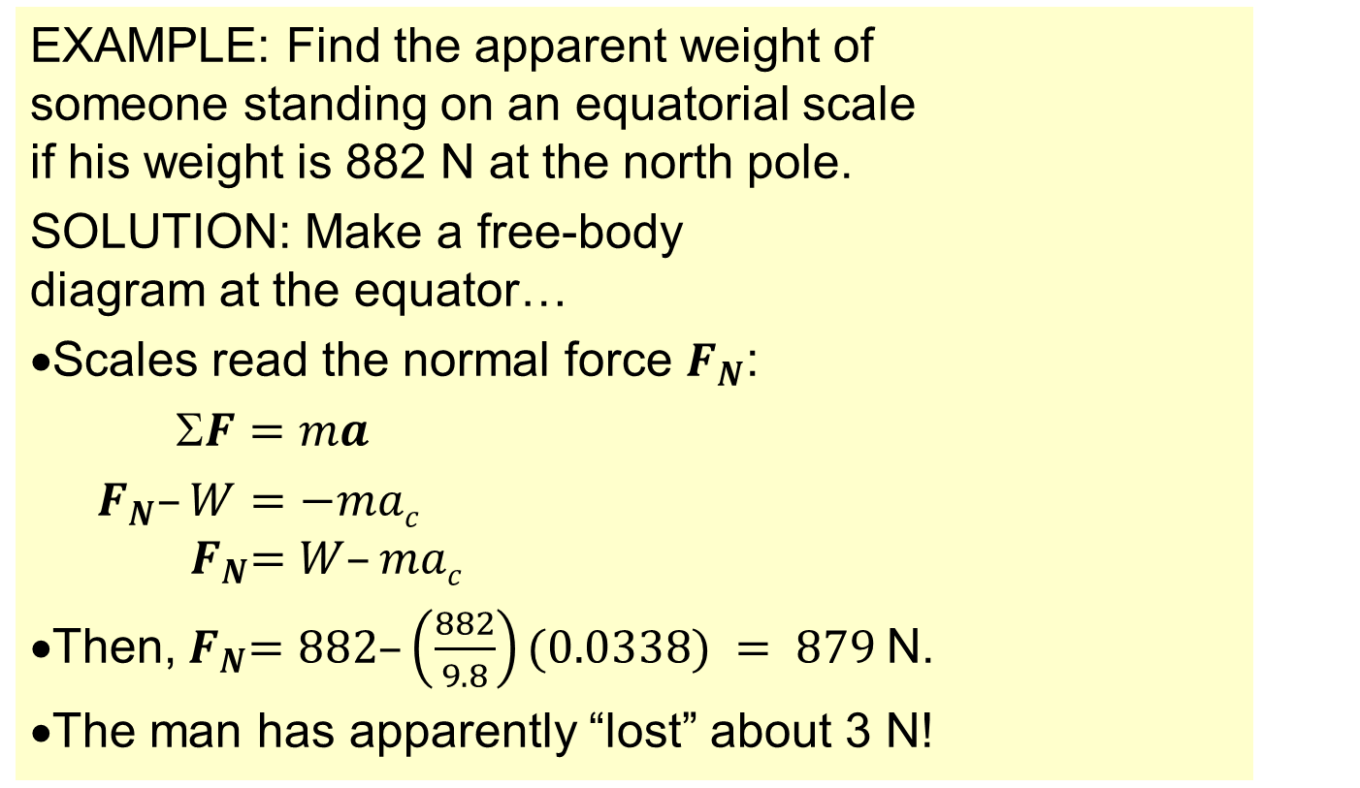

Topic 6: Circular motion and gravitation
6.1 – Circular motion
Solving centripetal acceleration and force problems
EXAMPLE: Find the apparent weight of someone standing on an equatorial scale if his weight is 882 N at the north pole.
SOLUTION: Make a free-body diagram at the equator…
•Scales read the normal force $F_{N}$:
$F=ma$
$F_{N}–W=−mac$
$${ F}_{N}=W–mac$$
•Then,${ F}_{N}=882–\left(\frac{882}{9.8}\right)(0.0338) = 879$N.
•The man has apparently “lost” about 3 N!
W
$$F_{N}$$
a_{c}
Notes:
© 2006 By Timothy K. Lund

Slide 37
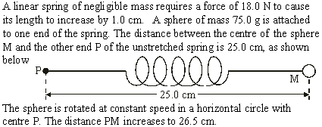

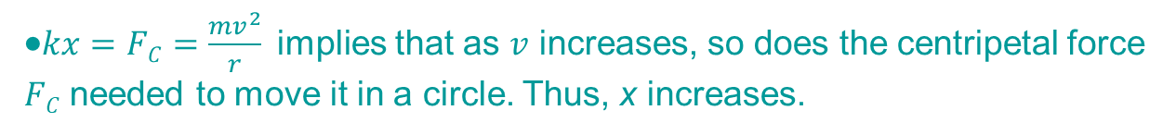

Topic 6: Circular motion and gravitation
6.1 – Circular motion
Solving centripetal acceleration and force problems
•Use $F=kx$(k = CONST).
•$kx=FC=\frac{mv^{2}}{r}$implies that as $v$ increases, so does the centripetal force $FC$ needed to move it in a circle. Thus, x increases.
Notes:
© 2006 By Timothy K. Lund

Slide 38


Topic 6: Circular motion and gravitation
6.1 – Circular motion
Solving centripetal acceleration and force problems
•$FC=\frac{mv^{2}}{r}$
$$v^{2}=\frac{rFC}{m}=\frac{0.265\left(27\right)}{0.075}$$
$$=95.4$$
$v = 9.8$ms⁻¹
•$kx=F → k=\frac{F}{x}=\frac{18}{0.010} = 1800$Nm⁻¹.
•$FC=kx=1800(0.265–0.250)=27$N.
Notes:
© 2006 By Timothy K. Lund

Slide 39
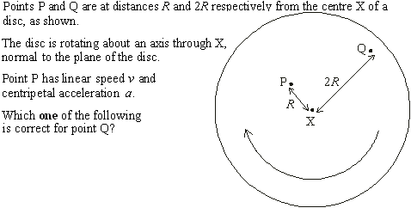
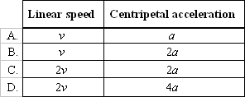
Topic 6: Circular motion and gravitation
6.1 – Circular motion
•Use v = rω (ω = CONST).
•Use a = rω² (ω = CONST).
Solving centripetal acceleration and force problems
•At P
r = R
v = Rω
a = R ω ²
•At Q
r = 2R
v = 2Rω = 2v
a = 2Rω ² = 2a
Notes:
© 2006 By Timothy K. Lund

Slide 40
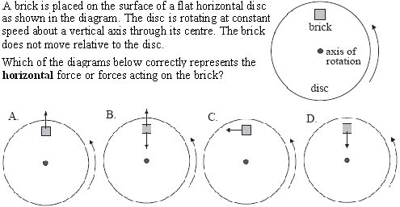
Topic 6: Circular motion and gravitation
6.1 – Circular motion
Solving centripetal acceleration and force problems
•Objects moving in uniform circular motion feel a centripetal (center-seeking) force.
Notes:
© 2006 By Timothy K. Lund

