Slide 1
Topic 5: Electricity and magnetism 5.3 – Electric cells
Essential idea: Electric cells allow us to store energy in a chemical form.
Nature of science: Long-term risks: Scientists need to balance the research into electric cells that can store energy with greater energy density to provide longer device lifetimes with the long-term risks associated with the disposal of the chemicals involved when batteries are discarded.
Notes:
© 2014 By Timothy K. Lund

Slide 2
Topic 5: Electricity and magnetism 5.3 – Electric cells
Understandings:
• Cells
• Internal resistance
• Secondary cells
• Terminal potential difference
• Electromotive force (emf)
Notes:
© 2014 By Timothy K. Lund

Slide 3
Topic 5: Electricity and magnetism 5.3 – Electric cells
Applications and skills:
• Investigating practical electric cells (both primary and secondary)
• Describing the discharge characteristic of a simple cell (variation of terminal potential difference with time)
• Identifying the direction of current flow required to recharge a cell
• Determining internal resistance experimentally
• Solving problems involving emf, internal resistance and other electrical quantities
Notes:
© 2014 By Timothy K. Lund

Slide 4
Topic 5: Electricity and magnetism 5.3 – Electric cells
Guidance:
• Students should recognize that the terminal potential difference of a typical practical electric cell loses its initial value quickly, has a stable and constant value for most of its lifetime, followed by a rapid decrease to zero as the cell discharges completely
Data booklet reference:
• ε = I ( R + r )
Notes:
© 2014 By Timothy K. Lund

Slide 5
Topic 5: Electricity and magnetism 5.3 – Electric cells
International-mindedness:
• Battery storage is important to society for use in areas such as portable devices, transportation options and back-up power supplies for medical facilities
Theory of knowledge:
• Battery storage is seen as useful to society despite the potential environmental issues surrounding their disposal. Should scientists be held morally responsible for the long-term consequences of their inventions and discoveries?
Utilization:
• The chemistry of electric cells (see Chemistry sub-topics 9.2 and C.6)
Notes:
© 2014 By Timothy K. Lund

Slide 6
Topic 5: Electricity and magnetism 5.3 – Electric cells
Cells
•To make a chemical cell, or a battery, you can begin with a container of weak acid, and two electrodes made of different metals.
•Different metals dissolve in acids at different rates.
•When a metal dissolves, it enters the acid as a positive ion, leaving behind an electron.
•We call the weak acid the electrolyte. We call the least negative metal the positive terminal. We call the most negative metal the negative terminal.
(+)
(-)
-
-
-
-
-
+
+
+
+
+
-
-
-
-
-
-
-
-
+
+
+
+
+
+
+
+
Weak Acid
The chemical cell
Electrolyte
Notes:
© 2014 By Timothy K. Lund

Slide 7
Topic 5: Electricity and magnetism 5.3 – Electric cells
Cells
•Think of a chemical cell as a device that converts chemical energy into electrical energy.
•If we connect conductors and a light bulb to the (+) and the (-) terminals, we see that electrons begin to flow in an electric current.
+
-
(+)
(-)
-
-
-
-
-
+
+
+
+
+
-
-
-
-
-
-
-
-
+
+
+
+
+
+
+
+
FYI
•Why do the electrons run from (-) to (+) in the external circuit instead of the reverse?
The chemical cell
Electrolyte
Notes:
© 2014 By Timothy K. Lund

Slide 8
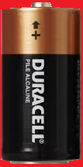
Topic 5: Electricity and magnetism 5.3 – Electric cells
Cells – primary and secondary
•Each time an electron leaves the (-), the acid creates another electron.
•Each time an electron enters the (+), the acid neutralizes an electron.
•This process is maintained until one of the metals or the electrolyte is completely used up.
•A primary cell can’t be recharged.
•A secondary cell can be recharged by applying an external voltage, reversing the chemical reaction.
+
-
(+)
(-)
-
-
-
-
-
+
+
+
+
+
-
-
-
-
-
-
-
-
+
+
+
+
+
+
+
+
The chemical cell
Electrolyte
Notes:
© 2014 By Timothy K. Lund

Slide 9
Topic 5: Electricity and magnetism 5.3 – Electric cells
Cells – current
PRACTICE: A current isn’t really just one electron moving through a circuit. It is in reality more like a chain of them, each one shoving the next through the circuit. Recalling the charge law “like charges repel, and unlike charges attract,” explain why the current flows from (-) to (+) in terms of the force of repulsion.
SOLUTION:
•Consider electrons at A and B.
•Both electrons feel a repulsive force at their respective electrodes.
+
-
(+)
B
A
(-)
-
-
-
-
-
+
+
+
+
+
-
-
-
-
-
-
-
-
+
+
+
+
+
+
+
+
The chemical cell
Electrolyte
Notes:
© 2014 By Timothy K. Lund

Slide 10
Topic 5: Electricity and magnetism 5.3 – Electric cells
Cells – current
PRACTICE: A current isn’t really just one electron moving through a circuit. It is in reality more like a chain of them, each one shoving the next through the circuit. Recalling the charge law “like charges repel, and unlike charges attract,” explain why the current flows from (-) to (+) in terms of the force of repulsion.
SOLUTION:
•But A’s is bigger than B’s because there are more negatives repelling at A than B. Thus A wins.
+
-
(+)
B
A
(-)
-
-
-
-
-
+
+
+
+
+
-
-
-
-
-
-
-
-
+
+
+
+
+
+
+
+
The chemical cell
Electrolyte
Notes:
© 2014 By Timothy K. Lund

Slide 11
Topic 5: Electricity and magnetism 5.3 – Electric cells
Cells – electric potential energy
PRACTICE: Consider electrons at points A and B. Which one has more potential energy?
SOLUTION:
•The electron at B has already traveled through the circuit and is returning to the cell so it can do no more work on the bulb.
•The electron at A still has the full circuit to travel and can thus still do work on the bulb.
•Thus the electron at A has more potential energy.
+
-
(+)
B
A
(-)
-
-
-
-
-
+
+
+
+
+
-
-
-
-
-
-
-
-
+
+
+
+
+
+
+
+
The chemical cell
Electrolyte
Notes:
© 2014 By Timothy K. Lund

Slide 12
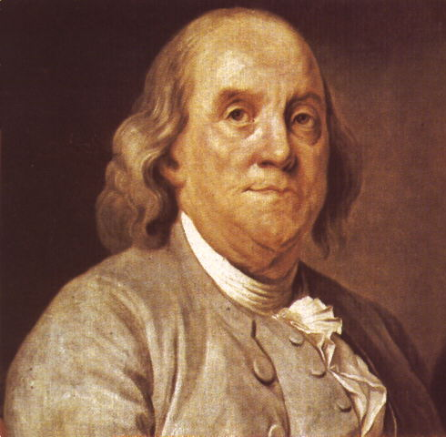
Topic 5: Electricity and magnetism 5.3 – Electric cells
Cells – conventional current
•Back in the days of Ben Franklin scientists understood that there were two types of electricity: positive and negative.
•What they didn’t know was which one was actually free to travel through a circuit.
•The influential Ben Franklin guessed wrongly that it was the positive charge.
•Thus, his vision of our chemical cell looked like the one on the next slide.
+
-
(+)
(-)
-
-
-
-
-
+
+
+
+
+
-
-
-
-
-
-
-
-
+
+
+
+
+
+
+
+
The chemical cell
Electrolyte
Notes:
© 2014 By Timothy K. Lund

Slide 13
Topic 5: Electricity and magnetism 5.3 – Electric cells
Cells – conventional current
We will use only conventional current in this course.
+
-
+
-
(+)
(-)
(+)
(-)
+
+
+
+
+
+
+
+
-
-
-
-
-
-
-
-
+
+
+
+
+
-
-
-
-
-
FYI
•Positive charge flow is called conventional current and is still used in circuit analysis.
-
-
-
-
-
+
+
+
+
+
-
-
-
-
-
-
-
-
+
+
+
+
+
+
+
+
= more positive
= less positive
less negative
more negative
Franklin’s chemical cell
The chemical cell
Electrolyte
Electrolyte
Notes:
© 2014 By Timothy K. Lund

Slide 14
Topic 5: Electricity and magnetism 5.3 – Electric cells
Cells – electric potential energy
PRACTICE: Consider positive charges at points A and B. Which one has more potential energy?
SOLUTION:
•The charge at B has already traveled through the circuit and is returning to the battery so it can do no more work on the bulb.
•The charge at A still has the full circuit to travel and can thus still do work on the bulb.
•Thus the positive charge at A has more potential energy.
+
-
(+)
A
B
(-)
+
+
+
+
+
+
+
+
-
-
-
-
-
-
-
-
+
+
+
+
+
-
-
-
-
-
Franklin’s chemical cell
Electrolyte
Notes:
© 2014 By Timothy K. Lund

Slide 15
Topic 5: Electricity and magnetism 5.3 – Electric cells
Cells – electric potential difference
•We define the electric potential difference $∆V$ as the amount of work done in moving a positive charge q from a point of lower potential energy to a point of higher potential energy.
•The units for electric potential difference are volts V or, as can be seen from the formula, J C⁻¹.
+
-
(+)
(-)
$$∆V=\frac{∆E_{P}}{q}$$
potential difference
+
+
+
+
+
+
+
+
-
-
-
-
-
-
-
-
+
+
+
+
+
-
-
-
-
-
FYI •Electric potential difference is often abbreviated p.d.
Electrolyte
Notes:
© 2014 By Timothy K. Lund

Slide 16
Topic 5: Electricity and magnetism 5.3 – Electric cells
Cells – electric potential difference
•Think of a battery as an engine that uses chemical energy to take positive charges and move them from low to high potential within the cell so that they can do work outside the cell in the external circuit.
•The schematic symbol for a switch is shown.
•For this circuit we have the schematic:
+
-
(+)
(-)
lamp
high potential
low potential
switch
Chemical energy
cell
(+)
(-)
Electrolyte
Notes:
© 2014 By Timothy K. Lund

Slide 17
Topic 5: Electricity and magnetism 5.3 – Electric cells
Cells – electric potential difference
•As an analogy to gravitational potential energy, think of the chemical cell as an elevator, powered by a chemical engine.
•Inside the cell, positive charges at low potential are raised through chemical energy to high potential.
•Outside the cell, positive charges at high potential are released into the external circuit to do their electrical work, losing energy as they go.
(+)
(-)
chemical cell
external circuit
Notes:
© 2014 By Timothy K. Lund

Slide 18
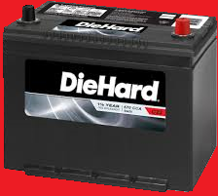
Topic 5: Electricity and magnetism 5.3 – Electric cells
Cells – electric potential difference
EXAMPLE:
200 μC of charge is brought from an electric potential of 2.0 V to an electric potential of 14 V through use of a car battery. What is the change in potential energy of the charge?
SOLUTION:
•From$∆V=\frac{∆E_{P}}{q}$ we see that $∆E_{P}=q∆V$. Thus
$∆E_{P}=q(V–V_{0})$
$∆E_{P}=(200{10}^{−6})(14 –2)$
$∆E_{P}=0.0024$J.
FYI
•Note the increase rather than the decrease.
Notes:
© 2014 By Timothy K. Lund

Slide 19
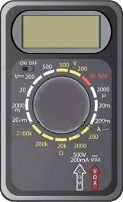
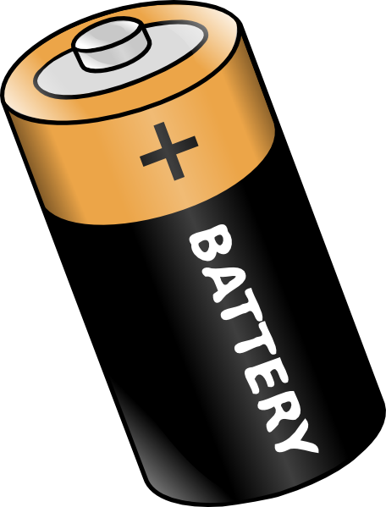
Topic 5: Electricity and magnetism 5.3 – Electric cells
Cells – electromotive force (emf)
•The electromotive force ε (or emf) of a cell is the amount of chemical energy converted to electrical energy per unit charge.
•Since energy per unit charge is volts, emf is measured in volts.
•This cell has an emf of ε = 1.6 V.
•Because the cell is not connected to any circuit we say that it is unloaded.
01.6
00.0
Notes:
© 2014 By Timothy K. Lund

Slide 20
Topic 5: Electricity and magnetism 5.3 – Electric cells
Cells – electromotive force (emf)
EXAMPLE: How much chemical energy is converted to electrical energy by the cell if a charge of 15 μC is drawn by the voltmeter?
SOLUTION:
•From $∆V=\frac{∆E_{P}}{q}$ we have $ε=\frac{∆E_{P}}{q}$.
•Thus
$∆E_{P}=εq$
$=(1.6)(15{10}^{−6})$
$=2.4{10}^{−5}$J.
01.6
Notes:
© 2014 By Timothy K. Lund

Slide 21
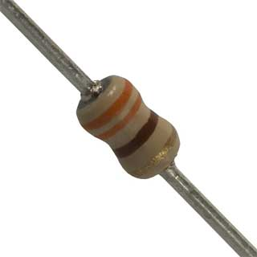
Topic 5: Electricity and magnetism 5.3 – Electric cells
Cells – internal resistance
•If we connect a resistor as part of an external circuit, we see that the voltage read by the meter goes down a little bit.
•We say that the cell is loaded because there is a resistor connected externally in a circuit.
•This cell has a loaded potential difference (p.d.) of V = 1.5 V.
01.5
01.6
Notes:
© 2014 By Timothy K. Lund

Slide 22
Topic 5: Electricity and magnetism 5.3 – Electric cells
Cells – internal resistance
•All cells and batteries have limits as to how rapidly the chemical reactions can maintain the voltage.
•There is an internal resistance r associated with a cell or a battery which causes the cell’s voltage to drop when there is an external demand for the cell’s electrical energy.
•The best cells will have small internal resistances.
•The internal resistance of a cell is why a battery becomes hot if there is a high demand for current from an external circuit.
•Cell heat will be produced at the rate given by
$$P=I^{2}r$$
$r$ = cell internal resistance
cell heat rate
Notes:
© 2014 By Timothy K. Lund

Slide 23
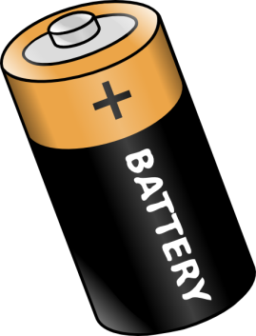
Topic 5: Electricity and magnetism 5.3 – Electric cells
Cells – internal resistance
PRACTICE: A battery has an internal resistance of r = 1.25 Ω. What is its rate of heat production if it is supplying an external circuit with a current of I = 2.00 A?
SOLUTION:
•Rate of heat production is power.
•$P=I^{2}r$
•$P={\left(2\right)}^{2}(1.25)=5.00$ J s⁻¹ ($5.00$ W.)
FYI
•If you double the current, the rate of heat generation will quadruple because of the $I^{2}$ dependency.
•If you accidentally “short circuit” a battery, the battery may even heat up enough to leak or explode!
Notes:
© 2014 By Timothy K. Lund

Slide 24
Topic 5: Electricity and magnetism 5.3 – Electric cells
Cells – internal resistance
•If we wish to consider the internal resistance of a cell, we can use the cell and the resistor symbols together, like this:
•And we may enclose the whole cell in a box of some sort to show that it is one unit.
•Suppose we connect our cell with its internal resistance r to an external circuit consisting of a single resistor of value R.
•All of the chemical energy from the battery is being consumed by the internal resistance r and the external load represented by the resistance R.
ε
r
ε
R
r
Notes:
© 2014 By Timothy K. Lund

Slide 25
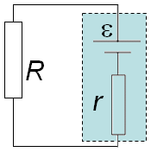
Topic 5: Electricity and magnetism 5.3 – Electric cells
Cells – internal resistance
•From E_{P} = qV we can deduce that the electrical energy being created by the cell is E_{P} = qε.
•The electrical energy being converted to heat energy by R is E_{P,R} = qV_{R}.
•The electrical energy being converted to heat energy by r is E_{P,r} = qV_{r}.
•From conservation of energy E_{P} = E_{P,R} + E_{P,r} so that qε = qV_{R} + qV_{r}.
•Note that the current I is the same everywhere.
•From Ohm’s law V_{R} = IR and V_{r} = Ir so that ε = IR + Ir.
ε = IR + Ir = I(R + r)
emf relationship
Notes:
© 2014 By Timothy K. Lund

Slide 26
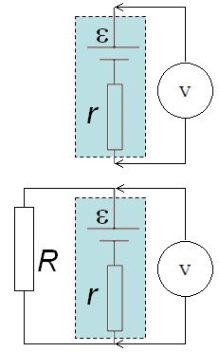
Topic 5: Electricity and magnetism 5.3 – Electric cells
Cells – internal resistance
EXAMPLE:
A cell has an unloaded voltage of 1.6 V and a loaded voltage of 1.5 V when a 330 Ω resistor is connected as shown.
Find ε. (b) Find I.
(c) Find the cell’s internal resistance.
SOLUTION:
(a) From the first schematic we see that $=1.6$V. (Unloaded cell.)
(b) From the second diagram we see that the voltage across the 330 Ω resistor is 1.5 V. (Loaded cell.)
•$V=IR$so that $1.5=I(330)$and $I=0.0045$A.
1.6 V
1.5 V
Notes:
© 2014 By Timothy K. Lund

Slide 27
Topic 5: Electricity and magnetism 5.3 – Electric cells
Cells – internal resistance
EXAMPLE: (Continued…)
A cell has an unloaded voltage of 1.6 V and a loaded voltage of 1.5 V when a 330 Ω resistor is connected as shown.
(c) Find the cell’s internal resistance.
SOLUTION:
(c) Use the emf relationship $=IR+Ir$.
$1.6=(0.0045)(330)+(0.0045)r$
$1.6=1.5+0.0045r$
$0.1=0.0045r$
$r=22 Ω$
1.6 V
1.5 V
Notes:
© 2014 By Timothy K. Lund

Slide 28
Topic 5: Electricity and magnetism 5.3 – Electric cells
Cells – terminal potential difference
EXAMPLE:
A cell has an unloaded voltage of 1.6 V and a loaded voltage of 1.5 V when a 330 Ω resistor is connected as shown.
(d) What is the terminal potential difference t.b.d. of the cell?
SOLUTION:
(d) The terminal potential difference is the potential difference at the terminals of the cell where it connects to the external circuit.
•This cell has an unloaded t.p.d of 1.6 V, and a loaded t.p.d. of 1.5 V. Note that the t.p.d. depends on the load.
1.6 V
1.5 V
Notes:
© 2014 By Timothy K. Lund

