Slide 1
Topic 5: Electricity and magnetism 5.3 – Electric cells
Essential idea: Electric cells allow us to store energy in a chemical form.
Nature of science: Long-term risks: Scientists need to balance the research into electric cells that can store energy with greater energy density to provide longer device lifetimes with the long-term risks associated with the disposal of the chemicals involved when batteries are discarded.
Notes:
© 2014 By Timothy K. Lund

Slide 2
Topic 5: Electricity and magnetism 5.3 – Electric cells
Understandings:
• Cells
• Internal resistance
• Secondary cells
• Terminal potential difference
• Electromotive force (emf)
Notes:
© 2014 By Timothy K. Lund

Slide 3
Topic 5: Electricity and magnetism 5.3 – Electric cells
Applications and skills:
• Investigating practical electric cells (both primary and secondary)
• Describing the discharge characteristic of a simple cell (variation of terminal potential difference with time)
• Identifying the direction of current flow required to recharge a cell
• Determining internal resistance experimentally
• Solving problems involving emf, internal resistance and other electrical quantities
Notes:
© 2014 By Timothy K. Lund

Slide 4
Topic 5: Electricity and magnetism 5.3 – Electric cells
Guidance:
• Students should recognize that the terminal potential difference of a typical practical electric cell loses its initial value quickly, has a stable and constant value for most of its lifetime, followed by a rapid decrease to zero as the cell discharges completely
Data booklet reference:
• ε = I ( R + r )
Notes:
© 2014 By Timothy K. Lund

Slide 5
Topic 5: Electricity and magnetism 5.3 – Electric cells
International-mindedness:
• Battery storage is important to society for use in areas such as portable devices, transportation options and back-up power supplies for medical facilities
Theory of knowledge:
• Battery storage is seen as useful to society despite the potential environmental issues surrounding their disposal. Should scientists be held morally responsible for the long-term consequences of their inventions and discoveries?
Utilization:
• The chemistry of electric cells (see Chemistry sub-topics 9.2 and C.6)
Notes:
© 2014 By Timothy K. Lund

Slide 6
Topic 5: Electricity and magnetism 5.3 – Electric cells
Cells
•To make a ________________ , or a battery, you can begin with a container of _______________, and _____ _____________________________________.
•___________________________________________.
•When a ______________, it enters the acid _______________, leaving behind an electron.
•We call the ______________ the ______________. We call the _____ _____________________________ _______. We call the ____________ metal the _____________________.
(+)
(-)
-
-
-
-
-
+
+
+
+
+
-
-
-
-
-
-
-
-
+
+
+
+
+
+
+
+
Weak Acid
The chemical cell
Electrolyte
Notes:
© 2014 By Timothy K. Lund

Slide 7
Topic 5: Electricity and magnetism 5.3 – Electric cells
Cells
•Think of a ____________ as a device that _________________________ ______________________.
•If we connect conductors and a light bulb to the (+) and the (-) terminals, we see that ___________ _____________________________.
+
-
(+)
(-)
-
-
-
-
-
+
+
+
+
+
-
-
-
-
-
-
-
-
+
+
+
+
+
+
+
+
FYI
•Why do the electrons run from (-) to (+) in the external circuit instead of the reverse?
The chemical cell
Electrolyte
Notes:
© 2014 By Timothy K. Lund

Slide 8
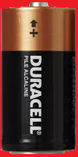
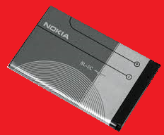
Topic 5: Electricity and magnetism 5.3 – Electric cells
Cells – primary and secondary
•Each time an ___________________, the __________________________.
•Each time an _________________ __, the ______________________.
•This process is maintained until one of the metals or the electrolyte is completely used up.
•A ___________ can’t be recharged.
•A _____________________ can be recharged by applying an external voltage, ______________________ _______________.
+
-
(+)
(-)
-
-
-
-
-
+
+
+
+
+
-
-
-
-
-
-
-
-
+
+
+
+
+
+
+
+
The chemical cell
Electrolyte
Notes:
© 2014 By Timothy K. Lund

Slide 9
Topic 5: Electricity and magnetism 5.3 – Electric cells
Cells – current
PRACTICE: A current isn’t really just one electron moving through a circuit. It is in reality more like a chain of them, each one shoving the next through the circuit. Recalling the charge law “like charges repel, and unlike charges attract,” explain why the current flows from (-) to (+) in terms of the force of repulsion.
SOLUTION:
+
-
(+)
B
A
(-)
-
-
-
-
-
+
+
+
+
+
-
-
-
-
-
-
-
-
+
+
+
+
+
+
+
+
The chemical cell
Electrolyte
Notes:
© 2014 By Timothy K. Lund

Slide 10
Topic 5: Electricity and magnetism 5.3 – Electric cells
Cells – current
PRACTICE: A current isn’t really just one electron moving through a circuit. It is in reality more like a chain of them, each one shoving the next through the circuit. Recalling the charge law “like charges repel, and unlike charges attract,” explain why the current flows from (-) to (+) in terms of the force of repulsion.
SOLUTION:
+
-
(+)
B
A
(-)
-
-
-
-
-
+
+
+
+
+
-
-
-
-
-
-
-
-
+
+
+
+
+
+
+
+
The chemical cell
Electrolyte
Notes:
© 2014 By Timothy K. Lund

Slide 11
Topic 5: Electricity and magnetism 5.3 – Electric cells
Cells – electric potential energy
PRACTICE: Consider electrons at points A and B. Which one has more potential energy?
SOLUTION:
+
-
(+)
B
A
(-)
-
-
-
-
-
+
+
+
+
+
-
-
-
-
-
-
-
-
+
+
+
+
+
+
+
+
The chemical cell
Electrolyte
Notes:
© 2014 By Timothy K. Lund

Slide 12
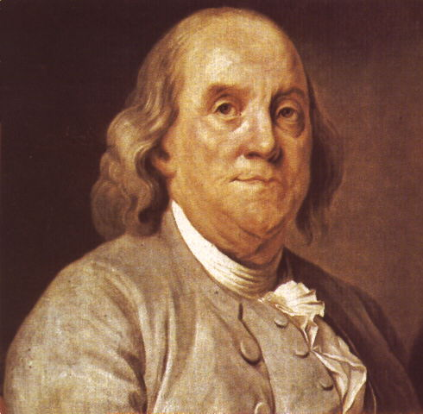
Topic 5: Electricity and magnetism 5.3 – Electric cells
Cells – conventional current
•Back in the days of Ben Franklin scientists understood that there were two types of electricity: positive and negative.
•What they ___________ was ______ _____________________________ _____________________.
•The influential Ben __________ _____________________________ _____________________.
•Thus, his vision of our chemical cell looked like the one on the next slide.
+
-
(+)
(-)
-
-
-
-
-
+
+
+
+
+
-
-
-
-
-
-
-
-
+
+
+
+
+
+
+
+
The chemical cell
Electrolyte
Notes:
© 2014 By Timothy K. Lund

Slide 13
Topic 5: Electricity and magnetism 5.3 – Electric cells
Cells – conventional current
We will use only conventional current in this course.
+
-
+
-
(+)
(-)
(+)
(-)
+
+
+
+
+
+
+
+
-
-
-
-
-
-
-
-
+
+
+
+
+
-
-
-
-
-
FYI
•Positive charge flow is called _______________________ and is still used in circuit analysis.
-
-
-
-
-
+
+
+
+
+
-
-
-
-
-
-
-
-
+
+
+
+
+
+
+
+
= more positive
= less positive
less negative
more negative
Franklin’s chemical cell
The chemical cell
Electrolyte
Electrolyte
Notes:
© 2014 By Timothy K. Lund

Slide 14
Topic 5: Electricity and magnetism 5.3 – Electric cells
Cells – electric potential energy
PRACTICE: Consider positive charges at points A and B. Which one has more potential energy?
SOLUTION:
+
-
(+)
A
B
(-)
+
+
+
+
+
+
+
+
-
-
-
-
-
-
-
-
+
+
+
+
+
-
-
-
-
-
Franklin’s chemical cell
Electrolyte
Notes:
© 2014 By Timothy K. Lund

Slide 15
Topic 5: Electricity and magnetism 5.3 – Electric cells
Cells – electric potential difference
•We define the __________________ _______________ as the _________ ____________________________ ____________________________ ____________________________ ___________________________.
•The units for electric potential difference are volts V or, as can be seen from the formula, J C⁻¹.
+
-
(+)
(-)
potential difference
+
+
+
+
+
+
+
+
-
-
-
-
-
-
-
-
+
+
+
+
+
-
-
-
-
-
FYI •Electric potential difference is ______________________.
Electrolyte
Notes:
© 2014 By Timothy K. Lund

Slide 16
Topic 5: Electricity and magnetism 5.3 – Electric cells
Cells – electric potential difference
•Think of a battery as an engine that uses chemical energy to ________ ____________________________ ____________________________ ____________________________ outside the cell in the external circuit.
•The schematic symbol for a switch is shown.
•For this circuit we have the schematic:
+
-
(+)
(-)
lamp
high potential
low potential
switch
Chemical energy
cell
(+)
(-)
Electrolyte
Notes:
© 2014 By Timothy K. Lund

Slide 17
Topic 5: Electricity and magnetism 5.3 – Electric cells
Cells – electric potential difference
•As an analogy to gravitational potential energy, think of the chemical cell as an elevator, powered by a chemical engine.
•Inside the cell, positive charges at low potential are raised through chemical energy to high potential.
•_______________________ ________________________ ________________________ ________________________ ________________________
(+)
(-)
chemical cell
external circuit
Notes:
© 2014 By Timothy K. Lund

Slide 18
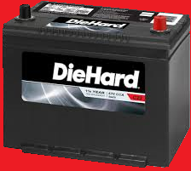
Topic 5: Electricity and magnetism 5.3 – Electric cells
Cells – electric potential difference
EXAMPLE:
200 μC of charge is brought from an electric potential of 2.0 V to an electric potential of 14 V through use of a car battery. What is the change in potential energy of the charge?
SOLUTION:
•From$∆V=\frac{∆E_{P}}{q}$ we see that $∆E_{P}=q∆V$. Thus
$∆E_{P}=$
FYI
•Note the increase rather than the decrease.
Notes:
© 2014 By Timothy K. Lund

Slide 19
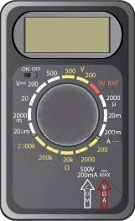
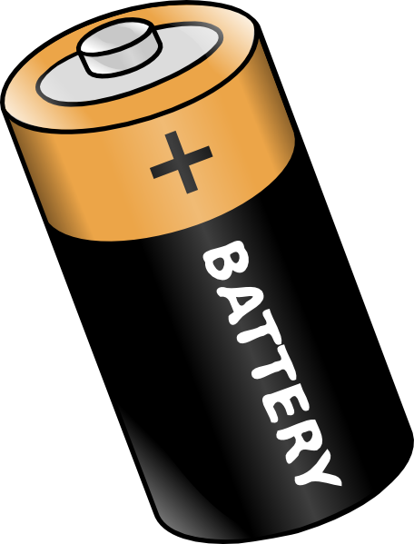
Topic 5: Electricity and magnetism 5.3 – Electric cells
Cells – electromotive force (emf)
•The ______________________________ of a cell is the _________________________________________ __________________.
•Since energy per unit charge is volts, __________________ __________.
•This cell has an emf of ε = 1.6 V.
•Because the cell is ___________________ ___________________________.
01.6
00.0
Notes:
© 2014 By Timothy K. Lund

Slide 20
Topic 5: Electricity and magnetism 5.3 – Electric cells
Cells – electromotive force (emf)
EXAMPLE: How much chemical energy is converted to electrical energy by the cell if a charge of 15 μC is drawn by the voltmeter?
SOLUTION:
•From $∆V=\frac{∆E_{P}}{q}$ we have $ε=\frac{∆E_{P}}{q}$.
•Thus
$∆E_{P}=εq$
01.6
Notes:
© 2014 By Timothy K. Lund

Slide 21
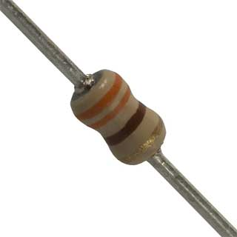
Topic 5: Electricity and magnetism 5.3 – Electric cells
Cells – internal resistance
•If we connect a resistor as part of an external circuit, we see that the voltage read by the meter goes down a little bit.
•We say that the cell is _______ because there is a resistor connected externally in a circuit.
•This cell has a __________________ ________________ of V = 1.5 V.
01.5
01.6
Notes:
© 2014 By Timothy K. Lund

Slide 22
Topic 5: Electricity and magnetism 5.3 – Electric cells
Cells – internal resistance
•All cells and batteries have _____________________ ____________________________________________.
•There is an ________________________ associated with a cell or a battery which _____________________ _____________________________________________________________________________________.
•The _______________________________________.
•The internal resistance of a cell is ________________ ______________________________________________________________________________________.
•Cell heat will be produced at the rate given by
cell heat rate
Notes:
© 2014 By Timothy K. Lund

Slide 23
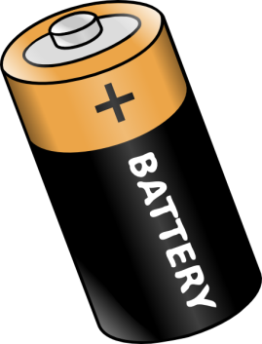
Topic 5: Electricity and magnetism 5.3 – Electric cells
Cells – internal resistance
PRACTICE: A battery has an internal resistance of r = 1.25 Ω. What is its rate of heat production if it is supplying an external circuit with a current of I = 2.00 A?
SOLUTION:
FYI
•If you double the current, the rate of heat generation will quadruple because of the $I^{2}$ dependency.
•If you accidentally “short circuit” a battery, the battery may even heat up enough to leak or explode!
Notes:
© 2014 By Timothy K. Lund

Slide 24
Topic 5: Electricity and magnetism 5.3 – Electric cells
Cells – internal resistance
•If we wish to consider the internal resistance of a cell, we _______________ ___________________________, like this:
•And we may _______________________ ___________________________________.
•Suppose we connect our cell with its internal resistance r to an external circuit consisting of a single resistor of value R.
•___________________________________ ___________________________________ ___________________________________ ___________________________________
ε
r
ε
R
r
Notes:
© 2014 By Timothy K. Lund

Slide 25
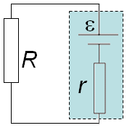
Topic 5: Electricity and magnetism 5.3 – Electric cells
Cells – internal resistance
•From E_{P} = qV we can deduce that the electrical energy being created by the cell is _________.
•The electrical energy being converted to heat energy by R is ___________.
•The electrical energy being converted to heat energy by r is ___________.
•From conservation of energy ______________ so that ________________
•Note that the current I is the same everywhere.
•From Ohm’s law V_{R} = IR and V_{r} = Ir so that _________
emf relationship
Notes:
© 2014 By Timothy K. Lund

Slide 26
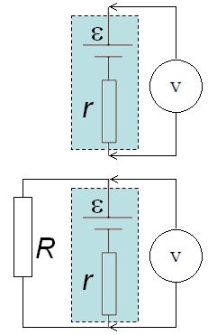
Topic 5: Electricity and magnetism 5.3 – Electric cells
Cells – internal resistance
EXAMPLE:
A cell has an unloaded voltage of 1.6 V and a loaded voltage of 1.5 V when a 330 Ω resistor is connected as shown.
Find ε. (b) Find I.
(c) Find the cell’s internal resistance.
SOLUTION:
(a) From the first schematic we see that $=$ (Unloaded cell.)
(b) From the second diagram we see that the voltage across the 330 Ω resistor is 1.5 V. (Loaded cell.)
•$V=IR$so that
1.6 V
1.5 V
Notes:
© 2014 By Timothy K. Lund

Slide 27
Topic 5: Electricity and magnetism 5.3 – Electric cells
Cells – internal resistance
EXAMPLE: (Continued…)
A cell has an unloaded voltage of 1.6 V and a loaded voltage of 1.5 V when a 330 Ω resistor is connected as shown.
(c) Find the cell’s internal resistance.
SOLUTION:
(c) Use the emf relationship $=IR+Ir$.
1.6 V
1.5 V
Notes:
© 2014 By Timothy K. Lund

Slide 28
Topic 5: Electricity and magnetism 5.3 – Electric cells
Cells – terminal potential difference
EXAMPLE:
A cell has an unloaded voltage of 1.6 V and a loaded voltage of 1.5 V when a 330 Ω resistor is connected as shown.
(d) What is the terminal potential difference t.b.d. of the cell?
SOLUTION:
(d) The ________________________ is ________________________________ ____________________________________________.
•___________________________________________ ____________________________________________.
1.6 V
1.5 V
Notes:
© 2014 By Timothy K. Lund

