Slide 1
Topic 4: Waves 4.5 – Standing waves
Essential idea: When traveling waves meet they can superpose to form standing waves in which energy may not be transferred.
Nature of science: Common reasoning process: From the time of Pythagoras onwards the connections between the formation of standing waves on strings and in pipes have been modeled mathematically and linked to the observations of the oscillating systems. In the case of sound in air and light, the system can be visualized in order to recognize the underlying processes occurring in the standing waves.
Notes:
© 2014 By Timothy K. Lund

Slide 2
Topic 4: Waves 4.5 – Standing waves
Understandings:
• The nature of standing waves
• Boundary conditions
• Nodes and antinodes
Applications and skills:
• Describing the nature and formation of standing waves in terms of superposition
• Distinguishing between standing and traveling waves
• Observing, sketching and interpreting standing wave patterns in strings and pipes
• Solving problems involving the frequency of a harmonic, length of the standing wave and the speed of the wave
Notes:
2
© 2014 By Timothy K. Lund

Slide 3
Topic 4: Waves 4.5 – Standing waves
Guidance:
• Students will be expected to consider the formation of standing waves from the superposition of no more than two waves
• Boundary conditions for strings are: two fixed boundaries; fixed and free boundary; two free boundaries
• Boundary conditions for pipes are: two closed boundaries; closed and open boundary; two open boundaries
• For standing waves in air, explanations will not be required in terms of pressure nodes and pressure antinodes
Notes:
3
© 2014 By Timothy K. Lund

Slide 4
Topic 4: Waves 4.5 – Standing waves
Guidance:
• The lowest frequency mode of a standing wave is known as the first harmonic
• The terms fundamental and overtone will not be used in examination questions
Data booklet reference:
• No formulas – you must be able to derive or recall standing wave formulas
Notes:
4
© 2014 By Timothy K. Lund

Slide 5
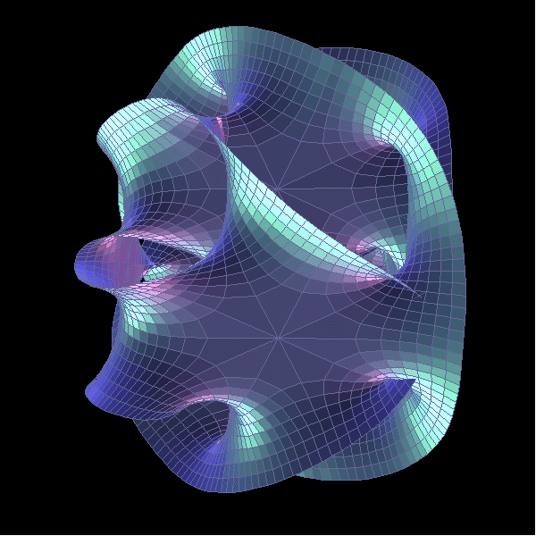
Topic 4: Waves 4.5 – Standing waves
International-mindedness:
• The art of music, which has its scientific basis in these ideas, is universal to all cultures, past and present. Many musical instruments rely heavily on the generation and manipulation of standing waves.
Theory of knowledge:
• There are close links between standing waves in strings and Schrodinger’s theory for the probability amplitude of electrons in the atom. Application to superstring theory requires standing wave patterns in 11 dimensions. What is the role of reason and imagination in enabling scientists to visualize scenarios that are beyond our physical capabilities?
Notes:
5
© 2014 By Timothy K. Lund

Slide 6
Topic 4: Waves 4.5 – Standing waves
Utilization:
• Students studying music should be encouraged to bring their own experiences of this art form to the physics classroom
Aims:
• Aim 3: students are able to both physically observe and qualitatively measure the locations of nodes and antinodes, following the investigative techniques of early scientists and musicians
Notes:
6
© 2014 By Timothy K. Lund

Slide 7
Topic 4: Waves 4.5 – Standing waves
Aims:
• Aim 6: experiments could include (but are not limited to): observation of standing wave patterns in physical objects (eg slinky springs); prediction of harmonic locations in an air tube in water; determining the frequency of tuning forks; observing or measuring vibrating violin/guitar strings
• Aim 8: the international dimension of the application of standing waves is important in music
Notes:
7
© 2014 By Timothy K. Lund

Slide 8
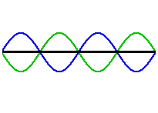
Topic 4: Waves 4.5 – Standing waves
The nature of standing waves
•The principle of superposition yields a surprising sum for two identical waves traveling in opposite directions.
•Snapshots of the blue and the green waves and their red sum shows a wave that appears to not be traveling.
•Because the resultant red wave is not traveling it is called a standing wave.
E
E
Notes:
© 2014 By Timothy K. Lund

Slide 9
Topic 4: Waves 4.5 – Standing waves
N
N
N
N
A
A
A
A
A
Nodes and antinodes
•The standing wave has two important properties.
•It does not travel to the left or the right as the blue and the green wave do.
•Its “lobes” grow and shrink and reverse, but do not go to the left or the right.
•Any points where the standing wave has no displacement is called a node (N).
•The lobes that grow and shrink and reverse are called antinodes (A).
N
N
N
N
N
N
N
A
A
A
A
A
A
Notes:
© 2014 By Timothy K. Lund

Slide 10
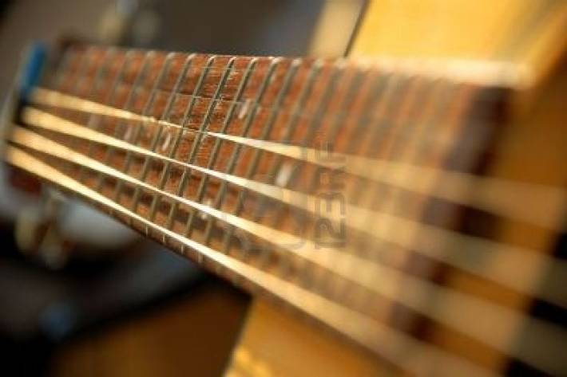
Topic 4: Waves 4.5 – Standing waves
Boundary conditions - strings
•You may be wondering how a situation could ever develop in which two identical waves come from opposite directions. Well, wonder no more.
•When you pluck a stringed instrument, waves travel to the ends of the string and reflect at each end, and return to interfere under precisely the conditions needed for a standing wave.
•Note that there are two nodes and one antinode.
•Why must there be a node at each end of the string?
L
Because it is fixed at each end.
N
N
A
Notes:
© 2014 By Timothy K. Lund

Slide 11
Topic 4: Waves 4.5 – Standing waves
Sketching and interpreting standing wave patterns
•Observe that precisely half a wavelength fits along the length of the string or ½λ = L.
•Thus we see that λ = 2L.
•Since $v$ = λ$f$ we see that $f=\frac{v}{2L}$for a string.
•This is the lowest frequency you can possibly get from this string configuration, so we call it the fundamental frequency $f$₁.
•The fundamental frequency of any system is also called the first harmonic.
L
N
N
1st harmonic
A
fundamental frequency $f_{1}=\frac{v}{2L}$
Notes:
© 2014 By Timothy K. Lund

Slide 12
Topic 4: Waves 4.5 – Standing waves
Sketching and interpreting standing wave patterns
•The next higher frequency has another node and another antinode.
•We now see that λ = L.
•Since $v$ = λ$f$ we see that $f=\frac{v}{L}$.
•This is the second lowest frequency you can possibly get and since we called the fundamental frequency $f$₁, we’ll name this one $f$₂.
•This frequency is also called the second harmonic.
L
N
N
N
2nd harmonic
A
A
$$f2 =\frac{v}{L}$$
Notes:
© 2014 By Timothy K. Lund

Slide 13
Topic 4: Waves 4.5 – Standing waves
Sketching and interpreting standing wave patterns
PRACTICE: Complete with sketch and formula.
•Remember that there are always nodes on each end of a string.
•Add a new well-spaced node each time.
•Decide the relationship between λ and L.
•We see that $=\left(\frac{2}{3}\right)L$.
•Since $v=λf$we see that $f=\frac{v}{\left(\frac{2}{3}\right)L}=\frac{3v}{2L}$.
$$f1=\frac{v}{2L}$$
$$f2=\frac{v}{L}$$
$f3=\frac{3v}{2L}$
Notes:
© 2014 By Timothy K. Lund

Slide 14
Topic 4: Waves 4.5 – Standing waves
Boundary conditions – closed pipes
•We can also set up standing waves in pipes.
•In the case of pipes, longitudinal waves are created (instead of transverse waves), and these waves are reflected from the ends of the pipe.
•Consider a closed pipe of length L which gets its wave energy from a mouthpiece on the left side.
•Why must the mouthpiece end be an antinode?
•Why must the closed end be a node?
(1/4)λ₁ = L
(3/4)λ₂ = L
(5/4)λ₂ = L
$$f1=\frac{v}{4L}$$
$$f2=\frac{3v}{4L}$$
$$f3=\frac{5v}{4L}$$
Source.
Air can’t move.
Notes:
© 2014 By Timothy K. Lund

Slide 15
Topic 4: Waves 4.5 – Standing waves
Boundary conditions – open pipes
•In an open-ended pipe you have an antinode at the open end because the medium can vibrate there (and, of course, another antinode at the mouthpiece).
(1/2)λ₁ = L
λ₂ = L
(3/2)λ₂ = L
$$f1=\frac{v}{2L}$$
$$f2=\frac{2v}{2L}$$
$$f3=\frac{3v}{2L}$$
FYI
•The IBO requires you to be able to make sketches of string and pipe harmonics (both open and closed) and find wavelengths and frequencies.
Notes:
© 2014 By Timothy K. Lund

Slide 16
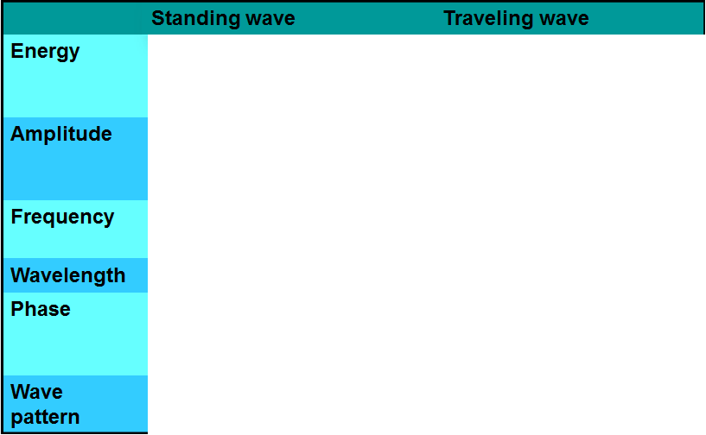
Topic 4: Waves 4.5 – Standing waves
E
E
Distinguishing between standing and traveling waves
•A standing wave consists of two traveling waves carrying energy in opposite directions, so the net energy flow through the wave is zero.
Notes:
© 2014 By Timothy K. Lund

Slide 17
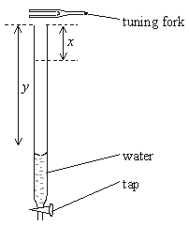
Topic 4: Waves 4.5 – Standing waves
Solving problems involving standing waves
PRACTICE: A tube is filled with water and a vibrating tuning fork is held above the open end. As the water runs out of the tap at the bottom sound is loudest when the water level is a distance x from the top. The next loudest sound comes when the water level is at a distance y from the top. Which expression for λ is correct?
A. λ = x B. λ = 2x C. λ = y-x D. λ = 2(y-x)
•v = λf and since v and f are constant, so is λ.
•The first possible standing wave is sketched.
•The sketch shows that λ = 4x, eliminating A and B.
Notes:
© 2014 By Timothy K. Lund

Slide 18
Topic 4: Waves 4.5 – Standing waves
Solving problems involving standing waves
PRACTICE: A tube is filled with water and a vibrating tuning fork is held above the open end. As the water runs out of the tap at the bottom sound is loudest when the water level is a distance x from the top. The next loudest sound comes when the water level is at a distance y from the top. Which expression for λ is correct?
A. λ = x B. λ = 2x C. λ = y-x D. λ = 2(y-x)
•The second possible standing wave is sketched.
•Notice that y – x is half a wavelength.
•Thus the answer is λ = 2(y - x).
y-x
Why didn’t the pitch change?
Notes:
© 2014 By Timothy K. Lund

Slide 19
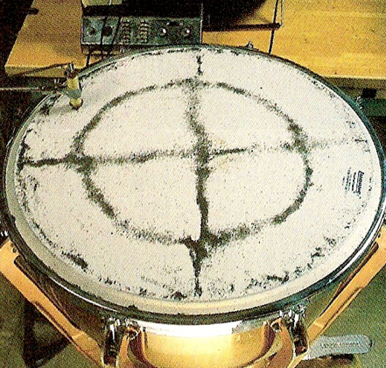
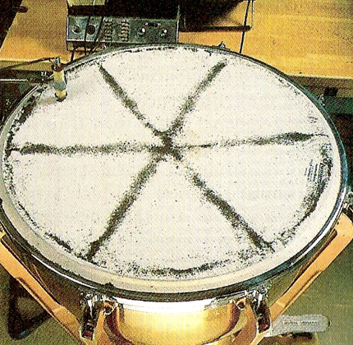
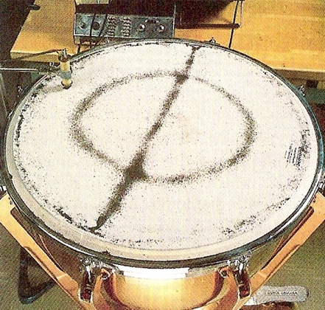
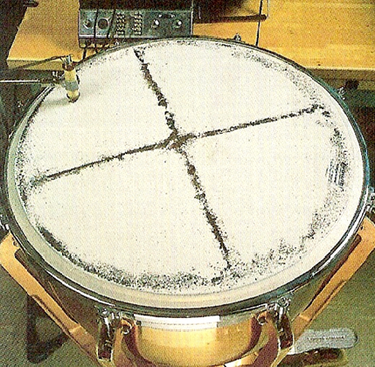
Topic 4: Waves 4.5 – Standing waves
Solving problems involving standing waves
PRACTICE: This drum head, set to vibrating at different resonant frequencies, has black sand on it, which reveals 2D standing waves.
•Does the sand reveal nodes, or does it reveal antinodes?
•Why does the edge have to be a node?
Nodes, because there is no displacement to throw the sand off.
The drumhead cannot vibrate at the edge.
Notes:
© 2014 By Timothy K. Lund

Slide 20
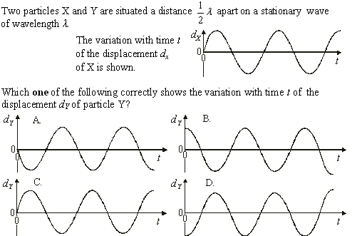
Topic 4: Waves 4.5 – Standing waves
Solving problems involving standing waves
•Alternate lobes have a 180º phase difference.
Notes:
© 2014 By Timothy K. Lund

Slide 21
Topic 4: Waves 4.5 – Standing waves
Solving problems involving standing waves
•Make a sketch. Then use $v=f$.
antinode
antinode
L
$$\frac{λ}{2}=L$$
$v$ $=$ λ$f$
$$f=\frac{v}{λ}$$
$$=2L$$
$$f=\frac{v}{2L}$$
Notes:
© 2014 By Timothy K. Lund

Slide 22
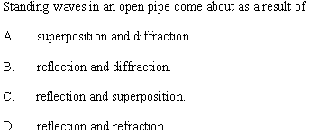
Topic 4: Waves 4.5 – Standing waves
Solving problems involving standing waves
•Reflection provides for two coherent waves traveling in opposite directions.
•Superposition is just the adding of the two waves to produce the single stationary wave.
Notes:
© 2014 By Timothy K. Lund

Slide 23
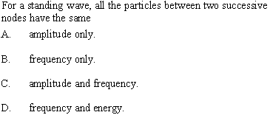
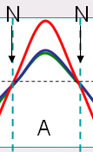
Topic 4: Waves 4.5 – Standing waves
Solving problems involving standing waves
•The figure shows the points between successive nodes.
•For every point between the two nodes f is the same.
•But the amplitudes are all different.
•Therefore the energies are also different.
Notes:
© 2014 By Timothy K. Lund

Slide 24
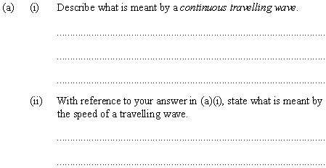
Topic 4: Waves 4.5 – Standing waves
Solving problems involving standing waves
•Energy transfer via a vibrating medium without interruption.
•The medium itself does not travel with the wave disturbance.
•Speed at which the wave disturbance propagates.
•Speed at which the wave front travels.
•Speed at which the energy is transferred.
Notes:
© 2014 By Timothy K. Lund

Slide 25
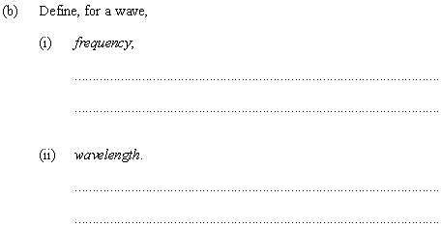
Topic 4: Waves 4.5 – Standing waves
Solving problems involving standing waves
•Frequency is number of vibrations per unit time.
FYI: IB frowns on you using particular units as in
“Frequency is number of vibrations per second.”
FYI: There will be lost points, people!
•Distance between successive crests (or troughs).
•Distance traveled by the wave in one oscillation of the source.
Notes:
© 2014 By Timothy K. Lund

Slide 26
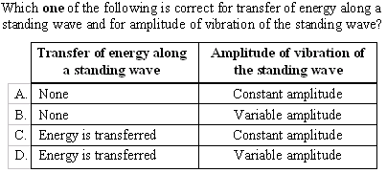
Topic 4: Waves 4.5 – Standing waves
Solving problems involving standing waves
•The waves traveling in opposite directions carry energy at same rate both ways. NO energy transfer.
•The amplitude is always the same for any point in a standing wave.
Notes:
© 2014 By Timothy K. Lund

Slide 27
Topic 4: Waves 4.5 – Standing waves
Solving problems involving standing waves
L
L
$$\frac{λ_{P}}{4}=L$$
$$\frac{λ_{Q}}{2} = L$$
$$=4L$$
$$fP =\frac{v}{4L}$$
$$=2L$$
$$fQ=\frac{v}{2L}$$
$$(v=f)$$
$$v=4LfP$$
$$fQ=\frac{4Lf_{P}}{2L}$$
$$\left(f=\frac{v}{λ}\right)$$
$$fQ=2fP$$
Notes:
© 2014 By Timothy K. Lund

Slide 28
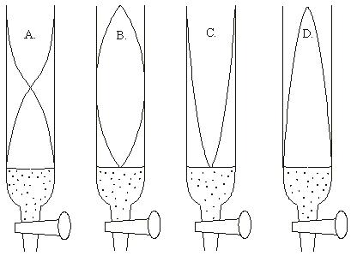
Topic 4: Waves 4.5 – Standing waves
Solving problems involving standing waves
•The tuning fork is the driving oscillator (and is at the top).
•The top is thus an antinode.
•The bottom “wall” of water allows NO oscillation.
•The bottom is thus a node.
Notes:
© 2014 By Timothy K. Lund

Slide 29
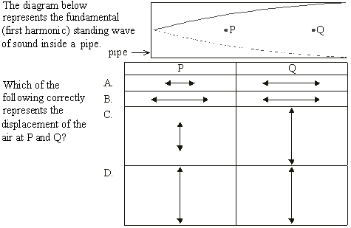
Topic 4: Waves 4.5 – Standing waves
Solving problems involving standing waves
•Sound is a longitudinal wave.
•Displacement is small at P, big at Q.
Notes:
© 2014 By Timothy K. Lund

Slide 30
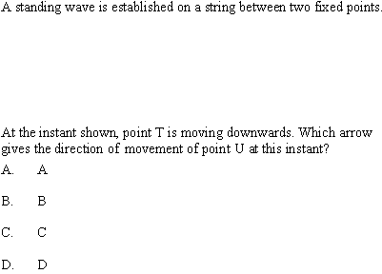
Topic 4: Waves 4.5 – Standing waves
Solving problems involving standing waves
•If the lobe at T is going down, so is the lobe at U.
Notes:
© 2014 By Timothy K. Lund

Slide 31
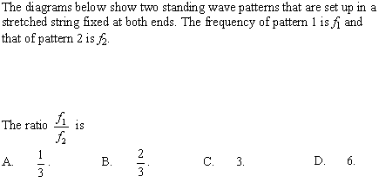
Topic 4: Waves 4.5 – Standing waves
Solving problems involving standing waves
•Pattern 1 is $\frac{1}{2}$ wavelength.
Thus $f2=3f1$so that $\frac{f1}{f2}$= $\frac{1}{3}$.
•Pattern 2 is $\frac{3}{2}$ wavelength.
Notes:
© 2014 By Timothy K. Lund

Slide 32
●Superstring theory uses 11-dimensional standing waves as its particle model.
●Particles are “grainy” at the quantum level.
●The “extra” spatial dimensions required by string theory are “curled” in upon themselves and only visible at very small dimensions.

