Slide 1
Topic 4: Waves 4.4 – Wave behavior
Essential idea: Waves interact with media and each other in a number of ways that can be unexpected and useful.
Nature of science: Competing theories: The conflicting work of Huygens and Newton on their theories of light and the related debate between Fresnel, Arago and Poisson are demonstrations of two theories that were valid yet flawed and incomplete. This is an historical example of the progress of science that led to the acceptance of the duality of the nature of light.
Notes:
© 2014 By Timothy K. Lund

Slide 2
Topic 4: Waves 4.4 – Wave behavior
Understandings:
• Reflection and refraction
• Snell’s law, critical angle and total internal reflection
• Diffraction through a single-slit and around objects
• Interference patterns
• Double-slit interference
• Path difference
Notes:
2
© 2014 By Timothy K. Lund

Slide 3
Topic 4: Waves 4.4 – Wave behavior
Applications and skills:
• Sketching and interpreting incident, reflected and transmitted waves at boundaries between media
• Solving problems involving reflection at a plane interface
• Solving problems involving Snell’s law, critical angle and total internal reflection
• Determining refractive index experimentally
• Qualitatively describing the diffraction pattern formed when plane waves are incident normally on a single-slit
• Quantitatively describing double-slit interference intensity patterns
Notes:
3
© 2014 By Timothy K. Lund

Slide 4
Topic 4: Waves 4.4 – Wave behavior
Guidance:
• Quantitative descriptions of refractive index are limited to light rays passing between two or more transparent media. If more than two media, only parallel interfaces will be considered
• Students will not be expected to derive the double-slit equation
• Students should have the opportunity to observe diffraction and interference patterns arising from more than one type of wave
Notes:
4
© 2014 By Timothy K. Lund

Slide 5
Topic 4: Waves 4.4 – Wave behavior
Data booklet reference:
• $\frac{n_{1}}{n_{2}}=\frac{\sin{θ_{2}}}{\sin{θ_{1}}}=\frac{v_{2}}{v_{1}}$
• $s=\frac{λD}{d}$
• Constructive interference: path difference = nλ
• Destructive interference: path difference = (n + ½)λ
International-mindedness:
• Characteristic wave behavior has been used in many cultures throughout human history, often tying closely to myths and legends that formed the basis for early scientific studies
Notes:
5
© 2014 By Timothy K. Lund

Slide 6
Topic 4: Waves 4.4 – Wave behavior
Theory of knowledge:
• Huygens and Newton proposed two competing theories of the behavior of light. How does the scientific community decide between competing theories?
Utilization:
• A satellite footprint on Earth is governed by the diffraction at the dish on the satellite
• Applications of the refraction and reflection of light range from the simple plane mirror through the medical endoscope and beyond. Many of these applications have enabled us to improve and extend our sense of vision.
Notes:
6
© 2014 By Timothy K. Lund

Slide 7
Topic 4: Waves 4.4 – Wave behavior
Reflection and refraction
•Wave reflection occurs when a wave meets a boundary, such as a solid object, or a change in the medium, and is at least partially diverted backwards.
•The angles of the rays are always measured with respect to the normal which is perpendicular to the surface.
•The relationship between the angle of incidence θ_{incident} and the angle of reflection θ_{reflect} is simple:
incident ray
θ_{incident}
normal
reflective surface
θ_{reflect}
reflected ray
θ_{incident} = θ_{reflect}
reflected waves
Notes:
© 2014 By Timothy K. Lund

Slide 8
Topic 4: Waves 4.4 – Wave behavior
Reflection and refraction
•We can also look at the wavefronts: Observe…
•During reflection the frequency and the wavelength of the wave do not change.
reflective surface
reflective surface
spherical wavefront
flat or straight wavefront
Notes:
© 2014 By Timothy K. Lund

Slide 9
Topic 4: Waves 4.4 – Wave behavior
Reflection and refraction
•During refraction the frequency and the period do not change.
•It should be clear that the incident wave is faster than the refracted wave in this example.
BOUN DARY
angle of incidence
REFRACTED WAVE
θ_{incidence}
normal
θ_{refraction}
angle of refraction
INCIDENT WAVE
CLEAR WATER
MUDDY WATER
Notes:
© 2014 By Timothy K. Lund

Slide 10
Topic 4: Waves 4.4 – Wave behavior
Snell’s law
•Snell’s law relates the wave’s velocities in two mediums to their angles:
BOUN DARY
θ₁
normal
θ₂
$$\frac{v2}{v1}=\frac{\sin{θ_{2}}}{\sin{θ_{1}}}$$
Snell’s law for refracted waves
EXAMPLE: A wave traveling at 20. ms⁻¹ hits a medium boundary at an angle of 28° relative to the normal to the boundary, and is refracted at 32°. What is the wave’s speed in the new medium?
•From Snell’s law we have $\frac{v2}{v1}=\frac{\sin{θ_{2}}}{\sin{θ_{1}}}$ so
$\frac{v2}{20}=\frac{\sin{32°}}{\sin{28°}}$
$v2=23$ ms⁻¹.
Notes:
© 2014 By Timothy K. Lund

Slide 11
Topic 4: Waves 4.4 – Wave behavior
Snell’s law
PRACTICE: A wave traveling at 50. m s⁻¹ strikes a boundary as shown. Part of the wave energy is reflected and part is refracted.
What is the angle of reflection?
SOLUTION:
•Since all angles are measured wrt the normal, the incident angle is 90°– 68° = 22°.
•This is also the reflected angle since θ_{incident} = θ_{reflect}.
BOUN DARY
68°
normal
22°
22°
75°
Notes:
© 2014 By Timothy K. Lund

Slide 12
Topic 4: Waves 4.4 – Wave behavior
Snell’s law
PRACTICE: A wave traveling at 50. m s⁻¹ strikes a boundary as shown. Part of the wave energy is reflected and part is refracted.
(b) What is the speed of the transmitted wave?
SOLUTION:
•The angle of refraction is 90° – 75° = 15°.
$\frac{v2}{v1}=\frac{\sin{θ_{2}}}{\sin{θ_{1}}}$
$\frac{v2}{50}=\frac{\sin{15°}}{\sin{22°}}$
$v2=35$ ms⁻¹.
BOUN DARY
68°
normal
22°
22°
15°
75°
Notes:
© 2014 By Timothy K. Lund

Slide 13
Topic 4: Waves 4.4 – Wave behavior
Snell’s law – the refractive index
•A refractive index n_{m} is often used when dealing with light waves. It is defined to be the ratio of the speed of light in vacuum c to the speed of light in the medium v_{m}.
$$n_{m}=\frac{c}{v_{m}}$$
n₁sin θ₁ = n₂sin θ₂
index of refraction
EXAMPLE: Show that the relationship between the indices of refraction and the angles is given by n₁sin θ₁ = n₂sin θ₂ for two transparent mediums.
SOLUTION:
From Snell’s law we have $\frac{v2}{v1}=\frac{\sin{θ_{2}}}{\sin{θ_{1}}}$ so that
$\frac{\sin{θ_{2}}}{\sin{θ_{1}}}=\frac{v2}{v1}=\frac{c/n_{2}}{c/n_{1}}=\frac{n1}{n2}$.
Cross multiplication yields $n1sin1=n2sin2$.
$n1=\frac{c}{v1}$ so that $v1=\frac{c}{n1}$. Similarly, $v2=\frac{c}{n2}$
θ₁
θ₂
n₁
n₂
Notes:
© 2014 By Timothy K. Lund

Slide 14
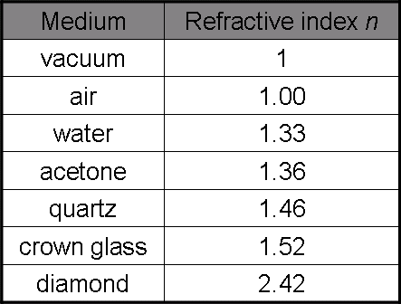
Topic 4: Waves 4.4 – Wave behavior
θ₁
θ₂
n₁
n₂
Snell’s law – the refractive index
A refractive index n_{m} is often used when dealing with light waves. It is defined to be the ratio of the speed of light in vacuum c to the speed of light in the medium v_{m}.
$$n_{m}=\frac{c}{v_{m}}$$
n₁sin θ₁ = n₂sin θ₂
index of refraction
EXAMPLE: Various indexes of refraction are shown here:
•Since $n=\frac{c}{v}$, then $v=\frac{c}{n}$.
•Since all of the n’s are greater than 1, all of the velocities are less than c.
•This means that light slows down in transparent media.
Notes:
© 2014 By Timothy K. Lund

Slide 15
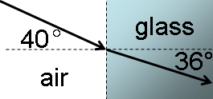
Topic 4: Waves 4.4 – Wave behavior
Snell’s law – the refractive index
PRACTICE: Light enters a glass sample and is refracted as in the figure.
(a) What is the index of refraction of the glass sample?
$n$₁sin θ₁ = $n$₂sin θ₂
1 sin 40° = $n$₂ sin 36°
$n$₂ = 1.1 (unitless).
(b) What is the speed of light in the glass sample? The speed of light in air is $c$ = 3.0×10⁸ m s⁻¹.
•From the definition of the index of refraction $n2=\frac{c}{v2}$. $v2=\frac{c}{n2}=\frac{{3.0×10}^{8}}{1.1}$
$= 2.7108$ms⁻¹.
Notes:
© 2014 By Timothy K. Lund

Slide 16
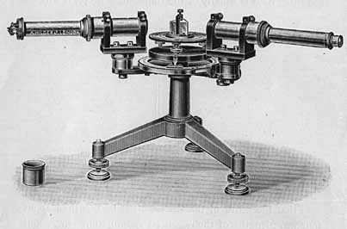
Topic 4: Waves 4.4 – Wave behavior
Snell’s law – the refractive index
Recall Snell’s law:
From $n$₁sinθ₁ = $n$₂sinθ₂ we get
$\frac{n_{1}}{n_{2}}=\frac{\sin{θ_{2}}}{\sin{θ_{1}}}$.
crown prism spectroscope
$$\frac{v2}{v1}=\frac{\sin{θ_{2}}}{\sin{θ_{1}}}$$
Snell’s law for refracted waves
So, Snell’s law can be expanded:
$$\frac{n_{1}}{n_{2}}=\frac{v2}{v1}=\frac{\sin{θ_{2}}}{\sin{θ_{1}}}$$
Snell’s law for refracted waves
where n = 1 for air and free space
EXAMPLE: The index of refraction for a particular glass is 1.65. What is the speed of light in it?
SOLUTION: Use $\frac{n_{1}}{n_{2}}=\frac{v2}{v1}$. Then
$\frac{1}{1.65}=\frac{v2}{3.0×{10}^{8}}$ so that v₂ = 1.8×10⁸ m s⁻¹.
Notes:
© 2014 By Timothy K. Lund

Slide 17
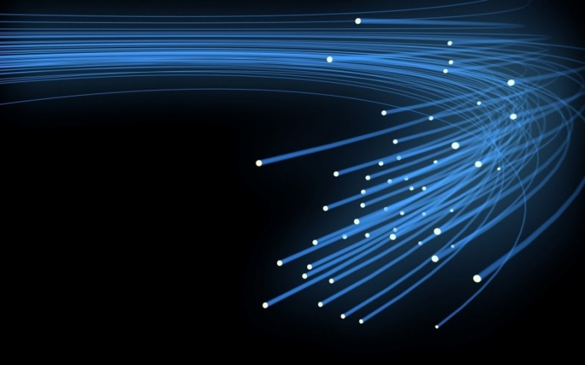
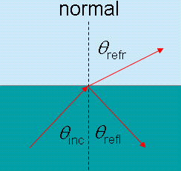
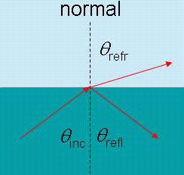
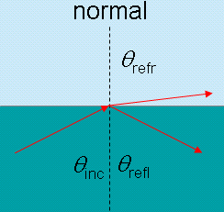
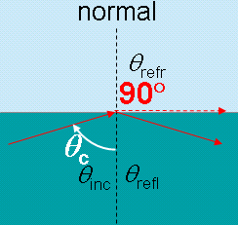
Topic 4: Waves 4.4 – Wave behavior
Snell’s law – total internal reflection
•When a wave moving in an optically dense region arrives at a boundary with a less dense medium it is possible to have all of the light reflected – trapping it inside. This is the principle behind fiber optics.
•The critical angle θ_{c} is that incident angle at which the angle of refraction θ_{refr} is 90°:
•Snell’s law gives us a relationship between the indices of refraction and the critical angle:
n₁sinθ_{c} = n₂sin90° = n₂(1).
n₂
n₁
sinθ_{c} = $\frac{n2}{n1}$
Snell’s law for critical angle
Notes:
© 2014 By Timothy K. Lund

Slide 18
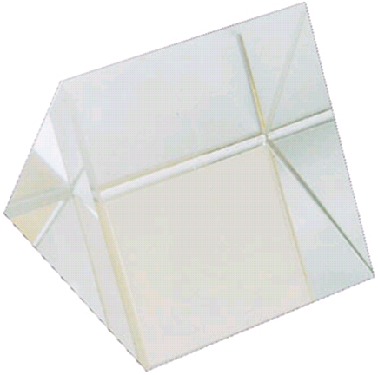
Topic 4: Waves 4.4 – Wave behavior
n₂
n₁
Snell’s law – total internal reflection
PRACTICE: A ray of light is trapped in piece of crown glass.
(a) What is its critical angle if the glass is in air?
(b) What is its critical angle if the glass is in water?
SOLUTION: Use sinθ_{c} = $\frac{n2}{n1}$ :
(a) sinθ_{c} = $\frac{n2}{n1}=\frac{1.00}{1.52} = 0.65789$ → θ_{c} = $41$°.
(b) sinθ_{c} = $\frac{n2}{n1}$ $=\frac{1.33}{1.52} =0.87500$ → θ_{c} = $61$°.
FYI
Since the sine of anything is always less than or equal to 1, you can always tell whether a critical angle exists.
Notes:
© 2014 By Timothy K. Lund

Slide 19
Topic 4: Waves 4.4 – Wave behavior
Diffraction through a single-slit and around objects
•If a wave meets a hole in a wall that is of comparable size to its wavelength, the wave will be bent through a process called diffraction.
•If the aperture (hole, opening, etc.) is much larger than the wavelength, diffraction will be minimal to nonexistent.
REFLECTED WAVE
DIFFRACTED WAVE
INCIDENT WAVE
FYI •Diffraction is caused by objects within the medium that interact with the wave. It is not caused by two mediums and their boundary.
Notes:
© 2014 By Timothy K. Lund

Slide 20
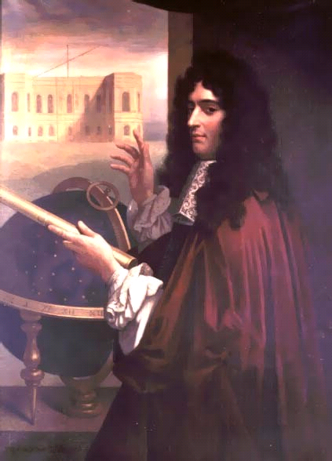
Topic 4: Waves 4.4 – Wave behavior
Diffraction through a single-slit and around objects
•Christian Huygens explained the behavior of diffraction through his famous principle:
“Every point on a wavefront emits a spherical wavelet of the same velocity and wavelength as the original wave.”
•Note that it is because of Huygen’s principle the waves can turn corners.
Notes:
© 2014 By Timothy K. Lund

Slide 21
Topic 4: Waves 4.4 – Wave behavior
Diffraction through a single-slit and around objects
•The reason waves can turn corners is that the incoming wave transmits a disturbance by causing the medium to vibrate.
•And wherever the medium vibrates it becomes the center of a new wave front as illustrated to the right.
•Note that the smaller the aperture b the more pronounced the diffraction effect.
b
b
b
FYI •The aperture size must be of the order of a wavelength in order for diffraction to occur.
b = 2λ
b = 6λ
b = 12λ
Notes:
© 2014 By Timothy K. Lund

Slide 22
Topic 4: Waves 4.4 – Wave behavior
Path difference
•This animation showing two coherent (in-phase and same frequency) wave sources S₁ and S₂ will show the following:
path difference = nλ
condition for constructive interference
n is an integer
L₁ = 4λ
L₂ = 3λ
P₁
L₁ = 4λ
L₂ = 2λ
S₁
S₂
Notes:
© 2014 By Timothy K. Lund

Slide 23
Topic 4: Waves 4.4 – Wave behavior
Path difference
•This animation showing two coherent wave sources S₁ and S₂ will show the following:
path difference = (n + ½)λ
condition for destructive interference
n is an integer
L₂ = 4λ
P₂
L₁ = 3.5λ
L₁ = 3λ
L₂ = 2.5λ
S₁
S₂
Notes:
© 2014 By Timothy K. Lund

Slide 24
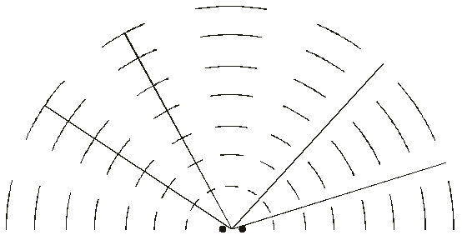
Topic 4: Waves 4.4 – Wave behavior
Double-source interference
PRACTICE: Two identical wave sources in a ripple tank produce waves having a wavelength of λ. The interference pattern is shown. Four reference lines are labeled A through D.
(a) Which reference line or lines represent constructive interference? ________
(b) Which reference line or lines represent destructive interference? ________
B
C
A
D
A and B
C and D
Notes:
© 2014 By Timothy K. Lund

Slide 25
Topic 4: Waves 4.4 – Wave behavior
Double-source interference
PRACTICE: Two identical wave sources in a ripple tank produce waves having a wavelength of λ. The interference pattern is shown. Four reference lines are labeled A through D.
(c) Which reference line or lines represent a path difference of 2.5λ? ________
•2.5λ is a condition for destructive interference.
•These two represent the smallest difference 0.5λ.
•C represents 1.5λ difference, and D is thus 2.5λ.
B
C
A
D
D
Notes:
© 2014 By Timothy K. Lund

Slide 26
Topic 4: Waves 4.4 – Wave behavior
Diffraction through a single-slit
•Huygen’s wavelets not only allow the wave to turn corners, they also interfere with each other.
Constructive interference
RELATIVE INTENSITY
Destructive interference
Notes:
© 2014 By Timothy K. Lund

Slide 27
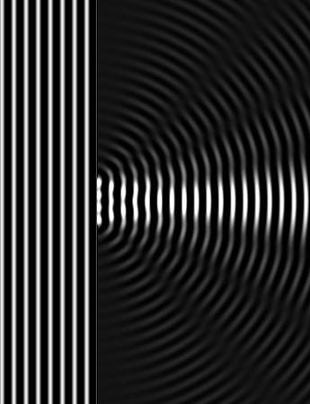
Topic 4: Waves 4.4 – Wave behavior
Diffraction through a single-slit
EXAMPLE: If light is diffracted by a circular hole, a planar cross-section of the interference looks like the picture below. What will the light look like head-on?
SOLUTION:
•Picture the waveform of the previous slide in 2D
Notes:
© 2014 By Timothy K. Lund

Slide 28
Topic 4: Waves 4.4 – Wave behavior
Double-slit interference
PRACTICE: Two apertures in a sea wall produce two diffraction patterns as shown in the animation.
(a) Which letter represents a maximum displacement above equilibrium? __
(b) Which letter represents a maximum displacement below equilibrium? __
(c) Which letter represents a minimum displacement from equilibrium? __
•Crest-crest = max high. Trough-trough = max low.
•Crest-trough = minimum displacement.
C (crest-crest)
A
B (trough-trough)
B
C
D
A (crest-trough)
Notes:
© 2014 By Timothy K. Lund

Slide 29
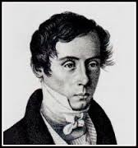
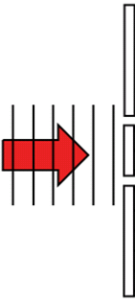
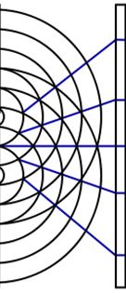
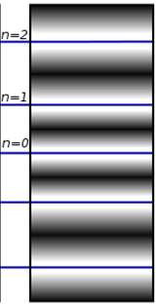
Topic 4: Waves 4.4 – Wave behavior
Double-slit interference
•Not surprisingly, double-slit interference happens with light waves too, as explored by Thomas Young in 1801.
•The following formula relates wavelength λ, slit separation d, distance D to screen, to separation s of central and first maxima:
λ
s
d
monochromatic light
D
$$s=\frac{λD}{d}$$
Young’s double-slit experiment
Notes:
© 2014 By Timothy K. Lund

Slide 30
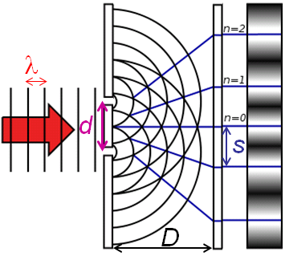
Topic 4: Waves 4.4 – Wave behavior
Double-slit interference
EXAMPLE: Coherent light having a wavelength of 675 nm is incident on an opaque card having two vertical slits separated by 1.25 mm. A screen is located 4.50 m away from the card. What is the distance between the central maximum and the first maximum?
SOLUTION: Use $s=\frac{λD}{d}$.
λ = 675×10 ⁻⁹ m, $D$ = 4.50 m, and $d$ = 1.25×10 ⁻³ m.
Thus
$s=\frac{λD}{d}= \frac{\left(675×{10}^{−9}\right)\left(4.50\right)}{1.25×{10}^{−3}}=$ $0.00243$m.
Notes:
© 2014 By Timothy K. Lund

Slide 31
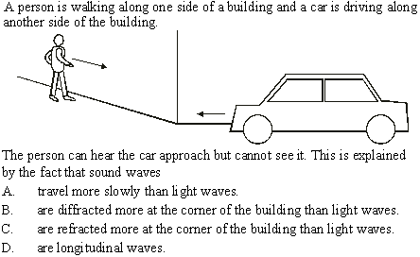
Topic 4: Waves 4.4 – Wave behavior
•All waves diffract – not just sound.
Wave behavior
•Diffraction allows waves to turn corners.
Notes:
© 2014 By Timothy K. Lund

Slide 32
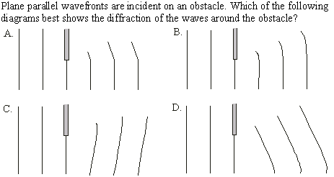
Topic 4: Waves 4.4 – Wave behavior
Wave behavior
Huygen says the wavelets will be spherical.
Notes:
© 2014 By Timothy K. Lund

Slide 33
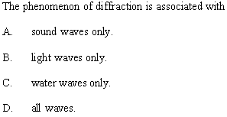
Topic 4: Waves 4.4 – Wave behavior
Wave behavior
Notes:
© 2014 By Timothy K. Lund

Slide 34
Topic 4: Waves 4.4 – Wave behavior
Wave behavior
PRACTICE: What wave behavior is being demonstrated here?
•Refraction.
T or F: The period changes in the different media.
T or F: The frequency changes in the different media.
T or F: The wavelength changes in the different media.
T or F: The wave speed changes in the different media.
T or F: The sound wave is traveling fastest in the warm air.
A sound pulse entering and leaving a pocket of cold air (blue).
Notes:
© 2014 By Timothy K. Lund

Slide 35
Topic 4: Waves 4.4 – Wave behavior
Wave behavior
PRACTICE: What wave behavior is being demonstrated here?
•Reflection. This is an echo from a wall.
T or F: The frequency of the reflected wave is different from the frequency of the incident wave?
Fill in the blanks: The angle of ___________ equals the angle of ___________.
Fill in the blank: In this example, both angles equal ___°.
•Remember that angles are measured with respect to the normal.
incidence
reflection
0
Notes:
© 2014 By Timothy K. Lund

Slide 36
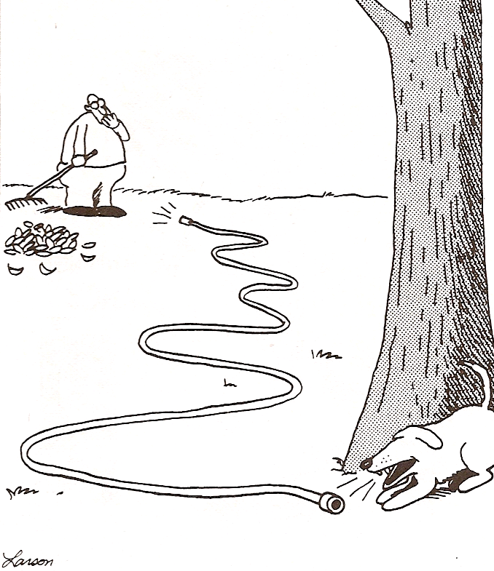
Topic 4: Waves 4.4 – Wave behavior
Wave behavior
PRACTICE: What wave behavior is being demonstrated here?
•Total internal reflection.
•This is the same principle behind fiber optics. Light is used instead of sound.
•Light travels faster than electrical signals so fiber optics are used in high speed communications networks such as token rings whenever possible.
Notes:
© 2014 By Timothy K. Lund

Slide 37
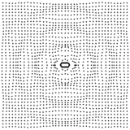
Topic 4: Waves 4.4 – Wave behavior
Wave behavior
PRACTICE: What wave behavior is being demonstrated here?
•Note that the red regions and the blue regions are 180° out of phase.
•Where they meet we have destructive interference in purple.
•In the purple regions there is no displacement.
•The condition for destructive interference is met there.
Notes:
© 2014 By Timothy K. Lund

Slide 38
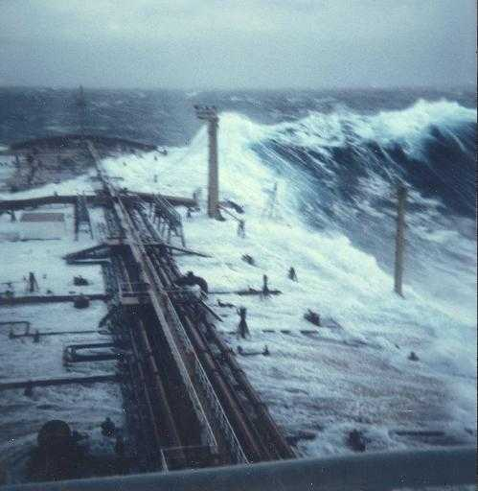
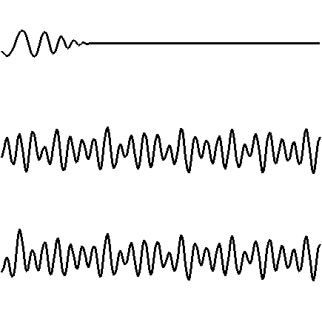
Topic 4: Waves 4.4 – Wave behavior
Wave behavior
PRACTICE: What wave behavior is being demonstrated here?
•Superposition.
SIGNAL WAVE
IRREGULAR SEA WAVE
SUPERPOSITION OF ABOVE TWO WAVES
SOURCE: http://www.math.uio.no/~karstent/waves/index_en.html
Notes:
© 2014 By Timothy K. Lund

