Slide 1
Topic 4: Waves
4.2 – Traveling waves
Essential idea: There are many forms of waves available to be studied. A common characteristic of all traveling waves is that they carry energy, but generally the medium through which they travel will not be permanently disturbed.
Nature of science: Patterns, trends and discrepancies: Scientists have discovered common features of wave motion through careful observations of the natural world, looking for patterns, trends and discrepancies and asking further questions based on these findings.
Notes:
© 2006 By Timothy K. Lund

Slide 2
Topic 4: Waves
4.2 – Traveling waves
Understandings:
• Traveling waves
• Wavelength, frequency, period and wave speed
• Transverse and longitudinal waves
• The nature of electromagnetic waves
• The nature of sound waves
Notes:
2
© 2006 By Timothy K. Lund

Slide 3
Topic 4: Waves
4.2 – Traveling waves
Applications and skills:
• Explaining the motion of particles of a medium when a wave passes through it for both transverse and longitudinal cases
• Sketching and interpreting displacement–distance graphs and displacement–time graphs for transverse and longitudinal waves
• Solving problems involving wave speed, frequency and wavelength
• Investigating the speed of sound experimentally
Notes:
3
© 2006 By Timothy K. Lund

Slide 4
Topic 4: Waves
4.2 – Traveling waves
Guidance:
• Students will be expected to derive c = f λ.
• Students should be aware of the order of magnitude of the wavelengths of radio, microwave, infrared, visible, ultraviolet, X-ray and gamma rays
Data booklet reference:
• c = f λ
Notes:
4
© 2006 By Timothy K. Lund

Slide 5
Topic 4: Waves
4.2 – Traveling waves
International-mindedness:
• Electromagnetic waves are used extensively for national and international communication
Theory of knowledge:
• Scientists often transfer their perception of tangible and visible concepts to explain similar non-visible concepts, such as in wave theory. How do scientists explain concepts that have no tangible or visible quality?
Notes:
5
© 2006 By Timothy K. Lund

Slide 6
Topic 4: Waves
4.2 – Traveling waves
Utilization:
• Communication using both sound (locally) and electromagnetic waves (near and far) involve wave theory
• Emission spectra are analysed by comparison to the electromagnetic wave spectrum (see Chemistry topic 2 and Physics sub-topic 12.1)
• Sight (see Biology sub-topic A.2)
Notes:
6
© 2006 By Timothy K. Lund

Slide 7
Topic 4: Waves
4.2 – Traveling waves
Aims:
• Aim 2: there is a common body of knowledge and techniques involved in wave theory that is applicable across many areas of physics
• Aim 4: there are opportunities for the analysis of data to arrive at some of the models in this section from first principles
• Aim 6: experiments could include (but are not limited to): speed of waves in different media; detection of electromagnetic waves from various sources; use of echo methods (or similar) for determining wave speed, wavelength, distance, or medium elasticity and/or density
Notes:
7
© 2006 By Timothy K. Lund

Slide 8
Topic 4: Waves
4.2 – Traveling waves
Traveling waves
•Consider a taut rope which is anchored securely to a table:
•You can send a single wave pulse through the rope by moving your hand up and then down exactly once:
•Or you can repeat the motion to produce a continuous traveling wave:
FYI
•Note that the rope as a whole doesn’t go to the right. The rope particles just __________________________.
Notes:
© 2006 By Timothy K. Lund

Slide 9
Topic 4: Waves
4.2 – Traveling waves
Traveling waves
•We can use a spring instead of a rope:
•You can send a single wave pulse through the spring by moving your hand forward and backward exactly once (push and pull):
•Or you can repeat the motion to produce a continuous traveling wave:
FYI
•Note that the spring as a whole doesn’t travel to the right. The spring particles just ____________________ _____________________.
Notes:
© 2006 By Timothy K. Lund

Slide 10
Topic 4: Waves
4.2 – Traveling waves
Traveling waves – energy transfer
•Consider a securely anchored taut rope:
•If we send a wave pulse through the rope, we see that when it reaches the end, it can do work on the mass:
•Note that in this case work was done against gravity in the form of an increase in the gravitational potential energy of the mass.
•You can think of the energy being transferred from your hand to the mass via the momentum or E_{K} of the particles while they vibrate.
∆h
∆E_{P} = mg∆h
Notes:
© 2006 By Timothy K. Lund

Slide 11
Topic 4: Waves
4.2 – Traveling waves
Transverse and longitudinal waves
•Both the rope and the spring were examples of traveling waves, and both traveled in the +x-direction.
•We call the material through which a wave propagates the __________. So far we have seen examples of two mediums: rope and spring steel.
•The rope transferred its wave pulses by vibrations which were ___________________________________ ____________________________________________.
•Any wave produced by _________________________ _______________ is called a ____________________.
v
Notes:
© 2006 By Timothy K. Lund

Slide 12
Topic 4: Waves
4.2 – Traveling waves
Transverse and longitudinal waves
•The spring transferred its wave pulses by vibrations which were ___________________________________ ___________________________________________.
•Any wave produced by _________________________ ____________ is called a _______________________.
v
Notes:
© 2006 By Timothy K. Lund

Slide 13
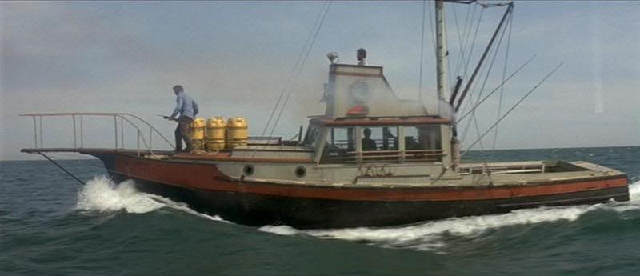

Topic 4: Waves
4.2 – Traveling waves
Transverse and longitudinal waves
PRACTICE: Categorize a water wave as transverse, or as longitudinal.
•If you have ever been fishing and used a bobber you should know the answer:
•Firstly, the wave velocity is to the left.
•Secondly, the bobber _____________________.
•Thus the water particles ____________________.
•Thus water waves are _________________ waves.
v
Transverse waves are perpendicular to the wave velocity.
Notes:
© 2006 By Timothy K. Lund

Slide 14

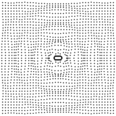
Topic 4: Waves
4.2 – Traveling waves
The nature of sound waves
EXAMPLE:
•Consider a speaker cone which is vibrating due to electrical input in the form of music.
•As the cone pushes outward, it squishes the air molecules together in a process called ___________________.
•As the cone retracts, it separates the air molecules in a process called ________________.
•Since the ___________________________________, _____________________________________.
v
Notes:
© 2006 By Timothy K. Lund

Slide 15
Topic 4: Waves
4.2 – Traveling waves
The nature of sound waves
•A “microscopic” view of a sound pulse may help:
FYI As you watch, observe that…
•there is a pulse velocity v.
•there is a compression or condensation.
•there is a decompression or rarefaction.
•the particles are displaced parallel to v.
Pulse Generator
Suppose the distance from the generator to the barrier is 5.0 m and the pulse took 22 s to reach it. Then the speed of sound in this medium is v =
Notes:
© 2006 By Timothy K. Lund

Slide 16
As you watch this animation look at the circular wave fronts as they travel through space from the sound source.
Observe further that the waves in the red sectors are out of phase with the waves in the blue sectors. By how much?

Slide 17
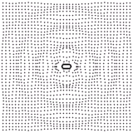
Topic 4: Waves
4.2 – Traveling waves
Wavefronts and rays
•Looking at a snapshot of the previous 2D animation we can label various parts:
•The _____________ are located at the ________________.
•The _____ are drawn from the source outward, and _____________________ _____________________.
FYI
•Rays and wavefronts are perpendicular to each other.
Notes:
© 2006 By Timothy K. Lund

Slide 18
Topic 4: Waves
4.2 – Traveling waves
Crests and troughs
•Compare the waves traveling through the mediums of rope and spring.
CREST
TROUGH
TRANSVERSE WAVE
COMPRESSION
RAREFACTION
LONGITUDINAL WAVE
Notes:
© 2006 By Timothy K. Lund

Slide 19
Topic 4: Waves
4.2 – Traveling waves
Explaining the motion of particles of a medium
•Here is an animation of transverse wave motion created by placing each of the blue particles of the medium in simple harmonic motion.
•As you watch the animation note that
-each particle has the same period T.
-each particle is slightly _______________.
-the wave crest appears to be moving left.
v
Displacement y
x
Notes:
© 2006 By Timothy K. Lund

Slide 20
Topic 4: Waves
4.2 – Traveling waves
Explaining the motion of particles of a medium
•Consider a snapshot of the following identical mass/spring systems, each of which is oscillating at the same period as the system to the right.
•Note that they are all out of phase in such a way that they form a wave as you move in the x-direction.
•At each position x we have a different value y.
•The systems at ______________________________.
y
x
x₁
x₂
Notes:
© 2006 By Timothy K. Lund

Slide 21
Topic 4: Waves
4.2 – Traveling waves
Explaining the motion of particles of a medium
•Now we see the same system a short time later:
•The mass at x₁ has gone lower.
•The mass at x₂ has gone lower.
•Which way does it appear the wave is traveling?
Left or right?
y
t₁ (from last slide)
x
x₁
x₂
y
t₂ (a short time later)
x
x₁
x₂
Notes:
© 2006 By Timothy K. Lund

Slide 22
Topic 4: Waves
4.2 – Traveling waves
Displacement and amplitude
•If we look at either of the graphs we can define various wave characteristics:
•The ______________ ___________________________________is called the _______________. In this graph it would be the y value.
•At a horizontal coordinate of x₁ along the length of the wave train we see that its displacement y is (-), whereas at x₂ we see that y is (+).
•The ___________________________________. The amplitude is just the ____________________________ ____________________________.
y
t₂ (a short time later)
x
x₁
x₂
Notes:
© 2006 By Timothy K. Lund

Slide 23
Topic 4: Waves
4.2 – Traveling waves
Period and wavelength
•The length in the horizontal dimension over which a wave repeats itself is called the wavelength, represented with the symbol λ (the Greek lambda).
•The ________________________________________ ____________________________________.
•The ________________________________________ ____________________________________.
y
t₂ (a short time later)
x
x₁
x₂
FYI
•The period is the same for all particles of the medium.
Notes:
© 2006 By Timothy K. Lund

Slide 24
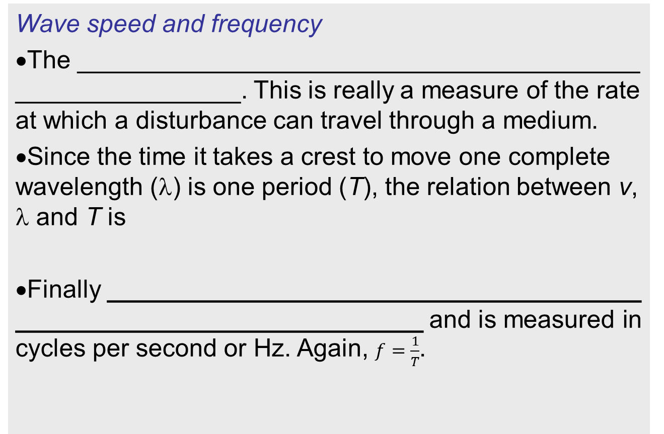
Topic 4: Waves
4.2 – Traveling waves
Wave speed and frequency
•The ________________________________________ ________________. This is really a measure of the rate at which a disturbance can travel through a medium.
•Since the time it takes a crest to move one complete wavelength (λ) is one period (T), the relation between v, λ and T is
•Finally ______________________________________ _____________________________ and is measured in cycles per second or Hz. Again, $f=\frac{1}{T}$.
relation between v, λ and T
relation between f and T
Notes:
© 2006 By Timothy K. Lund

Slide 25
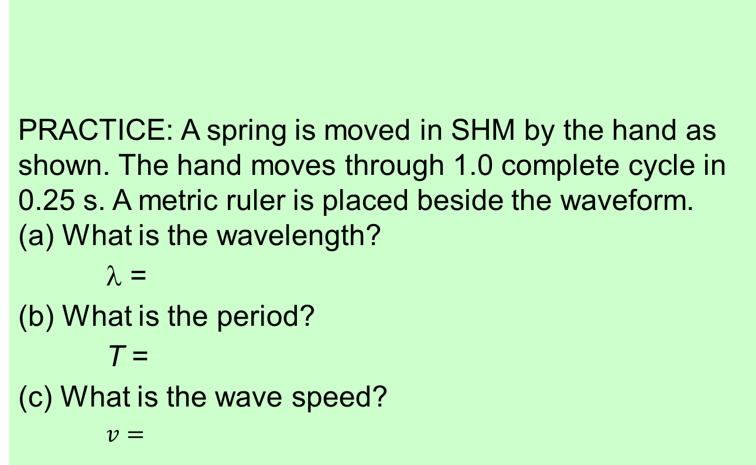
Topic 4: Waves
4.2 – Traveling waves
Solving wave speed and wavelength problems
PRACTICE: A spring is moved in SHM by the hand as shown. The hand moves through 1.0 complete cycle in 0.25 s. A metric ruler is placed beside the waveform.
(a) What is the wavelength?
λ =
(b) What is the period?
T =
(c) What is the wave speed?
$v=$
14
13
12
11
10
9
8
7
6
5
4
3
2
1
CM
Notes:
© 2006 By Timothy K. Lund

Slide 26
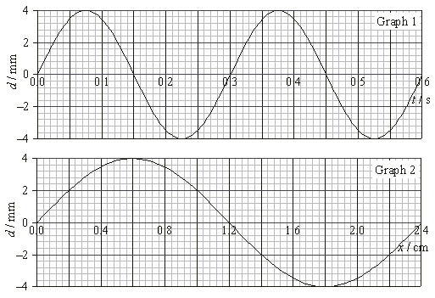
Topic 4: Waves
4.2 – Traveling waves
Either graph gives the correct amplitude.
Sketching and interpreting distance and time graphs
EXAMPLE:
Graph 1 shows the variation with time t of the displacement d of a traveling wave. Graph 2 shows the variation with distance x along the same wave of its displacement d.
(a) Use the graphs to determine the amplitude of the wave motion.
•Amplitude (maximum displacement) is ____________
Notes:
© 2006 By Timothy K. Lund

Slide 27
Topic 4: Waves
4.2 – Traveling waves
Graph 2 must be used since its horizontal axis is in cm (not seconds as in Graph 1).
Sketching and interpreting distance and time graphs
EXAMPLE:
Graph 1 shows the variation with time t of the displacement d of a traveling wave. Graph 2 shows the variation with distance x along the same wave of its displacement d.
(b) Use the graphs to determine the wavelength.
•Wavelength is measured in meters and is the length of a complete wave. λ =
Notes:
© 2006 By Timothy K. Lund

Slide 28
Topic 4: Waves
4.2 – Traveling waves
Graph 1 must be used since its horizontal axis is in s (not cm as in Graph 2).
Sketching and interpreting distance and time graphs
EXAMPLE:
Graph 1 shows the variation with time t of the displacement d of a traveling wave. Graph 2 shows the variation with distance x along the same wave of its displacement d.
(c) Use the graphs to determine the period.
•Period is measured in seconds and is the time for one complete wave. T =
Notes:
© 2006 By Timothy K. Lund

Slide 29
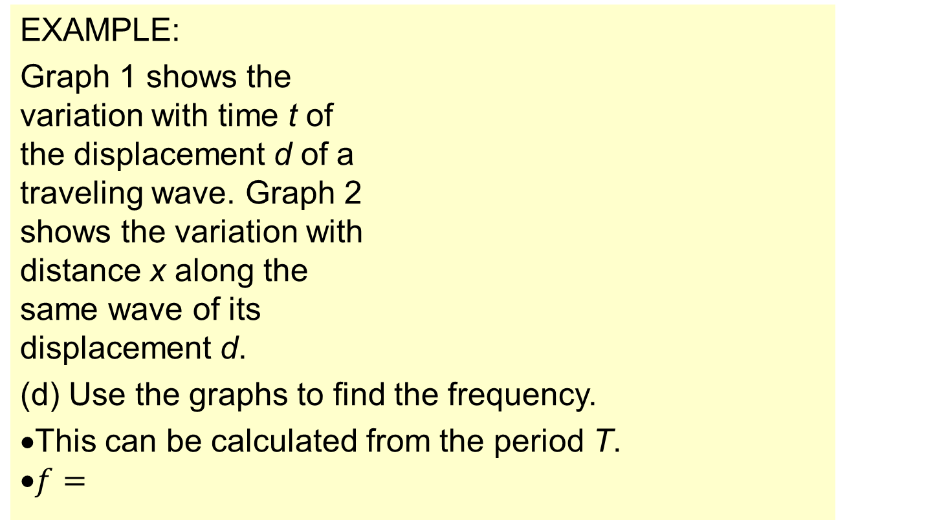
Topic 4: Waves
4.2 – Traveling waves
Sketching and interpreting distance and time graphs
EXAMPLE:
Graph 1 shows the variation with time t of the displacement d of a traveling wave. Graph 2 shows the variation with distance x along the same wave of its displacement d.
(d) Use the graphs to find the frequency.
•This can be calculated from the period T.
•$f=$
Notes:
© 2006 By Timothy K. Lund

Slide 30
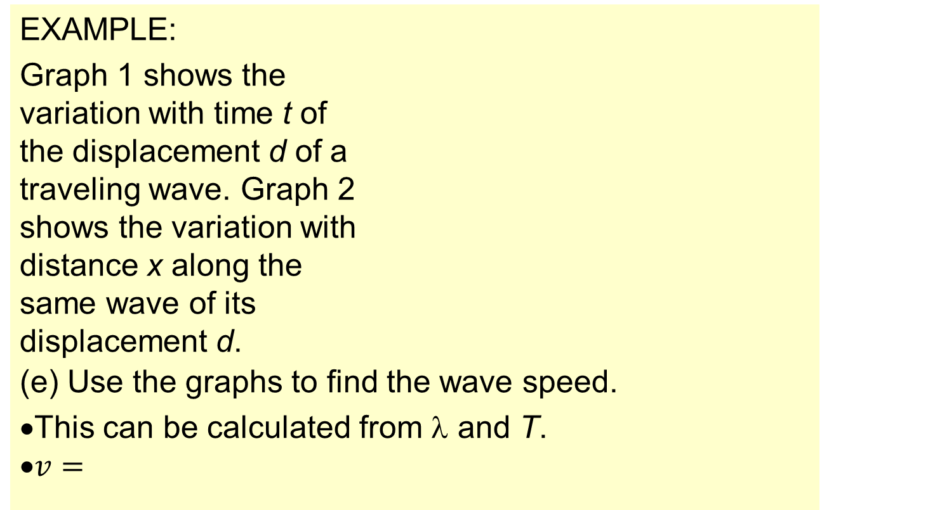
Topic 4: Waves
4.2 – Traveling waves
Sketching and interpreting distance and time graphs
EXAMPLE:
Graph 1 shows the variation with time t of the displacement d of a traveling wave. Graph 2 shows the variation with distance x along the same wave of its displacement d.
(e) Use the graphs to find the wave speed.
•This can be calculated from λ and T.
•$v=$
Notes:
© 2006 By Timothy K. Lund

Slide 31
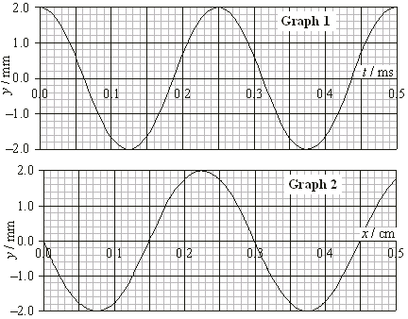
Topic 4: Waves
4.2 – Traveling waves
Graph 2 must be used for λ since its horizontal axis is in cm.
Sketching and interpreting distance and time graphs
PRACTICE: Graph 1 shows the variation with time t of the displacement y of a traveling wave. Graph 2 shows the variation with distance x along the same wave of its displacement.
(a) Use the graphs to determine the amplitude and wavelength of the wave motion.
Notes:
© 2006 By Timothy K. Lund

Slide 32
Topic 4: Waves
4.2 – Traveling waves
Graph 1 must be used for T since its horizontal axis is in ms.
Sketching and interpreting distance and time graphs
PRACTICE: Graph 1 shows the variation with time t of the displacement y of a traveling wave. Graph 2 shows the variation with distance x along the same wave of its displacement.
(b) Use the graphs to determine the period and the frequency.
Notes:
© 2006 By Timothy K. Lund

Slide 33
Topic 4: Waves
4.2 – Traveling waves
Sketching and interpreting distance and time graphs
PRACTICE: Graph 1 shows the variation with time t of the displacement y of a traveling wave. Graph 2 shows the variation with distance x along the same wave of its displacement.
(c) Use the graphs to determine the wave speed.
Notes:
© 2006 By Timothy K. Lund

Slide 34
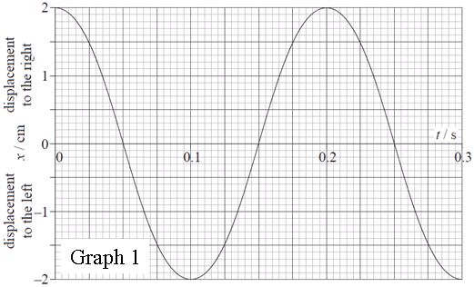

Topic 4: Waves
4.2 – Traveling waves
Sketching and interpreting distance and time graphs
EXAMPLE:
Graph 1 shows the variation with time t of the displacement x of a single particle in the medium carrying a longitudinal wave in the +x direction.
(a) Use the graph to determine the period and the frequency of the particle’s SHM.
•The period is the time for one cycle. T =
•$f=$
Notes:
© 2006 By Timothy K. Lund

Slide 35
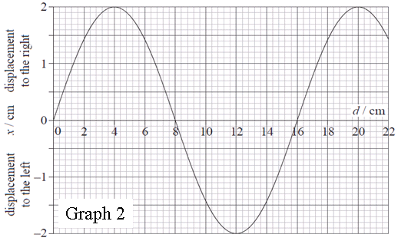
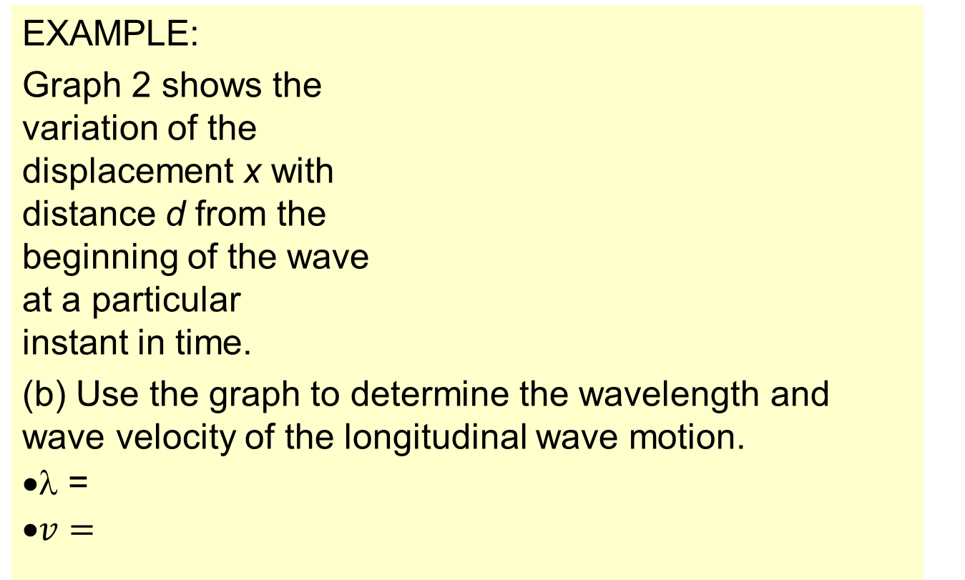
Topic 4: Waves
4.2 – Traveling waves
Sketching and interpreting distance and time graphs
EXAMPLE:
Graph 2 shows the variation of the displacement x with distance d from the beginning of the wave at a particular instant in time.
(b) Use the graph to determine the wavelength and wave velocity of the longitudinal wave motion.
•λ =
•$v=$
Notes:
© 2006 By Timothy K. Lund

Slide 36
Topic 4: Waves
4.2 – Traveling waves
Sketching and interpreting distance and time graphs
EXAMPLE:
Graph 2 shows the variation of the displacement x with distance d from the beginning of the wave at a particular instant in time.
(c) The equilibrium positions of 6 particles in the medium are shown below. Using ×’s, indicate the actual position of each particle at the instant shown above.
Notes:
© 2006 By Timothy K. Lund

Slide 37
Topic 4: Waves
4.2 – Traveling waves
Sketching and interpreting distance and time graphs
EXAMPLE:
Graph 2 shows the variation of the displacement x with distance d from the beginning of the wave at a particular instant in time.
(d) In the diagram label the center of a compression with a C and the center of a rarefaction with an R.
Notes:
© 2006 By Timothy K. Lund

Slide 38



Topic 4: Waves
4.2 – Traveling waves
Students will be expected to derive c = f λ
•From the above relations we get:
$v=$
$v=$
$$v=\frac{λ}{T}$$
relation between v, λ and T
$$f=\frac{1}{T}$$
relation between f and T
relation between v, λ and f
EXAMPLE: A traveling wave has a wavelength of 2.0 cm and a speed of 75 m s⁻¹. What is its frequency?
Notes:
© 2006 By Timothy K. Lund

Slide 39
Topic 4: Waves
4.2 – Traveling waves
The nature of electromagnetic waves
•All of us are familiar with light. But visible light is just a tiny fraction of the complete electromagnetic spectrum.
The Electromagnetic Spectrum
Microwaves Ultraviolet Light Gamma Rays
Radio, TV Cell Phones Infrared Light X-Rays
10⁴ 10⁶ 10⁸ 10¹⁰ 10¹² 10¹⁴ 10¹⁶ 10¹⁸
Frequency f / Hz
700 600 500 400
Wavelength λ / nm
Notes:
© 2006 By Timothy K. Lund

Slide 40
Topic 4: Waves
4.2 – Traveling waves
The nature of electromagnetic waves
•In free space (vacuum), all electromagnetic waves travel with the same speed v = 3.00×10⁸ m s⁻¹.
•We use the special symbol c for the speed of light.
relation between c, λ and f
where c = 3.00×10⁸ m s⁻¹
PRACTICE: The wavelength of a particular hue of blue light is 475 nm. What is its frequency?
•1 nm is 1×10 ⁻⁹ m so that λ =
•c = λf so that
•f =
700 600 500 400
Wavelength λ / nm
Notes:
© 2006 By Timothy K. Lund

Slide 41
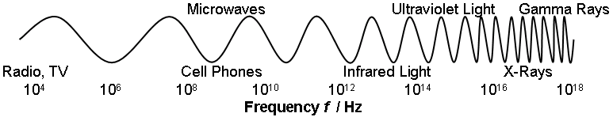
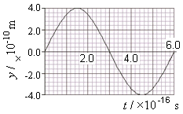
Topic 4: Waves
4.2 – Traveling waves
The nature of electromagnetic waves
c = λf
relation between c, λ and f
where c = 3.00×10⁸ m s⁻¹
PRACTICE: The graph shows one complete oscillation of a particular frequency of light.
(a) What is its frequency, and what part of the spectrum is it from?
SOLUTION: From the graph T =
•Then f =
Notes:
© 2006 By Timothy K. Lund

Slide 42
Topic 4: Waves
4.2 – Traveling waves
The nature of electromagnetic waves
c = λf
relation between c, λ and f
where c = 3.00×10⁸ m s⁻¹
PRACTICE: The graph shows one complete oscillation of a particular frequency of light.
(b) What is the wavelength of this light wave?
SOLUTION: All light has the same speed c, so we don’t need the x vs. d graph.
Notes:
© 2006 By Timothy K. Lund

Slide 43
Topic 4: Waves
4.2 – Traveling waves
700 600 500 400
Wavelength λ / nm
The nature of electromagnetic waves
c = λf
relation between c, λ and f
where c = 3.00×10⁸ m s⁻¹
PRACTICE: The graph shows one complete oscillation of a particular frequency of light.
(c) Determine whether or not this light is in the visible spectrum.
SOLUTION: The visible spectrum is from about 400 nm to 700 nm.
Notes:
© 2006 By Timothy K. Lund

Slide 44
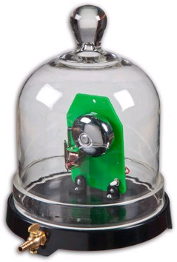
Topic 4: Waves
4.2 – Traveling waves
The nature of electromagnetic waves
•Perhaps in chemistry you have seen the bell jar demonstration.
•A ringing bell is placed inside a bell jar, and can be heard to ring.
•As air is removed from the sealed jar with a vacuum pump, the sound of the ringing bell diminishes until it cannot be heard. _______ ____________________________________________________________________________________________________________________________________
•But the demonstration also shows that ____________ ____________________________________. How so?
Notes:
© 2006 By Timothy K. Lund

Slide 45
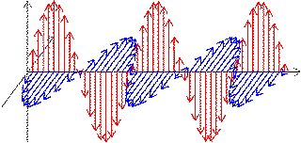
Topic 4: Waves
4.2 – Traveling waves
The nature of electromagnetic waves
•Here is an animation of a moving electric charge producing a changing electromagnetic field that propagates through space at c.
•The red arrows represent the electric field.
•The blue arrows represent the magnetic field.
c
The crests and troughs of each wave move to the right at the speed of light c.
Each region in space executes SHM in the form of oscillating E- and B-fields.
Notes:
© 2006 By Timothy K. Lund

Slide 46
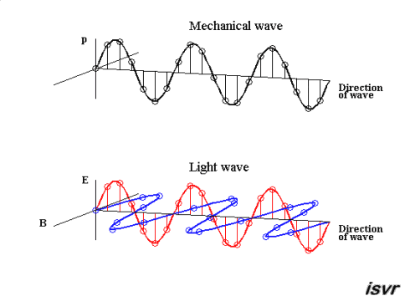
Topic 4: Waves
4.2 – Traveling waves
The nature of electromagnetic waves
•A more smooth animation is shown here.
v
FYI
•Each dot is in simple harmonic motion.
c
Notes:
© 2006 By Timothy K. Lund

