Slide 1
Topic 3: Thermal physics
3.1 – Thermal concepts
Essential idea: Thermal physics deftly demonstrates the links between the macroscopic measurements essential to many scientific models with the microscopic properties that underlie these models.
Nature of science: Evidence through experimentation: Scientists from the 17th and 18th centuries were working without the knowledge of atomic structure and sometimes developed theories that were later found to be incorrect, such as phlogiston and perpetual motion capabilities. Our current understanding relies on statistical mechanics providing a basis for our use and understanding of energy transfer in science.
Notes:
© 2006 By Timothy K. Lund

Slide 2
Topic 3: Thermal physics
3.1 – Thermal concepts
Understandings:
• Molecular theory of solids, liquids and gases
• Temperature and absolute temperature
• Internal energy
• Specific heat capacity
• Phase change
• Specific latent heat
Notes:
2
© 2006 By Timothy K. Lund

Slide 3
Topic 3: Thermal physics
3.1 – Thermal concepts
Applications and skills:
• Describing temperature change in terms of internal energy
• Using Kelvin and Celsius temperature scales and converting between them
• Applying the calorimetric techniques of specific heat capacity or specific latent heat experimentally
• Describing phase change in terms of molecular behaviour
• Sketching and interpreting phase change graphs
• Calculating energy changes involving specific heat capacity and specific latent heat of fusion and vaporization
Notes:
3
© 2006 By Timothy K. Lund

Slide 4
Topic 3: Thermal physics
3.1 – Thermal concepts
Guidance:
• Internal energy is taken to be the total intermolecular potential energy + the total random kinetic energy of the molecules
• Phase change graphs may have axes of temperature versus time or temperature versus energy
• The effects of cooling should be understood qualitatively but cooling correction calculations are not required
Data booklet reference:
• Q = mcΔT
• Q = mL
Notes:
4
© 2006 By Timothy K. Lund

Slide 5
Topic 3: Thermal physics
3.1 – Thermal concepts
International-mindedness:
• The topic of thermal physics is a good example of the use of international systems of measurement that allow scientists to collaborate effectively
Theory of knowledge:
• Observation through sense perception plays a key role in making measurements. Does sense perception play different roles in different areas of knowledge?
Notes:
5
© 2006 By Timothy K. Lund

Slide 6
Topic 3: Thermal physics
3.1 – Thermal concepts
Utilization:
• Pressure gauges, barometers and manometers are a good way to present aspects of this sub-topic
• Higher level students, especially those studying option B, can be shown links to thermodynamics (see Physics topic 9 and option sub-topic B.4)
• Particulate nature of matter (see Chemistry sub-topic 1.3) and measuring energy changes (see Chemistry sub-topic 5.1)
• Water (see Biology sub-topic 2.2)
Notes:
6
© 2006 By Timothy K. Lund

Slide 7
Topic 3: Thermal physics
3.1 – Thermal concepts
Aims:
• Aim 3: an understanding of thermal concepts is a fundamental aspect of many areas of science
• Aim 6: experiments could include (but are not limited to): transfer of energy due to temperature difference; calorimetric investigations; energy involved in phase changes
Notes:
7
© 2006 By Timothy K. Lund

Slide 8
Topic 3: Thermal physics
3.1 – Thermal concepts
intermolecular bond
Molecular theory of solids, liquids and gases
•The three phases of matter are are _______, _______, and _______.
•In a ______ the molecules can _______ ________. They __________________.
•In a ______ the molecules can _________ and _______________________________.
•In going from a ______________, ____ of the intermolecular ______________, giving the molecules more freedom of motion.
•In going from a ___________, ____ of the intermolecular ________________.
solid
liquid
Notes:
© 2006 By Timothy K. Lund

Slide 9
Topic 3: Thermal physics
3.1 – Thermal concepts
Phase change
•The process of going from a solid to a liquid is called _____________.
•The process of going from a liquid to a gas is called _____________.
•Each process can be reversed.
PHASE CHANGE PROCESS EXAMPLE
solid ⎯→ liquid melting ice to water
liquid ⎯→ solid freezing water to ice
liquid ⎯→ gas boiling water to steam
gas ⎯→ liquid condensing steam to droplets
solid ⎯→ gas sublimation frost evaporation
gas ⎯→ solid deposition frost
Notes:
© 2006 By Timothy K. Lund

Slide 10
Topic 3: Thermal physics
3.1 – Thermal concepts
Internal energy
•All substances are composed of individual molecules that are in vibration.
•As we ________ a substance its _________ ____________________. This is an _______ ______________________ of the molecules.
•Simultaneously, as heat energy is being added the molecules are also ________________. This is an _________________________ of the substance.
•The two energies together are called the __________ __________ of the substance. Thus _______________.
•When ______________ (heat) is ________________ ___________it is _____________________________.
Notes:
© 2006 By Timothy K. Lund

Slide 11
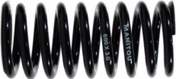

Topic 3: Thermal physics
3.1 – Thermal concepts
Internal energy
E_{INT} = E_{K} + E_{P}.
total internal energy
Total Internal Energy
Potential Energy
(due to inter-molecular forces)
Kinetic Energy (due to vibration and translation
Think of Hooke’s law F = -kx and phase change
The thermometer measures internal kinetic energy
Notes:
© 2006 By Timothy K. Lund

Slide 12
Topic 3: Thermal physics
3.1 – Thermal concepts
Temperature and absolute temperature
•Because absorption of thermal energy (heat) causes materials to expand, the fluid in a thermometer can be used to indirectly measure temperature.
•Since water is a readily-available substance that can be frozen, and boiled within a narrow range of temperatures, many thermometers are calibrated using these temperatures.
•We will be using the ______________ in physics because it is a simpler scale.
•____________ only reveals the __________________
•____________ reveals _________________________
100°
Boiling
212°
FAHRENHEIT SCALE
CELSIUS SCALE
0°
Freezing
32°
Notes:
© 2006 By Timothy K. Lund

Slide 13
Topic 3: Thermal physics
3.1 – Thermal concepts
Temperature and absolute temperature
•When ________________________________ __________________________________.
•The following experiment plots pressure p vs. temperature T in Celsius.
•We can extrapolate the graph.
•Now we repeat using different gases.
p
10
20
0
30
T (°C)
-300
-200
-100
0
100
200
300
Notes:
© 2006 By Timothy K. Lund

Slide 14
Topic 3: Thermal physics
3.1 – Thermal concepts
Temperature and absolute temperature
•The __________________ p that can exist is ______.
•Surprisingly, _________________________________ ____________________________________________.
•The _______________ at which the ______________ ________ (for all gases) is -273 °C.
p
-273.15 °C
T (°C)
-300
-200
-100
0
100
200
300
Notes:
© 2006 By Timothy K. Lund

Slide 15
Topic 3: Thermal physics
3.1 – Thermal concepts
Temperature and absolute temperature
•Because the lowest pressure that can exist is zero, this temperature is the _____________________________ _______, and it is called ________________.
•A new temperature scale that has absolute zero as its lowest value is called the _________________________.
0° C
Freezing
273 K
p
-273.15 °C
CELSIUS SCALE
KELVIN SCALE
Absolute zero
-273°C
0 K
T (°C)
-300
-200
-100
0
100
200
300
Notes:
© 2006 By Timothy K. Lund

Slide 16
Topic 3: Thermal physics
3.1 – Thermal concepts
Converting between Kelvin and Celsius temperatures
•The simple relationship between the Kelvin and Celsius scales is given here:
T(K) = T(°C) + 273
Kelvin and Celsius relationship
FYI •Note that there is no degree symbol on Kelvin temperatures.
0° C
Freezing
273 K
EXAMPLE: Convert 100°C to Kelvin, and 100 K to C°.
SOLUTION:
CELSIUS SCALE
KELVIN SCALE
Absolute zero
-273°C
0 K
Notes:
© 2006 By Timothy K. Lund

Slide 17
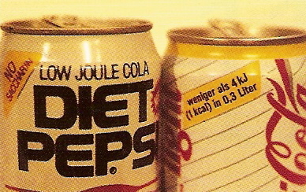
Topic 3: Thermal physics
3.1 – Thermal concepts
Specific heat capacity
•Traditionally in North America, heat energy is measured in calories or kilocalories.
•1 calorie is needed to raise the temperature of 1 gram (instead of a kilogram) of water 1 C°.
•In Europe they don’t talk about “low calorie cola.” (Sometimes)
•Instead, they talk about “low Joule cola.” (Sometimes)
One kilocalorie __________________ _______________________________ _______________________________
definition of the kilo-calorie
Notes:
© 2006 By Timothy K. Lund

Slide 18
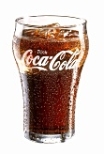
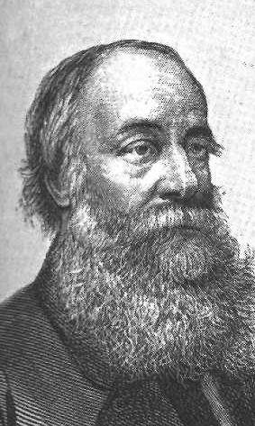
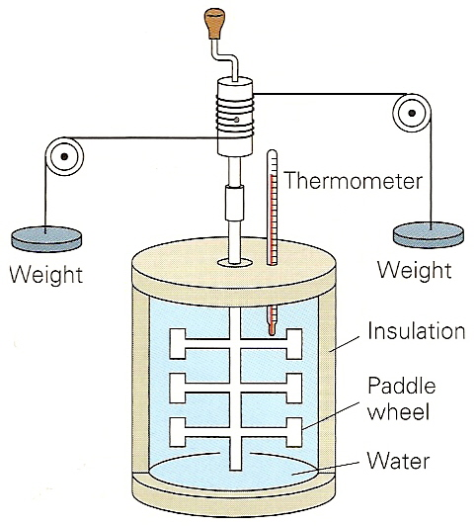
Topic 3: Thermal physics
3.1 – Thermal concepts
Specific heat capacity
•Obviously there must be a conversion between Joules (J) and kilocalories (kcal).
mechanical equivalent of heat
Notes:
© 2006 By Timothy K. Lund

Slide 19
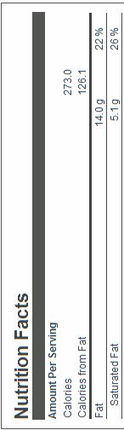


Topic 3: Thermal physics
3.1 – Thermal concepts
Specific heat capacity
EXAMPLE: How many joules is 450000 calories?
SOLUTION: Use 1 kcal = 4.186 kJ:
$450000cal=$
PRACTICE: A SnickersTM bar has 273.0 Cal. For foods, Calories are really kcal. How many joules are in a SnickersTM bar?
Notes:
© 2006 By Timothy K. Lund

Slide 20
Topic 3: Thermal physics
3.1 – Thermal concepts
Specific heat capacity
•Different materials absorb heat energy in different ways.
•This means that if we have two __________________ having the ___________ m, and each ______________ _____________________ Q, their ________________ ____________ ΔT ____________________.
•We define the __________________ c of a substance as the _______________________________________ ____________________________________________.
•___________________________________________.
specific heat capacity c defined
Notes:
© 2006 By Timothy K. Lund

Slide 21
Topic 3: Thermal physics
3.1 – Thermal concepts
Specific heat capacity
•Here are some specific heats for various materials.
Specific Heats c of Various Substances at 20°C and 1 atm.
Substance
J / kg·C°
kcal/kg·C° (or cal/g·C°)
Air (at 50°C)
1050
0.25
Water (at 15°C)
4186
1.00
Steam (at 110°C)
2010
0.48
Ice (at -5°C)
2100
0.50
Wood
1680
0.40
Ethyl Alcohol
2430
0.58
Steel
460
0.11
FYI
•Note that specific heat units for c are (J kg⁻¹ C°⁻¹).
Notes:
© 2006 By Timothy K. Lund

Slide 22
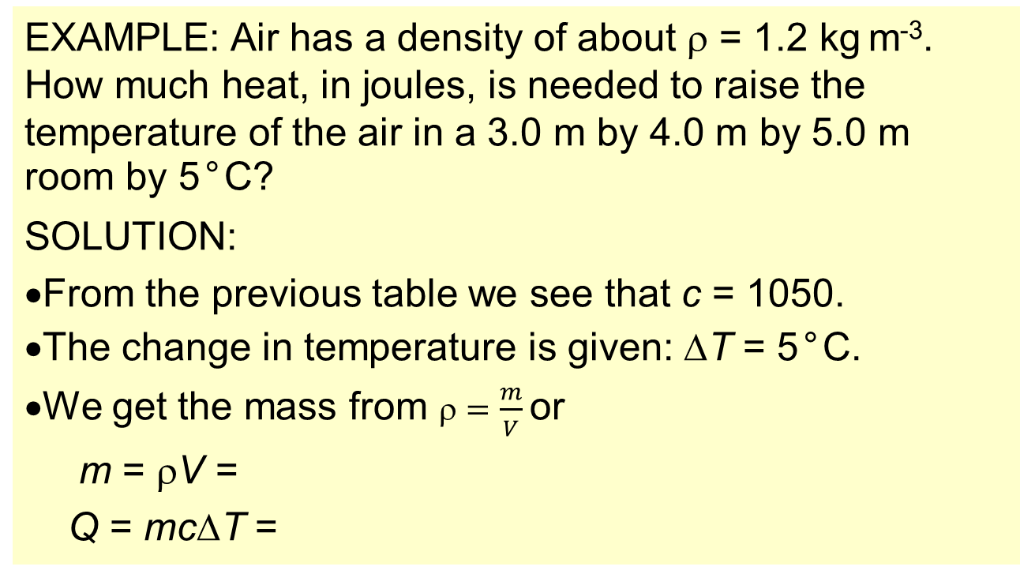
Topic 3: Thermal physics
3.1 – Thermal concepts
Calculating energies involving specific heat capacity
Q = mcΔT
specific heat capacity c defined
EXAMPLE: Air has a density of about ρ = 1.2 kg m⁻³. How much heat, in joules, is needed to raise the temperature of the air in a 3.0 m by 4.0 m by 5.0 m room by 5°C?
SOLUTION:
From the previous table we see that c = 1050.
The change in temperature is given: ΔT = 5°C.
We get the mass from $=\frac{m}{V}$or
m = ρV =
Q = mcΔT =
Notes:
© 2006 By Timothy K. Lund

Slide 23
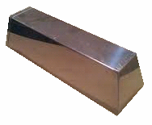
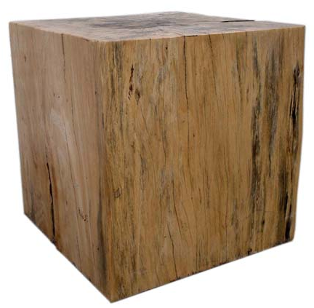
Topic 3: Thermal physics
3.1 – Thermal concepts
Calculating energies involving specific heat capacity
Q = mcΔT
specific heat capacity c defined
PRACTICE: Suppose we have a 200.-kg steel ingot and a 200.-kg block of wood, both at room temperature (20.0°C). If we add 1,143,000 J of heat (the energy of a SnickersTM bar) to each object, what will its final temperature be?
SOLUTION:
•For both, Q = mcΔT = mc(T – T₀).
Notes:
© 2006 By Timothy K. Lund

Slide 24


Topic 3: Thermal physics
3.1 – Thermal concepts
12
9
3
6
Sketching and interpreting phase change graphs
•Suppose a thermometer is frozen in ice, and the ice is further cooled to a temperature of -20°C. We slowly add heat, and plot the temperature vs. the heat Q added:
•Since the _____________ measures ________ ________, and since the __________________ ______________________________, the heat ______________________________________ _______________________.
100ºC
0ºC
T
INTERNAL ENERGY
POTENTIAL ENERGY
KINETIC ENERGY
100ºC
0ºC
Q
Notes:
© 2006 By Timothy K. Lund

Slide 25
Topic 3: Thermal physics
3.1 – Thermal concepts
Phase change in terms of molecular behavior
•As a model to help explain phase change consider a molecule in an open box which can move left and right but must remain “captured” in the box.
•As more heat is stored as potential energy, the particle in our model gains height.
•Finally, the potential energy is great enough to break the intermolecular bonds and change the phase of the substance.
•The molecule is free!
During phase change potential energy does change
During phase change temp-erature does not change
During phase change potential energy does change
Notes:
© 2006 By Timothy K. Lund

Slide 26
Topic 3: Thermal physics
3.1 – Thermal concepts
Specific latent heat
•___________ means ___________, by which we mean that there is no temperature indication that heat is being lost or gained by a substance.
•The __________________ L is defined in this formula:
•Note that since there is no temperature change during a phase change, there is no ΔT in our formula. The units for L are (J kg⁻¹).
T
Boiling Point
Melting Point
Q
Q = mL
specific latent heat L defined
FYI
•Use Q = mL ___________________(when ΔT = 0).
•Use Q = mcΔT otherwise (when ΔT ≠ 0).
Notes:
© 2006 By Timothy K. Lund

Slide 27
Topic 3: Thermal physics
3.1 – Thermal concepts
Specific latent heat
•Since there are ___________________(two plateaus), __________________________________________.
•L_{f} is the _____________________.
•L_{v} is the _______________________.
•The temperatures associated with the phase changes are also given.
Latent Heats Lof Various Substances at 1 atm.
Substance
Melting
Point °C
L_{f}
Boiling
Point °C
L_{v}
J/kg
kcal/kg
J/kg
kcal/kg
Water
0
3.33×10⁵
80
100
22.6×10⁵
540
Mercury
-39
0.12×10⁵
2.8
357
2.7×10⁵
65
Oxygen
-219
0.14×10⁵
3.3
-183
2.1×10⁵
51
Gold
1063
0.65×10⁵
15.4
2660
15.8×10⁵
377
T
Boiling Point
L_{v}
L_{f}
Melting Point
Q
Notes:
© 2006 By Timothy K. Lund

Slide 28
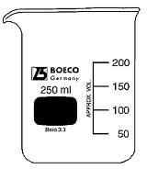


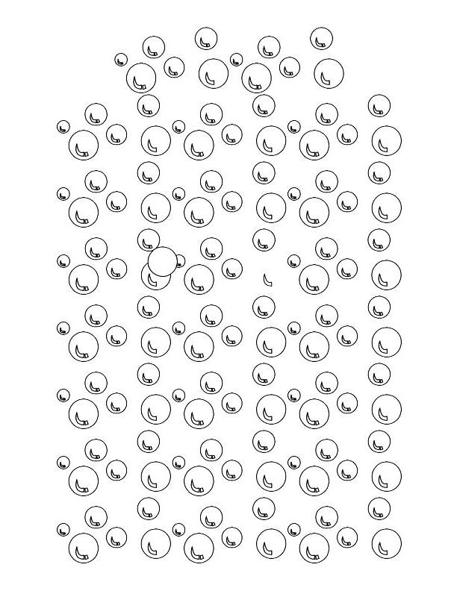
Topic 3: Thermal physics
3.1 – Thermal concepts
Specific latent heat
EXAMPLE: Compare boiling and evaporation.
SOLUTION:
•________ takes place within the whole liquid at the _______________, called the __________.
•___________ occurs only at the surface of a liquid and can occur at _________________.
•Evaporation can be enhanced by increasing the surface area, warming the liquid, or having air movement at the surface.
•_______________________________________ __________________________________. This is why sweating removes excess body heat so well!
Notes:
© 2006 By Timothy K. Lund

Slide 29
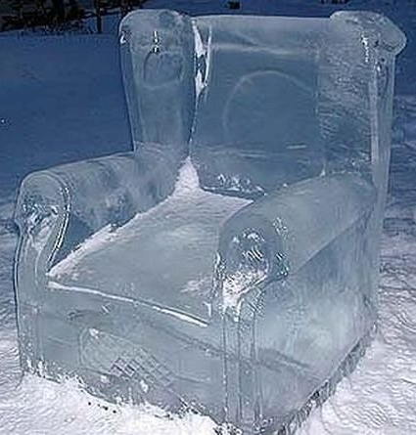
Topic 3: Thermal physics
3.1 – Thermal concepts
Calculating energies involving specific latent heat
Q = mL
specific latent heat L defined
EXAMPLE:
Bob has designed a 525-kg ice chair. How much heat must he remove from water at 0°C to make the ice chair (also at 0°C)?
SOLUTION:
In a phase change ΔT = 0 so we use Q = mL.
Since the phase change is freezing, we use L_{f}.
For the water-to-ice phase change L_{f} = 3.33×10⁵ J kg⁻¹.
Thus Q = mL =
Notes:
© 2006 By Timothy K. Lund

Slide 30
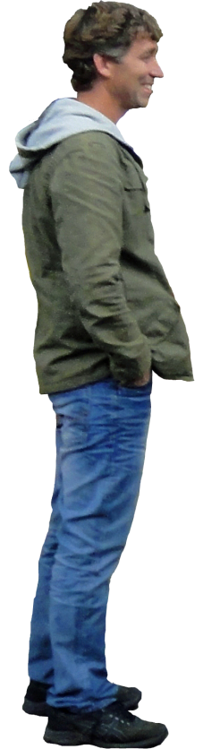
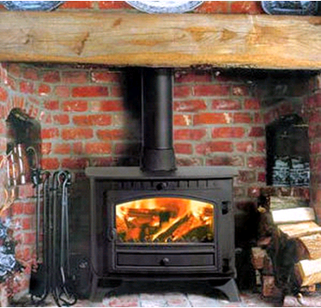
Topic 3: Thermal physics
3.1 – Thermal concepts
From this slide on is interesting, but not required for Topic 3
Conduction, convection and thermal radiation
•Thermal energy can be transferred from a warmer mass to a cooler mass by three means: ____________ _________________________________.
•This energy transfer is called ________ and _______.
•Only _________________ transfers heat __________ ______________________ such as solid, liquid or gas.
EXAMPLE: The heat from a wood-burning stove can be felt from all the way across the room because photons carrying infrared energy can travel through empty space. When these photons strike you, they are absorbed as heat. This process of thermal energy transfer is called thermal radiation. See Topic 8.2.
Notes:
30
© 2006 By Timothy K. Lund

Slide 31
Topic 3: Thermal physics
3.1 – Thermal concepts
Conduction, convection and thermal radiation
•When two objects of different temperatures ________, thermal energy is ______________________________ _____________ through a process called __________.
•When atoms of one portion of a medium are in contact with vibrating atoms of another portion, the vibration is transferred from atom to atom.
•High T portions vibrate more than low T portions, so we can imagine the vibration “impulse” to travel through the material, from high T to low T.
H
O
T
H
O
T
C
O
L
D
Direction of heat flow
Notes:
31
© 2006 By Timothy K. Lund

Slide 32
Topic 3: Thermal physics
3.1 – Thermal concepts
Conduction, convection and thermal radiation
•Consider a material that acts as a conductor of heat from the hot object to the cold object.
•During the process the hot object loses energy and cools, while the cold object gains energy and warms.
•At the end of the process the two ends have reached _______________________ at which point there is no more net transfer of heat.
12
20°C
9
3
40°C
100°C
60°C
80°C
60°C
6
Direction of heat flow
Notes:
© 2006 By Timothy K. Lund

Slide 33
Topic 3: Thermal physics
3.1 – Thermal concepts
Conduction, convection and thermal radiation
•Another form of heat transfer is called ____________.
•Convection ______________ (liquid or gas) as a ____________ of heat transfer.
•For example, hot air is less dense than cold air, so it rises.
•But as it rises it cools, and so becomes denser and sinks.
•We thus obtain a cycle, which forms a circulation called a _______________________.
•Convection currents drive many interesting physical systems as the next slides illustrate.
Convection current
Notes:
33
© 2006 By Timothy K. Lund

Slide 34
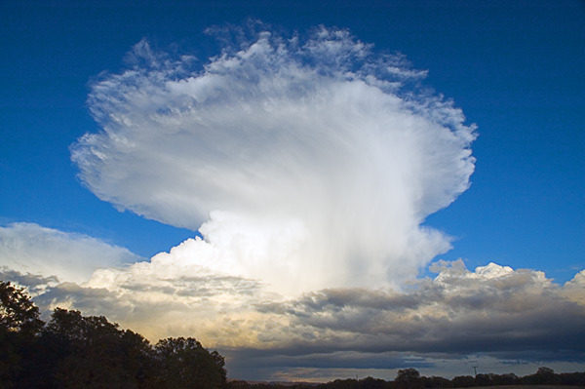
Topic 3: Thermal physics
3.1 – Thermal concepts
Conduction, convection and thermal radiation
EXAMPLE: Atmospheric convection - thunderheads.
Notes:
34
© 2006 By Timothy K. Lund

Slide 35
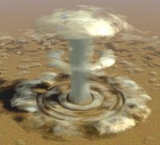
Topic 3: Thermal physics
3.1 – Thermal concepts
Conduction, convection and thermal radiation
EXAMPLE: Atmospheric convection - nuclear detonation.
Notes:
35
© 2006 By Timothy K. Lund

Slide 36
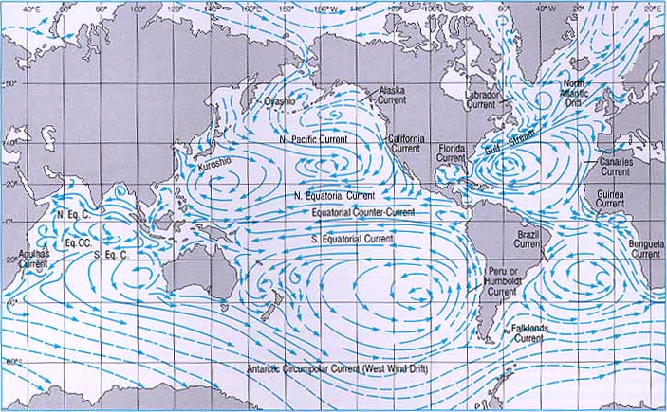
Topic 3: Thermal physics
3.1 – Thermal concepts
Conduction, convection and thermal radiation
EXAMPLE: Oceanic convection - currents.
Notes:
36
© 2006 By Timothy K. Lund

Slide 37
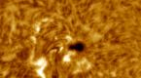
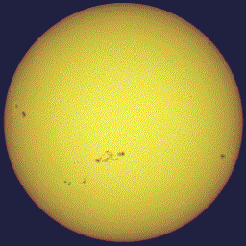
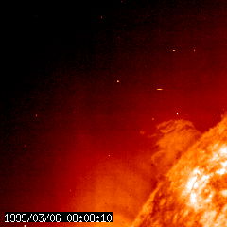
Topic 3: Thermal physics
3.1 – Thermal concepts
Conduction, convection and thermal radiation
EXAMPLE: Solar convection – sunspots and flares.
Notes:
37
© 2006 By Timothy K. Lund

Slide 38
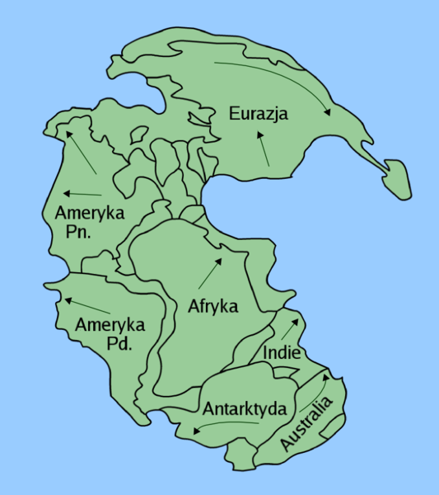
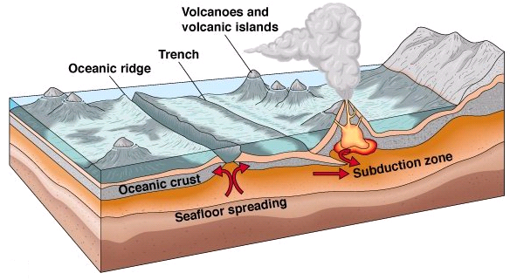
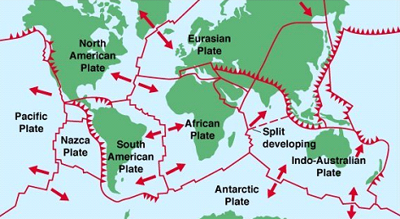
Topic 3: Thermal physics
3.1 – Thermal concepts
Conduction, convection and thermal radiation
EXAMPLE: Mantle convection – plate tectonics.
Notes:
38
© 2006 By Timothy K. Lund

Slide 39
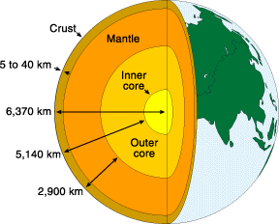
Topic 3: Thermal physics
3.1 – Thermal concepts
Plate tectonics - convection
•The residual heat from the formation of Earth, and the heat generated by radioactive decay deep within the mantle, combine to produce the perfect conditions for convection currents.
•Even though the mantle acts similar to a solid in many ways, it is really a special kind of fluid that would be liquid like lava if it weren’t for the tremendous pressure it is under due to overlaying layers.
Notes:
39
© 2006 By Timothy K. Lund

Slide 40
Topic 3: Thermal physics
3.1 – Thermal concepts
Plate tectonics - convection
•Specific to the NGSS, and related to convection currents, we have plate tectonics, which is the study of crustal plate motion over the surface of Earth over time.
•It is these convection currents in the mantle that drive plate tectonics.
•Spreading centers are where plates separate.
•Subduction zones are where plates collide.
Spreading center
Subduction zone
Crustal Plate
Crustal Plate
Crustal Plate
Mantle
Notes:
40
© 2006 By Timothy K. Lund

Slide 41
Topic 3: Thermal physics
3.1 – Thermal concepts
Plate tectonics - convection
•Spreading centers are usually located in the ocean and produce landforms called oceanic ridges.
•Oceanic ridges form because as the oceanic plates separate, magma can well up into the void.
Ocean
Oceanic Plate
Oceanic Plate
Crust
Mantle
•New crust is formed at the spreading centers.
Notes:
41
© 2006 By Timothy K. Lund

Slide 42
Topic 3: Thermal physics
3.1 – Thermal concepts
Plate tectonics - convection
•A true subduction zone is where one of two colliding plates is driven underneath the other.
•Mountains created by the buckling crust can form, as well as volcanoes, powered by melting crustal material.
Ocean trench
Ocean
Ocean Plate
Either Plate
Crust
Mantle
Mantle
•Ocean trenches form at subduction zones.
Notes:
42
© 2006 By Timothy K. Lund

Slide 43
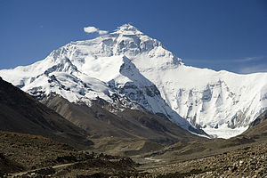
Topic 3: Thermal physics
3.1 – Thermal concepts
Plate tectonics - convection
•Generally when oceanic plates collide with land plates, the oceanic plate is the one that is driven underneath in the subduction zone.
•Plates can also collide and crumple, forming mountains without subduction.
•These are usually two land plates colliding.
Land Plate
Land Plate
Crust
Mantle
Notes:
43
© 2006 By Timothy K. Lund

Slide 44
Topic 3: Thermal physics
3.1 – Thermal concepts
Plate tectonics
•Pangaea is the name given to the early landform that was more or less all the present-day continents placed close together.
•Because of continental drift (on the average of two inches per year), Pangaea has split up into the present-day continents, which are still in motion.
•In the following animation, note how the Indie plate collides with the Eurazja plate. What mountain range do you think this collision created?
Notes:
44
© 2006 By Timothy K. Lund

Slide 45
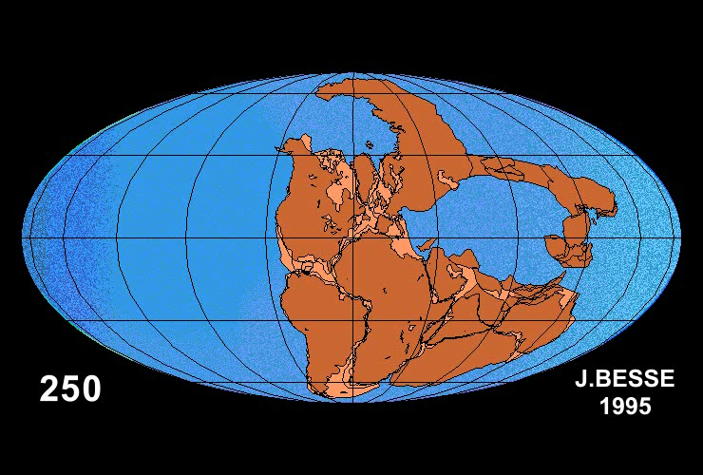
Ma
Credit: Jean Besse, Institut de Physique du Globe de Paris
Notes:
45
© 2006 By Timothy K. Lund

Slide 46
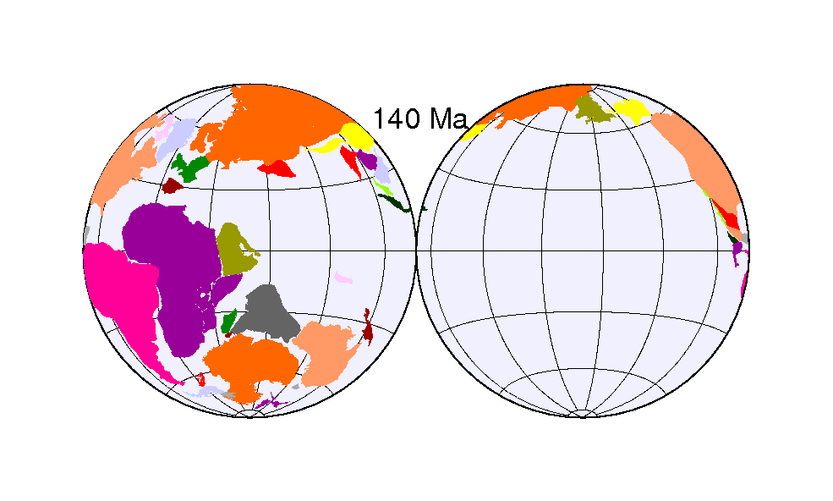
Credit: Alex Copley, Ashley Kennard, Jessica Kim, and Lindsey Stancliff
PRACTICE: How do you think continental drift might affect the evolution of living species?
Notes:
46
© 2006 By Timothy K. Lund

