Slide 1
Topic 2: Mechanics
2.4 – Momentum and impulse
Essential idea: Conservation of momentum is an example of a law that is never violated.
Nature of science: The concept of momentum and the principle of momentum conservation can be used to analyse and predict the outcome of a wide range of physical interactions, from macroscopic motion to microscopic collisions.
Notes:
© 2012 By Timothy K. Lund

Slide 2
Topic 2: Mechanics
2.4 – Momentum and impulse
Understandings:
• Newton’s second law expressed in terms of rate of change of momentum
• Impulse and force – time graphs
• Conservation of linear momentum
• Elastic collisions, inelastic collisions and explosions
Notes:
© 2012 By Timothy K. Lund

Slide 3
Topic 2: Mechanics
2.4 – Momentum and impulse
Applications and skills:
• Applying conservation of momentum in simple isolated systems including (but not limited to) collisions, explosions, or water jets
• Using Newton’s second law quantitatively and qualitatively in cases where mass is not constant
• Sketching and interpreting force – time graphs
• Determining impulse in various contexts including (but not limited to) car safety and sports
• Qualitatively and quantitatively comparing situations involving elastic collisions, inelastic collisions and explosions
Notes:
© 2012 By Timothy K. Lund

Slide 4
Topic 2: Mechanics
2.4 – Momentum and impulse
Guidance:
• Students should be aware that F = ma is the equivalent of F = Δp / Δt only when mass is constant
• Solving simultaneous equations involving conservation of momentum and energy in collisions will not be required
• Calculations relating to collisions and explosions will be restricted to one-dimensional situations
• A comparison between energy involved in inelastic collisions (in which kinetic energy is not conserved) and the conservation of (total) energy should be made
Notes:
© 2012 By Timothy K. Lund

Slide 5
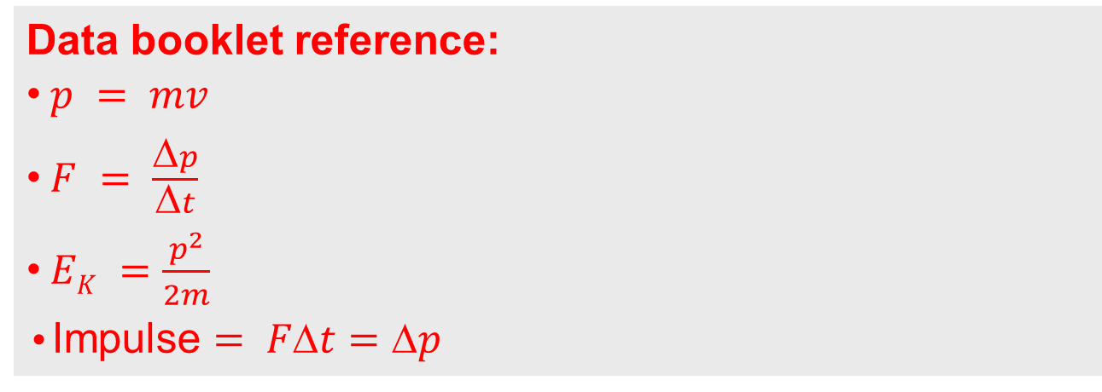
Topic 2: Mechanics
2.4 – Momentum and impulse
Data booklet reference:
• $p = mv$
• $F = \frac{Δp}{Δt}$
• $EK =\frac{p^{2}}{2m}$
•Impulse $= Ft=p$
Notes:
© 2012 By Timothy K. Lund

Slide 6
Topic 2: Mechanics
2.4 – Momentum and impulse
International-mindedness:
• Automobile passive safety standards have been adopted across the globe based on research conducted in many countries
Theory of knowledge:
• Do conservation laws restrict or enable further development in physics?
Utilization:
• Jet engines and rockets
• Martial arts
• Particle theory and collisions (see Physics sub-topic 3.1)
Notes:
© 2012 By Timothy K. Lund

Slide 7
Topic 2: Mechanics
2.4 – Momentum and impulse
Aims:
• Aim 3: conservation laws in science disciplines have played a major role in outlining the limits within which scientific theories are developed
• Aim 6: experiments could include (but are not limited to): analysis of collisions with respect to energy transfer; impulse investigations to determine velocity, force, time, or mass; determination of amount of transformed energy in inelastic collisions
• Aim 7: technology has allowed for more accurate and precise measurements of force and momentum, including video analysis of real-life collisions and modelling/simulations of molecular collisions
Notes:
© 2012 By Timothy K. Lund

Slide 8
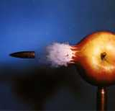
Topic 2: Mechanics
2.4 – Momentum and impulse
Newton’s second law in terms of momentum
•Linear momentum, p, is defined to be the product of an object’s mass m with its velocity v.
•Its units are obtained directly from the formula and are kg m s⁻¹.
p = mv
linear momentum
EXAMPLE: What is the linear momentum of a 4.0-gram NATO SS 109 bullet traveling at 950 m/s?
SOLUTION:
Convert grams to kg (jump 3 decimal places left) to get m = .004 kg.
Then p = mv = (.004)(950) = 3.8 kg m s⁻¹.
Notes:
© 2006 By Timothy K. Lund

Slide 9


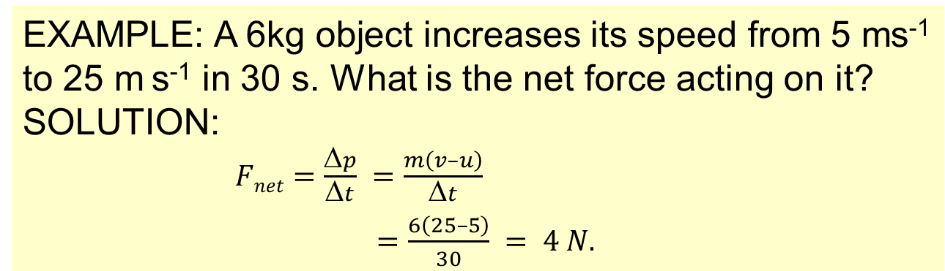
Topic 2: Mechanics
2.4 – Momentum and impulse
Newton’s second law in terms of momentum
•$Fnet=ma=m\left(\frac{v}{t}\right)=\frac{mv}{t}=\frac{p}{t}$
This last is Newton’s second law in terms of change in momentum rather than mass and acceleration.
p = mv
linear momentum
$$Fnet=\frac{Δp}{Δt}$$
Newton’s second law (p-form)
EXAMPLE: A 6kg object increases its speed from 5 ms⁻¹ to 25 m s⁻¹ in 30 s. What is the net force acting on it?
SOLUTION:
$Fnet=\frac{Δp}{Δt} =\frac{m\left(v–u\right)}{Δt}$
$=\frac{6\left(25–5\right)}{30} = 4 N.$
Notes:
© 2006 By Timothy K. Lund

Slide 10



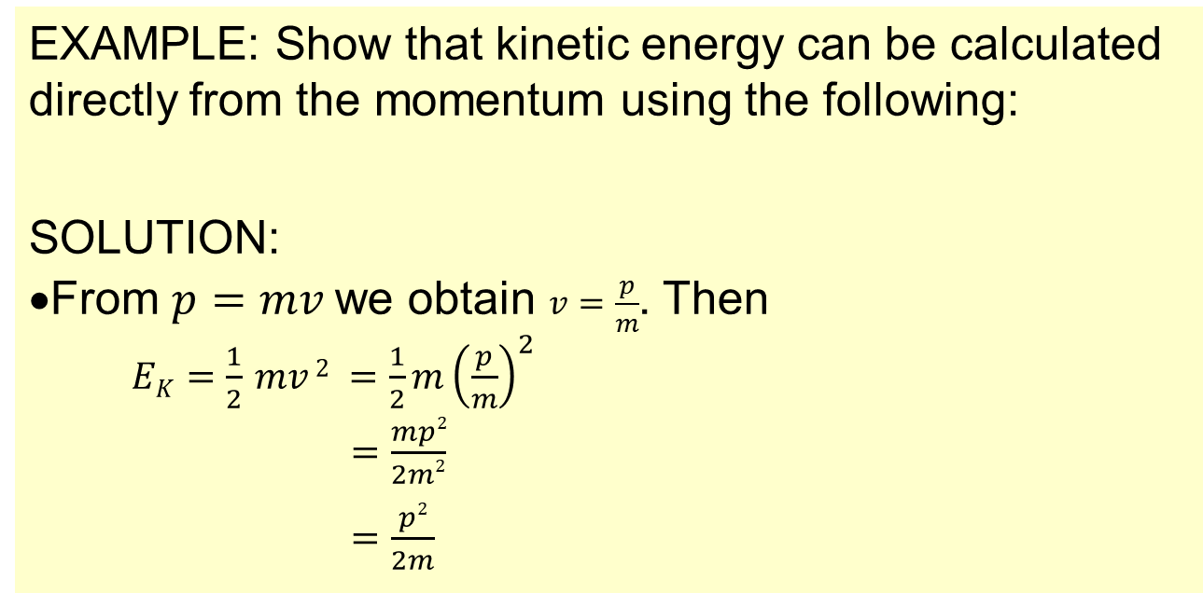
Topic 2: Mechanics
2.4 – Momentum and impulse
Kinetic energy in terms of momentum
$$p=mv$$
linear momentum
$$EK =\frac{1}{2} mv 2$$
kinetic energy
EXAMPLE: Show that kinetic energy can be calculated directly from the momentum using the following:
SOLUTION:
•From $p=mv$we obtain $v=\frac{p}{m}$. Then
$EK=\frac{1}{2} mv 2 =\frac{1}{2}m{\left(\frac{p}{m}\right)}^{2}$
$=\frac{mp2}{2m2}$
$=\frac{p2}{2m}$
$$EK=\frac{p2}{2m}$$
kinetic energy
Notes:
© 2006 By Timothy K. Lund

Slide 11
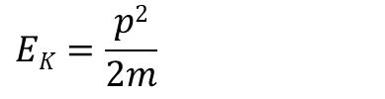
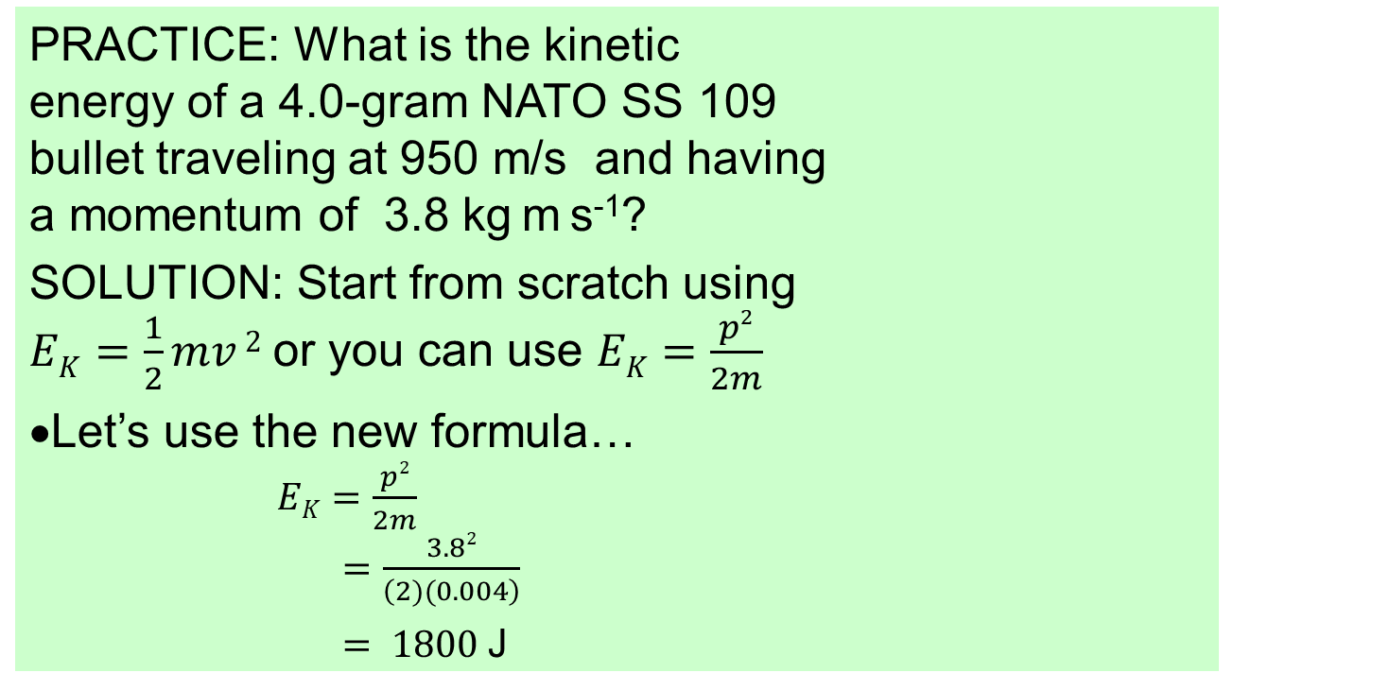
Topic 2: Mechanics
2.4 – Momentum and impulse
Kinetic energy in terms of momentum
$$EK=\frac{p2}{2m}$$
kinetic energy
PRACTICE: What is the kinetic energy of a 4.0-gram NATO SS 109 bullet traveling at 950 m/s and having a momentum of 3.8 kg m s⁻¹?
SOLUTION: Start from scratch using $EK=\frac{1}{2}mv 2$or you can use $EK=\frac{p2}{2m}$
•Let’s use the new formula…
$EK=\frac{p2}{2m}$
$=\frac{3.82}{\left(2)(0.004\right)}$
$= 1800$J
Notes:
© 2006 By Timothy K. Lund

Slide 12
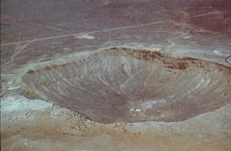
Topic 2: Mechanics
2.4 – Momentum and impulse
Collisions
•A collision is an event in which a relatively strong force acts on two or more bodies for a relatively short time.
•The Meteor Crater in the state of Arizona was the first crater to be identified as an impact crater.
•Between 20,000 to 50,000 years ago, a small asteroid about 80 feet in diameter impacted the Earth and formed the crater.
Notes:
© 2006 By Timothy K. Lund

Slide 13
Topic 2: Mechanics
2.4 – Momentum and impulse
Collisions
•Consider two colliding pool balls…
FYI
•A system boundary is the “area of interest” used by physicists in the study of complex processes.
•A closed system has no work done on its parts by external forces.
“Before” phase
system boundary
“During” phase
system boundary
“After” phase
system boundary
Notes:
© 2006 By Timothy K. Lund

Slide 14
Topic 2: Mechanics
2.4 – Momentum and impulse
Collisions
•If we take a close-up look at a collision between two bodies, we can plot the force acting on each mass during the collision vs. the time :
v_{Ai}
v_{Bi}
“Before” phase
A
B
F
During
Before
After
F_{AB}
F_{BA}
A
B
t
“During” phase
F_{AB}
A
B
F_{BA}
F_{AB}
F_{BA}
FYI
•Note the perfect symmetry of the action-reaction force pairs.
A
B
v_{Af}
v_{Bf}
“After” phase
A
B
Notes:
© 2006 By Timothy K. Lund

Slide 15
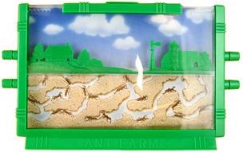
Topic 2: Mechanics
2.4 – Momentum and impulse
Impulse and force – time graphs
•Although the force varies with time, we can simplify it by “averaging it out” as follows:
•Imagine an ant farm (two sheets of glass with sand in between) filled with the sand in the shape of the above force curve:
•We now let the sand level itself out (by tapping or shaking the ant farm):
•The area of the rectangle is the same as the area under the original force vs. time curve.
•The average force F is the height of this rectangle.
Force
F
t
∆t
Notes:
© 2006 By Timothy K. Lund

Slide 16
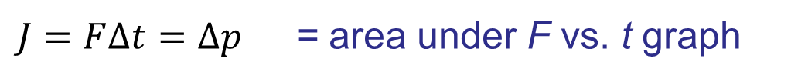
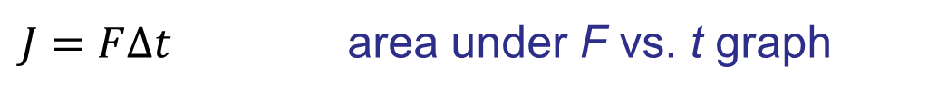
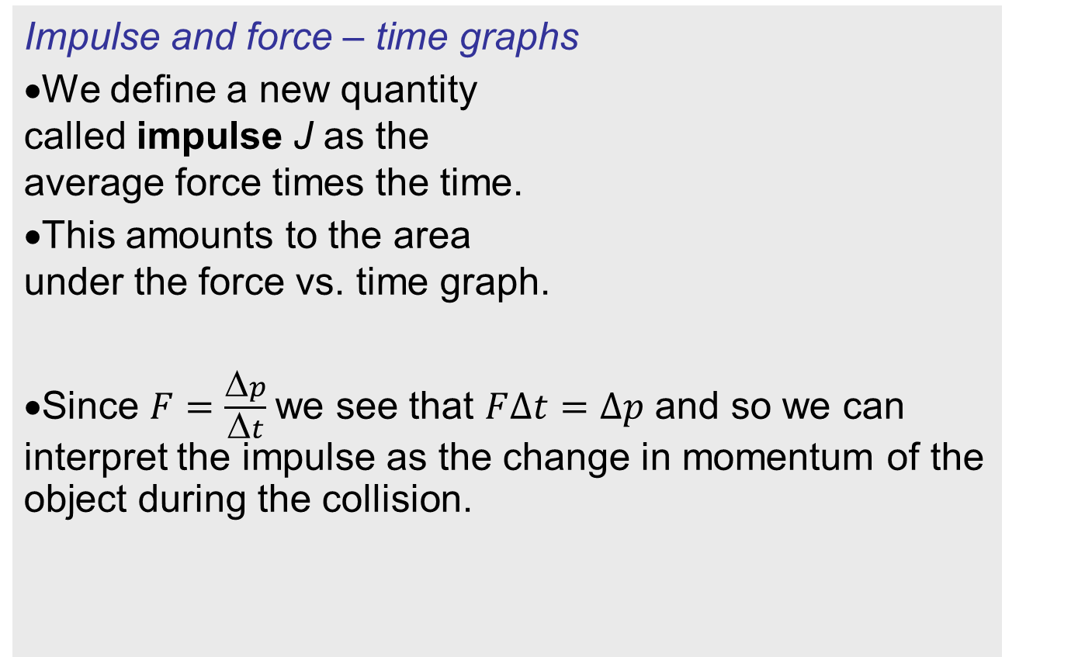
Topic 2: Mechanics
2.4 – Momentum and impulse
Impulse and force – time graphs
•We define a new quantity called impulse J as the average force times the time.
•This amounts to the area under the force vs. time graph.
•Since $F=\frac{Δp}{Δt}$we see that $F∆t=∆p$ and so we can interpret the impulse as the change in momentum of the object during the collision.
Force
F
t
∆t
Force
t
$J=F∆t$ area under F vs. t graph
impulse
$J=F∆t=∆p$ = area under F vs. t graph
impulse
Notes:
© 2006 By Timothy K. Lund

Slide 17
Topic 2: Mechanics
2.4 – Momentum and impulse
Impulse and force – time graphs
•It is well to point out here that during a collision there are two objects interacting with one another.
•Because of Newton’s third law, the forces are equal but opposite so that F = - F.
•Thus for one object, the area (impulse or momentum change) is positive, while for the other object the area (impulse or momentum change) is negative.
J = F ∆t = Δp = area under F vs. t graph
impulse
F
t
F
FYI
•Thus impulse can be positive or negative.
Notes:
© 2006 By Timothy K. Lund

Slide 18
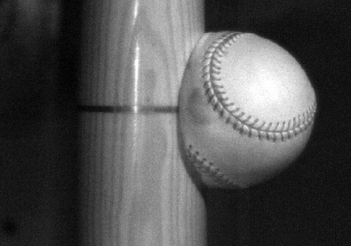


Topic 2: Mechanics
2.4 – Momentum and impulse
Impulse and force – time graphs
EXAMPLE: A 0.140-kg baseball comes in at 40.0 m/s, strikes the bat, and goes back out at 50.0 m/s. If the collision lasts 1.20 ms (a typical value), find the impulse imparted to the ball from the bat during the collision.
SOLUTION:
•We can use J = Δp:
J = p_{f} – p₀
= 7 – (- 5.6)
= 12.6 Ns.
v₀ = -40 m s⁻¹
p₀ = -40( 0.14 )
Before
p₀ = -5.6 kg m s⁻¹
v_{f} = +50 m/s
p_{f} = +50( 0.14 )
After
p_{f} = +7 kg m s⁻¹
FYI •The units for impulse can also be kg m s⁻¹.
Notes:
© 2006 By Timothy K. Lund

Slide 19
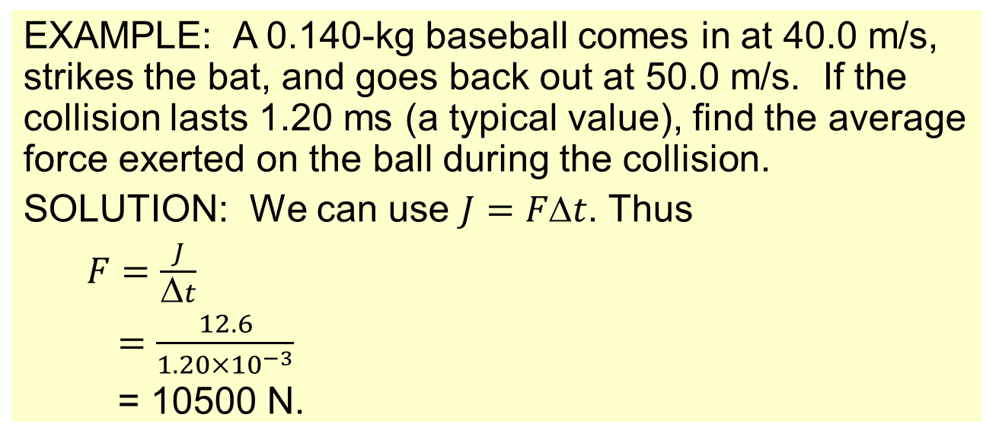
Topic 2: Mechanics
2.4 – Momentum and impulse
Impulse and force – time graphs
EXAMPLE: A 0.140-kg baseball comes in at 40.0 m/s, strikes the bat, and goes back out at 50.0 m/s. If the collision lasts 1.20 ms (a typical value), find the average force exerted on the ball during the collision.
SOLUTION: We can use $J=Ft$. Thus
$F=\frac{J}{Δt}$
$=\frac{12.6}{1.20×{10}^{−3}}$
= 10500 N.
F_{max}
F
FYI
F_{max} is even greater than F!
Notes:
© 2006 By Timothy K. Lund

Slide 20

Topic 2: Mechanics
2.4 – Momentum and impulse
Sketching and interpreting force – time graphs
J = F ∆t = Δp = area under F vs. t graph
impulse
PRACTICE: A bat striking a ball imparts a force to it as shown in the graph. Find the impulse.
SOLUTION:
Break the graph into simple areas of rectangles and triangles.
A₁ = $\frac{1}{2}$(3)(9) = 13.5 N s
A₂ = (4)(9) = 36 N s
A₃ = $\frac{1}{2}$(3)(9) = 13.5 N s
A_{tot} = A₁ + A₂ + A₃
A_{tot} = 13.5 + 36 + 13.5 = 63 N s.
9
6
Force F / n
3
0
0
5
10
Time t / s
Notes:
© 2006 By Timothy K. Lund

Slide 21
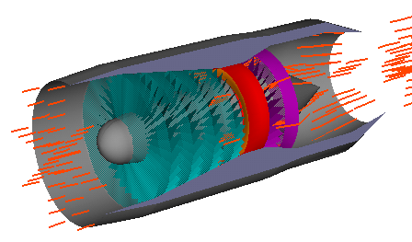
Topic 2: Mechanics
2.4 – Momentum and impulse
Impulse and force – time graphs
EXAMPLE:
How does a jet engine produce thrust?
SOLUTION:
•The jet engine sucks in air (at about the speed that the plane is flying through the air), heats it up, and expels it at a greater velocity.
•The momentum of the air changes since its velocity does, and hence an impulse has been imparted to it by the engine.
•The engine feels an equal and opposite impulse.
•Hence the engine creates a thrust.
T
v
u
Notes:
21
© 2006 By Timothy K. Lund

Slide 22

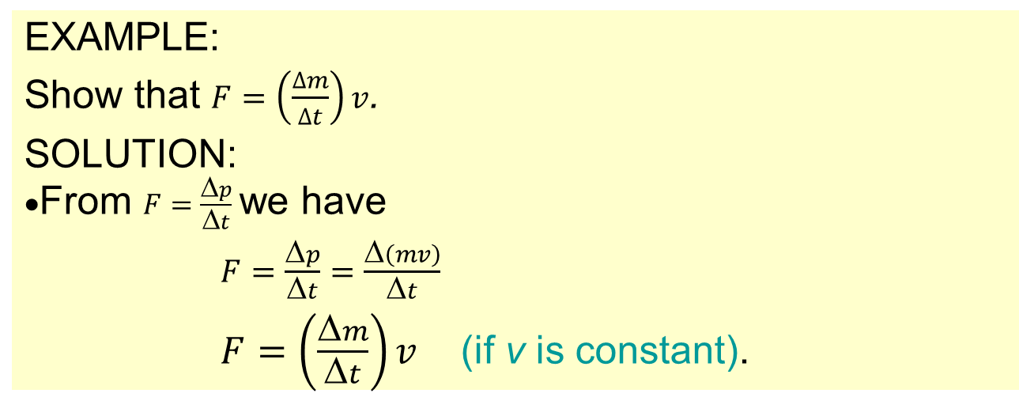
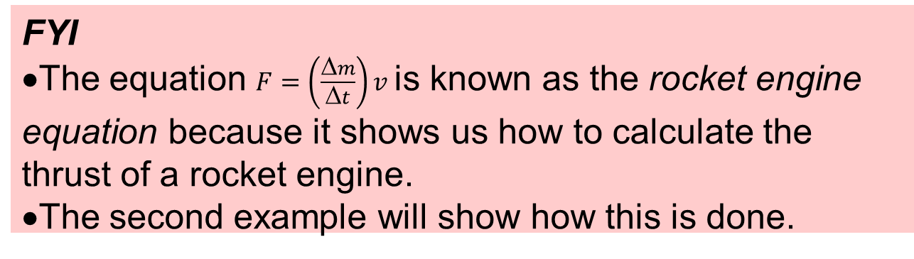
Topic 2: Mechanics
2.4 – Momentum and impulse
•This is a 2-stage rocket.
•The orange tanks hold fuel, and the blue tanks hold oxidizer.
•The oxidizer is needed so that the rocket works without air.
Impulse and force – time graphs
EXAMPLE:
Show that $F=\left(\frac{∆m}{∆t}\right)v$.
SOLUTION:
•From $F=\frac{Δp}{Δt}$we have
$F=\frac{Δp}{Δt}=\frac{Δ\left(mv\right)}{Δt}$
$F=\left(\frac{Δm}{Δt}\right)v$(if v is constant).
FYI
•The equation $F=\left(\frac{Δm}{Δt}\right)v$is known as the rocket engine equation because it shows us how to calculate the thrust of a rocket engine.
•The second example will show how this is done.
Notes:
22
© 2006 By Timothy K. Lund

Slide 23
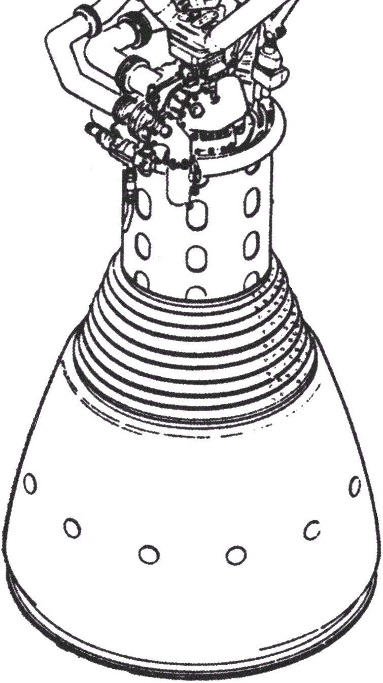
Topic 2: Mechanics
2.4 – Momentum and impulse
Impulse and force – time graphs
T
EXAMPLE:
What is the purpose of the rocket nozzle?
SOLUTION:
•In the combustion chamber the gas particles have random directions.
•The shape of the nozzle is such that the particles in the sphere of combustion are deflected in such a way that they all come out antiparallel to the rocket.
•This maximizes the impulse on the gases.
•The rocket feels an equal and opposite (maximized) impulse, creating a maximized thrust.
Notes:
23
© 2006 By Timothy K. Lund

Slide 24
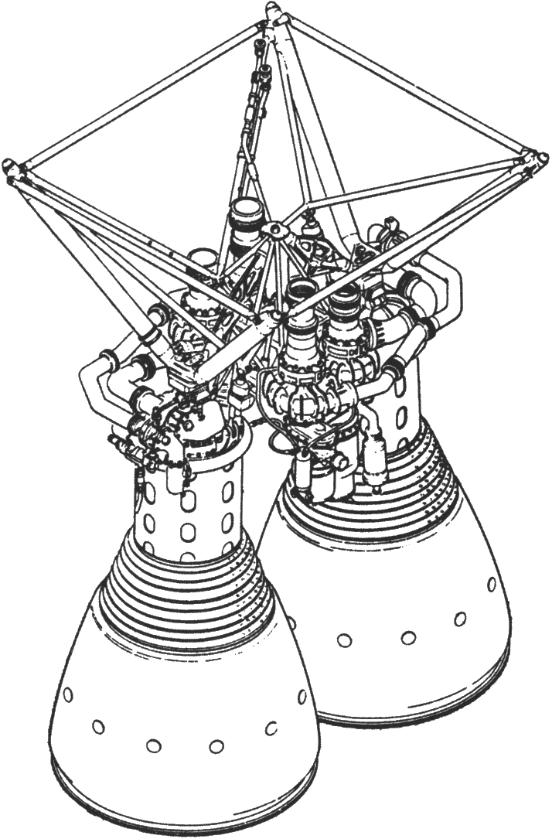

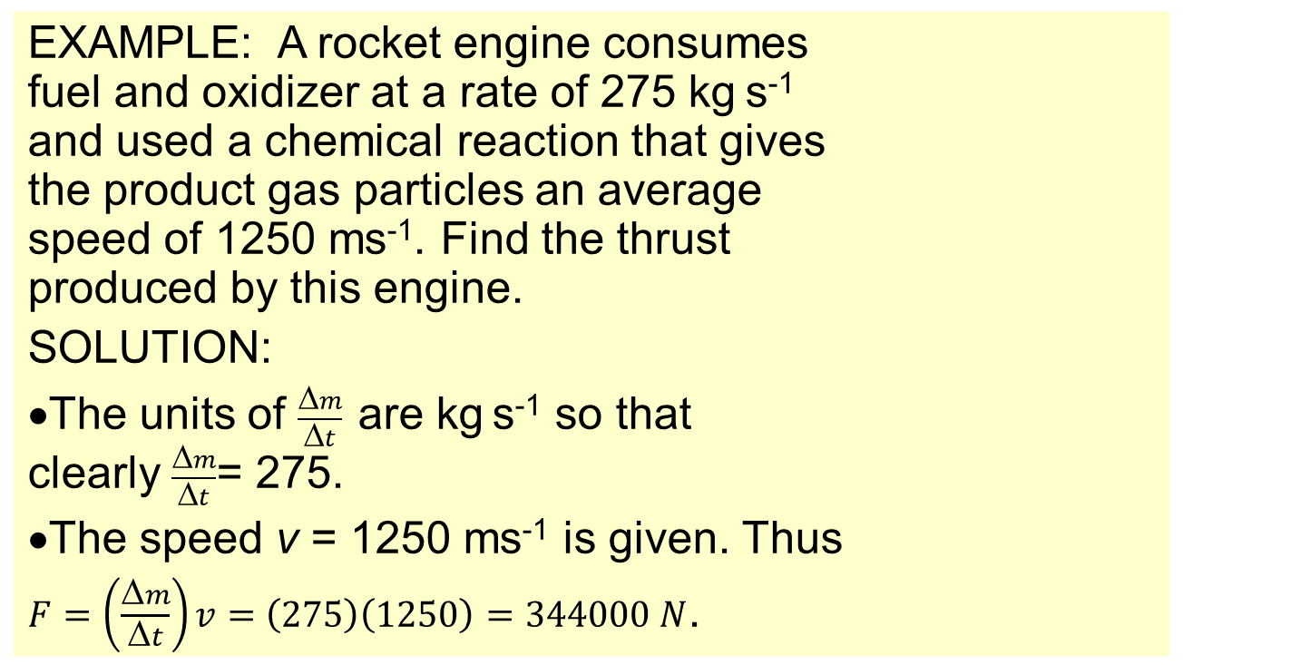
Topic 2: Mechanics
2.4 – Momentum and impulse
Impulse and force – time graphs
$$F=\left(\frac{Δm}{Δt}\right)v$$
rocket engine equation
EXAMPLE: A rocket engine consumes fuel and oxidizer at a rate of 275 kg s⁻¹ and used a chemical reaction that gives the product gas particles an average speed of 1250 ms⁻¹. Find the thrust produced by this engine.
SOLUTION:
•The units of $\frac{Δm}{Δt}$are kg s⁻¹ so that clearly $\frac{Δm}{Δt}$= 275.
•The speed v = 1250 ms⁻¹ is given. Thus
$F=\left(\frac{Δm}{Δt}\right)v=\left(275\right)\left(1250\right)=344000 N$.
Notes:
24
© 2006 By Timothy K. Lund

Slide 25


Topic 2: Mechanics
2.4 – Momentum and impulse
Conservation of linear momentum
•Recall Newton’s second law (p-form):
•If the net force acting on an object is zero, we have
$Fnet=\frac{Δp}{Δt}$
$0=\frac{Δp}{Δt}$
$0 = p$
•In words, if the net force is zero, then the momentum does not change – p is constant.
$$Fnet=\frac{Δp}{Δt}$$
Newton’s second law (p-form)
conservation of linear momentum
If F_{net} = 0 then p = CONST
FYI •If during a process a physical quantity does not change, that quantity is said to be conserved.
Notes:
© 2006 By Timothy K. Lund

Slide 26
Topic 2: Mechanics
2.4 – Momentum and impulse
The internal forces cancel
Conservation of linear momentum
•Recall that a system is a collection of more than one body, mutually interacting with each other – for example, colliding billiard balls:
•Note that F_{net} = ΣF_{external} + ΣF_{internal}.
•But Newton’s third law guarantees that ΣF_{internal} = 0.
•Thus we can refine the conservation of momentum:
If F_{ext} = 0 then p = CONST
conservation of linear momentum
Notes:
© 2006 By Timothy K. Lund

Slide 27



Topic 2: Mechanics
2.4 – Momentum and impulse
Conservation of linear momentum
If F_{ext} = 0 then p = CONST
conservation of linear momentum
EXAMPLE: A 2500-kg gondola car traveling at 3.0 ms⁻¹ has 1500-kg of sand dropped into it as it travels by. Find the initial momentum of the system.
SOLUTION: The system consists of sand and car:
p_{0,car} = m_{car}v_{0,car} = 2500(3) = 7500 kgms⁻¹.
p_{0,sand} = m_{sand}v_{0,sand} = 1500(0) = 0 kgms⁻¹.
p₀ = p_{0,car} + p_{0,sand} = 0 + 7500 kgms⁻¹ = 7500 kgms⁻¹.
Notes:
© 2006 By Timothy K. Lund

Slide 28
Topic 2: Mechanics
2.4 – Momentum and impulse
Conservation of linear momentum
If F_{ext} = 0 then p = CONST
conservation of linear momentum
EXAMPLE: A 2500-kg gondola car traveling at 3.0 ms⁻¹ has 1500-kg of sand dropped into it as it travels by. Find the final speed of the system.
SOLUTION: The initial and final momentums are equal:
p₀ = 7500 kgms⁻¹ = p_{f}.
p_{f} = (m_{sand} + m_{car}) v_{f} = (2500 + 1500) v_{f} = 4000 v_{f}.
7500 = 4000 v_{f} → v_{f} = 1.9 ms⁻¹.
Notes:
28
© 2006 By Timothy K. Lund

Slide 29
Topic 2: Mechanics
2.4 – Momentum and impulse
Conservation of linear momentum
If F_{ext} = 0 then p = CONST
conservation of linear momentum
EXAMPLE: A 12-kg block of ice is struck by a hammer so that it breaks into two pieces. The 4.0-kg piece travels travels at +16 m s⁻¹ in the x-direction. What is the velocity of the other piece?
SOLUTION: Make before/after sketches!
The initial momentum of the two is 0.
From p = CONST we have p₀ = p_{f}.
Since p = mv, we see that
(8 + 4)(0) = 8v + 4(16) → v = -8.0 m s⁻¹.
8
4
v
8
4
16
Notes:
© 2006 By Timothy K. Lund

Slide 30

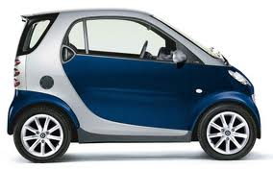

Topic 2: Mechanics
2.4 – Momentum and impulse
before
after
25
0
v_{f}
730
1800
730 +1800
Conservation of linear momentum
If F_{ext} = 0 then p = CONST
conservation of linear momentum
EXAMPLE: A 730-kg Smart Car traveling at 25 m s⁻¹ (x-dir) collides with a stationary 1800-kg Dodge Charger. The two vehicles stick together. Find their velocity immediately after the collision.
SOLUTION: Make sketches!
p₀ = p_{f} so that (730)(25) + 1800(0) = (730 + 1800)v_{f}.
18250 = 2530v_{f} → v_{f} = $\frac{18250}{2530}$ = 7.2 m s⁻¹.
Notes:
© 2006 By Timothy K. Lund

Slide 31

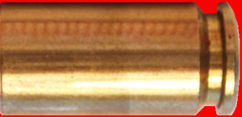

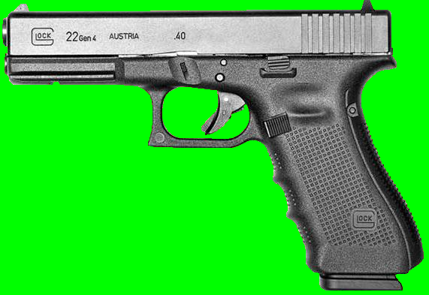


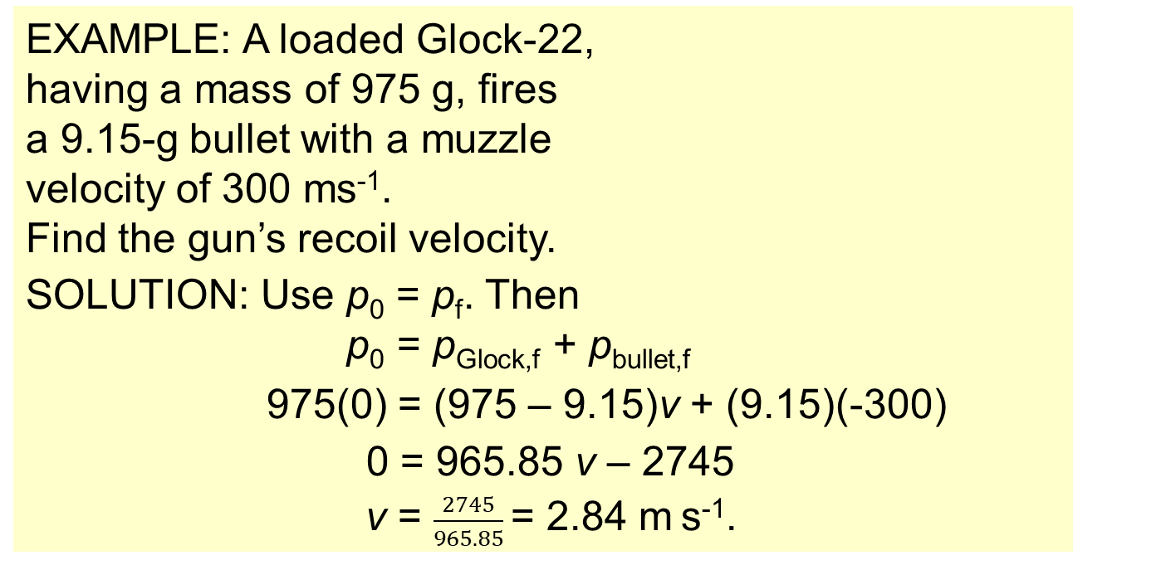
Topic 2: Mechanics
2.4 – Momentum and impulse
Conservation of linear momentum
If F_{ext} = 0 then p = CONST
conservation of linear momentum
EXAMPLE: A loaded Glock-22, having a mass of 975 g, fires a 9.15-g bullet with a muzzle velocity of 300 ms⁻¹.
Find the gun’s recoil velocity.
SOLUTION: Use p₀ = p_{f}. Then
p₀ = p_{Glock,f} + p_{bullet,f}
975(0) = (975 – 9.15)v + (9.15)(-300)
0 = 965.85 v – 2745
v = $\frac{2745}{965.85}$= 2.84 m s⁻¹.
Notes:
31
© 2006 By Timothy K. Lund

Slide 32
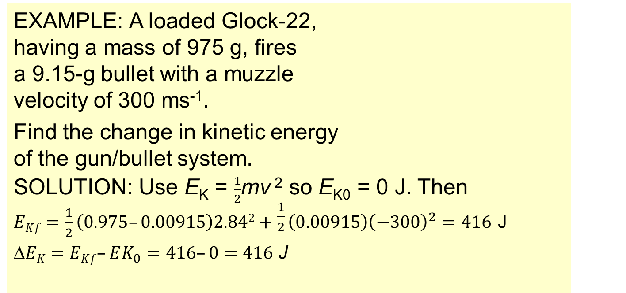
Topic 2: Mechanics
2.4 – Momentum and impulse
Conservation of linear momentum
If F_{ext} = 0 then p = CONST
conservation of linear momentum
EXAMPLE: A loaded Glock-22, having a mass of 975 g, fires a 9.15-g bullet with a muzzle velocity of 300 ms⁻¹.
Find the change in kinetic energy of the gun/bullet system.
SOLUTION: Use E_{K} = $\frac{1}{2}$mv ² so E_{K0} = 0 J. Then
$EKf=\frac{1}{2}\left(0.975–0.00915\right)2.842+\frac{1}{2}\left(0.00915\right){\left(−300\right)}^{2}=416$ J
$EK=EKf–EK_{0}=416–0=416$ J
Notes:
32
© 2006 By Timothy K. Lund

Slide 33
Topic 2: Mechanics
2.4 – Momentum and impulse
Comparing elastic collisions and inelastic collisions
•In an elastic collision, kinetic energy is conserved (it does not change). Thus E_{K,f} = E_{K,0}.
EXAMPLE:
Two billiard balls colliding in such a way that the speeds of the balls in the system remain unchanged.
•The red ball has the same speed as the white ball…
•Both balls have same speeds both before and after…
Notes:
© 2006 By Timothy K. Lund

Slide 34
Topic 2: Mechanics
2.4 – Momentum and impulse
Comparing elastic collisions and inelastic collisions
•In an inelastic collision, kinetic energy is not conserved (it does change). Thus E_{K,f} ≠ E_{K,0}.
EXAMPLE:
A baseball and a hard wall colliding in such a way that the speed of the ball changes.
Notes:
© 2006 By Timothy K. Lund

Slide 35
Topic 2: Mechanics
2.4 – Momentum and impulse
Comparing elastic collisions and inelastic collisions
•In a completely inelastic collision the colliding bodies stick together and end up with the same velocities, but different from the originals. E_{K,f} ≠ E_{K,0}.
EXAMPLE:
Two objects colliding and sticking together.
•The train cars hitch and move as one body…
•The cars collide and move (at first) as one body…
u₁
v
u₂
v
Notes:
© 2006 By Timothy K. Lund

Slide 36

Topic 2: Mechanics
2.4 – Momentum and impulse
Comparing elastic collisions and inelastic collisions
• An explosion is similar to a completely inelastic collision in that the bodies were originally stuck together and began with the same velocities. E_{K,f} ≠ E_{K,0}.
EXAMPLE:
Objects at rest suddenly separating into two pieces.
•A block of ice broken in two by a hammer stroke…
•A bullet leaving a gun
Notes:
© 2006 By Timothy K. Lund

Slide 37
Topic 2: Mechanics
2.4 – Momentum and impulse
Quantitatively analysing inelastic collisions
If F_{ext} = 0 then p = CONST
conservation of linear momentum
EXAMPLE: Two train cars having equal masses of 750 kg and velocities u₁ = 10. m s⁻¹ and u₂ = 5.0 m s⁻¹ collide and hitch together. What is their final speed?
SOLUTION: Use momentum conservation p₀ = p_{f}. Then
p_{1,0} + p_{2,0} = p_{1,f} + p_{2,f}
mu₁ + mu₂ = mv + mv
m(u₁ + u₂) = 2mv
10 + 5 = 2v → v = 7.5 m s⁻¹.
u₁
v
u₂
v
Notes:
© 2006 By Timothy K. Lund

Slide 38
Topic 2: Mechanics
2.4 – Momentum and impulse
Quantitatively analysing inelastic collisions
If F_{ext} = 0 then p = CONST
conservation of linear momentum
EXAMPLE: Two train cars having equal masses of 750 kg and velocities u₁ = 10. m s⁻¹ and u₂ = 5.0 m s⁻¹ collide and hitch together. Find the change in kinetic energy.
SOLUTION: Use E_{K} = ½mv ². Then
E_{K,f} = ½(m + m) v ²
= ½(750 + 750) 7.5 ² = 42187.5 J.
E_{K,0} = ½(750) 10 ² + ½(750) 5 ² = 46875 J.
ΔE_{K} = E_{K,f} – E_{K,0} = 42187.5 – 46875 = - 4700 J.
u₁
v
u₂
v
Notes:
© 2006 By Timothy K. Lund

Slide 39
Topic 2: Mechanics
2.4 – Momentum and impulse
Quantitatively analysing inelastic collisions
If F_{ext} = 0 then p = CONST
conservation of linear momentum
EXAMPLE: Two train cars having equal masses of 750 kg and velocities u₁ = 10. m s⁻¹ and u₂ = 5.0 m s⁻¹ collide and hitch together. Determine the type of collision.
SOLUTION:
•Since E_{K,f} ≠ E_{K,0}, this is an inelastic collision.
•Since the two objects travel as one (they are stuck together) this is also a completely inelastic collision.
u₁
v
u₂
v
Notes:
© 2006 By Timothy K. Lund

Slide 40
Topic 2: Mechanics
2.4 – Momentum and impulse
Quantitatively analysing inelastic collisions
If F_{ext} = 0 then p = CONST
conservation of linear momentum
EXAMPLE: Two train cars having equal masses of 750 kg and velocities u₁ = 10. m s⁻¹ and u₂ = 5.0 m s⁻¹ collide and hitch together. Was mechanical energy conserved?
SOLUTION:
•Mechanical energy E = E_{K} + E_{P}.
•Since the potential energy remained constant and the kinetic energy decreased, the mechanical energy was not conserved.
u₁
v
u₂
v
Notes:
© 2006 By Timothy K. Lund

Slide 41
Topic 2: Mechanics
2.4 – Momentum and impulse
Quantitatively analysing inelastic collisions
If F_{ext} = 0 then p = CONST
conservation of linear momentum
EXAMPLE: Two train cars having equal masses of 750 kg and velocities u₁ = 10. m s⁻¹ and u₂ = 5.0 m s⁻¹ collide and hitch together. Was total energy conserved?
SOLUTION:
•Total energy is always conserved.
•The loss in mechanical energy is ΔE_{K} = - 4700 J.
•The energy lost is mostly converted to heat (there is some sound, and possibly light, but very little).
u₁
v
u₂
v
Notes:
© 2006 By Timothy K. Lund

Slide 42

Topic 2: Mechanics
2.4 – Momentum and impulse
Quantitatively analysing inelastic collisions
EXAMPLE: Suppose a .020-kg bullet traveling horizontally at 300. m/s strikes a 4.0-kg block of wood resting on a wood floor. How fast is the block/bullet combo moving immediately after collision?
SOLUTION:
•If we consider the bullet-block combo as our system, there are no external forces in the x-direction at collision. Thus p_{f} = p₀ so that
mv_{f} + MV_{f} = mv_{i} + MV_{i}
.02v + 4 v = (.02)(300) + 4(0)
4.02v = 6
v = 1.5 m/s
the bullet and the block move at the same speed after collision (completely inelastic)
Notes:
© 2006 By Timothy K. Lund

Slide 43
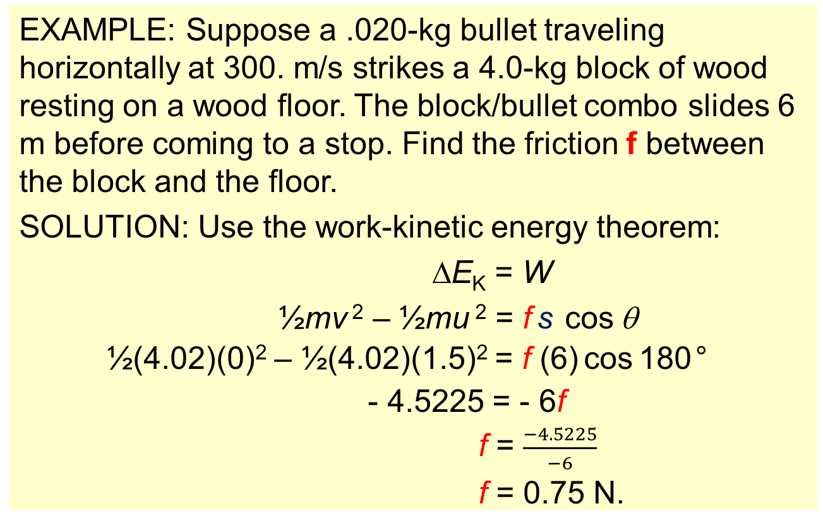
f
Topic 2: Mechanics
2.4 – Momentum and impulse
s
Quantitatively analysing inelastic collisions
EXAMPLE: Suppose a .020-kg bullet traveling horizontally at 300. m/s strikes a 4.0-kg block of wood resting on a wood floor. The block/bullet combo slides 6 m before coming to a stop. Find the friction f between the block and the floor.
SOLUTION: Use the work-kinetic energy theorem:
∆E_{K} = W
½mv ² – ½mu ² = f s cos θ
½(4.02)(0)² – ½(4.02)(1.5)² = f (6) cos 180°
- 4.5225 = - 6f
f = $\frac{−4.5225}{−6}$
f = 0.75 N.
Notes:
© 2006 By Timothy K. Lund

Slide 44
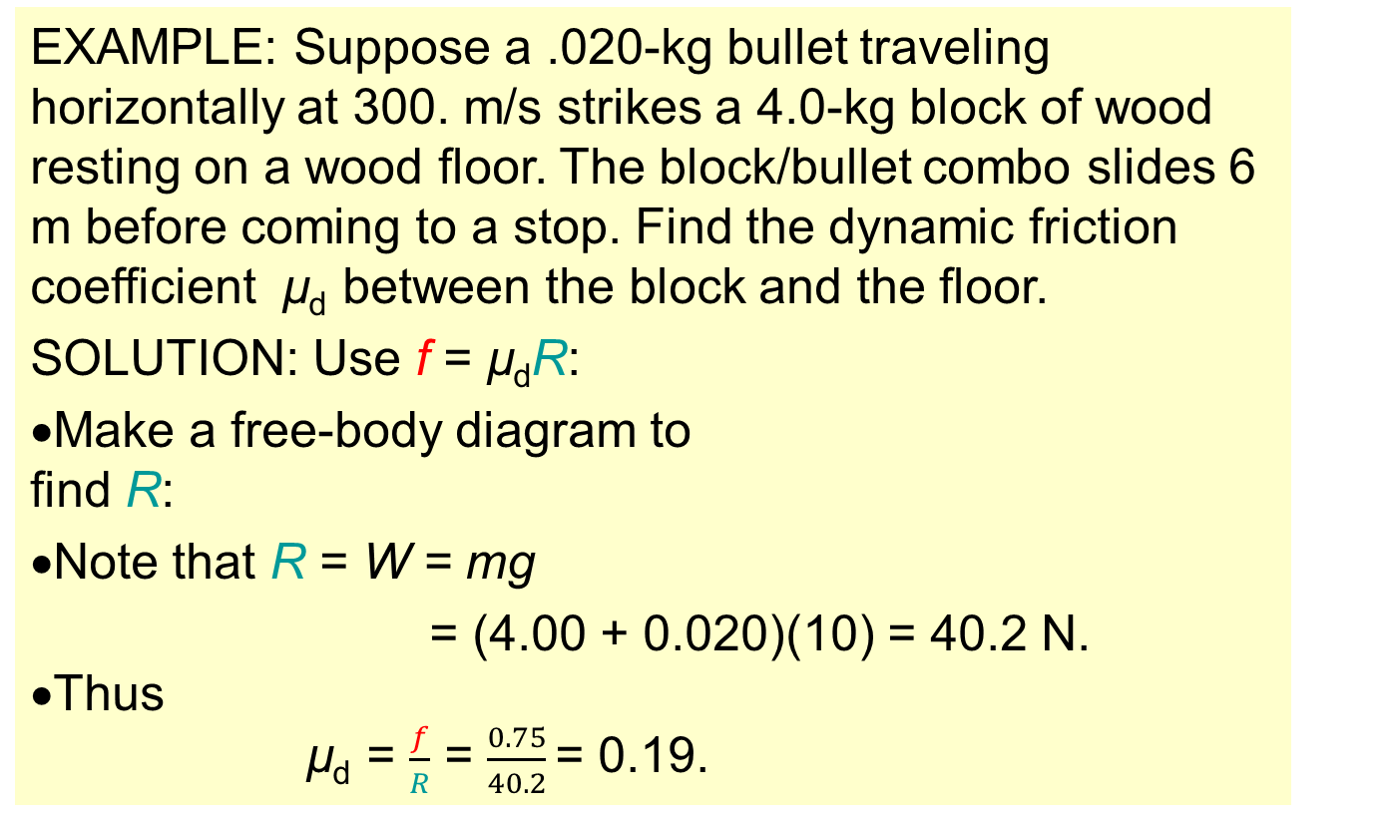
f
Topic 2: Mechanics
2.4 – Momentum and impulse
s
Quantitatively analysing inelastic collisions
EXAMPLE: Suppose a .020-kg bullet traveling horizontally at 300. m/s strikes a 4.0-kg block of wood resting on a wood floor. The block/bullet combo slides 6 m before coming to a stop. Find the dynamic friction coefficient µ_{d} between the block and the floor.
SOLUTION: Use f = µ_{d}R:
•Make a free-body diagram to find R:
•Note that R = W = mg
= (4.00 + 0.020)(10) = 40.2 N.
•Thus
µ_{d} = $\frac{f}{R}$ = $\frac{0.75}{40.2}$= 0.19.
R
f
W
Notes:
© 2006 By Timothy K. Lund

Slide 45
F
s
Topic 2: Mechanics
2.4 – Momentum and impulse
Quantitatively analysing inelastic collisions
EXAMPLE: Suppose a .020-kg bullet traveling horizontally at 300. m/s strikes a 4.0-kg block of wood resting on a wood floor. If the bullet penetrates .060 m of the block, find the average force F acting on it during its collision.
SOLUTION: Use the work-kinetic energy theorem on only the bullet:
∆E_{K} = W
½mv ² – ½mu ² = Fs cos θ
½(.02)(1.5)² – ½(.02)(300)² = - F (.06)
- 900 = - 0.06F
F = 15000 N
Notes:
© 2006 By Timothy K. Lund

