Slide 1
Topic 2: Mechanics
2.3 – Work, energy, and power
Essential idea: The fundamental concept of energy lays the basis upon which much of science is built.
Nature of science: Theories: Many phenomena can be fundamentally understood through application of the theory of conservation of energy. Over time, scientists have utilized this theory both to explain natural phenomena and, more importantly, to predict the outcome of previously unknown interactions. The concept of energy has evolved as a result of recognition of the relationship between mass and energy.
Notes:
© 2012 By Timothy K. Lund

Slide 2
Topic 2: Mechanics
2.3 – Work, energy, and power
Understandings:
• Kinetic energy
• Gravitational potential energy
• Elastic potential energy
• Work done as energy transfer
• Power as rate of energy transfer
• Principle of conservation of energy
• Efficiency
Notes:
© 2012 By Timothy K. Lund

Slide 3
Topic 2: Mechanics
2.3 – Work, energy, and power
Applications and skills:
• Discussing the conservation of total energy within energy transformations
• Sketching and interpreting force–distance graphs
• Determining work done including cases where a resistive force acts
• Solving problems involving power
• Quantitatively describing efficiency in energy transfers
Notes:
© 2012 By Timothy K. Lund

Slide 4
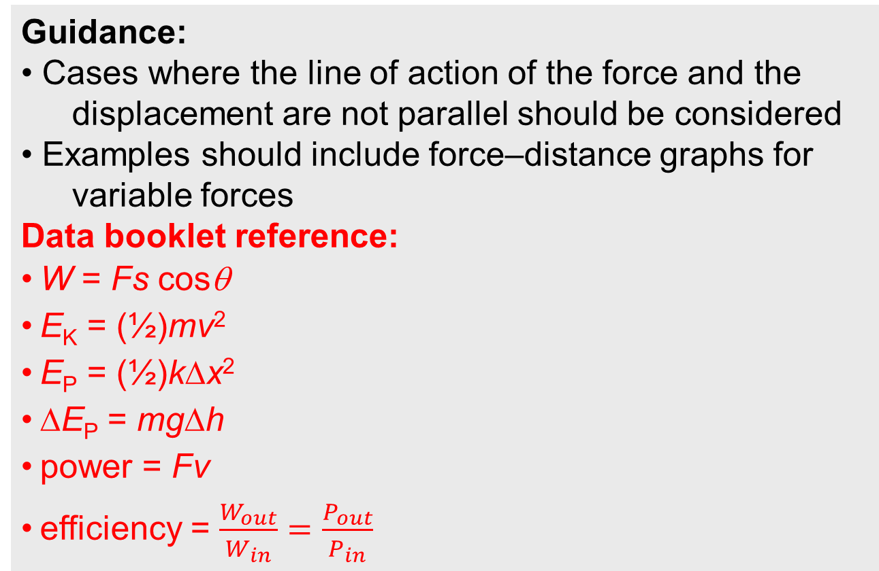
Topic 2: Mechanics
2.3 – Work, energy, and power
Guidance:
• Cases where the line of action of the force and the displacement are not parallel should be considered
• Examples should include force–distance graphs for variable forces
Data booklet reference:
• W = Fs cosθ
• E_{K} = (½)mv²
• E_{P} = (½)kΔx²
• ΔE_{P} = mgΔh
• power = Fv
• efficiency = $\frac{W_{out}}{W_{in}}=\frac{P_{out}}{P_{in}}$
Notes:
© 2012 By Timothy K. Lund

Slide 5
Topic 2: Mechanics
2.3 – Work, energy, and power
Theory of knowledge:
• To what extent is scientific knowledge based on fundamental concepts such as energy? What happens to scientific knowledge when our under-standing of such fundamental concepts changes or evolves?
Notes:
© 2012 By Timothy K. Lund

Slide 6
Topic 2: Mechanics
2.3 – Work, energy, and power
Utilization:
• Energy is also covered in other group 4 subjects (for example, see: Biology topics 2, 4 and 8; Chemistry topics 5, 15, and C; Sports, exercise and health science topics 3, A.2, C.3 and D.3; Environmental systems and societies topics 1, 2, and 3)
• Energy conversions are essential for electrical energy generation (see Physics topic 5 and sub-topic 8.1)
• Energy changes occurring in simple harmonic motion (see Physics sub-topics 4.1 and 9.1)
Notes:
© 2012 By Timothy K. Lund

Slide 7
Topic 2: Mechanics
2.3 – Work, energy, and power
Aims:
• Aim 6: experiments could include (but are not limited to): relationship of kinetic and gravitational potential energy for a falling mass; power and efficiency of mechanical objects; comparison of different situations involving elastic potential energy
• Aim 8: by linking this sub-topic with topic 8, students should be aware of the importance of efficiency and its impact of conserving the fuel used for energy production
Notes:
© 2012 By Timothy K. Lund

Slide 8

Topic 2: Mechanics
2.3 – Work, energy, and power
Determining work done by a force
EXAMPLE: Suppose we wish to find the speed of the ball when it reaches the bottom of the track. Discuss the problems in using free-body diagrams to find that final speed.
SOLUTION: Because the slope of the track is changing, so is the relative orientation of N and W.
Thus, the acceleration is not constant and we can’t use the kinematic equations.
Thus we can’t find v at the bottom of the track.
W
N
KEY
Notes:
© 2006 By Timothy K. Lund

Slide 9
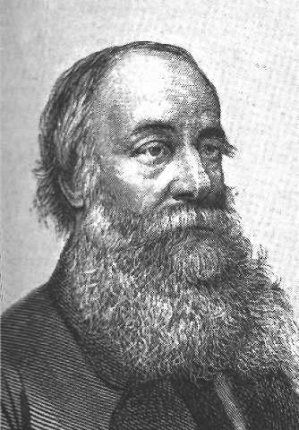
Topic 2: Mechanics
2.3 – Work, energy, and power
Determining work done by a force
•As we have stated, the principles of work and energy need to be mastered in order to solve this type of problem. We begin by defining work.
•In everyday use, work is usually thought of as effort expended by a body, you, on homework, or on a job.
•In physics, we define work W as force F times the displacement s, over which the force acts:
•The units of work are the units of force (Newtons) times distance (meters). For convenience, we call a Newton-meter (N m) a Joule (J) in honor of the physicist by that name.
W = Fs
work done by a constant force
Notes:
© 2006 By Timothy K. Lund

Slide 10

Topic 2: Mechanics
2.3 – Work, energy, and power
Determining work done by a force
W = Fs
work done by a constant force
EXAMPLE: Find the work done by the 25-Newton force F in displacing the box s = 15 meters.
SOLUTION:
W = Fs
W = (25 N)(15 m)
W = 380 N m = 380 J.
s
F
FYI •The units of (N m) are Joules (J). You can just keep them as (N m) if you prefer.
Notes:
© 2006 By Timothy K. Lund

Slide 11
Topic 2: Mechanics
2.3 – Work, energy, and power
Determining work done by a force
•If the force is not parallel to the displacement the formula for work has the minor correction
W = Fs
work done by a constant force
W = Fs cos θ
work done by a constant force not parallel to displacement
Where θ is the angle between F and s.
FYI
•If F and s are parallel, θ = 0° then cos 0° = ⁺1.
•If F and s are opposite direction, θ = 180° then cos 180° = -1.
F
s
parallel
F
s
antiparallel
Notes:
© 2006 By Timothy K. Lund

Slide 12
Topic 2: Mechanics
2.3 – Work, energy, and power
Determining work done by a force
W = Fs cos θ
work done by a constant force not parallel to displacement
Where θ is the angle between F and s.
PRACTICE: Find the work done by the force F = 25 N in displacing a box s = 15 m if the force and displacement are (a) parallel, (b) antiparallel and (c) at a 30° angle.
SOLUTION:
(a) W = Fs cos θ = (25)(15) cos 0° = 380 J.
(b) W = (25)(15) cos 180° = - 380 J.
(c) W = (25)(15) cos 30° = 320 J.
FYI •Work can be negative.
•F and the s are the magnitudes of F and s.
Notes:
© 2006 By Timothy K. Lund

Slide 13
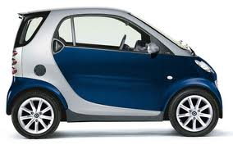
Topic 2: Mechanics
2.3 – Work, energy, and power
Determining work done by a force
EXAMPLE: Find the work done by the brakes in bringing a 730-kg Smart Car to a rest in 80. meters if its starting speed is 32 m/s.
SOLUTION: F and s are antiparallel so θ = 180°.
From s = 80 m and v² = u² + 2as we get
0² = 32² + 2a(80) so that a = -6.4 m s⁻².
Then F = ma = 730(-6.4) = - 4672 N |F| = +4672 N.
Finally, W = Fs cos θ
= (4672)(80) cos 180° = - 370000 J.
F
s
Notes:
© 2006 By Timothy K. Lund

Slide 14


Topic 2: Mechanics
2.3 – Work, energy, and power
FBD Crate
T
a = 0
Determining work done by a force
100
EXAMPLE: A pulley system is used to raise a 100-N crate 4 m as shown. Find the work done by the tension force T if the lift occurs at constant speed.
SOLUTION:
From the FBD since a = 0, T = 100 N.
From the statement of the problem, s = 4 m.
Since the displacement and the tension are parallel, θ = 0°.
Thus W = Ts cos θ = (100)(4) cos 0° = 400 J.
T
s
T
s
T
T
FYI
•Pulleys are used to redirect tension forces.
Notes:
© 2006 By Timothy K. Lund

Slide 15
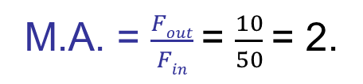
Topic 2: Mechanics
2.3 – Work, energy, and power
FBD Crate
T
T
a = 0
Determining work done by a force
100
EXAMPLE: A pulley system is used to raise a 100-N crate 4 m as shown. Find the work done by the tension force T if the lift occurs at constant speed.
SOLUTION:
From the FBD 2T = 100 so that T = 50 N
From the statement of the problem, s = 4 m.
Since the displacement and the tension are parallel, θ = 0°.
So W = T(2s) cos θ = (50)(2×4) cos 0° = 400 J.
T
T
2s
T
T
s
T
M.A. = $\frac{Fout}{Fin}$= $\frac{10}{50}$= 2.
FYI
•Pulleys are also used gain mechanical advantage.
Notes:
© 2006 By Timothy K. Lund

Slide 16
Topic 2: Mechanics
2.3 – Work, energy, and power
F
F
x
0
Sketching and interpreting force – distance graphs
•Consider a spring mounted to a wall as shown.
•If we pull the spring to the right, it resists in direct proportion to the distance it is stretched.
•If we push to the left, it resists compression similarly.
•It turns out that the spring force F is given by
•The minus sign gives the force the correct direction, namely, opposite the direction of the displacement s.
•Since F is in (N) and s is in (m), the units for the spring constant k are (N m⁻¹).
F = - ks
Hooke’s Law (the spring force)
Notes:
© 2006 By Timothy K. Lund

Slide 17
Topic 2: Mechanics
2.3 – Work, energy, and power
Sketching and interpreting force – distance graphs
F = - ks
Hooke’s Law (the spring force)
EXAMPLE: A force vs. displacement plot for a spring is shown. Find the value of the spring constant, and find the spring force if the displacement is -65 mm.
SOLUTION:
Pick any convenient point.
For this point F = -15 N and s = 30 mm = 0.030 m so that
F = -ks or -15 = -k(0.030)
k = 500 N m⁻¹.
F = -ks = -(500)(-65×10⁻³) = +32.5 N
F (N)
20
s(mm)
0
⁻20
⁻40
⁻20
0
20
40
Notes:
© 2006 By Timothy K. Lund

Slide 18
Topic 2: Mechanics
2.3 – Work, energy, and power
Sketching and interpreting force – distance graphs
F = - ks
Hooke’s Law (the spring force)
EXAMPLE: A force vs. displacement plot for a spring is shown. Find the work done by you if you displace the spring from 0 to 40 mm.
SOLUTION:
The graph shows the force F of the spring, not your force.
The force you apply will be opposite to the spring’s force according to F = +ks.
F = +ks is plotted in red.
F (N)
20
s(mm)
0
⁻20
⁻40
⁻20
0
20
40
Notes:
© 2006 By Timothy K. Lund

Slide 19
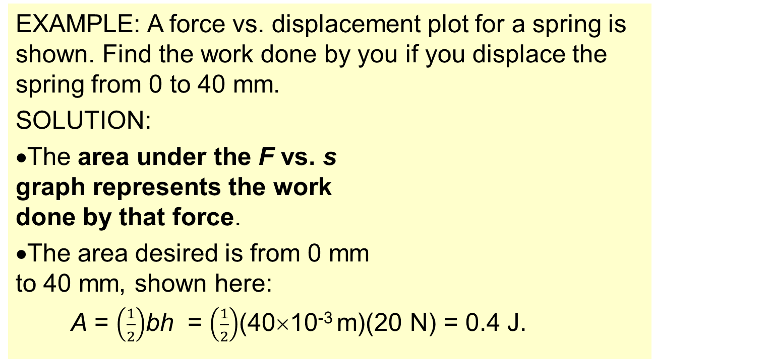
Topic 2: Mechanics
2.3 – Work, energy, and power
Sketching and interpreting force – distance graphs
F = - ks
Hooke’s Law (the spring force)
EXAMPLE: A force vs. displacement plot for a spring is shown. Find the work done by you if you displace the spring from 0 to 40 mm.
SOLUTION:
The area under the F vs. s graph represents the work done by that force.
The area desired is from 0 mm to 40 mm, shown here:
A = $\left(\frac{1}{2}\right)$bh = $\left(\frac{1}{2}\right)$(40×10⁻³ m)(20 N) = 0.4 J.
F (N)
20
s(mm)
0
⁻20
⁻40
⁻20
0
20
40
Notes:
© 2006 By Timothy K. Lund

Slide 20
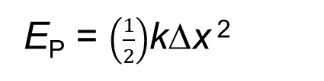
Topic 2: Mechanics
2.3 – Work, energy, and power
Elastic potential energy
E_{P} = $\left(\frac{1}{2}\right)$kΔx ²
Elastic potential energy
F
EXAMPLE: Show that the energy “stored” in a stretched or compressed spring is given by the above formula.
SOLUTION:
We equate the work W done in deforming a spring (having a spring constant k by a displacement Δx) to the energy E_{P} “stored” in the spring.
If the deformed spring is released, it will go back to its “relaxed” dimension, releasing all of its stored-up energy. This is why E_{P} is called potential energy.
s
Notes:
© 2006 By Timothy K. Lund

Slide 21
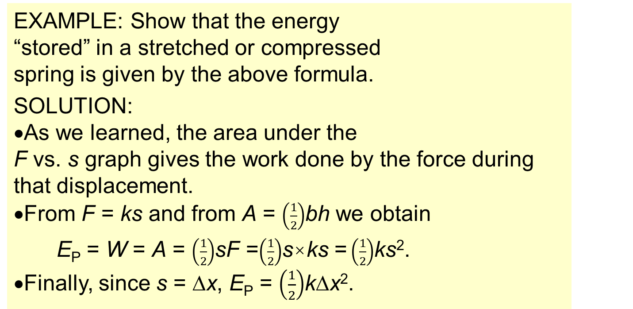
Topic 2: Mechanics
2.3 – Work, energy, and power
Elastic potential energy
E_{P} = $\left(\frac{1}{2}\right)$kΔx ²
Elastic potential energy
F
EXAMPLE: Show that the energy “stored” in a stretched or compressed spring is given by the above formula.
SOLUTION:
As we learned, the area under the F vs. s graph gives the work done by the force during that displacement.
From F = ks and from A = $\left(\frac{1}{2}\right)$bh we obtain
E_{P} = W = A = $\left(\frac{1}{2}\right)$sF =$\left(\frac{1}{2}\right)$s×ks =$\left(\frac{1}{2}\right)$ks².
•Finally, since s = Δx, E_{P} = $\left(\frac{1}{2}\right)$kΔx².
s
Notes:
© 2006 By Timothy K. Lund

Slide 22
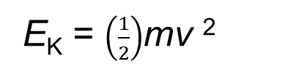
Topic 2: Mechanics
2.3 – Work, energy, and power
Kinetic energy
•Kinetic energy E_{K} is the energy of motion.
•The bigger the speed v, the bigger E_{K}.
•The bigger the mass m, the bigger E_{K}.
•The formula for E_{K}, justified later, is
•Looking at the units for E_{K} we have
kg(m/s)² = kg m² s⁻² = (kg m s⁻²)m.
•In the parentheses we have a mass times an acceleration which is a Newton.
•Thus E_{K} is measured in (N m), which are (J).
•Many books use K instead of E_{K} for kinetic energy.
E_{K} = $\left(\frac{1}{2}\right)$mv ²
kinetic energy
Notes:
© 2006 By Timothy K. Lund

Slide 23
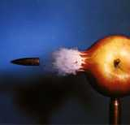
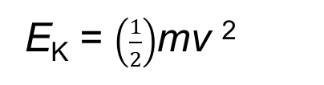
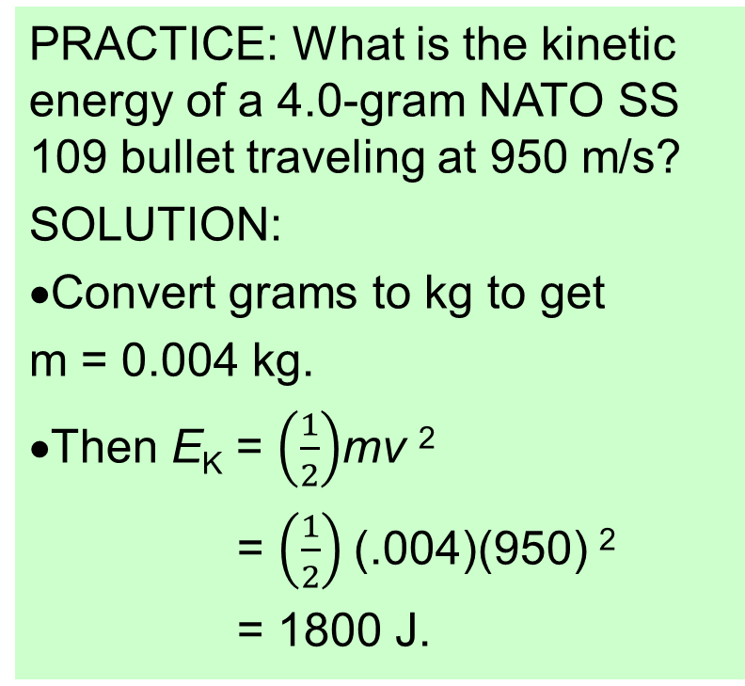
Topic 2: Mechanics
2.3 – Work, energy, and power
Kinetic energy
E_{K} = $\left(\frac{1}{2}\right)$mv ²
kinetic energy
PRACTICE: What is the kinetic energy of a 4.0-gram NATO SS 109 bullet traveling at 950 m/s?
SOLUTION:
Convert grams to kg to get
m = 0.004 kg.
Then E_{K} = $\left(\frac{1}{2}\right)$mv ²
= $\left(\frac{1}{2}\right)$(.004)(950) ²
= 1800 J.
Notes:
© 2006 By Timothy K. Lund

Slide 24
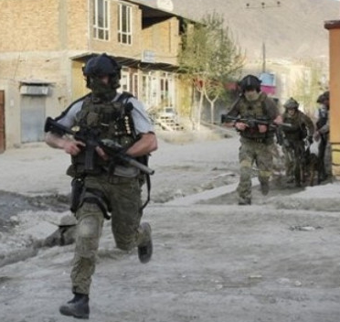
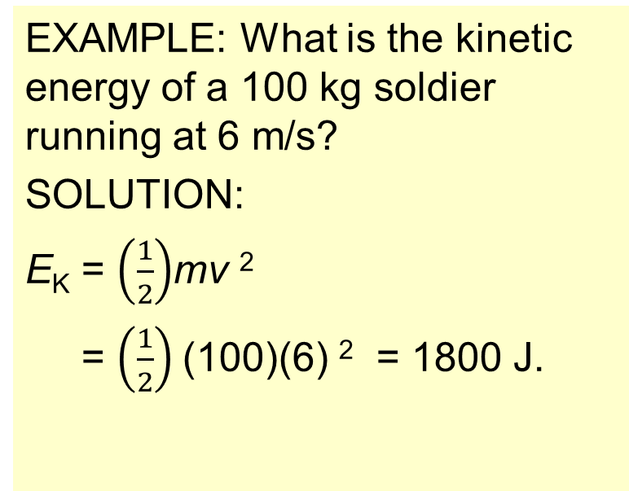
Topic 2: Mechanics
2.3 – Work, energy, and power
Kinetic energy
E_{K} = (1/2)mv ²
kinetic energy
EXAMPLE: What is the kinetic energy of a 100 kg soldier running at 6 m/s?
SOLUTION:
E_{K} = $\left(\frac{1}{2}\right)$mv ²
= $\left(\frac{1}{2}\right)$(100)(6) ² = 1800 J.
FYI
•Small and large objects can have the same E_{K}!
Notes:
© 2006 By Timothy K. Lund

Slide 25
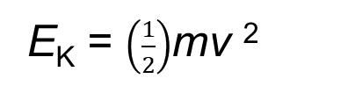

Topic 2: Mechanics
2.3 – Work, energy, and power
Work done as energy transfer
•It is no coincidence that work and kinetic energy have the same units. Observe the following derivation.
v² = u² + 2as
mv² = m(u² + 2as)
mv² = mu² + 2mas
mv² = mu² + 2Fs
$\left(\frac{1}{2}\right)$mv² = $\left(\frac{1}{2}\right)$mu² + Fs
E_{K,f} = E_{K,0} + W
E_{K,f} - E_{K,0} = W
∆E_{K} = W
W = Fs
work done by a constant force
E_{K} = $\left(\frac{1}{2}\right)$mv ²
kinetic energy
FYI
•This is called the Work-Kinetic Energy theorem.
•It is not in the Physics Data Booklet, but it is good to know how it is derived.
Notes:
© 2006 By Timothy K. Lund

Slide 26
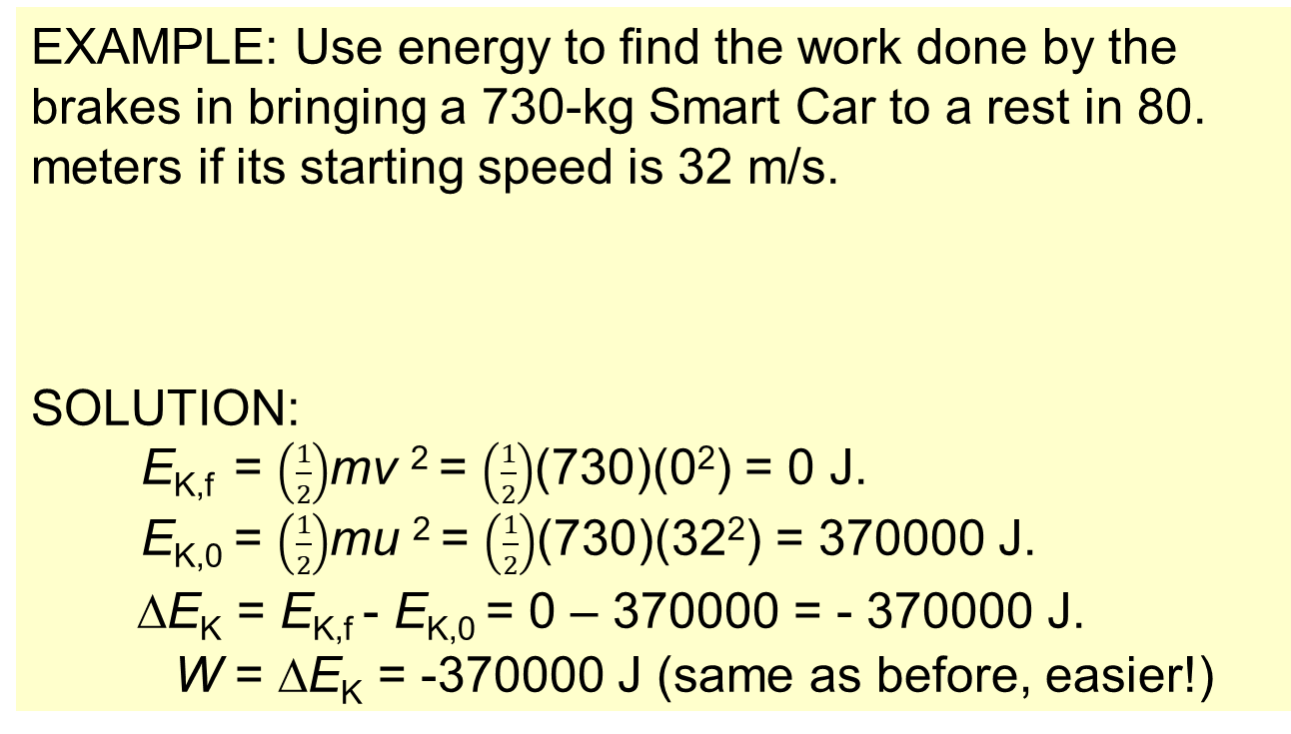
Topic 2: Mechanics
2.3 – Work, energy, and power
Work done as energy transfer
W = ∆E_{K}
work-kinetic energy theorem
EXAMPLE: Use energy to find the work done by the brakes in bringing a 730-kg Smart Car to a rest in 80. meters if its starting speed is 32 m/s.
SOLUTION:
E_{K,f} = $\left(\frac{1}{2}\right)$mv ² = $\left(\frac{1}{2}\right)$(730)(0²) = 0 J.
E_{K,0} = $\left(\frac{1}{2}\right)$mu ² = $\left(\frac{1}{2}\right)$(730)(32²) = 370000 J.
∆E_{K} = E_{K,f} - E_{K,0} = 0 – 370000 = - 370000 J.
W = ∆E_{K} = -370000 J (same as before, easier!)
F
s
Notes:
© 2006 By Timothy K. Lund

Slide 27

Topic 2: Mechanics
2.3 – Work, energy, and power
FBD Ball
F
a = 0
mg
Gravitational potential energy
•Consider a bowling ball resting on the floor: If we let go of it, it just stays put.
•If on the other hand we raise it to a height ∆h and then let it go, it will fall and speed up, gaining kinetic energy as it falls.
•Since the lift constitutes work against gravity (the weight of the ball) we have
W = Fs cos θ
W = mg∆h cos 0° = mg∆h.
•We call the energy due to the position of a weight gravitational potential energy.
∆E_{P} = mg∆h
gravitational potential energy change
Notes:
© 2006 By Timothy K. Lund

Slide 28
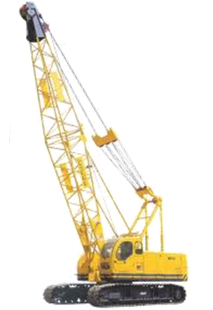
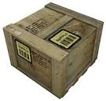
Topic 2: Mechanics
2.3 – Work, energy, and power
Gravitational potential energy
∆E_{P} = mg∆h
gravitational potential energy change
PRACTICE: Consider a crane which lifts a 2000-kg weight 18 m above its original resting place. What is the change in gravitational potential energy of the weight?
SOLUTION:
The change in gravitational potential energy is just
∆E_{P} = mg∆h = 2000(9.8)(18) = 350000 J.
FYI •Note that the units for ∆E_{P} are those of both work and kinetic energy.
Notes:
© 2006 By Timothy K. Lund

Slide 29
Topic 2: Mechanics
2.3 – Work, energy, and power
Work done as energy transfer
W = Fs
work done by a constant force
PRACTICE: Consider a crane which lifts a 2000-kg weight 18 m above its original resting place. How much work does the crane do?
SOLUTION:
The force F = mg = 2000(9.8) = 19600 N↑.
The displacement s = 18 m ↑.
Then W = Fs = 19600(18) = 350000 J.
FYI •Note that the work done by the crane is equal to the change in potential energy..
Notes:
© 2006 By Timothy K. Lund

Slide 30
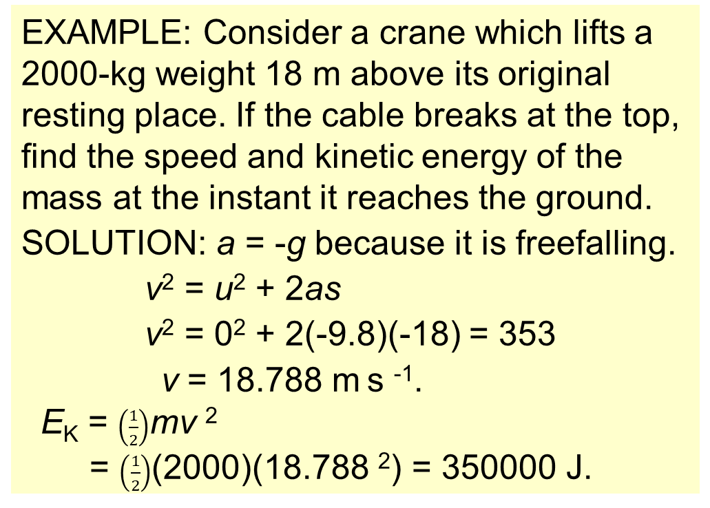
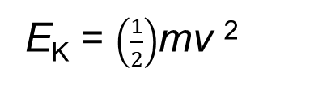
Topic 2: Mechanics
2.3 – Work, energy, and power
Principle of conservation of energy
E_{K} = $\left(\frac{1}{2}\right)$mv ²
kinetic energy
EXAMPLE: Consider a crane which lifts a 2000-kg weight 18 m above its original resting place. If the cable breaks at the top, find the speed and kinetic energy of the mass at the instant it reaches the ground.
SOLUTION: a = -g because it is freefalling.
v² = u² + 2as
v² = 0² + 2(-9.8)(-18) = 353
v = 18.788 m s ⁻¹.
E_{K} = $\left(\frac{1}{2}\right)$mv ²
= $\left(\frac{1}{2}\right)$(2000)(18.788 ²) = 350000 J.
Notes:
© 2006 By Timothy K. Lund

Slide 31
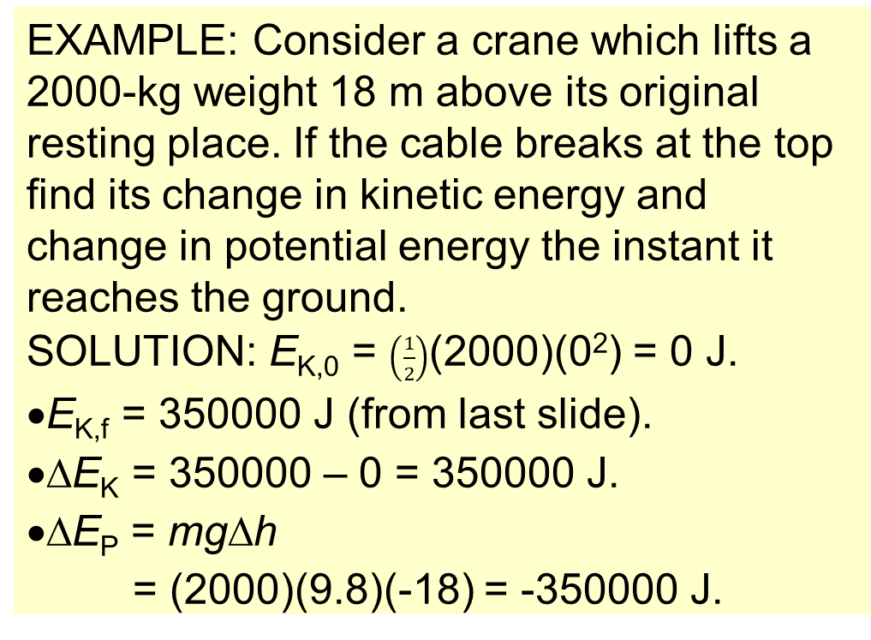
Topic 2: Mechanics
2.3 – Work, energy, and power
Principle of conservation of energy
∆E_{P} = mg∆h
gravitational potential energy change
EXAMPLE: Consider a crane which lifts a 2000-kg weight 18 m above its original resting place. If the cable breaks at the top find its change in kinetic energy and change in potential energy the instant it reaches the ground.
SOLUTION: E_{K,0} = $\left(\frac{1}{2}\right)$(2000)(0²) = 0 J.
•E_{K,f} = 350000 J (from last slide).
•∆E_{K} = 350000 – 0 = 350000 J.
•∆E_{P} = mg∆h
= (2000)(9.8)(-18) = -350000 J.
Notes:
© 2006 By Timothy K. Lund

Slide 32
Topic 2: Mechanics
2.3 – Work, energy, and power
Principle of conservation of energy
∆E_{P} = mg∆h
gravitational potential energy change
EXAMPLE: Consider a crane which lifts a 2000-kg weight 18 m above its original resting place. If the cable breaks at the top find the sum of the change in kinetic and the change in potential energies the instant it reaches the ground.
SOLUTION: From the previous slide
•∆E_{K} = 350000 J and
•∆E_{P} = -350000 J so that
∆E_{K} + ∆E_{P} = 350000 + ⁻ 350000 = 0.
•Hence ∆E_{K} + ∆E_{P} = 0 J.
Notes:
© 2006 By Timothy K. Lund

Slide 33
Topic 2: Mechanics
2.3 – Work, energy, and power
Discussing the conservation of total energy
•As demonstrated on the previous slide, if there is no friction or drag to remove energy from a system
•The above formula is known as the statement of the conservation of mechanical energy.
•Essentially, what it means is that if the kinetic energy changes (say it increases), then the potential energy changes (it will decrease) in such a way that the total energy change is zero!
•Another way to put it is “the total energy of a system never changes.”
∆E_{K} + ∆E_{P} = 0
conservation of energy
In the absence of friction and drag
Notes:
© 2006 By Timothy K. Lund

Slide 34
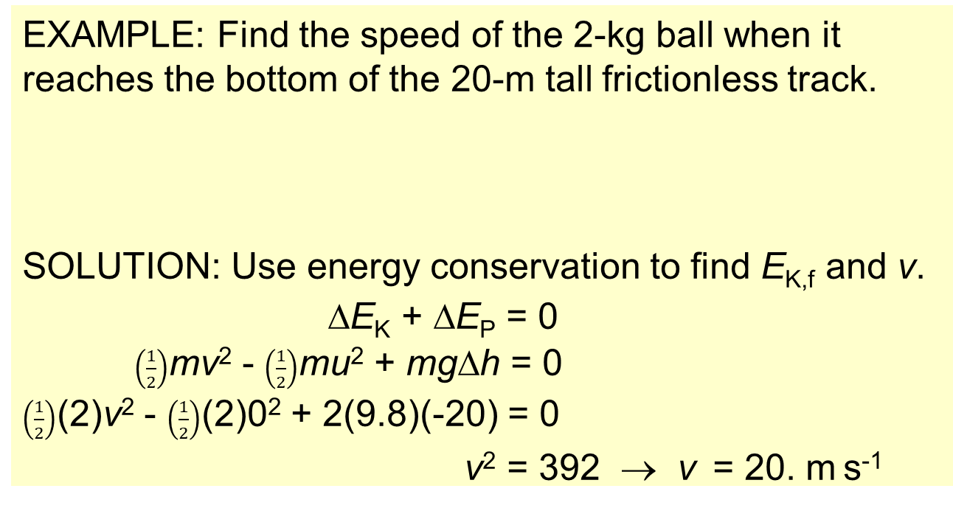
Topic 2: Mechanics
2.3 – Work, energy, and power
Discussing the conservation of total energy
∆E_{K} + ∆E_{P} = 0
conservation of energy
In the absence of friction and drag
EXAMPLE: Find the speed of the 2-kg ball when it reaches the bottom of the 20-m tall frictionless track.
SOLUTION: Use energy conservation to find E_{K,f} and v.
∆E_{K} + ∆E_{P} = 0
$\left(\frac{1}{2}\right)$mv² - $\left(\frac{1}{2}\right)$mu² + mg∆h = 0
$\left(\frac{1}{2}\right)$(2)v² - $\left(\frac{1}{2}\right)$(2)0² + 2(9.8)(-20) = 0
v² = 392 → v = 20. m s⁻¹
∆h
FYI •If friction is zero, m always cancels…
Notes:
© 2006 By Timothy K. Lund

Slide 35
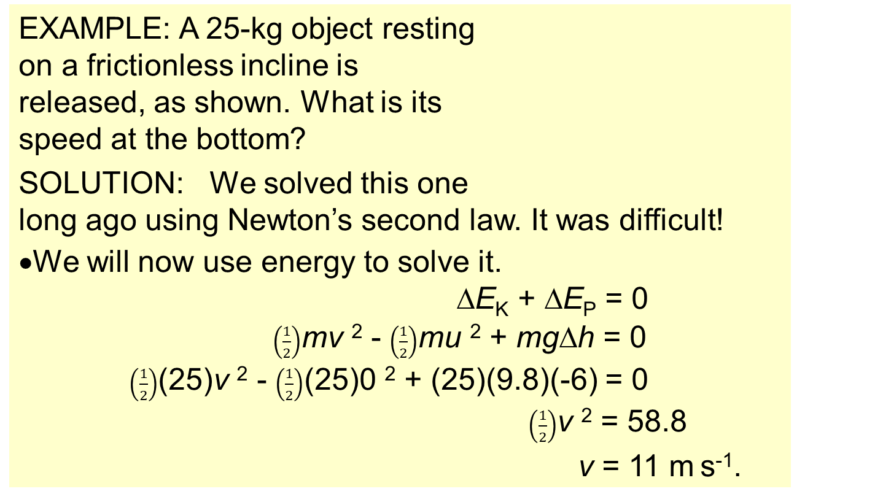
Topic 2: Mechanics
2.3 – Work, energy, and power
Discussing the conservation of total energy
EXAMPLE: A 25-kg object resting on a frictionless incline is released, as shown. What is its speed at the bottom?
SOLUTION: We solved this one long ago using Newton’s second law. It was difficult!
•We will now use energy to solve it.
∆E_{K} + ∆E_{P} = 0
$\left(\frac{1}{2}\right)$mv ² - $\left(\frac{1}{2}\right)$mu ² + mg∆h = 0
$\left(\frac{1}{2}\right)$(25)v ² - $\left(\frac{1}{2}\right)$(25)0 ² + (25)(9.8)(-6) = 0
$\left(\frac{1}{2}\right)$v ² = 58.8
v = 11 m s⁻¹.
u = 0
∆h
6.0 m
v = ?
30°
FYI •If friction and drag are zero, m always cancels…
Notes:
© 2006 By Timothy K. Lund

Slide 36
Topic 2: Mechanics
2.3 – Work, energy, and power
Discussing the conservation of total energy within energy transformations
•We have talked about kinetic energy (of motion).
•We have talked about potential energy (of position).
•We have chemical energy and nuclear energy.
•We have electrical energy and magnetic energy.
•We have sound energy and light energy.
•And we also have heat energy.
•In mechanics we only have to worry about the highlighted energy forms.
•We only worry about heat if there is friction or drag.
Notes:
© 2006 By Timothy K. Lund

Slide 37
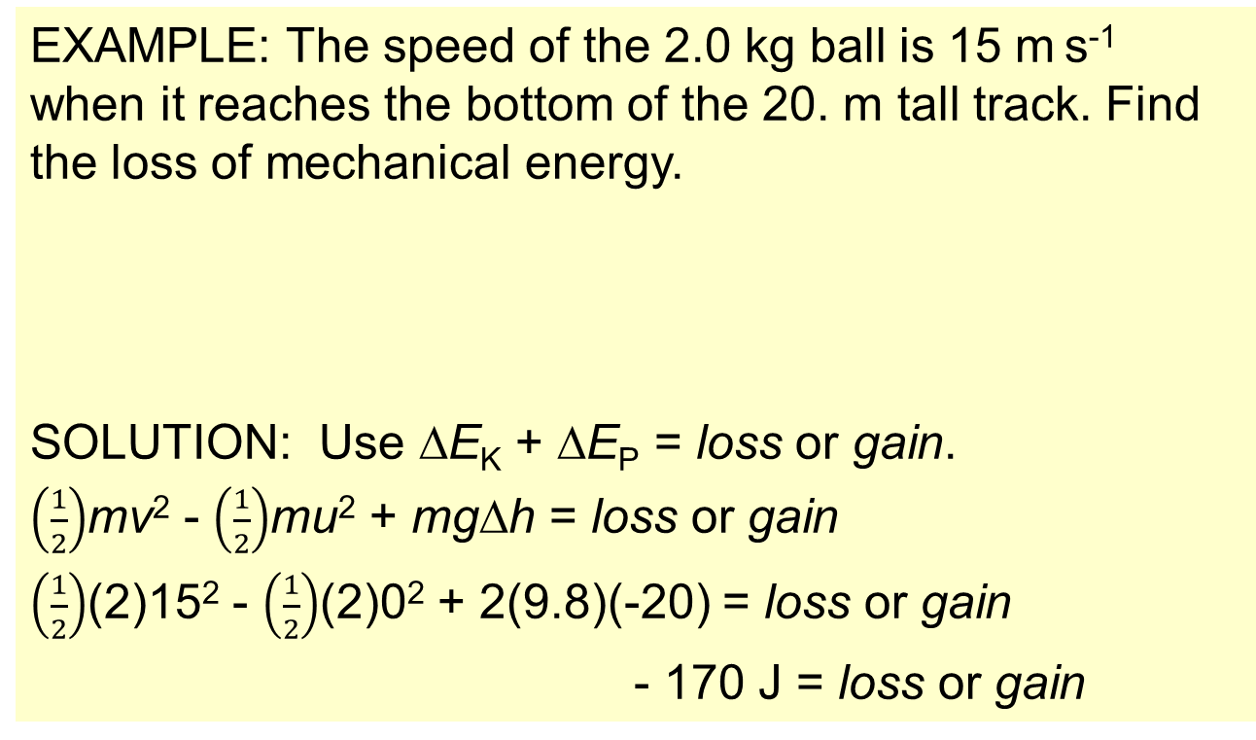
Topic 2: Mechanics
2.3 – Work, energy, and power
Discussing the conservation of total energy within energy transformations
EXAMPLE: The speed of the 2.0 kg ball is 15 m s⁻¹ when it reaches the bottom of the 20. m tall track. Find the loss of mechanical energy.
SOLUTION: Use ∆E_{K} + ∆E_{P} = loss or gain.
$\left(\frac{1}{2}\right)$mv² - $\left(\frac{1}{2}\right)$mu² + mg∆h = loss or gain
$\left(\frac{1}{2}\right)$(2)15² - $\left(\frac{1}{2}\right)$(2)0² + 2(9.8)(-20) = loss or gain
- 170 J = loss or gain
The system lost 170 J as drag and friction heat.
∆h
Notes:
© 2006 By Timothy K. Lund

Slide 38
Topic 2: Mechanics
2.3 – Work, energy, and power
Discussing the conservation of total energy within energy transformations
•Consider the pendulum to the right which is placed in position and held there.
•Let the green rectangle represent the potential energy of the system.
•Let the red rectangle represent the kinetic energy.
•Because there is no motion yet, there is no kinetic energy. But if we release it, the kinetic energy will grow as the potential energy diminishes.
•A continuous exchange between E_{K} and E_{P} occurs.
E_{K} + E_{P} = E_{T} = CONST
FYI •If the drag force is zero, E_{T} = CONST.
Notes:
© 2006 By Timothy K. Lund

Slide 39
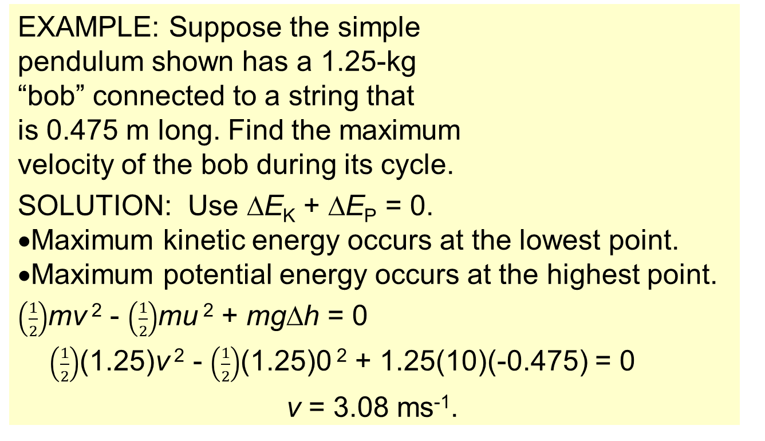
Topic 2: Mechanics
2.3 – Work, energy, and power
Discussing the conservation of total energy within energy transformations
E_{K} + E_{P} = E_{T} = CONST
EXAMPLE: Suppose the simple pendulum shown has a 1.25-kg “bob” connected to a string that is 0.475 m long. Find the maximum velocity of the bob during its cycle.
SOLUTION: Use ∆E_{K} + ∆E_{P} = 0.
•Maximum kinetic energy occurs at the lowest point.
•Maximum potential energy occurs at the highest point.
$\left(\frac{1}{2}\right)$mv ² - $\left(\frac{1}{2}\right)$mu ² + mg∆h = 0
$\left(\frac{1}{2}\right)$(1.25)v ² - $\left(\frac{1}{2}\right)$(1.25)0 ² + 1.25(10)(-0.475) = 0
v = 3.08 ms⁻¹.
FYI •Assume the drag force is zero.
Notes:
© 2006 By Timothy K. Lund

Slide 40
Topic 2: Mechanics
2.3 – Work, energy, and power
Discussing the conservation of total energy within energy transformations
•Consider the mass- spring system shown here. The mass is pulled to the right and held in place.
•Let the green rectangle represent the potential energy of the system.
•Let the red rectangle represent the kinetic energy of the system.
•A continuous exchange between E_{K} and E_{P} occurs.
•Note that the sum of E_{K} and E_{P} is constant.
E_{K} + E_{P} = E_{T} = CONST
x
FYI •If friction and drag are both zero, E_{T} = CONST.
Notes:
© 2006 By Timothy K. Lund

Slide 41
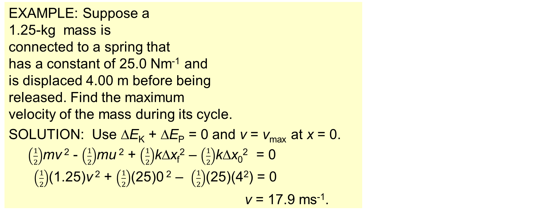
Topic 2: Mechanics
2.3 – Work, energy, and power
Discussing the conservation of total energy within energy transformations
E_{K} + E_{P} = E_{T} = CONST
EXAMPLE: Suppose a 1.25-kg mass is connected to a spring that has a constant of 25.0 Nm⁻¹ and is displaced 4.00 m before being released. Find the maximum velocity of the mass during its cycle.
SOLUTION: Use ∆E_{K} + ∆E_{P} = 0 and v = v_{max} at x = 0.
$\left(\frac{1}{2}\right)$mv ² - $\left(\frac{1}{2}\right)$mu ² + $\left(\frac{1}{2}\right)$k∆x_{f}² – $\left(\frac{1}{2}\right)$k∆x₀² = 0
$\left(\frac{1}{2}\right)$(1.25)v ² + $\left(\frac{1}{2}\right)$(25)0 ² – $\left(\frac{1}{2}\right)$(25)(4²) = 0
v = 17.9 ms⁻¹.
x
FYI •Assume the friction force is zero.
Notes:
© 2006 By Timothy K. Lund

Slide 42
Topic 2: Mechanics
2.3 – Work, energy, and power
Discussing the conservation of total energy within energy transformations
•If we plot both kinetic energy and potential energy vs. time for either system we would get the following graph:
E_{K} + E_{P} = E_{T} = CONST
Energy
time
x
Notes:
© 2006 By Timothy K. Lund

Slide 43



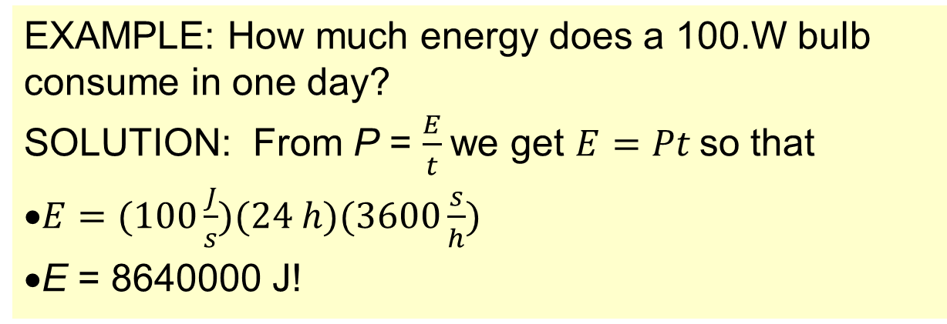

Topic 2: Mechanics
2.3 – Work, energy, and power
Power as rate of energy transfer
•Power is the rate of energy usage and so has the equation
•From the formula we see that power has the units of energy (J) per time (s) or (J s⁻¹) which are known as watts (W).
P = $\frac{E}{t}$
power
EXAMPLE: How much energy does a 100.W bulb consume in one day?
SOLUTION: From P = $\frac{E}{t}$we get $E=Pt$so that
$E=(100\frac{J}{s})(24 h)(3600\frac{s}{h})$
E = 8640000 J!
Notes:
© 2006 By Timothy K. Lund

Slide 44
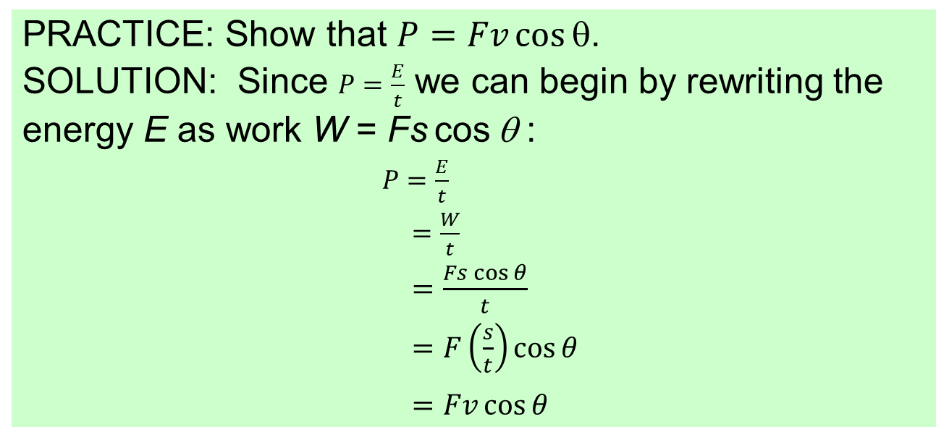
Topic 2: Mechanics
2.3 – Work, energy, and power
Power as rate of energy transfer
P = Fv cos θ
power
PRACTICE: Show that $P=Fv cos⁡$.
SOLUTION: Since $P=\frac{E}{t}$ we can begin by rewriting the energy E as work W = Fs cos θ :
$P=\frac{E}{t}$
$=\frac{W}{t}$
$=\frac{Fs\cos{θ}}{t}$
$=F\left(\frac{s}{t}\right)\cos{θ}$
$=Fv\cos{θ}$
FYI
•The Physics Data Booklet has only “P = Fv.”
Notes:
© 2006 By Timothy K. Lund

Slide 45
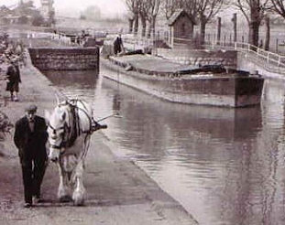
Topic 2: Mechanics
2.3 – Work, energy, and power
the last horse-drawn barge operated on the River Lea ...(1955)
Power as rate of energy transfer
P = Fv
power
EXAMPLE: Sam the horse, walking at 1.75 ms⁻¹, is drawing a barge having a drag force of 493 N along the River Lea as shown. The angle the draw rope makes with the velocity of the barge is 30°. Find the rate at which Sam is expending energy.
SOLUTION: Since energy rate is power, use
P = Fv cos θ
= (493)(1.75) cos 30°
= 747 W.
θ
v
F
FYI •Since 1 horsepower is 746 W, Sam is earning his keep, exactly as planned!
Notes:
© 2006 By Timothy K. Lund

Slide 46
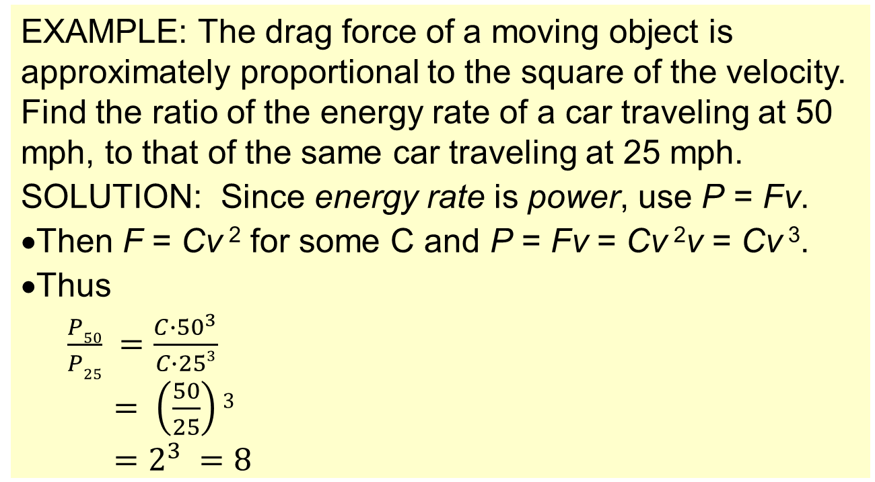
Topic 2: Mechanics
2.3 – Work, energy, and power
Power as rate of energy transfer
P = Fv
power
EXAMPLE: The drag force of a moving object is approximately proportional to the square of the velocity. Find the ratio of the energy rate of a car traveling at 50 mph, to that of the same car traveling at 25 mph.
SOLUTION: Since energy rate is power, use P = Fv.
•Then F = Cv ² for some C and P = Fv = Cv ²v = Cv ³.
•Thus
$\frac{P50}{P25} =\frac{C∙{50}^{3}}{C∙253}$
$= \left(\frac{50}{25}\right)3$
$=2^{3} =8$
FYI C = constant of proportionality
•It takes 8 times as much gas just to overcome air resistance if you double your speed! Ouch!
Notes:
© 2006 By Timothy K. Lund

Slide 47
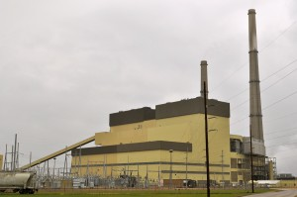
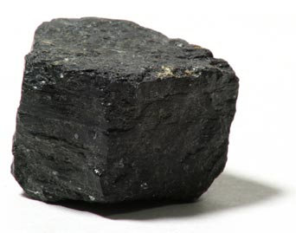
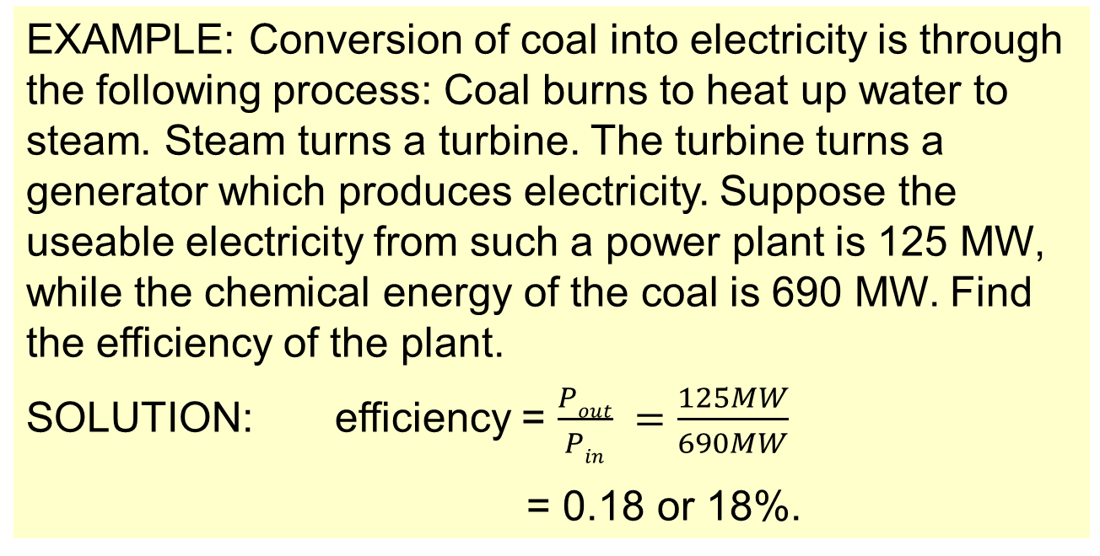

Topic 2: Mechanics
2.3 – Work, energy, and power
Quantitatively describing efficiency in energy transfers
•Efficiency is the ratio of output power to input power
efficiency = $\frac{Wout}{Win} =\frac{Pout}{Pin}$
efficiency
EXAMPLE: Conversion of coal into electricity is through the following process: Coal burns to heat up water to steam. Steam turns a turbine. The turbine turns a generator which produces electricity. Suppose the useable electricity from such a power plant is 125 MW, while the chemical energy of the coal is 690 MW. Find the efficiency of the plant.
SOLUTION: efficiency = $\frac{Pout}{Pin} =\frac{125MW}{690MW}$
= 0.18 or 18%.
Notes:
© 2006 By Timothy K. Lund

