Slide 1
Topic 2: Mechanics
2.1 – Motion
Understandings:
• Distance and displacement
• Speed and velocity
• Acceleration
• Graphs describing motion
• Equations of motion for uniform acceleration
• Projectile motion
• Fluid resistance and terminal speed
Notes:
1
© 2006 By Timothy K. Lund

Slide 2
Topic 2: Mechanics
2.1 – Motion
Applications and skills:
• Determining instantaneous and average values for velocity, speed and acceleration
• Solving problems using equations of motion for uniform acceleration
• Sketching and interpreting motion graphs
• Determining the acceleration of free-fall experimentally
• Analysing projectile motion, including the resolution of vertical and horizontal components of acceleration, velocity and displacement
• Qualitatively describing the effect of fluid resistance on falling objects or projectiles, including reaching terminal speed
Notes:
2
© 2006 By Timothy K. Lund

Slide 3
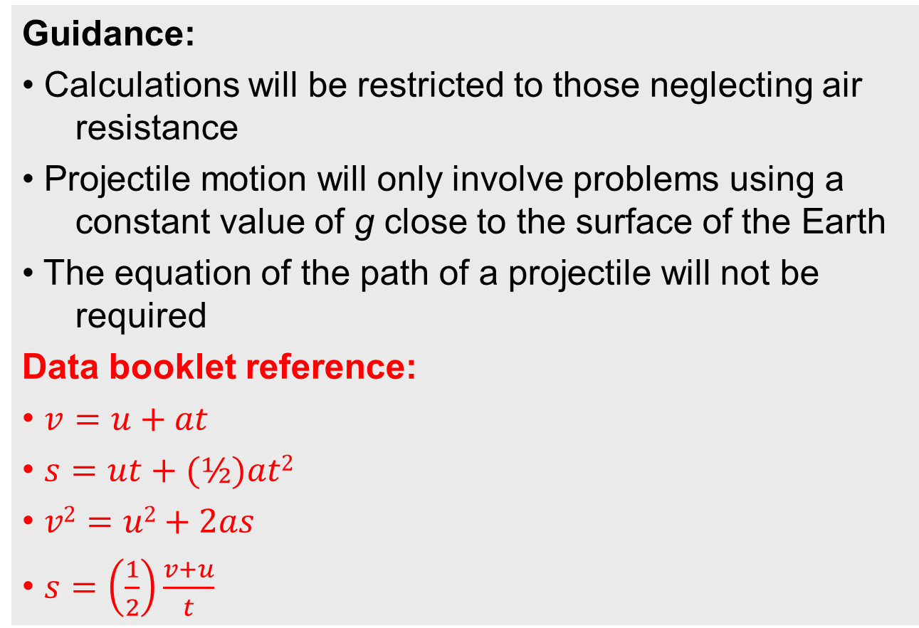
Topic 2: Mechanics
2.1 – Motion
Guidance:
• Calculations will be restricted to those neglecting air resistance
• Projectile motion will only involve problems using a constant value of g close to the surface of the Earth
• The equation of the path of a projectile will not be required
Data booklet reference:
• $v=u+at$
• $s=ut+(½)at2$
• $v2=u2+2as$
• $s=\left(\frac{1}{2}\right)\frac{v+u}{t}$
Notes:
3
© 2006 By Timothy K. Lund

Slide 4
Topic 2: Mechanics
2.1 – Motion
International-mindedness:
• International cooperation is needed for tracking shipping, land-based transport, aircraft and objects in space
Theory of knowledge:
• The independence of horizontal and vertical motion in projectile motion seems to be counter-intuitive. How do scientists work around their intuitions? How do scientists make use of their intuitions?
Notes:
4
© 2006 By Timothy K. Lund

Slide 5
Topic 2: Mechanics
2.1 – Motion
Utilization:
• Diving, parachuting and similar activities where fluid resistance affects motion
• The accurate use of ballistics requires careful analysis
• Biomechanics (see Sports, exercise and health science SL sub-topic 4.3)
• Quadratic functions (see Mathematics HL sub-topic 2.6; Mathematics SL sub-topic 2.4; Mathematical studies SL sub-topic 6.3)
• The kinematic equations are treated in calculus form in Mathematics HL sub-topic 6.6 and Mathematics SL sub-topic 6.6
Notes:
5
© 2006 By Timothy K. Lund

Slide 6
Topic 2: Mechanics
2.1 – Motion
Aims:
• Aim 2: much of the development of classical physics has been built on the advances in kinematics
• Aim 6: experiments, including use of data logging, could include (but are not limited to): determination of g, estimating speed using travel timetables, analysing projectile motion, and investigating motion through a fluid
• Aim 7: technology has allowed for more accurate and precise measurements of motion, including video analysis of real-life projectiles and modelling/simulations of terminal velocity
Notes:
6
© 2006 By Timothy K. Lund

Slide 7


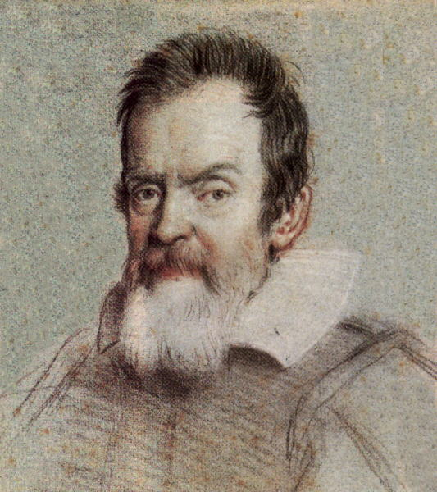

Topic 2: Mechanics
2.1 – Motion
Distance and displacement
•___________ is the branch of physics which concerns itself with forces, and how they affect a body's motion.
•_____________ is the sub-branch of mechanics which studies only a body's motion without regard to causes.
•_____________ is the sub-branch of mechanics which studies the forces which cause a body's motion.
The two pillars of mechanics
Galileo
Newton
Kinematics
Dynamics
(Calculus)
Notes:
© 2006 By Timothy K. Lund

Slide 8

Topic 2: Mechanics
2.1 – Motion
Distance and displacement
•___________ is the study of ____________________ ____________________, or in short, a study of motion.
•A study of motion begins with __________ and change in ____________.
•Consider Freddie the Fly, and his quest for food:
•The distance Freddie travels is simply how far he has flown, without regard to direction. Freddie's distance is 6 meters.
Melted chocolate chip
d = 6 m
Notes:
© 2006 By Timothy K. Lund

Slide 9
Topic 2: Mechanics
2.1 – Motion
Distance and displacement
•___________ is simply how far something has traveled without regard to direction. Freddy has gone 6 m.
•________________, on the other hand, is not only distance traveled, but also direction.
•This makes displacement a vector. It has a magnitude (6 m) and a direction (+ x-direction).
•We say Freddie travels through a displacement of 6 m in the positive x-direction.
Distance = 6 m
Displacement = 6 m in the positive x-direction
Notes:
© 2006 By Timothy K. Lund

Slide 10
Topic 2: Mechanics
2.1 – Motion
Distance and displacement
•Let’s revisit some previous examples of a ball moving through some displacements…
•Displacement A is just 15 m to the right (or +15 m for short).
•Displacement B is just 20 m to the left (or -20 m for short).
Displacement A
x(m)
Displacement B
x(m)
________
FYI
•Distance A is 15 m, and Distance B is 20 m. There is no regard for direction in distance.
______
Notes:
© 2006 By Timothy K. Lund

Slide 11
Topic 2: Mechanics
2.1 – Motion
Distance and displacement
•Now for some detailed analysis of these two motions…
•Displacement ∆x (or s) has the following formulas:
Displacement A
x(m)
Displacement B
x(m)
displacement
where x₂ is the final position
and x₁ is the initial position
FYI
•Many textbooks use ∆x for displacement, and IB uses s. Don’t confuse the “change in ∆” with the “uncertainty ∆” symbol. And don’t confuse s with seconds!
Notes:
© 2006 By Timothy K. Lund

Slide 12


Topic 2: Mechanics
2.1 – Motion
Distance and displacement
$$∆x=x2–x1$$
displacement
$$s=x2–x1$$
where x₂ is the final position
and x₁ is the initial position
EXAMPLE: Use the displacement formula to find each displacement. Note that the x = 0 coordinate has been placed on the number lines.
SOLUTION:
1
2
Displacement A
x(m)
2
0
1
Displacement B
x(m)
FYI
•The correct direction (sign) is automatic!
Notes:
© 2006 By Timothy K. Lund

Slide 13
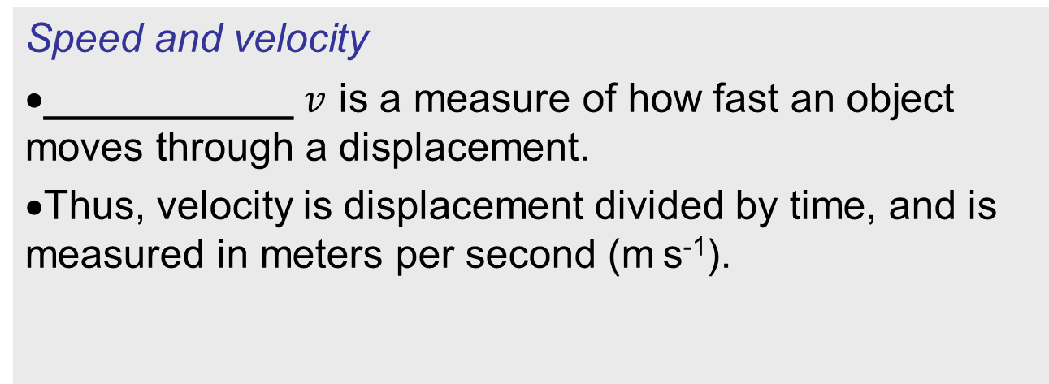
Topic 2: Mechanics
2.1 – Motion
Speed and velocity
•___________ $v$ is a measure of how fast an object moves through a displacement.
•Thus, velocity is displacement divided by time, and is measured in meters per second (m s⁻¹).
velocity
EXAMPLE: Find the velocity of the second ball (Ball B) if it takes 4 seconds to complete its displacement.
SOLUTION:
Notes:
© 2006 By Timothy K. Lund

Slide 14
Topic 2: Mechanics
2.1 – Motion
Speed and velocity
•From the previous example we calculated the velocity of the ball to be -5 m s⁻¹.
•Thus, the ball is moving 5 m s⁻¹ to the left.
•With disregard to the direction, we can say that the ball’s ________ is 5 m s⁻¹.
•We define ________ as distance divided by time, with disregard to direction.
PRACTICE: A runner travels 64.5 meters in the negative x-direction in 31.75 seconds. Find her velocity, and her speed.
SOLUTION:
Notes:
© 2006 By Timothy K. Lund

Slide 15


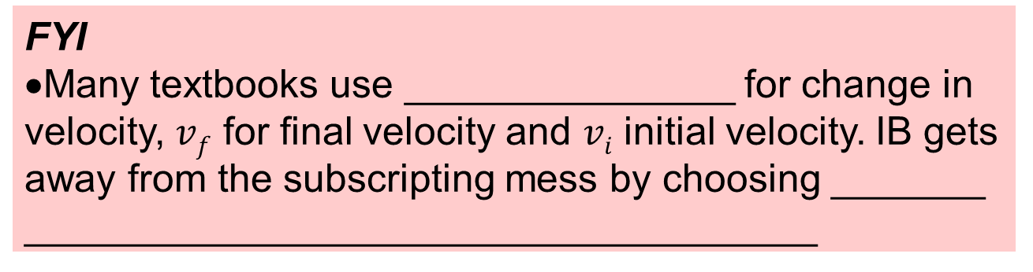
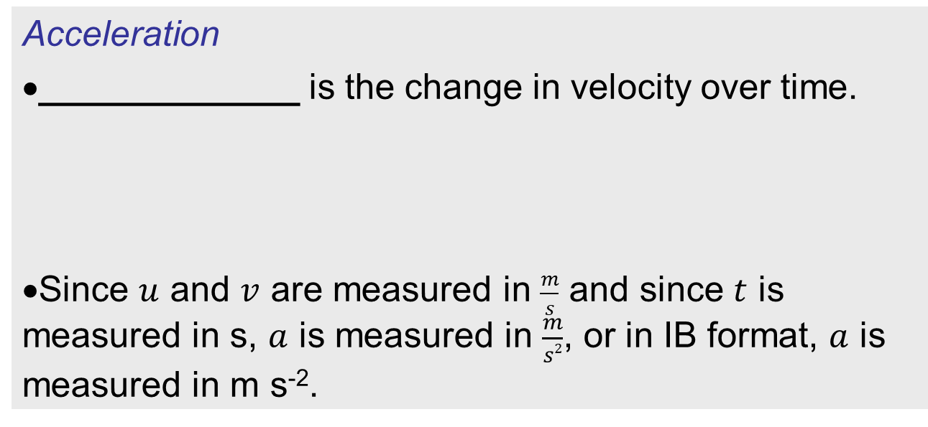
Topic 2: Mechanics
2.1 – Motion
Acceleration
•_____________ is the change in velocity over time.
•Since $u$ and $v$ are measured in $\frac{m}{s}$ and since $t$ is measured in s, $a$ is measured in $\frac{m}{s2}$, or in IB format, $a$ is measured in m s⁻².
acceleration
where $v$ is the final velocity
and $u$ is the initial velocity
FYI
•Many textbooks use _______________ for change in velocity, $vf$ for final velocity and $vi$ initial velocity. IB gets away from the subscripting mess by choosing _______ ____________________________________
Notes:
© 2006 By Timothy K. Lund

Slide 16





Topic 2: Mechanics
2.1 – Motion
Acceleration
acceleration
$a=\frac{∆v}{∆t}$
$$a=\frac{v–u}{t}$$
where $v$ is the final velocity
and $u$ is the initial velocity
EXAMPLE: A driver sees his speed is 5.0 m s⁻¹. He then simultaneously accelerates and starts a stopwatch. At the end of 10. s he observes his speed to be 35 m s⁻¹. What is his acceleration?
SOLUTION: Label each number with a letter:
Notes:
© 2006 By Timothy K. Lund

Slide 17
Topic 2: Mechanics
2.1 – Motion
Acceleration
acceleration
$a=\frac{∆v}{∆t}$
$$a=\frac{v–u}{t}$$
where $v$ is the final velocity
and $u$ is the initial velocity
PRACTICE:
Why is velocity a vector?
Why is acceleration a vector?
SOLUTION:
Notes:
© 2006 By Timothy K. Lund

Slide 18
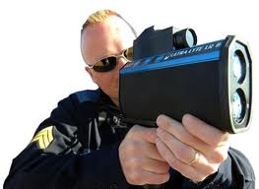


Topic 2: Mechanics
2.1 – Motion
Determining instantaneous and average values for velocity, speed and acceleration
•Consider a car whose position is changing.
•A patrol officer is checking its speed with a radar gun as shown.
•The radar gun measures the ___________ of the car during each successive snapshot, shown in yellow.
•How can you tell that the car is speeding up?
•What are you assuming about the radar gun time?
Notes:
© 2006 By Timothy K. Lund

Slide 19
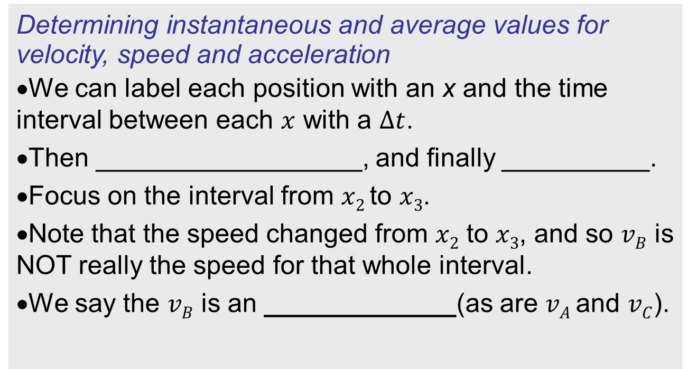
Topic 2: Mechanics
2.1 – Motion
Determining instantaneous and average values for velocity, speed and acceleration
•We can label each position with an x and the time interval between each $x$ with a $∆t$.
•Then __________________, and finally __________.
•Focus on the interval from $x2$ to $x3$.
•Note that the speed changed from $x2$ to $x3$, and so $vB$ is NOT really the speed for that whole interval.
•We say the $vB$ is an _____________(as are $vA$ and $vC$).
v_{A}
v_{B}
v_{C}
∆t
∆t
∆t
x₁
x₂
x₃
x₄
Notes:
© 2006 By Timothy K. Lund

Slide 20
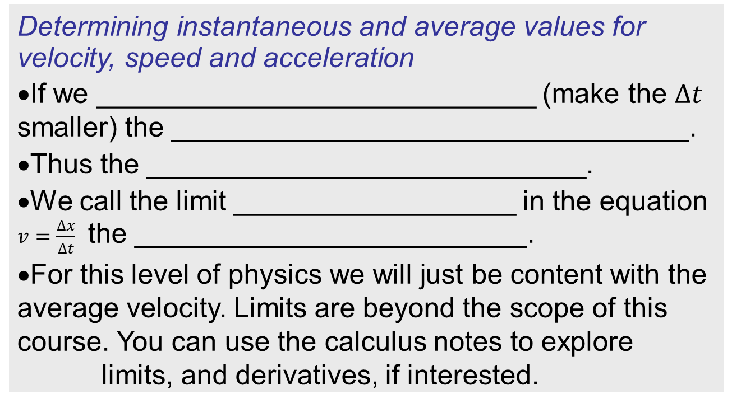
Topic 2: Mechanics
2.1 – Motion
Determining instantaneous and average values for velocity, speed and acceleration
•If we ____________________________ (make the $∆t$ smaller) the _________________________________.
•Thus the ____________________________.
•We call the limit __________________ in the equation $v=\frac{∆x}{∆t}$ the _________________________.
•For this level of physics we will just be content with the average velocity. Limits are beyond the scope of this course. You can use the calculus notes to explore limits, and derivatives, if interested.
Notes:
© 2006 By Timothy K. Lund

Slide 21
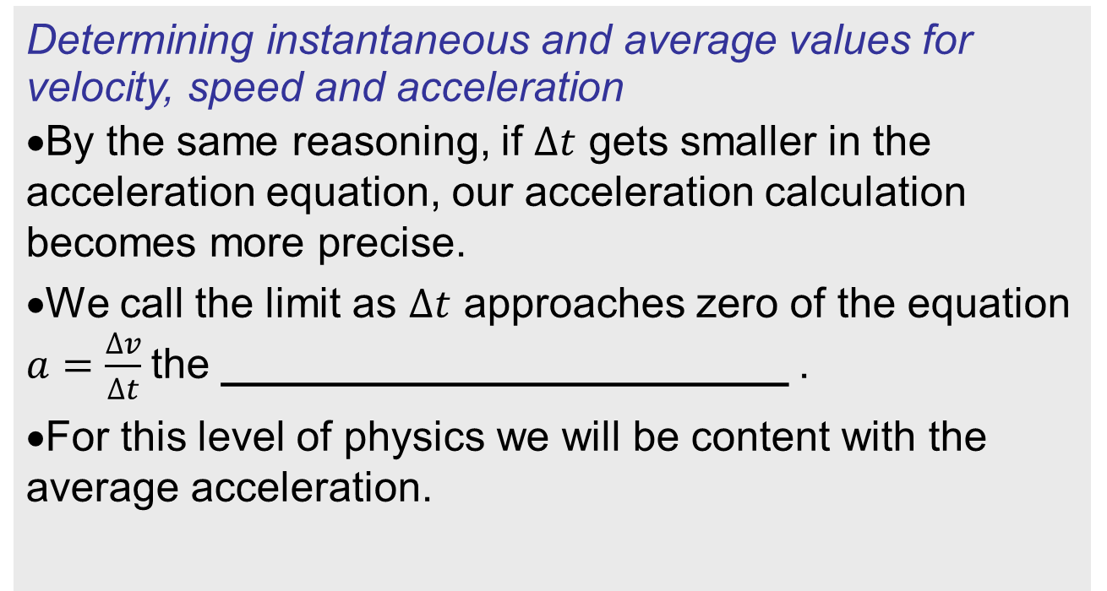
Topic 2: Mechanics
2.1 – Motion
Determining instantaneous and average values for velocity, speed and acceleration
•By the same reasoning, if $∆t$ gets smaller in the acceleration equation, our acceleration calculation becomes more precise.
•We call the limit as $∆t$ approaches zero of the equation $a=\frac{∆v}{∆t}$the ________________________ .
•For this level of physics we will be content with the average acceleration.
Notes:
© 2006 By Timothy K. Lund

Slide 22
Topic 2: Mechanics
2.1 – Motion
Equations of motion for uniform acceleration
•The equations for uniformly accelerated motion are also known as the _____________________. They are listed here
•They can only be used if the acceleration __________ _________________________.
•They are used so commonly throughout the physics course that we will name them.
Notes:
© 2006 By Timothy K. Lund

Slide 23
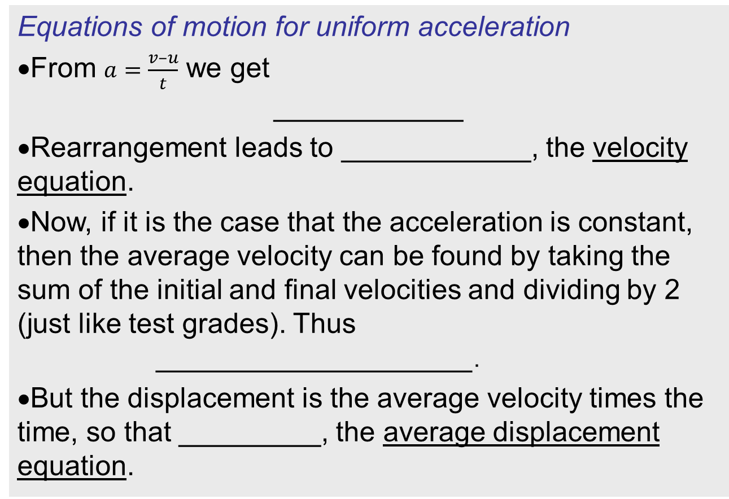
Topic 2: Mechanics
2.1 – Motion
Equations of motion for uniform acceleration
•From $a=\frac{v–u}{t}$ we get
____________
•Rearrangement leads to ____________, the velocity equation.
•Now, if it is the case that the acceleration is constant, then the average velocity can be found by taking the sum of the initial and final velocities and dividing by 2 (just like test grades). Thus
____________________.
•But the displacement is the average velocity times the time, so that _________, the average displacement equation.
Notes:
© 2006 By Timothy K. Lund

Slide 24
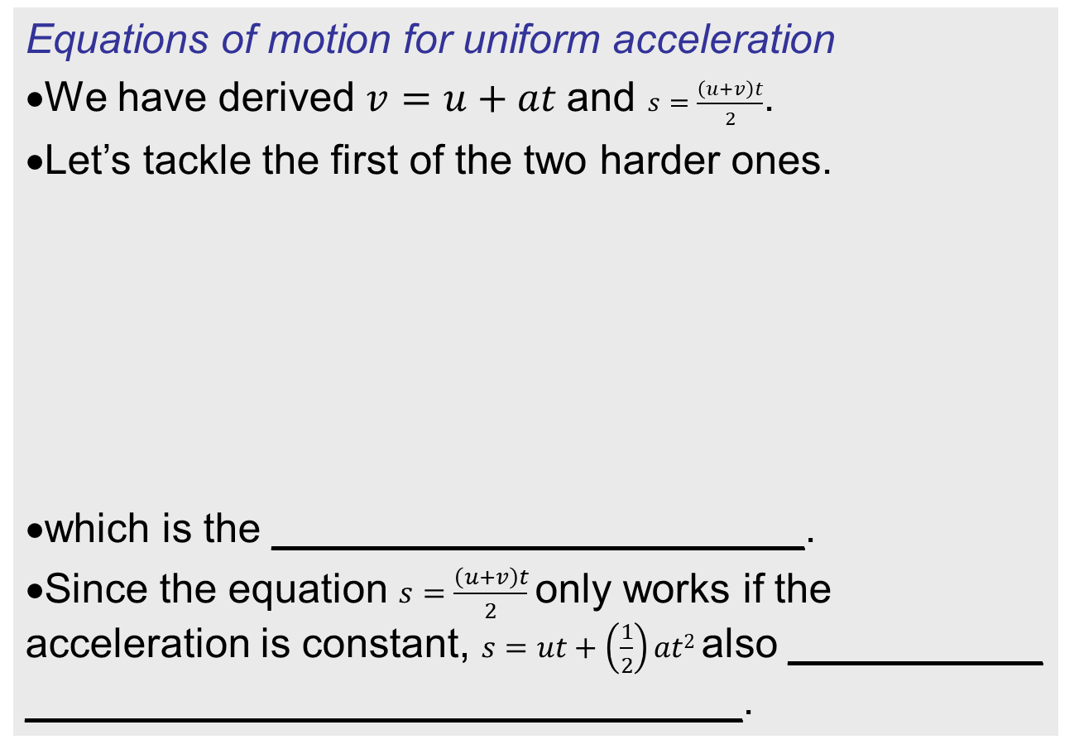
Topic 2: Mechanics
2.1 – Motion
Equations of motion for uniform acceleration
•We have derived $v=u+at$and $s=\frac{\left(u+v\right)t}{2}$.
•Let’s tackle the first of the two harder ones.
•which is the _______________________.
•Since the equation $s=\frac{\left(u+v\right)t}{2}$only works if the acceleration is constant, $s=ut+\left(\frac{1}{2}\right)at2$also ___________ _______________________________.
Notes:
© 2006 By Timothy K. Lund

Slide 25
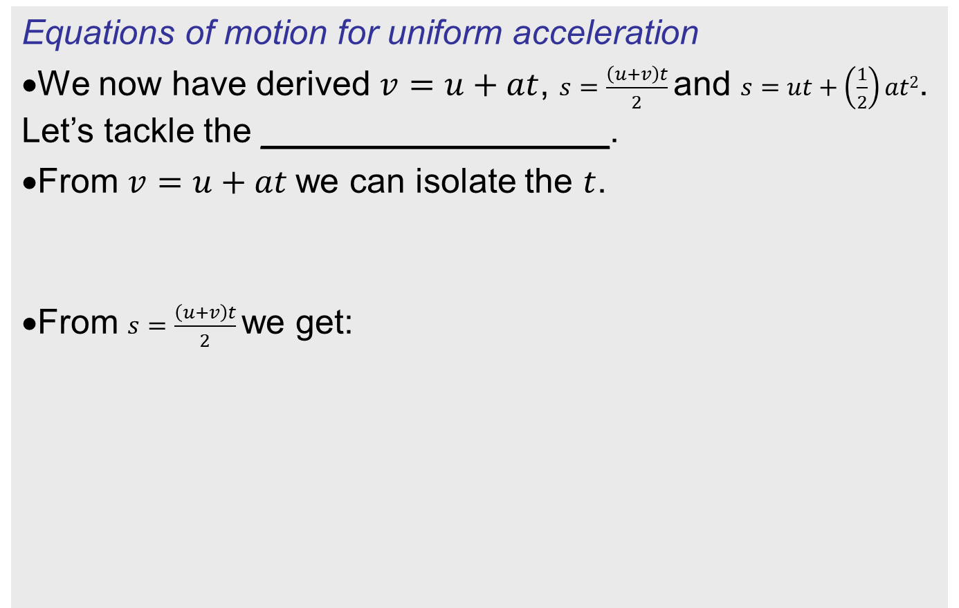
Topic 2: Mechanics
2.1 – Motion
Equations of motion for uniform acceleration
•We now have derived $v=u+at$, $s=\frac{\left(u+v\right)t}{2}$and $s=ut+\left(\frac{1}{2}\right)at2$. Let’s tackle the __________________.
•From $v=u+at$we can isolate the $t$.
•From $s=\frac{\left(u+v\right)t}{2}$we get:
Notes:
© 2006 By Timothy K. Lund

Slide 26




Topic 2: Mechanics
2.1 – Motion
Equations of motion for uniform acceleration
•Just in case you haven’t written these down, here they are again.
•We will practice using these equations soon. They are extremely important.
•Before we do, though, we want to talk about freefall and its special acceleration g.
$$s=ut+\left(\frac{1}{2}\right)at2$$
Displacement
kinematic equations
$$v=u+at$$
Velocity
$$v2=u2+2as$$
Timeless
a is constant
$$s=\frac{\left(u+v\right)t}{2}$$
Average displacement
Notes:
© 2006 By Timothy K. Lund

Slide 27
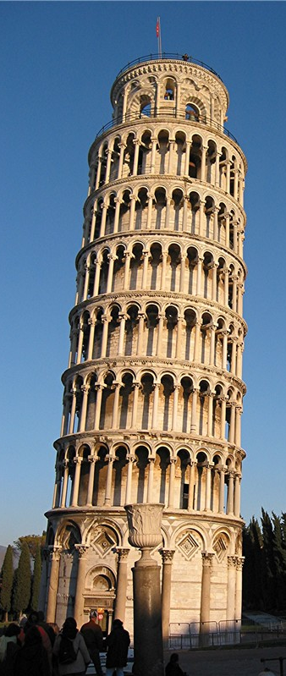
Topic 2: Mechanics
2.1 – Motion
Determining the acceleration of free-fall experimentally
•Everyone knows that when you drop an object, it picks up speed when it falls.
•Galileo did his famous freefall experiments on the tower of Pisa long ago, and determined that all objects fall at the same acceleration in the absence of air resistance.
•Thus, as the next slide will show, an apple and a feather will fall side by side!
Free Fall in a Vacuum - Video
Notes:
© 2006 By Timothy K. Lund

Slide 28
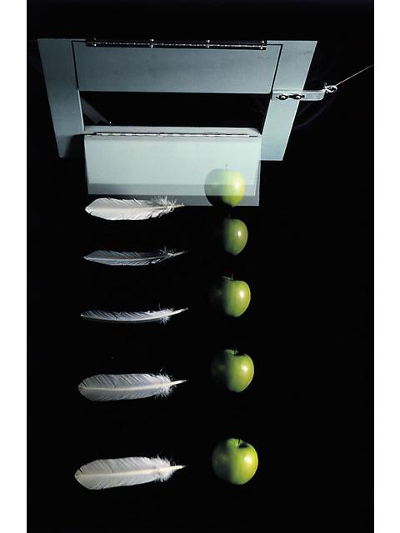
Topic 2: Mechanics
2.1 – Motion
Determining the acceleration of free-fall experimentally
•Consider the multiflash image of an apple and a feather falling in a partial vacuum:
•If we choose a convenient spot on the apple, and mark its position, we get a series of marks like so:
Notes:
© 2006 By Timothy K. Lund

Slide 29
Topic 2: Mechanics
2.1 – Motion
Determining the acceleration of free-fall experimentally
•Now we SCALE our data. Given that the apple is 8 cm in horizontal diameter we can superimpose this scale on our photograph.
•Then we can estimate the position in cm of each image.
0 cm
-9 cm
-22 cm
-37 cm
-55 cm
Notes:
© 2006 By Timothy K. Lund

Slide 30
Topic 2: Mechanics
2.1 – Motion
Determining the acceleration of free-fall experimentally
•Suppose we know that the time between images is 0.056 s.
•We make a table starting with the raw data columns of t and y.
•We then make calculations columns in Δt, Δy and v.
0 cm
-9 cm
-22 cm
t(s)
y(cm)
Δt
Δy
v
t(s)
y(cm)
Δt
Δy
v
.000
0
.000
0
.056
-9
.056
-37 cm
-161
.056
-9
.056
-9
-161
-9
FYI: To find Δt you need to subtract TWO t's. Therefore the first entry for Δt is BLANK.
FYI: To find v you need to divide Δy by Δt. By convention, CURRENT Δy DIVIDED BY CURRENT Δt.
.112
-22
.056
-13
-232
FYI: To find Δy you need to subtract TWO y's. By convention, CURRENT y MINUS PREVIOUS y.
.112
-22
.056
-13
-232
FYI: To find Δt you need to subtract TWO t's. By convention, CURRENT t MINUS PREVIOUS t.
.168
-37
.056
-15
-268
.168
-37
.056
-15
-268
FYI: Same thing for the first Δy.
.224
-55
.056
-18
-321
.224
-55
.056
-18
-321
-55 cm
FYI: Since v = Δy / Δt, the first v entry is also BLANK.
Notes:
© 2006 By Timothy K. Lund

Slide 31
Topic 2: Mechanics
2.1 – Motion
Determining the acceleration of free-fall experimentally
•Now we plot v vs. t on a graph.
t(s)
y(cm)
Δt
Δy
v
.000
0
.056
-9
.056
-9
-161
.112
-22
.056
-13
-232
.168
-37
.056
-15
-268
v
.224
-55
.056
-18
-321
TIME / sec
.000
.056
.112
.168
.224
0
t
-50
-100
VELOCITY / cm sec⁻¹
-150
-200
-250
-300
Notes:
© 2006 By Timothy K. Lund

Slide 32
Topic 2: Mechanics
2.1 – Motion
Determining the acceleration of free-fall experimentally
FYI
•The graph v vs. t is linear. Thus a is constant.
•The y-intercept (the initial velocity of the apple) is not zero. But this just means we don’t have all of the images of the apple.
v
TIME (sec)
.000
.056
.112
.168
.224
0
t / s
-50
-100
VELOCITY (cm/sec)
-150
-200
-250
-300
Notes:
32
© 2006 By Timothy K. Lund

Slide 33
Topic 2: Mechanics
2.1 – Motion
Determining the acceleration of free-fall experimentally
FYI
•Finally, the acceleration is the slope of the v vs. t graph:
a =
Δv
Δt
=
-220 cm/s
0.224 s
= -982 cm/s²
v
TIME (sec)
.000
.056
.112
.168
.224
0
t / s
-50
Δt = 0.224 s
-100
VELOCITY (cm/sec)
-150
-200
Δv = -220 cm/s
-250
-300
Notes:
33
© 2006 By Timothy K. Lund

Slide 34
Topic 2: Mechanics
2.1 – Motion
Determining the acceleration of free-fall experimentally
•Since this acceleration due to gravity is so important we give it the name g.
•ALL objects accelerate at ___ , where
__________
in the absence of air resistance.
•We can list the values for g in three ways:
•Hammer and feather drop Apollo 15
g = 980 cm s⁻²
We usually round the metric value to 10.
magnitude of the freefall acceleration
g = 9.80 m s⁻²
g = 32 ft s⁻²
g = 10. m s⁻²
Notes:
© 2006 By Timothy K. Lund

Slide 35
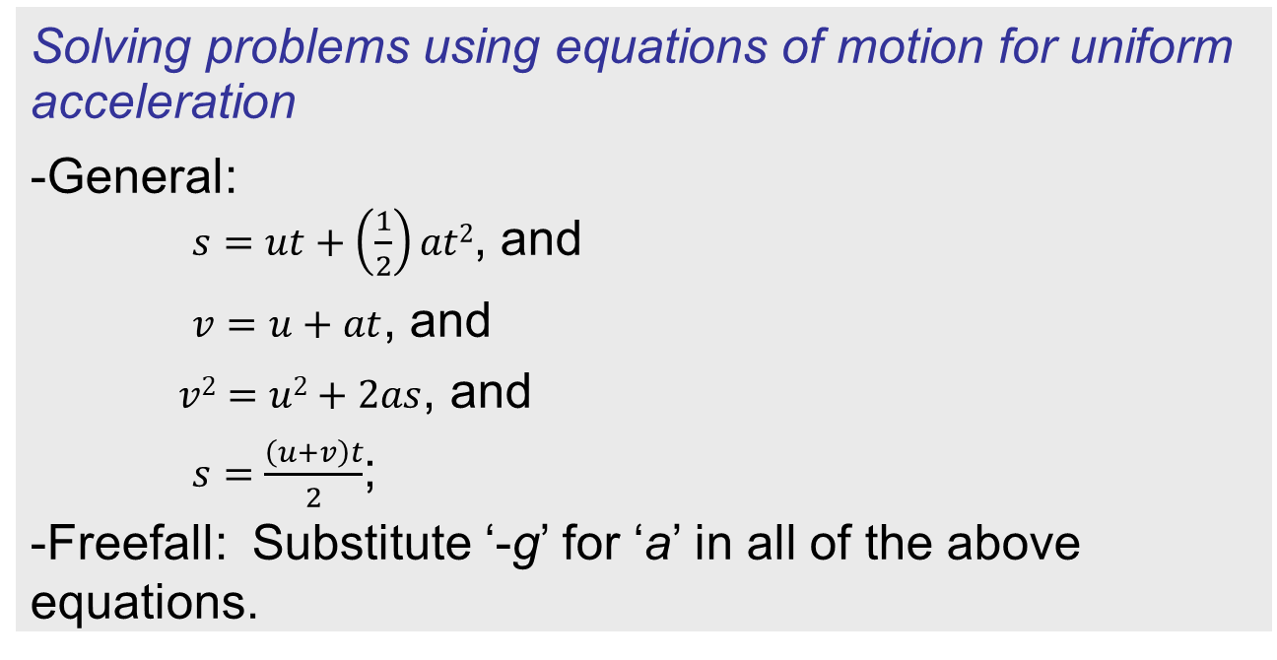
Topic 2: Mechanics
2.1 – Motion
Solving problems using equations of motion for uniform acceleration
-General:
$s=ut+\left(\frac{1}{2}\right)at2$, and
$v=u+at$, and
$v2=u2+2as$, and
$s=\frac{\left(u+v\right)t}{2}$;
-Freefall: Substitute ‘-g’ for ‘a’ in all of the above equations.
FYI
•The kinematic equations will be used throughout the year. We must master them NOW!
Notes:
© 2006 By Timothy K. Lund

Slide 36

Topic 2: Mechanics
2.1 – Motion
Solving problems using equations of motion for uniform acceleration
EXAMPLE: How far will a rocket go in 30.0 seconds if its acceleration is 20.0 m s ⁻²?
KNOWN
FORMULAS
1
2
s = ut + at²
v = u + at
v² = u² + 2as
s = ?
SOLUTION
WANTED
•t is known - drop the timeless eq’n.
•Since v is not wanted, drop the velocity eq'n:
Notes:
© 2006 By Timothy K. Lund

Slide 37
Topic 2: Mechanics
2.1 – Motion
Solving problems using equations of motion for uniform acceleration
EXAMPLE: How fast will Pinky and the Brain be going at this instant?
KNOWN
FORMULAS
1
2
s = ut + at²
v = u + at
v² = u² + 2as
v = ?
SOLUTION
WANTED
•t is known - drop the timeless eq’n.
•Since v is wanted, drop the displacement eq'n:
Notes:
© 2006 By Timothy K. Lund

Slide 38
Topic 2: Mechanics
2.1 – Motion
Solving problems using equations of motion for uniform acceleration
EXAMPLE: How fast will the rocket be going when it has traveled a total of 18000 m?
KNOWN
FORMULAS
1
2
s = ut + at²
v = u + at
v² = u² + 2as
v = ?
SOLUTION
WANTED
•Since t is not known - drop the two eq’ns which have time in them.
Notes:
© 2006 By Timothy K. Lund

Slide 39
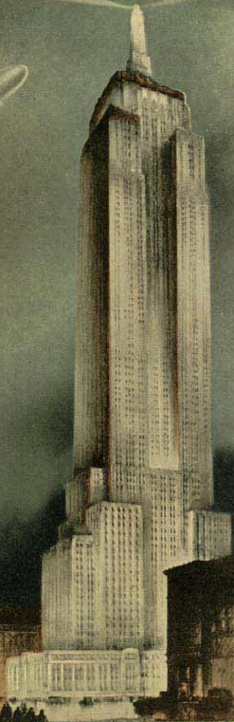
Topic 2: Mechanics
2.1 – Motion
Solving problems using equations of motion for uniform acceleration
EXAMPLE: A ball is dropped off of the Empire State Building (381 m tall). How fast is it going when it hits ground?
KNOWN
FORMULAS
1
2
s = ut + at²
v = u + at
v² = u² + 2as
v = ?
SOLUTION
WANTED
Notes:
© 2006 By Timothy K. Lund

Slide 40
Topic 2: Mechanics
2.1 – Motion
Solving problems using equations of motion for uniform acceleration
EXAMPLE: A ball is dropped off of the Empire State Building (381 m tall). How long does it take to reach the ground?
KNOWN
FORMULAS
1
2
s = ut + at²
v = u + at
v² = u² + 2as
t = ?
SOLUTION
WANTED
Notes:
© 2006 By Timothy K. Lund

Slide 41
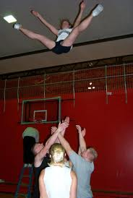
Topic 2: Mechanics
2.1 – Motion
Solving problems using equations of motion for uniform acceleration
EXAMPLE: A cheer leader is thrown up with an initial speed of 7 m s⁻¹. How high does she go?
KNOWN
FORMULAS
1
2
s = ut + at²
v = u + at
v² = u² + 2as
s = ?
SOLUTION
WANTED
Notes:
© 2006 By Timothy K. Lund

Slide 42
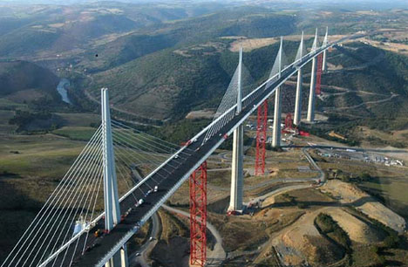
Topic 2: Mechanics
2.1 – Motion
Solving problems using equations of motion for uniform acceleration
EXAMPLE: A ball is thrown upward at 50 m s⁻¹ from the top of the 300-m Millau Viaduct, the highest bridge in the world. How fast does it hit ground?
KNOWN
FORMULAS
1
2
s = ut + at²
v = u + at
v² = u² + 2as
v = ?
SOLUTION
WANTED
Notes:
© 2006 By Timothy K. Lund

Slide 43
Topic 2: Mechanics
2.1 – Motion
Solving problems using equations of motion for uniform acceleration
EXAMPLE: A ball is thrown upward at 50 m s⁻¹ from the top of the 300-m Millau Viaduct, the highest bridge in the world. How long is it in flight?
KNOWN
FORMULAS
1
2
s = ut + at²
v = u + at
v² = u² + 2as
t = ?
WANTED
SOLUTION
Notes:
© 2006 By Timothy K. Lund

Slide 44
Topic 2: Mechanics
2.1 – Motion
Sketching and interpreting motion graphs
•The _________________________________ is the __________.
•The ________________________________ is the ______________. We already did this example with the falling feather/apple presentation.
•You will have ample opportunity to find the slopes of distance-time, displacement-time and velocity-time graphs in your labs.
Notes:
© 2006 By Timothy K. Lund

Slide 45
Topic 2: Mechanics
2.1 – Motion
Sketching and interpreting motion graphs
EXAMPLE: Suppose Freddie the Fly begins at x = 0 m, and travels at a constant velocity for 6 seconds as shown. Find two points, sketch a displacement vs. time graph, and then find and interpret the slope and the area of your graph.
SOLUTION:
•The two points are _________and ___________.
•The sketch is on the next slide.
t = 0,
x = 0
x/m
t = 6 s,
x = 18
Notes:
© 2006 By Timothy K. Lund

Slide 46
Topic 2: Mechanics
2.1 – Motion
Sketching and interpreting motion graphs
SOLUTION:
•The _________________________________
•Thus the ________________, which is interpreted as Freddie’s ___________.
Notes:
© 2006 By Timothy K. Lund

Slide 47
Topic 2: Mechanics
2.1 – Motion
Sketching and interpreting motion graphs
•The ____________________________ is the ____________________.
•The ________________________________is the _________________________.
•You will have ample opportunity to draw distance-time, displacement-time and velocity-time graphs in your labs.
Notes:
© 2006 By Timothy K. Lund

Slide 48
Topic 2: Mechanics
2.1 – Motion
Sketching and interpreting motion graphs
EXAMPLE: Calculate and interpret the area under the given v vs. t graph. Find and interpret the slope.
SOLUTION:
50
40
30
VELOCITY (ms⁻¹ )
20
10
0
10
15
20
t
0
5
TIME (sec)
Notes:
© 2006 By Timothy K. Lund

Slide 49

Topic 2: Mechanics
2.1 – Motion
Determine relative velocity in one and two dimensions
•Suppose you are a passenger in a car on a perfectly level and straight road, moving at a constant velocity. Your velocity relative to the pavement might be 60 mph.
•Your velocity relative to the driver of your car is zero. Whereas your velocity relative to an oncoming car might be 120 mph.
•Your velocity can be measured relative to any reference frame.
A
Notes:
© 2006 By Timothy K. Lund

Slide 50

Topic 2: Mechanics
2.1 – Motion
Determine relative velocity in one and two dimensions
•Consider two cars, A and B, shown below.
•Suppose you are in car A moving at $vA=+20ms^{−1}$ and next to you is car B, moving at $vB=+40 ms^{−1}$.
•As far as you are concerned your velocity relative to car B is $vAB=−20 m{ s}^{−1}$ because you seem to be moving backwards relative to B’s coordinate system.
•We write
velocity of A relative to B
B
A
Notes:
© 2006 By Timothy K. Lund

Slide 51

Topic 2: Mechanics
2.1 – Motion
B
Determine relative velocity in one and two dimensions
•The equation works even in two dimensions.
•Suppose you are in car A which is moving at $vA=+40m{ s}^{−1}$ and approaching you at right angles is a car B is moving at $vB=−20ms^{−1}$ as shown.
•Since A and B are moving perpendicular to one another, use a vector diagram to find $vAB$. The solution is on the next slide.
y
x
A
Notes:
© 2006 By Timothy K. Lund

Slide 52

Topic 2: Mechanics
2.1 – Motion
B
Determine relative velocity in one and two dimensions
•Draw in the vectors and use $vAB=vA−vB$.
A
Notes:
© 2006 By Timothy K. Lund

Slide 53
Topic 2: Mechanics
2.1 – Motion
Qualitatively describing the effect of fluid resistance on falling objects or projectiles, including reaching terminal speed
Students should know what is meant by _____________________.
This is when the ____________________________ ___________________.
Notes:
© 2006 By Timothy K. Lund

Slide 54
Topic 2: Mechanics
2.1 – Motion
"A female Blue Whale weighing 190 metric tonnes (418,877lb) and measuring 27.6m (90ft 5in) in length suddenly materialized above the Southern Ocean on 20 March 1947."
y
Guinness World Records.
Falkland Islands Philatelic Bureau. 2 March 2002.
At first, v = 0.
Qualitatively describing the effect of fluid resistance on falling objects or projectiles, including reaching terminal speed
•Suppose a blue whale suddenly materializes high above the ground.
•The __________________________ ____________________________
•Thus, _________________________ _____________________________.
•Once the _______________________ ______________, the whale will _____ _______________.
•It has reached __________________.
W
Then, as v increases, so does D.
y
D
W
v
v reaches a maximum value, called terminal speed. D = W.
D
y
v_{terminal}
W
Notes:
© 2006 By Timothy K. Lund

Slide 55




Topic 2: Mechanics
2.1 – Motion
Projectile motion
•A _____________ is an object that has been given an initial velocity by some sort of short-lived force, and then ___________________________________________.
•Baseballs, stones, or bullets are all examples of projectiles executing ______________________.
•You know that all objects moving through air feel an air resistance (recall sticking your hand out of the window of a moving car).
FYI
•We will ignore air resistance in the discussion that follows…
Notes:
© 2006 By Timothy K. Lund

Slide 56
Topic 2: Mechanics
2.1 – Motion
Analysing projectile motion
•Regardless of the air resistance, the ______________ ________________________________________________________________________________________
a_{y} = -g
a_{y} = -g
Speeding up in -y dir.
Slowing down in +y dir.
a_{x} = 0
Constant speed in +x dir.
Notes:
© 2006 By Timothy K. Lund

Slide 57
Topic 2: Mechanics
2.1 – Motion
Analysing projectile motion
•The trajectory of a projectile in the absence of air is ________________. Know this!
Notes:
© 2006 By Timothy K. Lund

Slide 58
Topic 2: Mechanics
2.1 – Motion
Analysing projectile motion with fluid resistance
•If there is air resistance, it is proportional to the square of the velocity. Thus, when the ball moves fast its deceleration is greater than when it moves slow.
•Peak to left of original one.
•Pre-peak distance more than post-peak.
SKETCH POINTS
Notes:
© 2006 By Timothy K. Lund

Slide 59


Topic 2: Mechanics
2.1 – Motion
Analysing projectile motion
•Recall the kinematic equations:
•Since we worked only in 1D at the time, we didn’t have to distinguish between x and y in these equations.
•Now we appropriately modify the above to meet our new requirements of simultaneous equations:
$$s=ut+\left(\frac{1}{2}\right)at 2$$
Displacement
kinematic equations 1D
Velocity
$$v=u+at$$
a is constant
kinematic equations 2D
a_{x} and a_{y} are constant
Notes:
© 2006 By Timothy K. Lund

Slide 60
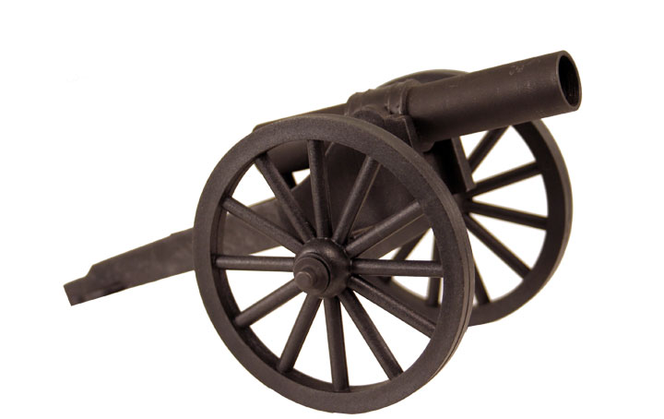

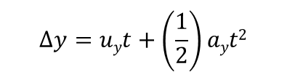

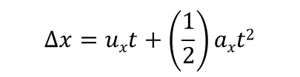
Topic 2: Mechanics
2.1 – Motion
$$∆x=uxt+\left(\frac{1}{2}\right)axt2$$
$vx=ux+axt$
equations of projectile motion
$$∆y=uyt+\left(\frac{1}{2}\right)ayt2$$
$vy=uy+ayt$
PRACTICE: A cannon fires a projectile with a muzzle velocity of 56 ms⁻¹ at an angle of inclination of 15º.
(a) What are u_{x} and u_{y}?
SOLUTION: Make a velocity triangle.
u = 56 m s⁻¹
θ = 15º
Notes:
© 2006 By Timothy K. Lund

Slide 61
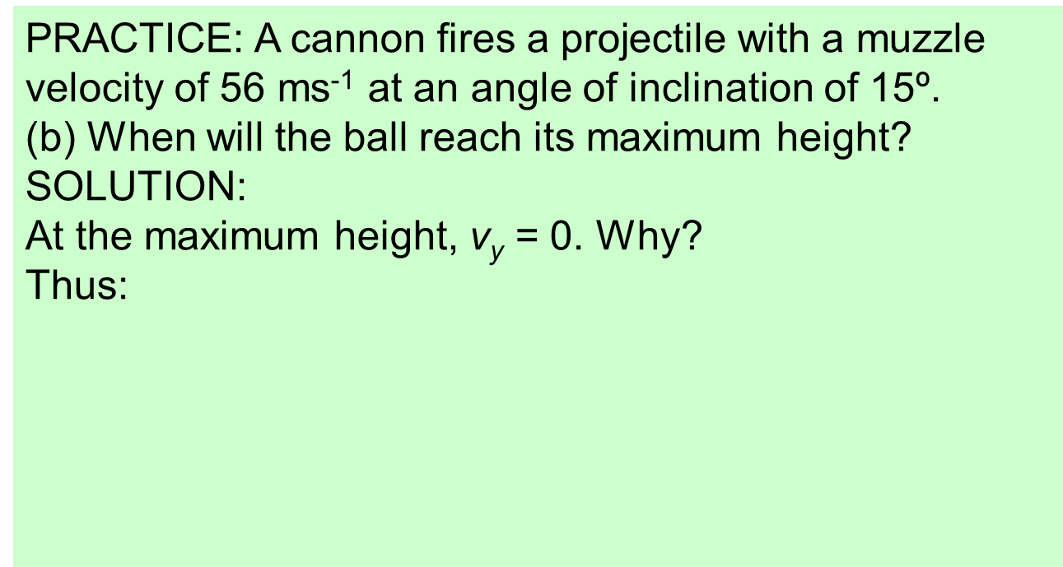
Topic 2: Mechanics
2.1 – Motion
$$∆x=uxt+\left(\frac{1}{2}\right)axt2$$
$vx=ux+axt$
reduced equations of projectile motion
$$∆y=uyt+\left(\frac{1}{2}\right)ayt2$$
$vy=uy+ayt$
PRACTICE: A cannon fires a projectile with a muzzle velocity of 56 ms⁻¹ at an angle of inclination of 15º.
(b) When will the ball reach its maximum height?
SOLUTION:
At the maximum height, v_{y} = 0. Why?
Thus:
Notes:
© 2006 By Timothy K. Lund

Slide 62
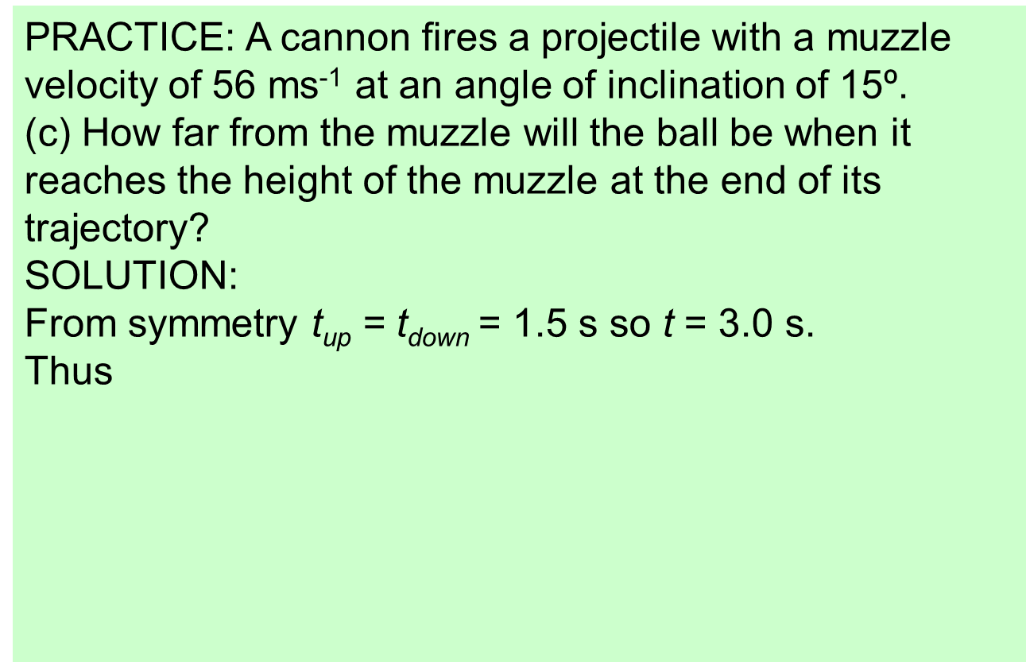
Topic 2: Mechanics
2.1 – Motion
Analysing projectile motion
PRACTICE: A cannon fires a projectile with a muzzle velocity of 56 ms⁻¹ at an angle of inclination of 15º.
(c) How far from the muzzle will the ball be when it reaches the height of the muzzle at the end of its trajectory?
SOLUTION:
From symmetry t_{up} = t_{down} = 1.5 s so t = 3.0 s.
Thus
Notes:
© 2006 By Timothy K. Lund

Slide 63


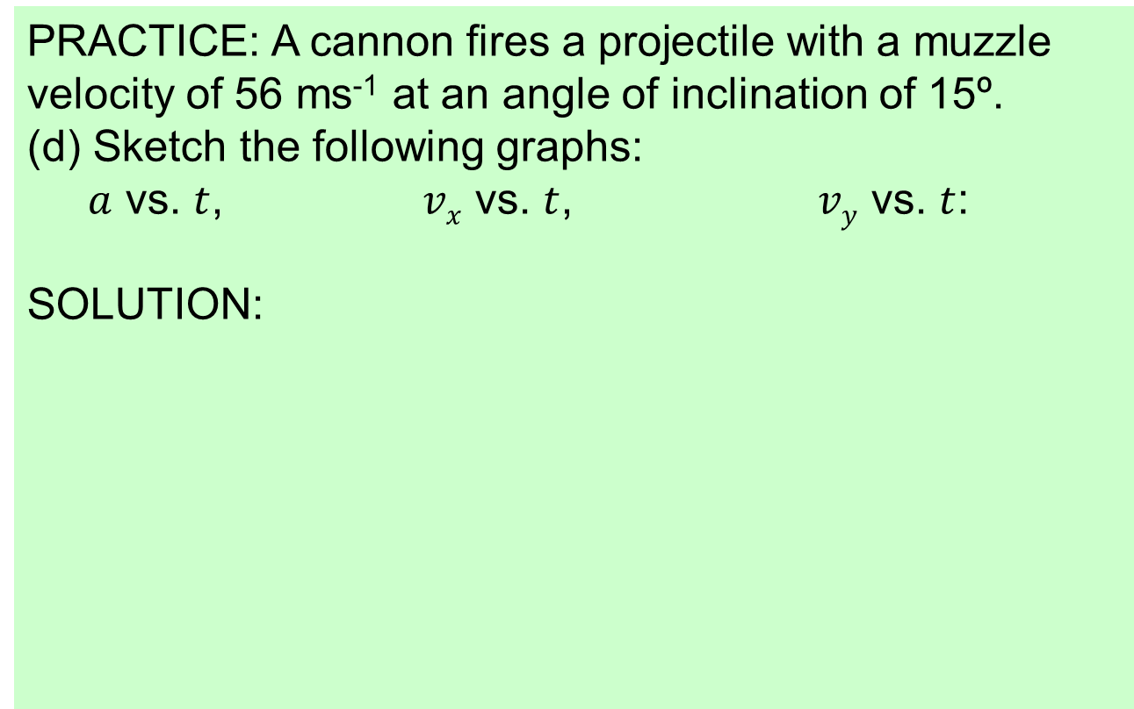

Topic 2: Mechanics
2.1 – Motion
Analysing projectile motion
PRACTICE: A cannon fires a projectile with a muzzle velocity of 56 ms⁻¹ at an angle of inclination of 15º.
(d) Sketch the following graphs:
$a$ vs. $t$, $vx$ vs. $t$, $vy$ vs. $t$:
SOLUTION:
$$ay$$
t
$$vx$$
t
$$vy$$
t
Notes:
© 2006 By Timothy K. Lund

Slide 64
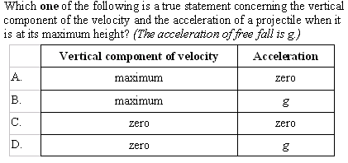
Topic 2: Mechanics
2.1 – Motion
Analysing projectile motion
Notes:
© 2006 By Timothy K. Lund

Slide 65
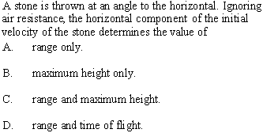
Topic 2: Mechanics
2.1 – Motion
Analysing projectile motion
Notes:
© 2006 By Timothy K. Lund

Slide 66
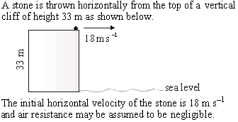

Topic 2: Mechanics
2.1 – Motion
Analysing projectile motion
Notes:
© 2006 By Timothy K. Lund

Slide 67

Topic 2: Mechanics
2.1 – Motion
Analysing projectile motion
Notes:
© 2006 By Timothy K. Lund

Slide 68
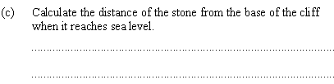
Topic 2: Mechanics
2.1 – Motion
Analysing projectile motion
Notes:
© 2006 By Timothy K. Lund

Slide 69

Topic 2: Mechanics
2.1 – Motion
Analysing projectile motion
Notes:
© 2006 By Timothy K. Lund

Slide 70
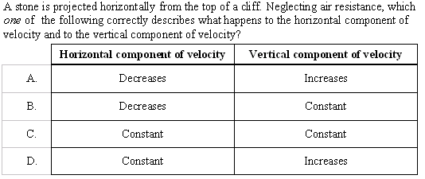
Topic 2: Mechanics
2.1 – Motion
Analysing projectile motion
Notes:
© 2006 By Timothy K. Lund

Slide 71
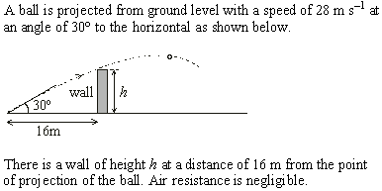
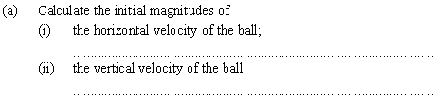
Topic 2: Mechanics
2.1 – Motion
Analysing projectile motion
Notes:
© 2006 By Timothy K. Lund

Slide 72

Topic 2: Mechanics
2.1 – Motion
Analysing projectile motion
Notes:
© 2006 By Timothy K. Lund

Slide 73
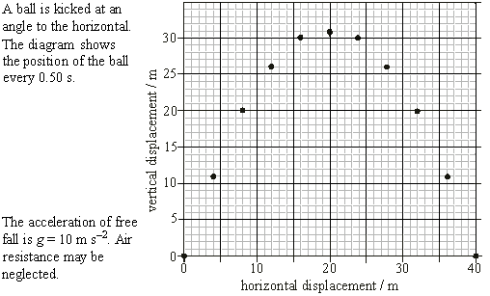

Topic 2: Mechanics
2.1 – Motion
Analysing projectile motion
Notes:
© 2006 By Timothy K. Lund

Slide 74

Topic 2: Mechanics
2.1 – Motion
Analysing projectile motion
Notes:
© 2006 By Timothy K. Lund

Slide 75

Topic 2: Mechanics
2.1 – Motion
Analysing projectile motion
0.5s
11 m
0.0s
4 m
Notes:
© 2006 By Timothy K. Lund

Slide 76

Topic 2: Mechanics
2.1 – Motion
Analysing projectile motion
Notes:
© 2006 By Timothy K. Lund

