Slide 1
Topic 12: Quantum & nuclear physics - AHL 12.2 – Nuclear physics
Topic 12.2 is an extension of Topic 7.2.
Essential idea: The idea of discreteness that we met in the atomic world continues to exist in the nuclear world as well.
Nature of science: (1) Theoretical advances and inspiration: Progress in atomic, nuclear and particle physics often came from theoretical advances and strokes of inspiration. (2) Advances in instrumentation: New ways of detecting subatomic particles due to advances in electronic technology were also crucial. (3) Modern computing power: (4) Finally, the analysis of the data gathered in modern particle detectors in particle accelerator experiments would be impossible without modern computing power.
Notes:
© 2015 by Timothy K. Lund

Slide 2
Topic 12: Quantum & nuclear physics - AHL 12.2 – Nuclear physics
Understandings:
• Rutherford scattering and nuclear radius
• Nuclear energy levels
• The neutrino
• The law of radioactive decay and the decay constant
Applications and skills:
• Describing a scattering experiment including location of minimum intensity for the diffracted particles based on their de Broglie wavelength
• Explaining deviations from Rutherford scattering in high energy experiments
• Describing experimental evidence for nuclear energy levels
Notes:
© 2015 by Timothy K. Lund

Slide 3
Topic 12: Quantum & nuclear physics - AHL 12.2 – Nuclear physics
Applications and skills:
• Solving problems involving the radioactive decay law for arbitrary time intervals
• Explaining the methods for measuring short and long half-lives
Guidance:
• Students should be aware that nuclear densities are approximately the same for all nuclei and that the only macroscopic objects with the same density as nuclei are neutron stars
• The small angle approximation is usually not appropriate to use to determine the location of the minimum intensity
Notes:
© 2015 by Timothy K. Lund

Slide 4
Topic 12: Quantum & nuclear physics - AHL 12.2 – Nuclear physics
Data booklet reference:
• R = R₀A^{1/3}
• $sinθ=\frac{λ}{D}$
• N = N₀e ^{-λt}
• A = λN₀e ^{-λt}
Theory of knowledge:
• Much of the knowledge about subatomic particles is based on the models one uses to interpret the data from experiments. How can we be sure that we are discovering an “independent truth” not influenced by our models? Is there such a thing as a single truth?
Notes:
© 2015 by Timothy K. Lund

Slide 5
Topic 12: Quantum & nuclear physics - AHL 12.2 – Nuclear physics
Utilization:
• Knowledge of radioactivity, radioactive substances and the radioactive decay law are crucial in modern nuclear medicine (see Physics option sub-topic C.4)
Aims:
• Aim 2: detection of the neutrino demonstrates the continuing growing body of knowledge scientists are gathering in this area of study
Notes:
© 2015 by Timothy K. Lund

Slide 6
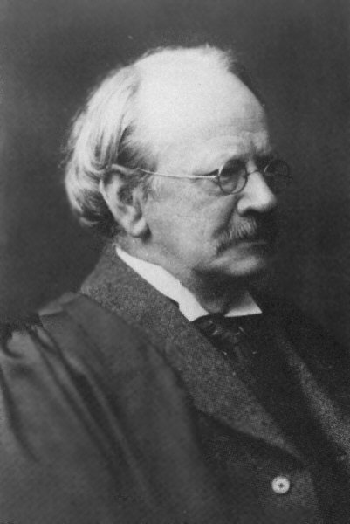
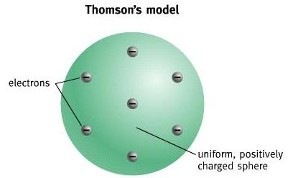
Topic 12: Quantum & nuclear physics - AHL 12.2 – Nuclear physics
Rutherford scattering
•In 1897 British physicist J.J. Thomson discovered the electron, and went on to propose a "plum pudding" model of the atom in which all of the electrons were embedded in a spherical positive charge the size of the atom.
•In the next slides we will disprove this model…
“Plum pudding” model of the atom
atomic diameter
+7
Notes:
© 2015 by Timothy K. Lund

Slide 7
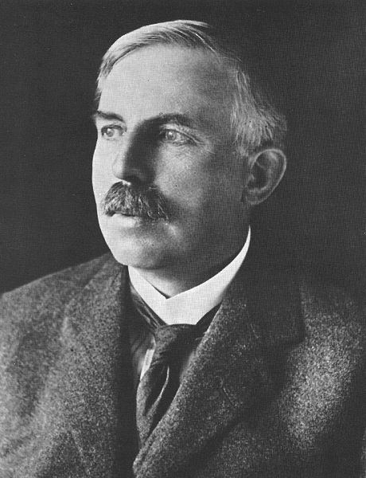
Topic 12: Quantum & nuclear physics - AHL 12.2 – Nuclear physics
Rutherford scattering
•In 1911 British physicist Ernest Rutherford conducted experiments on the structure of the atom by sending alpha particles through gold leaf.
•Gold leaf is like tin foil, but it can be made much thinner so that the alpha particles only travel through a thin layer of atoms.
FYI
•An alpha (α) particle is a double-positively charged particle emitted by radioactive materials such as uranium.
Notes:
© 2015 by Timothy K. Lund

Slide 8
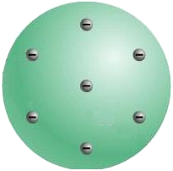
Topic 12: Quantum & nuclear physics - AHL 12.2 – Nuclear physics
Rutherford scattering
•Rutherford proposed that alpha particles would travel more or less straight through the atom without deflection if Thomson’s “plum pudding” model was correct:
scintillation screen
α
α
α
FYI
•Instead of observing minimal scattering as predicted by the “plum pudding” model, Rutherford observed the scattering as shown on the next slide:
Notes:
© 2015 by Timothy K. Lund

Slide 9
Topic 12: Quantum & nuclear physics - AHL 12.2 – Nuclear physics
Rutherford scattering
•Here we see that the deflections are much more scattered...
•Rutherford proposed that all of the positive charge of the atom was located in the center, and he coined the term nucleus for this location.
nucleus
The Rutherford Model
atom
Notes:
© 2015 by Timothy K. Lund

Slide 10
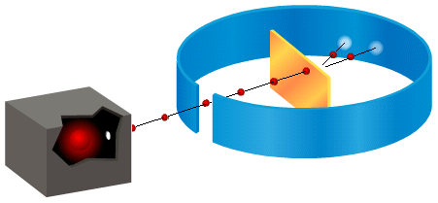
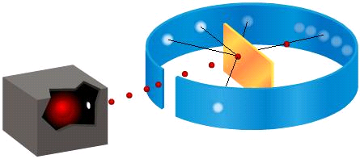
Topic 12: Quantum & nuclear physics - AHL 12.2 – Nuclear physics
Rutherford scattering
expected results
actual results
FYI
•IBO requires you to qualitatively understand the Geiger-Marsden scattering experiment.
Notes:
© 2015 by Timothy K. Lund

Slide 11
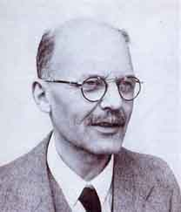
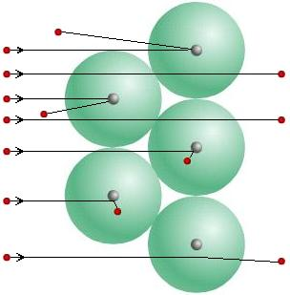
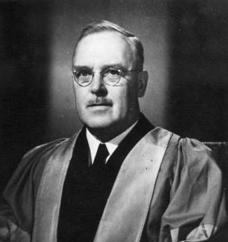
Topic 12: Quantum & nuclear physics - AHL 12.2 – Nuclear physics
Rutherford scattering
•Only by assuming a concentration of positive charge at the center of the atom, as opposed to “spread out” as in the plum pudding model, could Rutherford and his team explain the results of the experiment.
Geiger
Marsden
Notes:
© 2015 by Timothy K. Lund

Slide 12
Topic 12: Quantum & nuclear physics - AHL 12.2 – Nuclear physics
Rutherford scattering
PRACTICE: In the Geiger-Marsden experiment α particles are scattered by gold nuclei. The experimental results indicate that most α particles are
A. Scattered only at small angles.
B. Scattered only at large angles.
C. Absorbed by the target.
D. Scattered back along the original path.
SOLUTION:
•Observing the image…
•Most α particles scatter at small angles.
Notes:
© 2015 by Timothy K. Lund

Slide 13
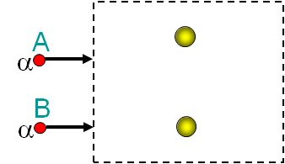
Topic 12: Quantum & nuclear physics - AHL 12.2 – Nuclear physics
Rutherford scattering
PRACTICE: In 1913 Geiger and Marsden fired alpha particles at gold foil. The diagram shows two such alpha particles (α) at A and B and two gold nuclei within the foil. Sketch in the likely paths for each alpha particle within the box.
SOLUTION:
•Since α particles and nuclei are both (+) the α particles will be repelled.
•From A the particle will scatter at a small angle. Remember it is repulsed, not attracted.
•From B the particle will scatter at a large angle.
Notes:
© 2015 by Timothy K. Lund

Slide 14
Topic 12: Quantum & nuclear physics - AHL 12.2 – Nuclear physics
The nuclear radius
•Now let’s calculate a ballpark figure for the nuclear radius by firing an alpha particle (q = +2e) at a nucleus (Q = +Ze). Assume the α begins far enough away that there is no E_{P} between it and the nucleus.
$$E0=E_{K0}+E_{P0}=EK$$
•But as the α approaches the nucleus, repulsion will occur, and $EP=\frac{kQq}{r}$will increase, slowing it down.
•In fact, at closest approach R₀, the α will momentarily stop before reversing direction.
•Thus at the point of closest approach $EK=0$and
$E=E_{K}+E_{P}=\frac{kQq}{R_{0}}=\frac{kZe\left(2e\right)}{R_{0}}=\frac{2Zke^{2}}{R_{0}}$.
R₀
Notes:
© 2015 by Timothy K. Lund

Slide 15
Topic 12: Quantum & nuclear physics - AHL 12.2 – Nuclear physics
The nuclear radius
PRACTICE: Suppose an alpha particle having a kinetic energy of 2.75 MeV is made to approach a silicon nucleus (Z = 14). Find a ballpark figure for the radius to the silicon nucleus.
SOLUTION:
•$EKα=\left(2.75×{10}^{6} eV\right)\left(\frac{1.60 ×{10}^{−19} J}{eV}\right) = 4.40 ×{10}^{−13}$J.
•From conservation of energy, $E0=E$. Thus from the previous page we have $EKα=\frac{2Zke^{2}}{R_{0}}$ which means
$R_{0}=\frac{2Zke^{2}}{E_{kα}}$
$=\frac{2\left(14\right)\left(8.99×{10}^{9}\right){\left(1.60 ×{10}^{−19}\right)}^{2}}{4.40 ×{10}^{−13}}=1.46×{10}^{−14}$ m.
R₀
This is an UPPER limit. Why?
Notes:
© 2015 by Timothy K. Lund

Slide 16
Topic 12: Quantum & nuclear physics - AHL 12.2 – Nuclear physics
The nuclear radius
•Though its proof is beyond the scope of this course, the physical radius of the nucleus also depends on its neutrons, which contribute no charge. Thus the atomic mass number A is used, and here is the result:
$R=R_{0}A^{\frac{1}{3}}$ where R₀ = 1.2×10⁻¹⁵ m
nuclear radius
EXAMPLE: Find the radius of a gold nucleus.
SOLUTION:
•The atomic mass of gold is A =197.
•Thus, the radius of a gold nucleus is
$R=R_{0}A^{\frac{1}{3}}$
$=\left(1.2×{10}^{−15}\right){\left(197\right)}^{\frac{1}{3}}$
$=6.98{10}^{−15}$m.
Notes:
© 2015 by Timothy K. Lund

Slide 17
Topic 12: Quantum & nuclear physics - AHL 12.2 – Nuclear physics
The nuclear radius
$R=R_{0}A^{\frac{1}{3}}$ where R₀ = 1.2×10⁻¹⁵ m
nuclear radius
EXAMPLE: Show that the density of a gold nucleus is about $ρ=2.3{10}^{17}$kg m⁻³.
SOLUTION: Use $ρ=\frac{m}{V}$.
•The mass of a nucleus is given by $m   Am_{p}$.
•The volume of a nucleus is given by $V=\left(\frac{4}{3}\right)πR^{3}$.
•But $R3={\left(R_{0}A^{\frac{1}{3}}\right)}^{3}=R_{0}^{3}A$so that
$V=\left(\frac{4}{3}\right)πR^{3}=\left(\frac{4}{3}\right)πR_{0}^{3}A$.
•Hence $ρ=\frac{m}{V}=\frac{Am_{p}}{\left(\frac{4}{3}\right)πR_{0}^{3}A}$.
$ρ=\frac{1.67×{10}^{−27}}{\left(\frac{4}{3}\right)π{\left(1.2×{10}^{−15}\right)}^{3}}=2.3×{10}^{17}$kg m⁻³.
FYI • Because the A cancelled, ALL nuclei have this density. As do neutron stars!
Notes:
© 2015 by Timothy K. Lund

Slide 18
Topic 12: Quantum & nuclear physics - AHL 12.2 – Nuclear physics
The nuclear radius
PRACTICE: A neutron star is the densest material known and has a density of ρ = 2.3×10¹⁷ kg m⁻³. Calculate the mass and weight of one cubic centimeter of such a star.
SOLUTION: Use $ρ=\frac{m}{V} → m=ρV$.
$V=\left(1 cm^{3}\right){\left(\frac{1 m}{100 cm}\right)}^{3}=1×{10}^{−6}$m³.
$m=ρV=(2.3{10}^{17})(1{10}^{−6})=2.3{10}^{11}$kg.
$W=mg=(2.3{10}^{11})(9.8) = 2.3{10}^{12}$N.
FYI
•This is 230,000,000 tonnes!
Notes:
18
© 2015 by Timothy K. Lund

Slide 19
Topic 12: Quantum & nuclear physics - AHL 12.2 – Nuclear physics
The nuclear radius – determined by diffraction
•In contrast to determination of the radius by head-on collisions with alpha particles, a nuclear diameter D can also be determined by measuring the diffraction of a beam of high-energy electrons or neutrons having a de Broglie wavelength of λ.
•Electrons work well because they do not respond to the strong force inside the nucleus.
•Neutrons work well because they are not affected by the Coulomb force.
•The nuclear barrier acts like a single-slit having a width D. Thus
$$\sin{θ}=\frac{λ}{D}$$
nuclear scattering
Notes:
19
© 2015 by Timothy K. Lund

Slide 20
Topic 12: Quantum & nuclear physics - AHL 12.2 – Nuclear physics
The nuclear radius – determined by diffraction
$$\sin{θ}=\frac{λ}{D}$$
nuclear scattering
EXAMPLE: A beam of 80.0 MeV neutrons are diffracted upon passing through a thin lead foil. The first minimum in the diffraction pattern is measured at 12.6°. Estimate the diameter of the lead nucleus.
SOLUTION: Use $λ=\frac{h}{p}$and $m=1.67{10}^{−27}$kg.
•$EK=(80.0{10}^{6} eV)(1.60{10}^{−19} J/eV)=1.28{10}^{−11}$J.
•Since $EK=\frac{p^{2}}{2m}$we see that
$p^{2}=2mE_{K}=2\left(1.67×{10}^{−27}\right)\left(1.28×{10}^{−11}\right)$
$=4.275{10}^{−38}$
$p = 2.068{10}^{−19}$
Continued…
Notes:
20
© 2015 by Timothy K. Lund

Slide 21
Topic 12: Quantum & nuclear physics - AHL 12.2 – Nuclear physics
The nuclear radius – determined by diffraction
$$\sin{θ}=\frac{λ}{D}$$
nuclear scattering
EXAMPLE: A beam of 80.0 MeV neutrons are diffracted upon passing through a thin lead foil. The first minimum in the diffraction pattern is measured at 12.6°. Estimate the diameter of the lead nucleus.
SOLUTION:
If $p=2.068{10}^{−19}$, then
$λ=\frac{h}{p}=\frac{6.63×{10}^{−34}}{2.068×{10}^{−19}}=3.207×{10}^{−15}$ m.
Thus, $D=\frac{λ}{\sin{θ}}=\frac{3.207×{10}^{−15}}{\sin{12.6°}}$
$=1.47{10}^{−14}$m.
Continued…
Notes:
21
© 2015 by Timothy K. Lund

Slide 22
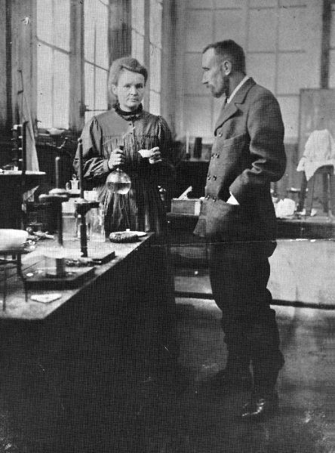
Topic 12: Quantum & nuclear physics - AHL 12.2 – Nuclear physics
Radioactivity
•In 1893, Pierre and Marie Curie announced the discovery of two radioactive elements, radium and polonium.
•When these elements were placed by a radio receiver, that receiver picked up some sort of activity coming from the elements.
•Studies showed this “radioactivity” was not affected by “normal” physical and chemical processes.
Notes:
© 2015 by Timothy K. Lund

Slide 23
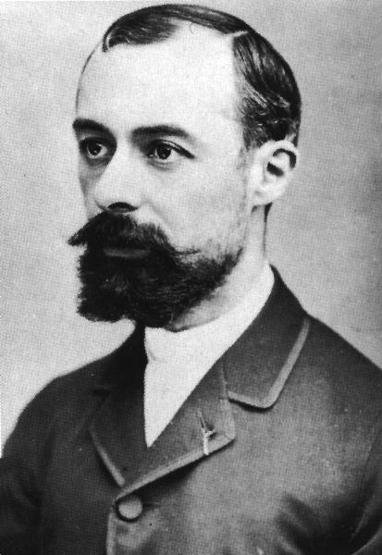
Topic 12: Quantum & nuclear physics - AHL 12.2 – Nuclear physics
Radioactivity
•In 1896, while studying a uranium compound, French scientist Henri Becquerel discovered that a nearby photographic plate had some- how been exposed to some source of "light" even though it had not been uncovered.
•Apparently the darkening of the film was caused by some new type of radiation being emitted by the uranium compound.
•This radiation had sufficient energy to pass through the cardboard storage box and the glass of the photographic plates.
Notes:
© 2015 by Timothy K. Lund

Slide 24
Topic 12: Quantum & nuclear physics - AHL 12.2 – Nuclear physics
Radioactivity
•Studies showed that there were three types of radioactive particles.
•If a radioactive substance is placed in a lead chamber and its emitted particles passed through a magnetic field, as shown, the three different types of radioactivity can be distinguished.
•Alpha particles (α) are two protons and two neutrons. This is identical to a helium nucleus ⁴He.
•Beta particles (β) are electrons that come from the nucleus.
•Gamma rays (γ) are photons and have no charge.
heavy
+2
α
0
γ
-1
β⁻
light
Notes:
© 2015 by Timothy K. Lund

Slide 25
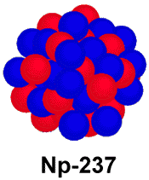
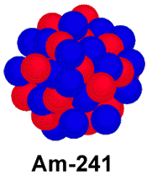
Topic 12: Quantum & nuclear physics - AHL 12.2 – Nuclear physics
Radioactivity – alpha decay (α)
•When a nucleus emits an alpha particle (α) it loses two protons and two neutrons.
•All alpha particles have an energy of about 5 MeV.
•The decay just shown has the form
²⁴¹Am → ²³⁷Np + ⁴He.
•Since the energy needed to knock electrons off of atoms is just about 10 eV, one alpha particle can ionize a lot of atoms.
•It is just this ionization process that harms living tissue, and is much like burning at the cell level.
α
Notes:
© 2015 by Timothy K. Lund

Slide 26
Topic 12: Quantum & nuclear physics - AHL 12.2 – Nuclear physics
Radioactivity – alpha decay (α)
•As we will find out later, the total energy of the americium nucleus will equal the total energy of the neptunium nucleus plus the total energy of the alpha particle.
²⁴¹Am → ²³⁷Np + ⁴He
•According to E = mc² each portion has energy due to mass itself. It turns out that the right hand side is short by about 5 MeV (considering mass only), so the alpha particle must make up for the mass defect by having 5 MeV of kinetic energy.
mass defect of 5 MeV
E_{K} = 5 MeV
Notes:
© 2015 by Timothy K. Lund

Slide 27
Topic 12: Quantum & nuclear physics - AHL 12.2 – Nuclear physics
Radioactivity – beta decay (β)
•There are two types of beta (β) particle decay:
•In β⁻ decay, a neutron becomes a proton and an electron is emitted from the nucleus:
¹⁴C → ¹⁴N + ν + e⁻.
•In β⁺ decay, a proton becomes a neutron and a positron is emitted from the nucleus:
¹⁰C → ¹⁰B + ν + e⁺.
•In short, a beta particle is either an electron or an antielectron.
β⁻
β⁺
Notes:
© 2015 by Timothy K. Lund

Slide 28
Topic 12: Quantum & nuclear physics - AHL 12.2 – Nuclear physics
Radioactivity – beta decay (β)
•In contrast to the alpha particle, it was discovered that beta particles could have a large variety of kinetic energies.
•In order to conserve energy it was postulated that another particle called a neutrino was created to carry the additional E_{K} needed to balance the energy.
same total energy
medium
slow
medium
fast
Notes:
© 2015 by Timothy K. Lund

Slide 29
Topic 12: Quantum & nuclear physics - AHL 12.2 – Nuclear physics
Radioactivity – gamma decay (γ)
•Recall that electrons in an atom moving from an excited state to a de-excited state release a photon.
•Nuclei can also have excited states.
•When a nucleus de-excites, it also releases a photon. This process is called gamma (γ) decay.
²³⁴Pu* → ²³⁴Pu + γ
•Thus gamma decay is evidence that just as the atom has discrete energy levels, so, too, does the nucleus.
FYI
•An asterisk * denotes an excited nucleus.
Notes:
© 2015 by Timothy K. Lund

Slide 30
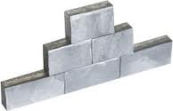
Topic 12: Quantum & nuclear physics - AHL 12.2 – Nuclear physics
The ionizing effect of radiation
•Since alpha particles are charged +2 and are heavy, they are stopped by a few centimeters of air, or even a sheet of paper.
•Beta particles are charged -1 and are smaller and lighter. They can travel a few meters in air, or a few millimeters in aluminum.
•The gamma rays are uncharged and have very high energy. They can travel a few centimeters in lead, or a very long distance through air.
•Neutrinos can travel through miles of lead!
Notes:
© 2015 by Timothy K. Lund

Slide 31
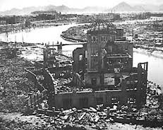
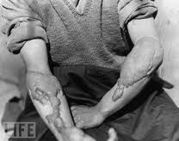
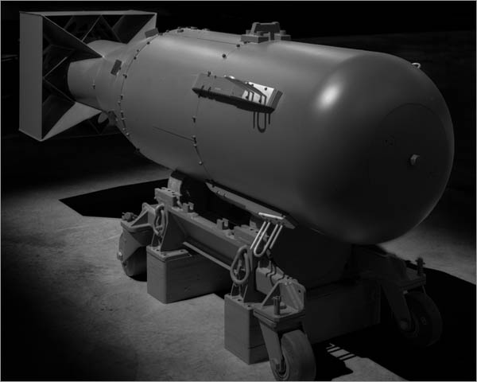
Topic 12: Quantum & nuclear physics - AHL 12.2 – Nuclear physics
The ionizing effect of radiation
•In living organisms, radiation causes its damage mainly by ionization in the living cells.
•All three particles energize atoms in the living tissue to the point that they lose electrons and become charged (ions).
•All three are thus detrimental to living cells.
Notes:
© 2015 by Timothy K. Lund

Slide 32
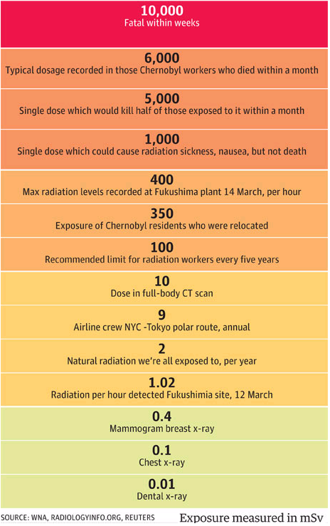
Topic 12: Quantum & nuclear physics - AHL 12.2 – Nuclear physics
The ionizing effect of radiation
•High exposure: damage to central nervous system and death within weeks.
•Medium exposure: damage to stomach and intestines leading to general sickness and diarrhea.
•Low exposure: hair loss, bleeding and diarrhea.
FYI
•There is evidence that cancer and genetic mutations can occur after exposure to radiation.
Notes:
© 2015 by Timothy K. Lund

Slide 33
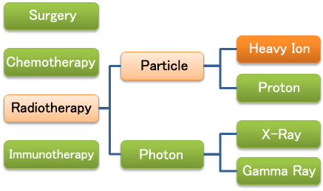
Topic 12: Quantum & nuclear physics - AHL 12.2 – Nuclear physics
The ionizing effect of radiation
•There are uses for radiation…
-X-rays of teeth and bones
-radiotherapy for cancer treatment
Cancer treatment
FYI
•In radiotherapy radiation is used because rapidly dividing cancer cells are more susceptible to the damaging effects of radiation than healthy cells.
Notes:
© 2015 by Timothy K. Lund

Slide 34
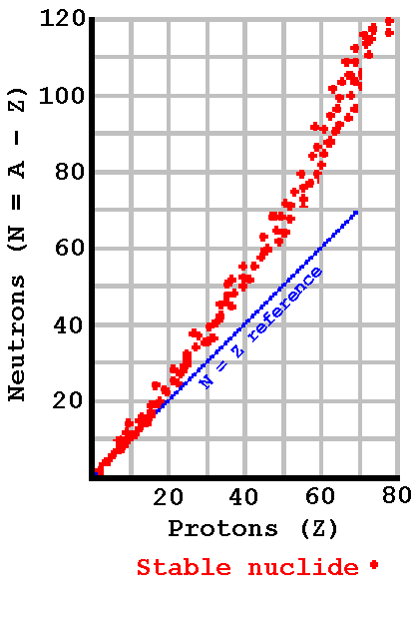
²⁰²Hg(1.53:1)
₈₀
Topic 12: Quantum & nuclear physics - AHL 12.2 – Nuclear physics
Unstable region
Too many neutrons
β⁻ decay.
Nuclear stability
•Why are some nuclei stable and others unstable.
•Stable isotopes exist for elements having atomic numbers Z = 1 to 83.
•Up to Z = 20, the neutron- proton ratio is close to 1.
•Beyond Z = 20, the neutron -proton ratio is bigger than 1, and grows with atomic number.
•The extra neutrons add to the strong force without increasing the repulsive Coulomb force.
¹¹⁰Cd(1.29:1)
₄₈
Unstable region
Too many protons
β⁺ decay
⁶Li(1.00:1)
₃
Unstable nuclides
Notes:
© 2015 by Timothy K. Lund

Slide 35
DECAY SERIES for ²³⁸U
147
146
145
144
143
142
141
140
139
138
137
136
135
134
133
132
131
130
129
128
127
126
125
124
123
²³⁸U
²³⁴Th
α
β
²³⁴Pa
β
²³⁴U
²³⁰Th
α
²²⁶Ra
α
²²²Rn
α
Question: What type of beta decay is represented in this decay series?
Neutron Number (N)
²¹⁸Po
α
²¹⁴Pb
α
β
²¹⁸At
Answer: Since Z increases and N decreases, it must be β⁻ decay.
α
β
²¹⁴Bi
²¹⁰Tl
α
β
²¹⁴Po
Question: What would β⁺ decay look like? (N increases and Z decreases.)
β
α
²¹⁰Pb
β
²¹⁰Bi
²⁰⁶Tl
α
β
²¹⁰Po
Answer: The arrow would point LEFT and UP one unit each.
α
β
β
²⁰⁶Pb (STABLE)
80 81 82 83 84 85 86 87 88 89 90 91 92 93 94 95
Proton Number (Z)
Notes:
© 2015 by Timothy K. Lund

Slide 36
Topic 12: Quantum & nuclear physics - AHL 12.2 – Nuclear physics
Radioactive half-life
•As we have seen, some nuclides are unstable.
•What this means is that an unstable nucleus may spontaneously decay into another nucleus (which may or may not be stable).
•Given many identical unstable nuclides, which particular ones will decay in any particular time is impossible to predict.
•In other words, the decay process is random.
•But random though the process is, if there is a large enough population of an unstable nuclide, the probability that a certain proportion will decay in a certain time is well defined.
Notes:
© 2015 by Timothy K. Lund

Slide 37
Topic 12: Quantum & nuclear physics - AHL 12.2 – Nuclear physics
Radioactive half-life
EXAMPLE: Here we have a collection of unstable Americium-241 nuclides.
•We don’t know which particular nucleus will decay next.
•All we can say is that a certain proportion will decay in a certain amount of time.
•The quantum tunneling allowed by the Heisenberg uncertainty principle explains the probability of decay.
Notes:
© 2015 by Timothy K. Lund

Slide 38
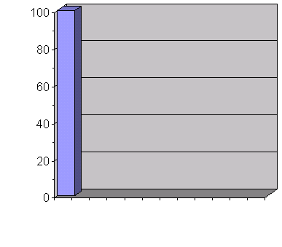
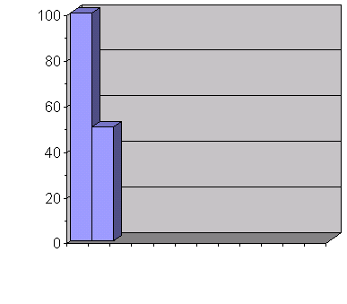
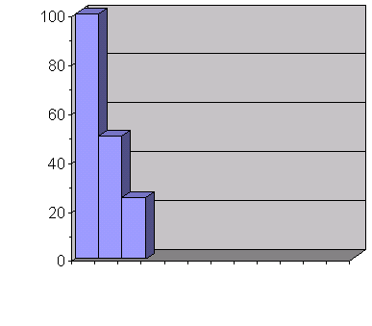
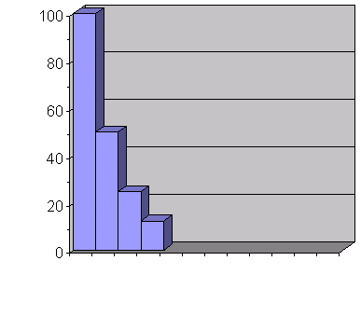
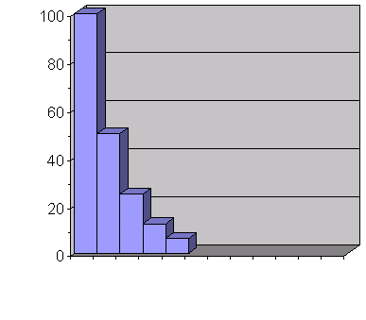
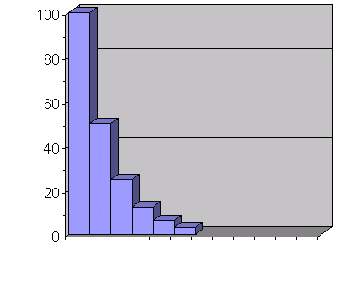
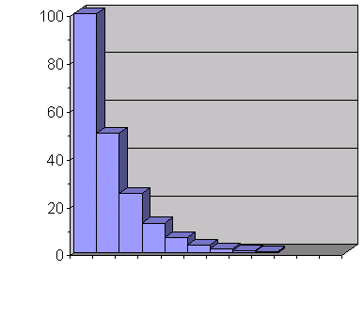
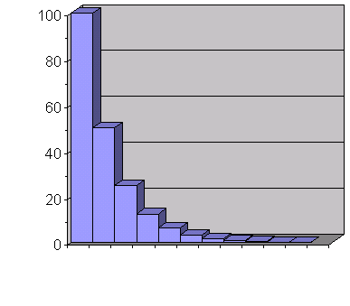
Topic 12: Quantum & nuclear physics - AHL 12.2 – Nuclear physics
Radioactive half-life
•Obviously the higher the population of Americium-241 there is, the more decays there will be in a time interval.
•But each decay decreases the population.
•Hence the decay rate decreases over time for a fixed sample.
•It is an exponential decrease in decay rate.
²⁴¹Am remaining
Time axis
Notes:
© 2015 by Timothy K. Lund

Slide 39
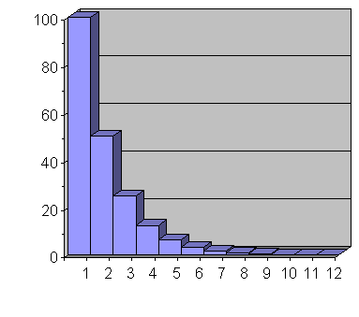
Topic 12: Quantum & nuclear physics - AHL 12.2 – Nuclear physics
Radioactive half-life
•We call the time it takes half of the population of an unstable nuclide to decay the radioactive half-life of that nuclide.
•Thus the previous graph had the time axis in increments of half-life.
•From the graph we see that half of the original 100 nuclei have decayed after 1 half-life.
•Thus after 1 half-life, only 50 of the original population of 100 have retained their original form.
•And the process continues…
N (population)
Time (half-lives)
Notes:
© 2015 by Timothy K. Lund

Slide 40
Topic 12: Quantum & nuclear physics - AHL 12.2 – Nuclear physics
The law of radioactive decay and the decay constant
•The higher the initial population of a radioactive material, the more decays there will be in a time interval.
•But each decay decreases the population.
•Hence the decay rate decreases over time for a fixed sample and it is an exponential decrease.
where N₀ is the initial population, N is the new one, t is the time, and λ is the decay constant.
Radioactive material remaining
Time in half-lives
N = N₀e ^{-λt}
law of radioactive decay
Notes:
© 2015 by Timothy K. Lund

Slide 41
Topic 12: Quantum & nuclear physics - AHL 12.2 – Nuclear physics
The law of radioactive decay and the decay constant
EXAMPLE: Show that the relationship between half-life and decay constant is given by $T_{\text{½}}=\frac{ln 2}{λ}$.
SOLUTION:
Use $N=N_{0}e^{−λt}$. Then $N=\frac{N_{0}}{2}$when $t=T_{\text{½}}$.
$N=N_{0}e^{−λt}$
$\frac{N_{0}}{2}$ $=N_{0}e^{−λT_{\text{½}} }$
$\left(\frac{1}{2}\right)=e^{−λT_{\text{½}}}$
$\ln\left(\frac{1}{2}\right)=−λT_{\text{½}}$
$–\ln\left(\frac{1}{2}\right)=λT_{\text{½}}$
$ln⁡2 =λT_{\text{½}}$
Exponential decay function.
Substitution.
Cancel N₀.
ln x and e^{x} are inverses.
Multiply by ⁻1.
– ln $\left(\frac{1}{x}\right)$ = +ln x.
$$T_{\text{½}} =\frac{ln 2}{λ}$$
decay constant and half-life
Notes:
© 2015 by Timothy K. Lund

Slide 42
Topic 12: Quantum & nuclear physics - AHL 12.2 – Nuclear physics
The law of radioactive decay and the decay constant
EXAMPLE: The half-life of U-238 is 4.5×10¹⁰ y and for I-123 is 13.3 h. Find the decay constant for each radioactive nuclide.
SOLUTION:
•Use $T_{\text{½}} =\frac{ln 2}{λ}$. Then $λ=\frac{ln 2}{T_{\text{½}}}$.
•For U-238 we have
$λ=\frac{ln 2}{T_{\text{½}}}=\frac{0.693}{4.5×{10}^{10} y}=1.5×{10}^{−11}$y⁻¹.
•For I-123 we have
$λ=\frac{ln 2}{T_{\text{½}}}=\frac{0.693}{13.3 h}=0.052$h⁻¹.
FYI
•The decay constant is the probability of decay of a nucleus per unit time.
Notes:
© 2015 by Timothy K. Lund

Slide 43
Topic 12: Quantum & nuclear physics - AHL 12.2 – Nuclear physics
The law of radioactive decay and the decay constant
PRACTICE: Radioactive decay is a random process. This means that
A. a radioactive sample will decay continuously.
B. some nuclei will decay faster than others.
C. it cannot be predicted how much energy will be released.
D. it cannot be predicted when a particular nucleus will decay.
SOLUTION:
Just know this!
Notes:
43
© 2015 by Timothy K. Lund

Slide 44
Topic 12: Quantum & nuclear physics - AHL 12.2 – Nuclear physics
The law of radioactive decay and the decay constant
EXAMPLE: Suppose the activity of a radioactive sample decreases from X Bq to X / 16 Bq in 80 minutes. What is the half-life of the substance?
SOLUTION: Since A is proportional to N₀ we have
N₀ → $\left(\frac{1}{2}\right)$N₀ → $\left(\frac{1}{4}\right)$N₀ → $\left(\frac{1}{8}\right)$N₀ → $\left(\frac{1}{16}\right)$N₀
so that 4 half-lives = 80 min and t_{half} = 20 min.
t_{half}
t_{half}
t_{half}
t_{half}
Notes:
44
© 2015 by Timothy K. Lund

Slide 45
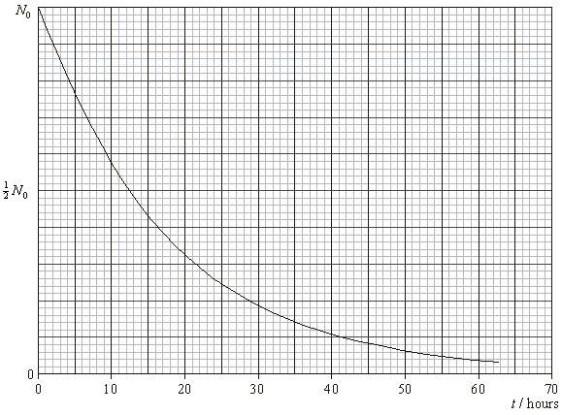
Topic 12: Quantum & nuclear physics - AHL 12.2 – Nuclear physics
The law of radioactive decay and the decay constant
EXAMPLE: Find the half-life of the radioactive nuclide shown here. N₀ is the starting population of the nuclides.
SOLUTION:
•Find the time at which the population has halved…
•The half-life is about 12.5 hours.
Notes:
45
© 2015 by Timothy K. Lund

Slide 46
Topic 12: Quantum & nuclear physics - AHL 12.2 – Nuclear physics
The law of radioactive decay and the decay constant
EXAMPLE: Suppose you have 64 grams of a radioactive material which decays into 1 gram of radioactive material in 10 hours. What is the half-life of this material?
SOLUTION:
•The easiest way to solve this problem is to keep cutting the original amount in half...
•Note that there are 6 half-lives in 10 h = 600 min.
•Thus t_{half} = 100 min.
64
32
16
8
4
2
1
t_{half}
t_{half}
t_{half}
t_{half}
t_{half}
t_{half}
Notes:
46
© 2015 by Timothy K. Lund

Slide 47
Topic 12: Quantum & nuclear physics - AHL 12.2 – Nuclear physics
The law of radioactive decay and the decay constant
EXAMPLE: A nuclide X has a half-life of 10 s. On decay a stable nuclide Y is formed. Initially, a sample contains only the nuclide X. After what time will 87.5% of the sample have decayed into Y?
A. 9.0 s B. 30 s C. 80 s D. 90 s
SOLUTION:
•We want only 12.5% of X to remain.
•Thus t = 3t_{half} = 3(10) = 30 s.
100%
50%
25%
12.5%
t_{half}
t_{half}
t_{half}
Notes:
47
© 2015 by Timothy K. Lund

Slide 48
Topic 12: Quantum & nuclear physics - AHL 12.2 – Nuclear physics
The law of radioactive decay and the decay constant
•60 days is 2 half-lives for P so N_{P} is $\frac{1}{4}$ of what it started out as.
•60 days is 3 half-lives for Q so N_{Q} is $\frac{1}{8}$ of what it started out as.
•Thus $\frac{N_{P}}{N_{Q}}=\frac{\left(\frac{1}{4}\right)}{\left(\frac{1}{8}\right)}=\left(\frac{1}{4}\right)×\left(\frac{8}{1}\right)=\frac{8}{4}=2$.
Notes:
48
© 2015 by Timothy K. Lund

Slide 49
Topic 12: Quantum & nuclear physics - AHL 12.2 – Nuclear physics
Some typical half-lives
Nuclide
Primary Decay
Half-Life
Rubidium-87
β-
4.7×10¹⁰ y
Uranium-238
α
4.5×10⁹ y
Plutonium-239
α
2.4×10⁴ y
Carbon-14
β-
5730 y
Radium-226
α
1600 y
Strontium-90
β-
28 y
Cobalt-60
β-
5.3 y
Radon-222
α
3.82 d
Iodine-123
EC
13.3 h
Polonium-218
α , β-
3.05 min
Oxygen-19
β-
27 s
Polonium-213
α
4×10⁻¹⁶ s
Notes:
© 2015 by Timothy K. Lund

Slide 50
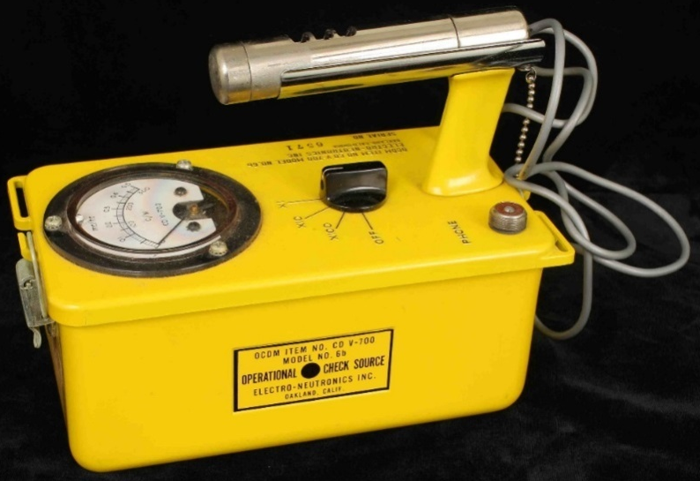
Topic 12: Quantum & nuclear physics - AHL 12.2 – Nuclear physics
Decay rates
•Rather than measuring the amount of remaining radioactive nuclide there is in a sample (which is hard to do) we measure instead the decay rate (which is much easier).
•Decay rates are measured using various devices, most commonly the Geiger-Mueller counter.
•Decay rates are measured in Becquerels (Bq).
I Bq = 1 $\frac{decay}{second}$
Becquerel decay rate
Notes:
© 2015 by Timothy K. Lund

Slide 51
Topic 12: Quantum & nuclear physics - AHL 12.2 – Nuclear physics
Decay rates
•The activity rate A is given by
•The ΔN is the change in the number of nuclei, and is negative (the radioactive sample loses population with each decay).
•The negative sign is in $A=−\frac{ΔN}{Δt}$ to make the activity A positive.
•$A=λN$shows that the activity is proportional to the remaining population of radioactive nuclei.
•Since $N=N_{0}e^{−λt}$the last equation $A=λN_{0}e^{−λt}$ is true.
$$A=–\frac{ΔN}{Δt}=λN=λN_{0}e^{−λt}$$
decay rate or activity
Notes:
© 2015 by Timothy K. Lund

Slide 52
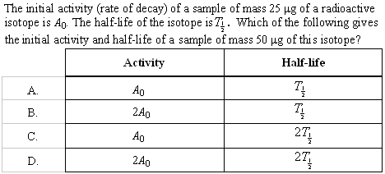
Topic 12: Quantum & nuclear physics - AHL 12.2 – Nuclear physics
Decay rates
•Recall that the activity is proportional to the number radioactive atoms.
•But the half-life is the same for any amount of the atoms…
Notes:
© 2015 by Timothy K. Lund

Slide 53
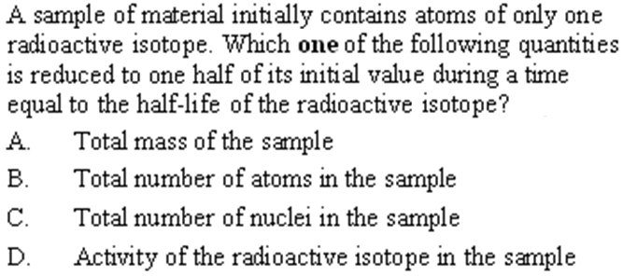
Topic 12: Quantum & nuclear physics - AHL 12.2 – Nuclear physics
Decay rates
•Remember that the mass of the material does not change appreciatively during radioactive decay.
•Nuclei are just transmuted.
Notes:
53
© 2015 by Timothy K. Lund

Slide 54
Topic 12: Quantum & nuclear physics - AHL 12.2 – Nuclear physics
Radioactive decay
⁰e
¹p
₁
₁
It is a proton.
•If you look at the lower numbers you see that we are short a positive charge on the right:
•The only two particles with a positive charge (that we have studied) are the beta+ and the proton.
•Looking at the nucleon number we see that it must be the proton.
Notes:
© 2015 by Timothy K. Lund

Slide 55
Topic 12: Quantum & nuclear physics - AHL 12.2 – Nuclear physics
Radioactive decay
•The CO₂ in the atmosphere has a specific percentage of carbon-14.
•The moment the wood dies, the carbon-14 is NOT replenished.
•Since the carbon-14 is always disintegrating and is NOT being replenished in the dead wood, its activity will decrease over time.
Notes:
© 2015 by Timothy K. Lund

Slide 56
Topic 12: Quantum & nuclear physics - AHL 12.2 – Nuclear physics
Radioactive decay
•From $Thalf=\frac{\ln{2}}{λ}$ we get$λ=\frac{\ln{2}}{Thalf}=\frac{0.693}{5500}=0.00013 \text{y}\text{−1}$
•From $A=λN$we see that in the beginning $9.6=λN0$and now $2.1=λN$.
•Thus $N=N_{0}e^{−λt}$becomes $2.1=9.6e^{−λt}$so that $\frac{2.1}{9.6}=e^{−λt}$ → $\ln\left(\frac{2.1}{9.6}\right)=\ln\left(e^{−λt}\right)$→ $−1.5198=−λt$
•Thus $t=\frac{1.5198}{0.00013}=12000$y.
Notes:
© 2015 by Timothy K. Lund

Slide 57
Topic 12: Quantum & nuclear physics - AHL 12.2 – Nuclear physics
Radioactive decay
•The activity would be too small to be reliable.
•For this sample
A = 9.1e^{-λt} becomes
A = 9.1e^{-0.00013(20000)} = 0.68 decay min⁻¹.
Notes:
© 2015 by Timothy K. Lund

Slide 58
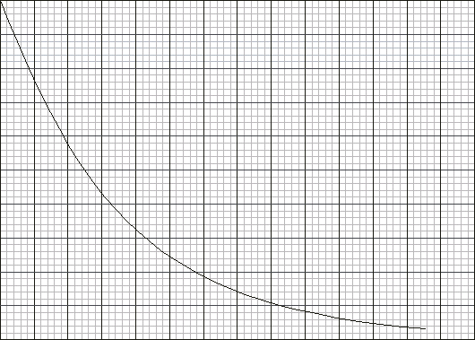
Topic 12: Quantum & nuclear physics - AHL 12.2 – Nuclear physics
Radioactive decay
PRACTICE: A sample of radioactive carbon-14 decays into a stable isotope of nitrogen. As the carbon-14 decays, the rate at which the amount of nitrogen is produced
A. decreases linearly with time.
B. increases linearly with time.
C. decreases exponentially with time.
D. increases exponentially with time.
SOLUTION:
•The key here is that the sample mass remains constant. The nuclides are just changing in their proportions.
•Note that the slope (rate) of the red graph is decreasing exponentially with time.
Carbon
Nitrogen
Notes:
© 2015 by Timothy K. Lund

Slide 59
Topic 12: Quantum & nuclear physics - AHL 12.2 – Nuclear physics
Radioactive decay
PRACTICE: An isotope of radium has a half-life of 4 days. A freshly prepared sample of this isotope contains N atoms. The time taken for $\frac{7N}{8}$of the atoms of this isotope to decay is
A. 32 days.
B. 16 days.
C. 12 days.
D. 8 days.
SOLUTION: Read the problem carefully. If $\frac{7N}{8}$has decayed, only $\frac{1N}{8}$atoms of the isotope remain.
N→$\left(\frac{1}{2}\right)$N →$\left(\frac{1}{4}\right)$N →$\left(\frac{1}{8}\right)$N is 3 half-lives.
That would be 12 days since each half-life is 4 days.
Notes:
59
© 2015 by Timothy K. Lund

Slide 60
Topic 12: Quantum & nuclear physics - AHL 12.2 – Nuclear physics
Radioactive decay
•Isotopes of an element have the same number of protons and electrons, but differing numbers of neutrons.
42
β⁻
•The lower left number is the number of protons.
•Since protons are positive, the new atom has one more positive value than the old.
•Thus a neutron decayed into a proton and an electron (β⁻) decay.
•And the number of nucleons remains the same…
Notes:
© 2015 by Timothy K. Lund

Slide 61
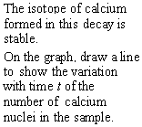
Topic 12: Quantum & nuclear physics - AHL 12.2 – Nuclear physics
Radioactive decay
•Just “flip” the original curve so that the amounts always add up to N₀.
Notes:
61
© 2015 by Timothy K. Lund

Slide 62
Topic 12: Quantum & nuclear physics - AHL 12.2 – Nuclear physics
Radioactive decay
•Recall that γ-ray decay happens when the nucleus goes from an excited state to a de-excited state.
•It is the gamma decay that leads us to the conclusion that excited nuclei, just like excited atoms, release photons of discrete energy, implying discrete energy levels.
Notes:
62
© 2015 by Timothy K. Lund

Slide 63
Topic 12: Quantum & nuclear physics - AHL 12.2 – Nuclear physics
Radioactive decay
•Since the ratio is $\frac{1}{2}$, for each nickel atom there are 2 cobalt atoms.
•Thus, out of every three atoms, 1 is nickel and 2 are cobalt.
•Thus, the remaining cobalt is $\left(\frac{2}{3}\right)$N₀.
Notes:
63
© 2015 by Timothy K. Lund

