Slide 1
Topic 11: Electromagnetic induction - AHL 11.3 – Capacitance
Topic 11.3 is an extension of Topics 5.1, 5.4, and 10.2.
Essential idea: Capacitors can be used to store electrical energy for later use.
Nature of science: Relationships: Examples of exponential growth and decay pervade the whole of science. It is a clear example of the way that scientists use mathematics to model reality. This topic can be used to create links between physics topics but also to uses in chemistry, biology, medicine and economics.
Notes:
© 2015 by Timothy K. Lund

Slide 2
Topic 11: Electromagnetic induction - AHL 11.3 – Capacitance
Understandings:
• Capacitance
• Dielectric materials
• Capacitors in series and parallel
• Resistor-capacitor (RC) series circuits
• Time constant
Notes:
2
© 2015 by Timothy K. Lund

Slide 3
Topic 11: Electromagnetic induction - AHL 11.3 – Capacitance
Applications and skills:
• Describing the effect of different dielectric materials on capacitance
• Solving problems involving parallel-plate capacitors
• Investigating combinations of capacitors in series or parallel circuits
• Determining the energy stored in a charged capacitor
• Describing the nature of the exponential discharge of a capacitor
• Solving problems involving the discharge of a capacitor through a fixed resistor
• Solving problems involving the time constant of an RC circuit for charge, voltage and current
Notes:
3
© 2015 by Timothy K. Lund

Slide 4
Topic 11: Electromagnetic induction - AHL 11.3 – Capacitance
Guidance:
• Only single parallel-plate capacitors providing a uniform electric field, in series with a load, need to be considered (edge effect will be neglected)
• Problems involving the discharge of capacitors through fixed resistors need to be treated both graphically and algebraically
• Problems involving the charging of a capacitor will only be treated graphically
• Derivation of the charge, voltage and current equations as a function of time is not required
Notes:
4
© 2015 by Timothy K. Lund

Slide 5
Topic 11: Electromagnetic induction - AHL 11.3 – Capacitance
Data booklet reference:
• $C=\frac{q}{V}$
• $Cparallel = C1+C2+…$
• $\frac{1}{C_{series}}=\frac{1}{C_{1}}+\frac{1}{C_{2}}+…$
• $C=\frac{εA}{d}$
• $E=\left(\frac{1}{2}\right)CV^{2}$
• $τ=RC$
• $q=q_{0}e^{−\left(\frac{t}{τ}\right)}$
• $I=I_{0}e^{−\left(\frac{t}{τ}\right)}$
• $V=V_{0}e^{−\left(\frac{t}{τ}\right)}$
Notes:
5
© 2015 by Timothy K. Lund

Slide 6
Topic 11: Electromagnetic induction - AHL 11.3 – Capacitance
International-mindedness:
• Lightning is a phenomenon that has fascinated physicists from Pliny through Newton to Franklin. The charged clouds form one plate of a capacitor with other clouds or Earth forming the second plate. The frequency of lightning strikes varies globally, being particularly prevalent in equatorial regions. The impact of lightning strikes is significant with many humans and animals being killed annually and huge financial costs to industry from damage to buildings, communication and power transmission systems, and delays or the need to reroute air transport.
Notes:
6
© 2015 by Timothy K. Lund

Slide 7
Topic 11: Electromagnetic induction - AHL 11.3 – Capacitance
Utilization:
• The charge and discharge of capacitors obeys rules that have parallels in other branches of physics including radioactivity (see Physics sub-topic 7.1)
Notes:
7
© 2015 by Timothy K. Lund

Slide 8
Topic 11: Electromagnetic induction - AHL 11.3 – Capacitance
Aims:
• Aim 3: the treatment of exponential growth and decay by graphical and algebraic methods offers both the visual and rigorous approach so often characteristic of science and technology
• Aim 6: experiments could include (but are not limited to): investigating basic RC circuits; using a capacitor in a bridge circuit; examining other types of capacitors; verifying time constant Essential idea: Generation and transmission of alternating current (ac) electricity has transformed the world.
Notes:
8
© 2015 by Timothy K. Lund

Slide 9
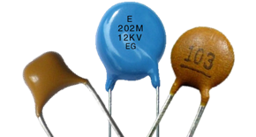
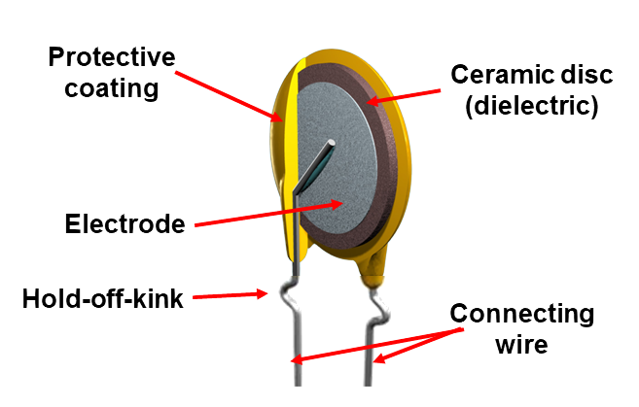
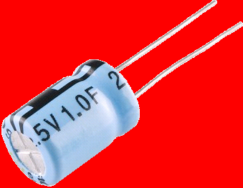
Topic 11: Electromagnetic induction - AHL 11.3 – Capacitance
Capacitance
•A capacitor is an electronic device that stores charge.
•In its simplest form, it is made up of two separated parallel plates. In between the plates we can have air, vacuum, or a non-conductive material called a dielectric.
•Although there are other types of capacitors, in this topic we will study the parallel plate capacitor. Its schematic is shown here, and is comprised of two parallel lines.
•An electrolytic capacitor has a higher capacity than a parallel plate capacitor.
Notes:
9
© 2015 by Timothy K. Lund

Slide 10
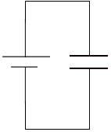
Topic 11: Electromagnetic induction - AHL 11.3 – Capacitance
Capacitance
•We define the capacitance C to be the charge q per unit voltage V which the capacitor is capable of maintaining.
•The units for capacitance are Coulombs per volt which are called farads and abbreviated F.
$$C=\frac{q}{V}$$
definition of capacitance
EXAMPLE: A 1.50-V cell is connected to a 275 μF capacitor in the circuit shown. How much charge is stored on the capacitor’s plates?
SOLUTION: Use $C=\frac{q}{V}$→ $q=CV$.
$q$ = $CV$ = 275×10⁻⁶×1.50 = 4.13 ×10⁻⁴ C.
FYI
•Don’t confuse $C$ (capacitance) with C (Coulombs).
Notes:
10
© 2015 by Timothy K. Lund

Slide 11
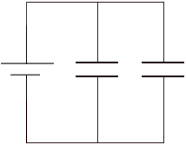
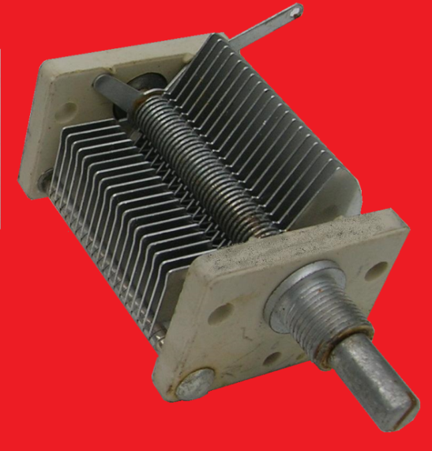
Topic 11: Electromagnetic induction - AHL 11.3 – Capacitance
Capacitance – parallel
•Just as we connected resistors in parallel, so too can we connect capacitors.
•Because the capacitors are in parallel, they each have the cell’s voltage V.
•Thus V = V₁ = V₂.
•From C = $\frac{q}{V}$we get q = CV. Thus
q = CV, q₁ = C₁V₁ , and q₂ = C₂V₂.
•Conservation of charge tells us that q = q₁ + q₂:
CV = C₁V₁ + C₂V₂
CV = C₁V + C₂V
C = C₁ + C₂
V
C₁
C₂
a variable capacitor takes advantage of many parallel plates…
C = C₁ + C₂ + …
parallel capacitance
Notes:
11
© 2015 by Timothy K. Lund

Slide 12
Topic 11: Electromagnetic induction - AHL 11.3 – Capacitance
Capacitance – parallel
V
C₁
C₂
EXAMPLE: A 1.50-V cell is connected to C₁ = 275 μF and C₂ = 38 μF in the circuit.
(a) What value should a single replacement capacitor have?
SOLUTION: The capacitors are in parallel.
C = C₁ + C₂ = 275×10⁻⁶ + 38×10⁻⁶
= 313×10⁻⁶ F.
(b) How much charge has the battery placed on the capacitors?
SOLUTION:
q = CV = 313×10⁻⁶×1.50
= 470×10⁻⁶ C.
Notes:
12
© 2015 by Timothy K. Lund

Slide 13
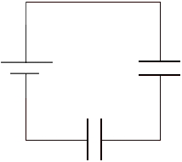
Topic 11: Electromagnetic induction - AHL 11.3 – Capacitance
Capacitance – series
•We can also connect capacitors in series:
•Because the capacitors are in series, they each have the same charge $q$.
•Thus $q=q1=q2$.
•From $C=\frac{q}{V}$we get $V=\frac{q}{C}$. Thus
$V=\frac{q}{C}$, $V1=\frac{q1}{C1}$, and $V2=\frac{q2}{C2}$.
•Conservation of energy tells us that $V=V1+V2$so that
$\frac{q}{C} =\frac{q1}{C1}+\frac{q2}{C2}$
V
C₂
C₁
$⇒ \frac{1}{C}=\frac{1}{C1}+\frac{1}{C2}$
$$\frac{1}{C}=\frac{1}{C1}+\frac{1}{C2} +…$$
series capacitance
FYI Note that the series/parallel formulas for capacitance are reversed from those for resistance!
Notes:
13
© 2015 by Timothy K. Lund

Slide 14
Topic 11: Electromagnetic induction - AHL 11.3 – Capacitance
V
C₂
Capacitance – series
EXAMPLE: A 1.50-V cell is connected to C₁ = 275μF and C₂ = 38 μF in the circuit.
(a) What value should a single replacement capacitor have?
SOLUTION: The capacitors are in series.
$\frac{1}{C} =\frac{1}{C1}+\frac{1}{C2}$
$=\frac{1}{275×{10}^{−6}} +\frac{1}{38×{10}^{−6}} = 29952.2$.
$C=\frac{1}{29952.2} = 3.34×{10}^{−5}$F.
(b) How much charge has the battery placed on each capacitor? What are their voltages?
SOLUTION: Series capacitors have the same charge.
$q=CV=\left(3.34×{10}^{−5}\right)(1.50) = 5.01×{10}^{−5}$C.
$V1=\frac{q1}{C1} =\frac{5.01×{10}^{−5}}{275×{10}^{−6}} = 0.18$V.
$V2=\frac{q2}{C2} =\frac{5.01×{10}^{−5}}{38×{10}^{−6}} = 1.32$V.
C₁
Note that ΣV_{Ci} = V.
Notes:
14
© 2015 by Timothy K. Lund

Slide 15
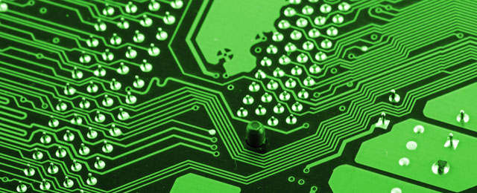
Topic 11: Electromagnetic induction - AHL 11.3 – Capacitance
Dielectric materials
•A simple capacitor consists of two conductors separated by non-conductive space.
•Thus, even the wires in an electronic circuit have capacitance. In extremely high frequency circuits this inter-wire capacitance may cause problems and must be minimized through proper design.
•Capacitors are, however, used in most electronics devices, and large capacity in small space is the premium.
•Capacitors are used as filters, coupling devices, voltage smoothing (as in the full-wave rectifier), and timing devices.
+ + + + + +
– – – – – –
Notes:
15
© 2015 by Timothy K. Lund

Slide 16
Topic 11: Electromagnetic induction - AHL 11.3 – Capacitance
Dielectric materials
•When capacitance is desired, large capacity in a small space is the premium.
•In order to increase the ability of a capacitor to store charge, we use conductive plates instead of wires.
•There are two ways to increase the capacitance.
1: Increase the area over which charge can be stored (thus the like charges can “spread out” and chill in their own personal space).
2: Decrease the distance between the plates (thus the charges on the opposite plates attract even more to each other, making it easier for the cell to “pump” charge into the device).
d
A
Notes:
16
© 2015 by Timothy K. Lund

Slide 17
Topic 11: Electromagnetic induction - AHL 11.3 – Capacitance
Dielectric materials
•Because the attractive force between charges is, by Coulomb’s law, $F=\frac{kq_{1}q_{2}}{d^{2}}$, we see that it grows quadratically with decreasing plate separation d.
•Charge leakage can occur through air or vacuum. So what manufacturers do is they place a non-conductive material called a dielectric between the plates. This will both reduce arcing and the electric force, increasing the capacity of the capacitor.
•The epsilon ε is the permittivity of the dielectric. Recall that the permittivity of free space (and air) is ε₀ = 8.85×10⁻¹² F m⁻¹.
dielectric
$$C=\frac{εA}{d}$$
parallel-plate capacitor
Notes:
17
© 2015 by Timothy K. Lund

Slide 18
Topic 11: Electromagnetic induction - AHL 11.3 – Capacitance
Dielectric materials
•What a dielectric material does is it essentially reduces the electric field by the ratio $\frac{ε_{0}}{ε}$.
•The way it does this is that the molecules in the dielectric material are polarized in response to the electric field of the plates, and create an oppositely-oriented electric field.
•This dielectric field cancels some of the original field, thereby diminishing the overall E-field between the plates.
•From $q=CV$and recalling from 10.2 that $V=Ed$, we see that $\frac{q}{C}=V=Ed$so that $C=\frac{q}{Ed}$. This tells us that the smaller the electric field is, the larger the capacitance.
Notes:
18
© 2015 by Timothy K. Lund

Slide 19
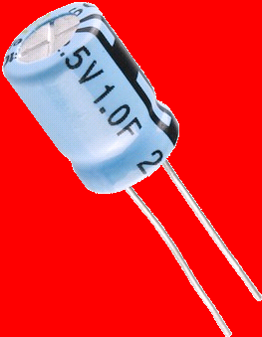
Topic 11: Electromagnetic induction - AHL 11.3 – Capacitance
Dielectric materials
EXAMPLE: A 275 μF capacitor will be manufactured using a dielectric having a permittivity of 4.00ε₀ and circular plates having a diameter of 2.50 cm. What should the plate separation (and the thickness of the dielectric) be? Is it likely that this large a capacity could be constructed using parallel plate architecture?
SOLUTION: Use $C=\frac{εA}{d}$.
•The area in the formula is the area of one plate.
$A =\frac{πd^{2}}{4} =\frac{π{\left(2.50×{10}^{−2}\right)}^{2}}{4}=4.909×{10}^{−4}$ m².
$d =\frac{εA}{C}=\frac{\left(4.00\right)\left(8.85×{10}^{−12}\right)\left(4.909×{10}^{−4}\right)}{275×{10}^{−6}}=6.32×{10}^{−11}$ m.
•Given that the plate separation is of the order of an atomic diameter, it is very unlikely that one could construct a 275 μF parallel plate capacitor.
Notes:
19
© 2015 by Timothy K. Lund

Slide 20
Topic 11: Electromagnetic induction - AHL 11.3 – Capacitance
Energy stored in a capacitor
•From the relationship $C=\frac{q}{V}$we can write $V=\left(\frac{1}{C}\right)q$.
•We see, then, that the graph of V vs. q is a straight line having a slope of $\left(\frac{1}{C}\right)$:
•Recall that the work done by a cell is given by $W=qV$, provided $V$ and $q$ are constant. If they are not constant, $W$ = area under the $V$ vs. $q$ graph.
•Since the area of a triangle is $\left(\frac{1}{2}\right)bh$we have $W=\left(\frac{1}{2}\right)qV$.
•From conservation of energy, this is then the energy stored in a capacitor.
V
q
$$E=\left(\frac{1}{2}\right)qV=\left(\frac{1}{2}\right)CV2$$
energy stored in a capacitor
Notes:
20
© 2015 by Timothy K. Lund

Slide 21
Topic 11: Electromagnetic induction - AHL 11.3 – Capacitance
Energy stored in a capacitor
E = ½qV = ½CV ²
energy stored in a capacitor
PRACTICE: On the previous slide it was shown that the energy stored in a capacitor is E = ½qV. Show that the energy stored in a capacitor is also given by E = ½CV ². Then, find the energy stored in a 275 μF capacitor charged up to 1.50 V.
SOLUTION:
•Use the definition of capacitance $C=\frac{q}{V}$.
•Then $q=CV$so that
$E=\left(\frac{1}{2}\right)qV=\left(\frac{1}{2}\right)\left(CV\right)V=\left(\frac{1}{2}\right)CV2$.
•Finally,
$E=\left(\frac{1}{2}\right)CV2=\left(\frac{1}{2}\right)\left(275×{10}^{−6}\right)(1.502) = 3.09×{10}^{−4}$J.
Notes:
21
© 2015 by Timothy K. Lund

Slide 22
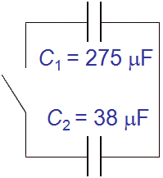
Topic 11: Electromagnetic induction - AHL 11.3 – Capacitance
Solving problems involving parallel-plate capacitors
EXAMPLE: Two capacitors are in the circuit shown. C₁ is fully charged at 1.50 V, and C₂ is initially uncharged.
What is the electrical energy stored in C₁?
(b) What is the charge on C₁’s plates?
SOLUTION:
(a) $E=\left(\frac{1}{2}\right)CV2 = 3.09×{10}^{−4}$J (see previous slide).
(b) $q=CV=(275{10}^{−6})(1.50) = 4.125{10}^{−4}$C.
Notes:
22
© 2015 by Timothy K. Lund

Slide 23
Topic 11: Electromagnetic induction - AHL 11.3 – Capacitance
Solving problems involving parallel-plate capacitors
EXAMPLE: Continued…
(c) When the switch is closed, what will the charge on C₁ be? What charge will C₂ have?
SOLUTION: The capacitors are in parallel. Thus
$V1=V2 →\frac{q1}{C1} =\frac{q2}{C2}$.
•Thus $q2=\left(\frac{C2}{C1}\right)q1$.
•From conservation of charge, $q1+q2=4.125{10}^{−4}$ C.
$$4.125{10}^{−4}=q1+q2$$
$$=q1+\left(\frac{C2}{C1}\right)q1$$
$=q1\left(1+\frac{38}{275}\right)$
$q1=3.62 {10}^{−4}$C.
$$3.62 {10}^{−4}+q2=4.125{10}^{−4}$$
$q2=5.01 {10}^{−5}$C.
Notes:
23
© 2015 by Timothy K. Lund

Slide 24
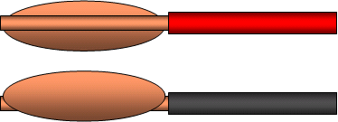
Topic 11: Electromagnetic induction - AHL 11.3 – Capacitance
Solving problems involving parallel-plate capacitors
EXAMPLE: A capacitor having no dielectric has a capacitance of 325 pF. It is charged up to 6.00 V by momentarily attaching it to a battery, and then disconnecting it.
(a) What is the energy stored in the capacitor at this voltage?
(b) What is the charge on the capacitor?
SOLUTION:
(a) $E=\left(\frac{1}{2}\right)CV^{2}=\left(\frac{1}{2}\right)\left(325×{10}^{−12}\right)(6.00)2=5.85×{10}^{−9}$J.
(b) $q=CV=(325{10}^{−12})(6.00) = 1.95{10}^{−9}$C.
Notes:
24
© 2015 by Timothy K. Lund

Slide 25
Topic 11: Electromagnetic induction - AHL 11.3 – Capacitance
Solving problems involving parallel-plate capacitors
EXAMPLE: A capacitor having no dielectric has a capacitance of 325 pF. It is charged up to 6.00 V by momentarily attaching it to a battery, and then disconnecting it.
(c) A dielectric having a permittivity of 2ε₀ is now carefully inserted between the plates of the capacitor. What is its new capacitance?
SOLUTION: Use $C=\frac{εA}{d}$.
(c) $C0=\frac{ε0A}{d}$and $C=\frac{\left(2ε0\right)A}{d}$so that
$C=2C0=2(325 pF)=650$. pF.
dielectric
Notes:
25
© 2015 by Timothy K. Lund

Slide 26
Topic 11: Electromagnetic induction - AHL 11.3 – Capacitance
Solving problems involving parallel-plate capacitors
EXAMPLE: A capacitor having no dielectric has a capacitance of 325 pF. It is charged up to 6.00 V by momentarily attaching it to a battery, and then disconnecting it.
(d) What is the charge on the new capacitor?
(e) What is the voltage on the new capacitor?
SOLUTION:
(d) The charge does not change. Why?
Thus $q = 1.95{10}^{−9}$C.
(e) From $q=CV$we see that
$V=\frac{q}{C} =\frac{1.95×{10}^{−9}}{650×{10}^{−12}}= 3.00$V.
dielectric
Conservation of charge.
Notes:
26
© 2015 by Timothy K. Lund

Slide 27
Topic 11: Electromagnetic induction - AHL 11.3 – Capacitance
Solving problems involving parallel-plate capacitors
EXAMPLE: Continued…
(f) What is the energy stored in the new capacitor?
(g) Explain the discrepancy between (f) and (a).
SOLUTION:
(f) Use either $E=\left(\frac{1}{2}\right)CV2$or $E=\left(\frac{1}{2}\right)qV$:
$E=\left(\frac{1}{2}\right)qV=\left(\frac{1}{2}\right)(1.95×{10}^{−9})(3.00)=2.93×{10}^{−9}$J.
(g) This is half the energy stored in the capacitor without the dielectric. The dielectric would be attracted into the void: The “inserter” would have to do negative work!
dielectric
Notes:
27
© 2015 by Timothy K. Lund

Slide 28
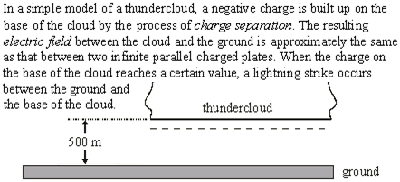
Topic 11: Electromagnetic induction - AHL 11.3 – Capacitance
Solving problems involving parallel-plate capacitors
•Charge can be neither created nor destroyed.
+ + + + + + + + + + + + + + +
•It can be separated into (+) and (-) in equal quantities.
•The (-) was separated from the ground, leaving behind an equal amount of (+).
Notes:
© 2015 by Timothy K. Lund

Slide 29
Topic 11: Electromagnetic induction - AHL 11.3 – Capacitance
Solving problems involving parallel-plate capacitors
+ + + + + + + + + + + + + + +
•The electric field strength E at any point in space is equal to the force per unit charge at that point.
•If in doubt, find the applicable formula and translate it into words. “E = F / q.”
Notes:
© 2015 by Timothy K. Lund

Slide 30
Topic 11: Electromagnetic induction - AHL 11.3 – Capacitance
Solving problems involving parallel-plate capacitors
+ + + + + + + + + + + + + + +
•Just recall that between parallel plates the E-field is uniform (equally spaced), and it points from (+) toward (-).
Notes:
© 2015 by Timothy K. Lund

Slide 31
Topic 11: Electromagnetic induction - AHL 11.3 – Capacitance
Solving problems involving parallel-plate capacitors
$•σ=\frac{q}{A} =\frac{20C}{7×{10}^{6}m^{2}} = 2.86×{10}^{−6}$C m⁻².
ε₀ = 8.85×10⁻¹² C² N⁻¹ m⁻² (from Data Booklet).
•Then $E=\frac{σ}{ε0}=\frac{2.86×{10}^{−6}}{8.85×{10}^{−12}} = 3×105$Vm⁻¹.
Notes:
© 2015 by Timothy K. Lund

Slide 32
Topic 11: Electromagnetic induction - AHL 11.3 – Capacitance
Solving problems involving parallel-plate capacitors
•σ is the same everywhere on the cloud.
•ε₀ is the same in air as in free space.
•The ground and the cloud’s lower surface are flat and parallel.
Notes:
© 2015 by Timothy K. Lund

Slide 33
Topic 11: Electromagnetic induction - AHL 11.3 – Capacitance
Solving problems involving parallel-plate capacitors
•Use $E=−\frac{∆V}{∆r}$and ignore the sign:
•Then ∆V = E ∆r = (3×10⁵)(500) = 1.5×10⁸ V!
Notes:
© 2015 by Timothy K. Lund

Slide 34
Topic 11: Electromagnetic induction - AHL 11.3 – Capacitance
Solving problems involving parallel-plate capacitors
$I=\frac{q}{t} =\frac{20C}{20×{10}^{−3}s} = 1000$A.
$∆EP=q∆V=(20)(1.5108)=3109$J.
Or…$P=IV=(1000)(1.5108)=1.51011$ W.
$E=Pt=(1.51011)(20{10}^{−3})= 3109$ J.
Notes:
© 2015 by Timothy K. Lund

Slide 35
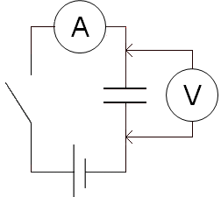
Topic 11: Electromagnetic induction - AHL 11.3 – Capacitance
Charging a capacitor
PRACTICE: A 1.50-V cell is connected to a 275 μF capacitor in the circuit shown.
(a) Make a sketch graph of what the voltmeter reads after the switch is closed.
SOLUTION:
•Before the switch is closed the voltage on the capacitor is zero.
•After the switch is closed, the voltage will increase from zero to 1.50 V in a very short amount of time as the plates store the charge.
•Then the capacitor’s voltage will remain at 1.50 V.
1.50
V / V
t
Notes:
35
© 2015 by Timothy K. Lund

Slide 36
Topic 11: Electromagnetic induction - AHL 11.3 – Capacitance
Charging a capacitor
PRACTICE: A 1.50-V cell is connected to a 275 μF capacitor in the circuit shown.
(b) Make a sketch graph of what the ammeter reads after the switch is closed.
SOLUTION:
•Before the switch is closed the current is zero.
•After the switch is closed, the current will begin at a maximum value and will decrease rapidly as the plates “fill up” with charge and repel further charge.
•Then the current will remain at zero.
MAX
I / A
t
Notes:
36
© 2015 by Timothy K. Lund

Slide 37
Topic 11: Electromagnetic induction - AHL 11.3 – Capacitance
Charging a capacitor
PRACTICE: A 1.50-V cell is connected to a 275 μF capacitor in the circuit shown.
(c) Make a sketch graph of the charge q on the plates after the switch is closed.
SOLUTION:
•Before the switch is closed the charge is zero.
•After the switch is closed, the charge will rapidly “fill up” the plates and slow down the subsequent flow due to repulsion.
•Then the charge will reach a maximum value on the plates, stopping the flow of further charge.
MAX
q / C
t
Notes:
37
© 2015 by Timothy K. Lund

Slide 38
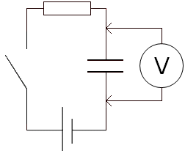
Topic 11: Electromagnetic induction - AHL 11.3 – Capacitance
RC series circuits – charging
R
PRACTICE: A 1.50-V cell is connected in series to a capacitor and resistor.
Make a sketch graph showing the family of curves representing the voltage across the resistor after the switch is closed as RC increases.
SOLUTION:
•Before the switch is closed the current is zero.
•After the switch is closed, the current will begin at a maximum value and will decrease rapidly as the plates “fill up” with charge and repel further charge.
•Then the current will remain at zero.
C
MAX
I / A
t
Notes:
38
© 2015 by Timothy K. Lund

Slide 39
Topic 11: Electromagnetic induction - AHL 11.3 – Capacitance
RC series circuits – charging
R
PRACTICE: A 1.50-V cell is connected in series to a capacitor and resistor.
Make a sketch graph showing the family of curves representing the voltage across the resistor after the switch is closed as RC increases.
SOLUTION:
•Because the voltage across the resistor is proportional to the current (V = IR), its graph will have the same shape as I:
•Furthermore, the bigger R and C are, the longer it will take for the capacitor to charge and the current to stop.
C
MAX
I / A
t
1.50
V / V
high RC
medium RC
low RC
t
Notes:
39
© 2015 by Timothy K. Lund

Slide 40
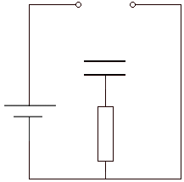
Topic 11: Electromagnetic induction - AHL 11.3 – Capacitance
A
B
RC series circuits – discharging
PRACTICE: A two-position switch can alternately charge (A) and discharge (B) a capacitor C through a resistor R.
Make sketch graphs of what the charge across the capacitor C reads when the switch is placed (a) at position A, and (b) at position B.
SOLUTION:
(a) When the switch is placed at A the circuit is connected to the cell and thus begins to charge.
(b) When the switch is then placed at B, the capacitor begins to discharge through the wire and the resistor.
+
C
–
R
q₀
switch in position A to charge
q / Q
t
q₀
switch in position B to discharge
q / C
t
Notes:
40
© 2015 by Timothy K. Lund

Slide 41
Topic 11: Electromagnetic induction - AHL 11.3 – Capacitance
A
B
RC series circuits – discharging
•Suppose the capacitor is fully charged.
•Then we place the switch to position B for discharge:
•The (+) on the top plate then travels CW through the wire and the resistor to the bottom plate:
•If we use Kirchhoff’s rule for V we see that following the loop in the direction of the current we have
$Vi=0  V_{C} –IR=0$.
•But since $VC=\frac{q}{C}$and since $I=\frac{Δq}{Δt}$ we have
$\frac{q}{C}–\left(\frac{Δq}{Δt}\right)R=0$ $\frac{Δq}{Δt}= –\left(\frac{q}{RC}\right)$.
•The (–) sign on the right hand side shows that Δq is ALWAYS negative during discharge.
+
–
C
R
Notes:
41
© 2015 by Timothy K. Lund

Slide 42
Topic 11: Electromagnetic induction - AHL 11.3 – Capacitance
RC series circuits – discharging
•We can write the results of the RC discharge thus:
•As an aside, and beyond the scope of this course, the exponential form comes from the associated differential equation: $\frac{dq}{dt} = –\frac{q}{τ}$. It turns out that $q=q_{0}e^{−\frac{t}{τ}}$ is its time-dependent solution.
RC discharge
$$I=\frac{Δq}{Δt}= –\left(\frac{q}{τ}\right)$$
$$q=q_{0}e^{−\frac{t}{τ}}$$
where τ = RC
FYI
•Many of the formulas we use in IB physics are easily derived using both differential and integral calculus. Although IB requires you to use the resulting formulaic solutions to the differential equations, you do not have to derive them.
Notes:
42
© 2015 by Timothy K. Lund

Slide 43
Topic 11: Electromagnetic induction - AHL 11.3 – Capacitance
RC series circuits – discharging
•We call τ = RC the time constant, and see that it has the units of seconds (time).
RC discharge
$$I=\frac{Δq}{Δt}= –\left(\frac{q}{τ}\right)$$
$$q=q_{0}e^{−\frac{t}{τ}}$$
where τ = RC
EXAMPLE: A 275 μF capacitor is charged to 6.00 V. It is then discharged through a 10.0 MΩ resistor.
(a) Find the time constant.
(b) Find the initial charge on the plates.
SOLUTION:
(a) The time constant is τ = RC.
$τ=RC=(10.0{10}^{6})(275{10}^{−6})=2750$s.
(b) $q0=CV0=(275{10}^{−6})(6.00)=0.00165$C.
Notes:
43
© 2015 by Timothy K. Lund

Slide 44
Topic 11: Electromagnetic induction - AHL 11.3 – Capacitance
RC series circuits – discharging
$$I=\frac{Δq}{Δt}= –\left(\frac{q}{τ}\right)$$
RC discharge
$$q=q_{0}e^{−\frac{t}{τ}}$$
where τ = RC
EXAMPLE: A 275 μF capacitor is charged to 6.00 V. It is then discharged through a 10.0 MΩ resistor.
(c) Find the charge on the plates exactly one time constant after discharge has begun.
SOLUTION:
(c) Substitute $t=$and $q0=0.00165$ C into $q=q_{0}e^{−\frac{t}{τ}}$.
$$q=q_{0}e^{−\frac{t}{τ}}=0.00165e^{−\frac{τ}{τ}}= 0.00165e^{−1}$$
$=\frac{0.00165}{e} =\frac{0.00165}{2.7183} = 0.000607$C.
•This is 37% of its original charge.
Notes:
44
© 2015 by Timothy K. Lund

Slide 45
Topic 11: Electromagnetic induction - AHL 11.3 – Capacitance
RC series circuits – discharging
•Because of the relationships $V=\frac{q}{C}$and $I=\frac{V}{R}$ we can derive the next two formulas easily:
•Keep in mind that $V=V_{0}e^{−\frac{t}{τ}}$ is the voltage across the capacitor and not the resistor. The resistor will have a starting voltage of zero. Kirchhoff’s rule for V would produce the resistor voltage formula $VR=V0(1 –e^{−\frac{t}{τ}}).$
$$I=\frac{Δq}{Δt}= –\left(\frac{q}{τ}\right)$$
RC discharge
$$q=q_{0}e^{−\frac{t}{τ}}$$
where τ = RC
$$I=I_{0}e^{−\frac{t}{τ}}$$
$$V=V_{0}e^{−\frac{t}{τ}}$$
RC discharge
where $I0=\frac{q_{0}}{RC} , V0=\frac{q_{0}}{C}$
FYI
•The IBO does not require you to know the charging formulae. You only need to make sketch graphs.
Notes:
45
© 2015 by Timothy K. Lund

Slide 46
Topic 11: Electromagnetic induction - AHL 11.3 – Capacitance
RC series circuits – discharging
$$I=\frac{Δq}{Δt}= –\left(\frac{q}{τ}\right)$$
RC discharge
$$q=q_{0}e^{−\frac{t}{τ}}$$
where τ = RC
EXAMPLE: A 275 μF capacitor is charged to 6.00 V. It is then discharged through a 10.0 MΩ resistor. Find the average current during the first 1375 s of discharge.
SOLUTION: Use q₀ = 0.00165 C, and τ = 2750 s.
•Substitute t = 0 and t = 1375 into q = q₀ e ^{-t / τ}.
$qi =0.00165e^{−\frac{0}{2750}}= 0.00165$ C
$qf = 0.00165e^{−\frac{1375}{2750}}= 0.00100$C
$I=\frac{Δq}{Δt}=\frac{\left(0.00100–0.00165\right)}{1375}$
$=–4.73{10}^{−7}$A.
Ignore the (–) sign.
Notes:
46
© 2015 by Timothy K. Lund

Slide 47
Topic 11: Electromagnetic induction - AHL 11.3 – Capacitance
RC series circuits – discharging
$$I=\frac{Δq}{Δt}= –\left(\frac{q}{τ}\right)$$
RC discharge
$$q=q_{0}e^{−\frac{t}{τ}}$$
where τ = RC
EXAMPLE: A 275 μF capacitor is charged to 6.00 V. It is then discharged through a 10.0 MΩ resistor. Find the instantaneous current at t = 1375 s.
SOLUTION: Use q₀ = 0.00165 C, and τ = 2750 s.
•Substitute t = 1375 s into $q=q_{0}e^{−\frac{t}{τ}}$.
$q=0.00165e^{−\frac{1375}{2750}}= 0.00100$C
$I= –\frac{q}{τ}$
$$= –\frac{0.00100}{2750}$$
$= –3.64{10}^{−7}$A.
Ignore the (–) sign.
Notes:
47
© 2015 by Timothy K. Lund

Slide 48
Topic 11: Electromagnetic induction - AHL 11.3 – Capacitance
RC series circuits – discharging
$$I=I_{0}e^{−\frac{t}{τ}}$$
$$V=V_{0}e^{−\frac{t}{τ}}$$
RC discharge
where $I0=\frac{q_{0}}{RC} , V0=\frac{q_{0}}{C}$
PRACTICE: A 275 μF capacitor is charged to 6.00 V. It is then discharged through a 10.0 MΩ resistor. Find the instantaneous voltage at t = 1375 s. Then find the instantaneous current using Ohm’s law.
SOLUTION: Use q₀ = 0.00165 C, and τ = 2750 s.
•Substitute t = 1375 s into $V=V_{0}e^{−\frac{t}{τ}}$.
$V =6.00e^{−\frac{1375}{2750}}=3.64$V.
$I=\frac{V}{R}$
$=\frac{3.64}{10.0×{10}^{6}}$
$= 3.64{10}^{−7}$A.
Note that this is the same answer as we got on the previous slide.
Notes:
48
© 2015 by Timothy K. Lund

Slide 49
Topic 11: Electromagnetic induction - AHL 11.3 – Capacitance
RC series circuits – discharging
•Suppose we want to find the “half-life” of a charged capacitor (when its voltage/charge/current will have decayed to half its original value).
•Substitute $V=\left(\frac{1}{2}\right)V0$into $V=V_{0}e^{−\frac{t}{τ}}$.
$\left(\frac{1}{2}\right)V0=V_{0}e^{−\frac{t}{τ}}$
$\left(\frac{1}{2}\right)= e^{−\frac{t}{τ}}$.
$\ln\left(\frac{1}{2}\right)=$ $−\frac{t}{τ}$
$–\ln\left(2\right)\text{=} −\frac{t}{τ}$
$\ln\left(2\right)\text{= }\frac{t}{τ}$
ln ln
T_{1/2} = τ ln 2
half-life
Notes:
49
© 2015 by Timothy K. Lund

Slide 50
Topic 11: Electromagnetic induction - AHL 11.3 – Capacitance
RC series circuits – discharging
T_{1/2} = τ ln 2
half-life
PRACTICE: A timer using a capacitor and a resistor needs the RC circuit to have a half-life of 2500 seconds. It will be using a capacitor of 275 μF. What value should the resistor have?
SOLUTION:
•Substitute T_{1/2} = 2500 s into T_{1/2} = τ ln 2.
$2500 =ln⁡2$
$=\frac{2500}{\ln{2}}=3606.74$ s.
•But $=RC → R=\frac{τ}{C}$. Thus
$R =\frac{τ}{C}=\frac{3606.74}{275×{10}^{−6}}= 1.312×107$ Ω ($13.1$ MΩ).
Notes:
50
© 2015 by Timothy K. Lund

