Slide 1
Topic 11: Electromagnetic induction - AHL 11.1 – Electromagnetic induction
Topic 11.1 is an extension of Topics 5.1, 5.4, 8.1 and 10.2.
Essential idea: The majority of electricity generated throughout the world is generated by machines that were designed to operate using the principles of electromagnetic induction.
Nature of science: Experimentation: In 1831 Michael Faraday, using primitive equipment, observed a minute pulse of current in one coil of wire only when the current in a second coil of wire was switched on or off but nothing while a constant current was established. Faraday’s observation of these small transient currents led him to perform experiments that led to his law of electromagnetic induction.
Notes:
© 2015 by Timothy K. Lund

Slide 2
Topic 11: Electromagnetic induction - AHL 11.1 – Electromagnetic induction
Understandings:
• Electromotive force (emf)
• Magnetic flux and magnetic flux linkage
• Faraday’s law of induction
• Lenz’s law
Applications and skills:
• Describing the production of an induced emf by a changing magnetic flux and within a uniform magnetic field
• Solving problems involving magnetic flux, magnetic flux linkage and Faraday’s law
• Explaining Lenz’s law through the conservation of energy
Notes:
2
© 2015 by Timothy K. Lund

Slide 3
Topic 11: Electromagnetic induction - AHL 11.1 – Electromagnetic induction
Guidance:
• Quantitative treatments will be expected for straight conductors moving at right angles to magnetic fields and rectangular coils moving in and out of fields and rotating in fields
• Qualitative treatments only will be expected for fixed coils in a changing magnetic field and ac generators
Data booklet reference:
• Φ = BAcos θ
• ε = $\frac{−N∆Φ}{Δt}$
• ε = BVℓ
• ε = BVℓN
Notes:
3
© 2015 by Timothy K. Lund

Slide 4
Topic 11: Electromagnetic induction - AHL 11.1 – Electromagnetic induction
Theory of knowledge:
• Terminology used in electromagnetic field theory is extensive and can confuse people who are not directly involved. What effect can lack of clarity in terminology have on communicating scientific concepts to the public?
Utilization:
• Applications of electromagnetic induction can be found in many places including transformers, electromagnetic braking, geophones used in seismology, and metal detectors
Notes:
4
© 2015 by Timothy K. Lund

Slide 5
Topic 11: Electromagnetic induction - AHL 11.1 – Electromagnetic induction
Aims:
• Aim 2: the simple principles of electromagnetic induction are a powerful aspect of the physicist’s or technologist’s armory when designing systems that transfer energy from one form to another
Notes:
5
© 2015 by Timothy K. Lund

Slide 6
Topic 11: Electromagnetic induction - AHL 11.1 – Electromagnetic induction
Electromotive force (emf)
•Consider the magnetic field (B-field) provided by a horseshoe magnet ( a curved bar magnet).
•If we place a stationary charge q within the B-field, it will feel NO MAGNETIC FORCE.
•Yet if we project the charge q through the B-field with a velocity v it will feel a force:
North
South
$$F = qvB sinφ$$
magnetic force on a moving charge
where φ is angle between v and B
Notes:
© 2015 by Timothy K. Lund

Slide 7
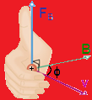
Topic 11: Electromagnetic induction - AHL 11.1 – Electromagnetic induction
Induced electromotive force (emf)
•It should thus come as no surprise that moving a piece of wire (a conductor) through a magnetic field produces a magnetic force on the charges in the moving wire:
•Don’t forget the right-hand-rule!
+
v
B
Notes:
© 2015 by Timothy K. Lund

Slide 8
Topic 11: Electromagnetic induction - AHL 11.1 – Electromagnetic induction
Induced electromotive force (emf)
•Consider this new experiment: If the north pole of a magnetic is suddenly thrust through a looped conductor, a current is created.
T or F: Current travels through the circuit only while the magnet is moving through the loop.
T or F: Current direction depends on which direction the magnet is being moved through the loop.
0
-
+
Notes:
© 2015 by Timothy K. Lund

Slide 9
Topic 11: Electromagnetic induction - AHL 11.1 – Electromagnetic induction
Induced electromotive force (emf)
•Since moving a conductor through a magnetic field produces a current, this very action must therefore induce an electromotive force (emf) in the conductor.
•Since moving a magnetic field trough a conductor produces a current, this very action must therefore induce an emf in the conductor.
•We have shown, therefore, that all we need is relative motion between a conductor and a magnetic field in order to induce an emf.
FYI
•This is the principle behind electricity generation using turbines and generators. Motion of a conductor through a B-field produces an emf which can drive a current.
Notes:
© 2015 by Timothy K. Lund

Slide 10
Topic 11: Electromagnetic induction - AHL 11.1 – Electromagnetic induction
Induced electromotive force – straight wire through B
EXAMPLE: Show that the emf ε induced in a straight conductor of length ℓ moving at velocity v through a magnetic field of strength B is
SOLUTION: Note that since v B then φ = 90º:
$F=qvB\sin{φ} =qvB\sin{90°}=qvB$.
Recall that $E=\frac{V}{x}=\frac{V}{ℓ}$and that $F=qE$.
Since $F=qE=\frac{qV}{ℓ}$and $F=qvB$, we have
$\frac{qV}{ℓ}=qvB$
$V=Bvℓ=$.
ε = Bvℓ
induced emf in a straight wire
where v and B are perpendicular
**The IBO expects you to derive this formula**
Notes:
© 2015 by Timothy K. Lund

Slide 11
Topic 11: Electromagnetic induction - AHL 11.1 – Electromagnetic induction
Induced electromotive force – straight wire through B
PRACTICE:
The Boeing Dreamliner, having wingspan of 60 m, is flying through Earth’s magnetic field near Tuscon (B = 56 μT) at 265 ms⁻¹. Treating the wing as a straight wire, find the induced emf from wingtip to wingtip.
SOLUTION:
ε = Bvℓ = (56×10⁻⁶)(60)(265) = 0.90 V.
FYI
•Sometimes weaker magnetic field strength is measured in gauss instead of tesla.
•The conversion is 1 gauss = 10⁻⁴ tesla.
•Thus the B in this example is B = 0.56 gauss.
Notes:
© 2015 by Timothy K. Lund

Slide 12
Topic 11: Electromagnetic induction - AHL 11.1 – Electromagnetic induction
Magnetic flux
•Consider the experiment where the plane of the loop is in the same plane as the moving magnetic field:
T or F: Because of the orientation of the loop most of the magnetic field lines to NOT pass through the area of the loop.
T or F: There is no current generated in this experiment.
0
-
+
Notes:
© 2015 by Timothy K. Lund

Slide 13
Topic 11: Electromagnetic induction - AHL 11.1 – Electromagnetic induction
Magnetic flux
(1)
PRACTICE: Compare the B-field lines that intersect the area of a loop in Case 1: the B-field is parallel to the plane of the loop, and in Case 2: the B-field is perpendicular to the plane of the loop.
SOLUTION:
•In (1) note that the loop has no B-field lines passing through it.
•In (2) note that the loop has many rows of B-field lines passing through it.
(2)
FYI
•The moving-magnet experiments showed that the induced emf depends on the relative orientations of the B-field and area.
Notes:
© 2015 by Timothy K. Lund

Slide 14
Topic 11: Electromagnetic induction - AHL 11.1 – Electromagnetic induction
Magnetic flux
•Because of the importance in orientation between the area A of the loop and the magnetic field B, a new quantity called magnetic flux Φ is here defined.
•Obviously we have to somehow define the direction of an area. Quite simply, the direction of an area is perpendicular (or normal) to the plane of that area.
Φ = BA cos θ
θ is angle between A and B
magnetic flux
B
•Note that as θ → 90º, Φ → 0.
direction of circle
direction of rectangle
•At θ = 90º, no B-field lines “pierce” A.
A
A
circular area ( πr ² )
rectangular area ( L×W )
A
Notes:
© 2015 by Timothy K. Lund

Slide 15
Topic 11: Electromagnetic induction - AHL 11.1 – Electromagnetic induction
Magnetic flux
PRACTICE:
Find the magnetic flux in each case. In each case the strength of the B-field is 1.5 T and the area is 0.20 m².
SOLUTION: Use Φ = BA cos θ.
(1) θ = 0º so Φ = 1.5(0.20) cos 0º = 0.30 T m².
(2) θ = 30º so Φ = 1.5(0.20) cos 30º = 0.26 T m².
(3) θ = 90º so Φ = 1.5(0.20) cos 90º = 0.0 T m².
(4) θ = 150º so Φ = 1.5(0.20) cos 150º = -0.26 T m².
(5) θ = 180º so Φ = 1.5(0.20) cos 180º = -0.30 T m².
Note that Φ can be negative.
B
B
B
B
1
2
3
4
5
B
A
30º
A
A
30º
A
A
Notes:
© 2015 by Timothy K. Lund

Slide 16
Topic 11: Electromagnetic induction - AHL 11.1 – Electromagnetic induction
Magnetic flux density
•Magnetic flux is measured in T m² which are also known as webers (Wb). Thus 1 T m² = 1 Wb.
•We define the magnetic flux density as the magnetic flux per unit area. Thus
magnetic flux density = $\frac{Φ}{A\cos{θ}}$
•But from the definition of magnetic flux we see that Φ = BA cos θ
magnetic flux density = $\frac{BA\cos{θ}}{A\cos{θ}}$
magnetic flux density = B.
FYI
•Be aware that the magnetic flux density and magnetic field strength are the same thing-namely the B-field.
Notes:
© 2015 by Timothy K. Lund

Slide 17
Topic 11: Electromagnetic induction - AHL 11.1 – Electromagnetic induction
Magnetic flux linkage
•If instead of a single loop we make a coil of N loops, the flux Φ through each loop is “linked” to each of the other loops in what is termed flux linkage.
•Each loop produces its own emf, and the emfs from each loop add to the total emf.
•Note that an emf is only produced while the flux is changing.
flux linkage = NΦ
flux linkage
N is the number of loops
0
-
+
Notes:
© 2015 by Timothy K. Lund

Slide 18
Topic 11: Electromagnetic induction - AHL 11.1 – Electromagnetic induction
Induced electromotive force
•As all of our demonstrations have shown, only while the flux is changing does an emf get produced.
•Since flux Φ = BA cos θ, there are three ways to change the flux:
(1) Change the B-field.
(2) Change the area A.
(3) Change the relative orientation θ of A and B.
0
-
+
FYI
•Recall that (3) is the way a generator produces electricity at a power plant. A coil in a generator is rotated by a turbine, thus changing θ.
Notes:
© 2015 by Timothy K. Lund

Slide 19
Topic 11: Electromagnetic induction - AHL 11.1 – Electromagnetic induction
Induced electromotive force
EXAMPLE: Explain why when the switch is closed in the first circuit, the ammeter in the second reads a current for an instant.
SOLUTION:
While the switch is open there is no current through the black coil and thus no B-field.
The instant the switch is closed, current flows and a B-field is created by the black coil.
While the B-field is growing, the blue coil intercepts it, and its magnetic flux begins to grow, too, thus inducing an emf in the blue coil.
Once the B-field becomes steady the flux stops changing, and the induced emf drops back to zero.
A
This is the principle behind radio and TV.
Notes:
© 2015 by Timothy K. Lund

Slide 20
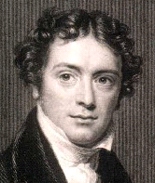
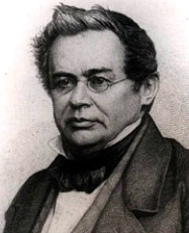
Topic 11: Electromagnetic induction 11.1 – Electromagnetic induction
Faraday’s law of induction and Lenz’s law
•Faraday’s law states that the emf induced in a coil is equal to the rate of change in the flux linkage in the coil.
•Lenz’s law states that an induced current will have a direction such that it will oppose the change in flux that produced it. Hence, the (-) sign in Faraday’s law.
$$=\frac{–NΔΦ}{Δt}$$
Faraday’s law
**Ignore the (-) if direction is not needed.**
PRACTICE: Suppose the magnetic flux in the presence of a coil having 240 loops is changing at a rate of 0.25 Wbs⁻¹. What is the induced emf?
SOLUTION: Use N = 240 and $\frac{ΔΦ}{Δt} = 0.25$.
$=\frac{NΔΦ}{Δt}=240(0.25)=60$. V.
Notes:
© 2015 by Timothy K. Lund

Slide 21
Topic 11: Electromagnetic induction 11.1 – Electromagnetic induction
Faraday’s law of induction and Lenz’s law
EXAMPLE: Explain why when the switch is closed in the first circuit, the induced current produces a flux change that is opposite to the original flux change.
SOLUTION:
•Suppose the induced flux change were NOT opposite.
•Then the induced flux change would ADD to the original, thus inducing a runaway flux change leading to infinite induced current!
•Clearly this is NOT possible. It violates conservation of energy. Thus by reductio ad absurdum we see that Lenz’s law is a statement of conservation of energy.
A
Notes:
© 2015 by Timothy K. Lund

Slide 22
Topic 11: Electromagnetic induction - AHL 11.1 – Electromagnetic induction
Faraday’s law of induction and Lenz’s law
PRACTICE: Watch the experiment. The maximum voltage is about 18 V.
(a) What would be the effect, if any, of reversing the magnetic so that the south pole goes in first?
(b) What would be the effect of doubling the oscillation speed of the magnet?
SOLUTION:
(a) The sign of the flux would be reversed so that the meter would reverse. Thus on moving the magnet to the right the meter would deflect left.
(b) Since the Δt in $\frac{ΔΦ}{Δt}$would be cut in half, so the emf would double to about 36 V.
ε = -N
ΔΦ
Δt
Magnet reversal → cos(180º+ θ) = - cos θ.
Notes:
© 2015 by Timothy K. Lund

Slide 23
Topic 11: Electromagnetic induction - AHL 11.1 – Electromagnetic induction
Faraday’s law of induction and Lenz’s law
PRACTICE: Watch the experiment. The maximum voltage is about 18 V.
(c) At the original oscillation rate, what would you predict the voltage induced in a single loop to be?
(d) If there were 150 loops, what would the voltage be?
SOLUTION: (c) From $ε=\frac{NΔΦ}{Δt}$ we see that
$18=\left(\frac{(7)ΔΦ}{Δt}\right)$
$2.6$V$=\frac{ΔΦ}{Δt}$(the emf for each loop)
(d) $150×2.6$= 390 V.
1234567
ε = -N
ΔΦ
Δt
Notes:
© 2015 by Timothy K. Lund

Slide 24
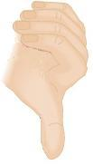
Topic 11: Electromagnetic induction - AHL 11.1 – Electromagnetic induction
Faraday’s law of induction and Lenz’s law
PRACTICE: Watch the experiment. The maximum voltage is about 18 V.
(d) Determine the direction of the induced current in the first loop of the coil while the magnet is moving right.
SOLUTION:
(d) Lenz’s law states that the induced current will try to oppose the flux increase.
•Since the B-field is increasing right, the B-field created by the induced current will point left.
•Using the right hand rule for coils, the current should flow anticlockwise as seen from the left.
ε = -N
ΔΦ
Δt
I
Notes:
© 2015 by Timothy K. Lund

Slide 25
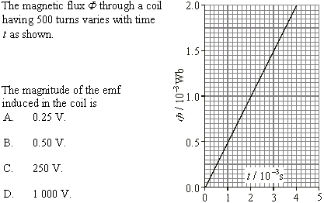
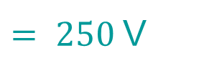
Topic 11: Electromagnetic induction - AHL 11.1 – Electromagnetic induction
Electromagnetic induction problems
$\frac{ΔΦ}{Δt} =\frac{2×{10}^{−3}}{4×{10}^{−3}}= 0.5$.
N = 500.
$=\frac{NΔΦ}{Δt}$
$$= 500(0.5)$$
$= 250$V
Notes:
© 2015 by Timothy K. Lund

Slide 26
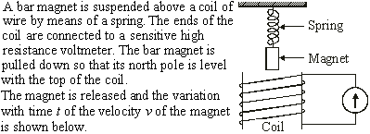
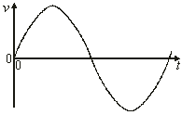
Topic 11: Electromagnetic induction - AHL 11.1 – Electromagnetic induction
•ε is maximum when change in flux is maximum.
Electromagnetic induction problems
M
M
•Change in flux is maximum when v is maximum.
Notes:
© 2015 by Timothy K. Lund

Slide 27
Topic 11: Electromagnetic induction - AHL 11.1 – Electromagnetic induction
•ε is zero when change in flux is zero.
Electromagnetic induction problems
Z
Z
Z
•Change in flux is zero when v is zero.
Notes:
© 2015 by Timothy K. Lund

Slide 28
Topic 11: Electromagnetic induction - AHL 11.1 – Electromagnetic induction
Electromagnetic induction problems
•The magnet is oscillating because of the spring.
•Thus the B-field is oscillating, and hence the flux linkage is oscillating.
•Hence the induced emf is oscillating because of Faraday’s law (and Lenz’s law).
Notes:
© 2015 by Timothy K. Lund

Slide 29
Topic 11: Electromagnetic induction - AHL 11.1 – Electromagnetic induction
Electromagnetic induction problems
θ
•Magnetic flux is given by Φ = BA cos θ where θ is the angle between the B-field and the NORMAL to the area.
•Thus Φ = BS cos θ = BS cos( 90º – φ ) = BS sinφ.
FYI
•Beware of the IBO. They will try to catch you off of your guard. No, really.
•Don’t forget the identity cos( 90º – φ ) = sin φ.
Notes:
© 2015 by Timothy K. Lund

Slide 30
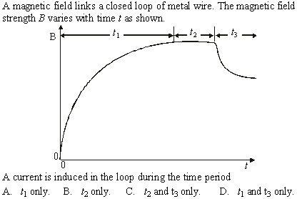
Topic 11: Electromagnetic induction - AHL 11.1 – Electromagnetic induction
Electromagnetic induction problems
•A current will be induced if the magnetic flux is changing.
•The magnetic flux is changing whenever the magnetic field is.
Notes:
© 2015 by Timothy K. Lund

Slide 31
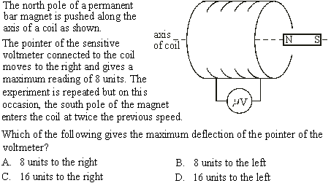
Topic 11: Electromagnetic induction - AHL 11.1 – Electromagnetic induction
Electromagnetic induction problems
•Reversed pole → reversed deflection: LEFT.
•Doubled speed → doubled emf: 16 units.
Notes:
© 2015 by Timothy K. Lund

Slide 32
Topic 11: Electromagnetic induction - AHL 11.1 – Electromagnetic induction
Electromagnetic induction problems
change in magnetic flux linkage
•Use Faraday’s law: $=\frac{–NΔΦ}{Δt}$
time rate
FYI
•Only one choice is a RATE.
•Remember that flux linkage has the N in it whereas flux does not.
Notes:
© 2015 by Timothy K. Lund

Slide 33
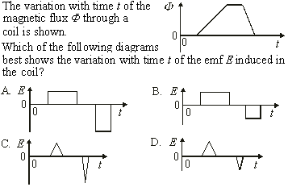
Topic 11: Electromagnetic induction - AHL 11.1 – Electromagnetic induction
Electromagnetic induction problems
less steep
more steep
•E is proportional to the slopes $\left(E=\frac{ΔΦ}{Δt}\right).$
•E is thus constant where the slopes are.
Notes:
© 2015 by Timothy K. Lund

Slide 34
Topic 11: Electromagnetic induction - AHL 11.1 – Electromagnetic induction
Electromagnetic induction problems
•Faraday’s law says that the induced emf is equal to the rate of change of the magnetic flux.
•Be sure to read the questions CAREFULLY and COMPLETELY.
Notes:
© 2015 by Timothy K. Lund

Slide 35
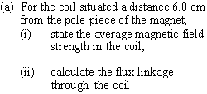
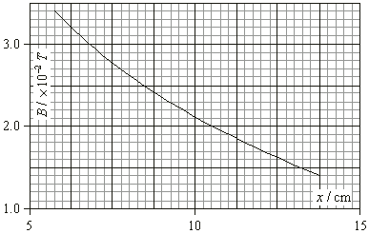
Topic 11: Electromagnetic induction - AHL 11.1 – Electromagnetic induction
•flux link. = NΦ
= NBA cos 0º
Electromagnetic induction problems
= NBA
A
B
•B = 3.3×10⁻² T.
•NBA = 250(3.3×10⁻²)(1.7×10⁻⁴) = 0.0014 Wb.
Notes:
© 2015 by Timothy K. Lund

Slide 36
Topic 11: Electromagnetic induction - AHL 11.1 – Electromagnetic induction
Electromagnetic induction problems
B = 1.7×10⁻² T.
NBA = 250(1.7×10⁻²)(1.7×10⁻⁴) = 0.0007 Wb.
ΔNBA = 0.0007 - 0.0014 = -0.0007 Wb. (0.0007 is the magnitude)
Notes:
© 2015 by Timothy K. Lund

Slide 37
Topic 11: Electromagnetic induction - AHL 11.1 – Electromagnetic induction
Electromagnetic induction problems
$=\frac{NΔΦ}{Δt}=\frac{0.0007}{0.35}=0.002$ V
Notes:
© 2015 by Timothy K. Lund

