Slide 1
Topic 11: Electromagnetic induction - AHL 11.1 – Electromagnetic induction
Topic 11.1 is an extension of Topics 5.1, 5.4, 8.1 and 10.2.
Essential idea: The majority of electricity generated throughout the world is generated by machines that were designed to operate using the principles of electromagnetic induction.
Nature of science: Experimentation: In 1831 Michael Faraday, using primitive equipment, observed a minute pulse of current in one coil of wire only when the current in a second coil of wire was switched on or off but nothing while a constant current was established. Faraday’s observation of these small transient currents led him to perform experiments that led to his law of electromagnetic induction.
Notes:
© 2015 by Timothy K. Lund

Slide 2
Topic 11: Electromagnetic induction - AHL 11.1 – Electromagnetic induction
Understandings:
• Electromotive force (emf)
• Magnetic flux and magnetic flux linkage
• Faraday’s law of induction
• Lenz’s law
Applications and skills:
• Describing the production of an induced emf by a changing magnetic flux and within a uniform magnetic field
• Solving problems involving magnetic flux, magnetic flux linkage and Faraday’s law
• Explaining Lenz’s law through the conservation of energy
Notes:
2
© 2015 by Timothy K. Lund

Slide 3
Topic 11: Electromagnetic induction - AHL 11.1 – Electromagnetic induction
Guidance:
• Quantitative treatments will be expected for straight conductors moving at right angles to magnetic fields and rectangular coils moving in and out of fields and rotating in fields
• Qualitative treatments only will be expected for fixed coils in a changing magnetic field and ac generators
Data booklet reference:
• Φ = BAcos θ
• ε = $\frac{−N∆Φ}{Δt}$
• ε = BVℓ
• ε = BVℓN
Notes:
3
© 2015 by Timothy K. Lund

Slide 4
Topic 11: Electromagnetic induction - AHL 11.1 – Electromagnetic induction
Theory of knowledge:
• Terminology used in electromagnetic field theory is extensive and can confuse people who are not directly involved. What effect can lack of clarity in terminology have on communicating scientific concepts to the public?
Utilization:
• Applications of electromagnetic induction can be found in many places including transformers, electromagnetic braking, geophones used in seismology, and metal detectors
Notes:
4
© 2015 by Timothy K. Lund

Slide 5
Topic 11: Electromagnetic induction - AHL 11.1 – Electromagnetic induction
Aims:
• Aim 2: the simple principles of electromagnetic induction are a powerful aspect of the physicist’s or technologist’s armory when designing systems that transfer energy from one form to another
Notes:
5
© 2015 by Timothy K. Lund

Slide 6
Topic 11: Electromagnetic induction - AHL 11.1 – Electromagnetic induction
Electromotive force (emf)
•Consider the _______ ___________ provided by a _____________ _________ (a curved bar magnet).
•If we place a ________________ q within the B-field, it will feel ________________________.
•Yet if we ________________________________ with a velocity v it __________________:
North
South
magnetic force on a moving charge
where φ is angle between v and B
Notes:
© 2015 by Timothy K. Lund

Slide 7
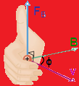
Topic 11: Electromagnetic induction - AHL 11.1 – Electromagnetic induction
Induced electromotive force (emf)
•It should thus come as no surprise that moving a piece of wire (a conductor) through a magnetic field produces a magnetic force on the charges in the moving wire:
•Don’t forget the ________________________!
+
v
B
Notes:
© 2015 by Timothy K. Lund

Slide 8
Topic 11: Electromagnetic induction - AHL 11.1 – Electromagnetic induction
Induced electromotive force (emf)
•Consider this new experiment: If the north pole of a magnetic is suddenly thrust through a looped conductor, a current is created.
T or F: Current travels through the circuit only while the magnet is moving through the loop.
T or F: Current direction depends on which direction the magnet is being moved through the loop.
0
-
+
Notes:
© 2015 by Timothy K. Lund

Slide 9
Topic 11: Electromagnetic induction - AHL 11.1 – Electromagnetic induction
Induced electromotive force (emf)
•Since ______________________________________ ___________________, this very action must therefore _______________________________in the conductor.
•Since ______________________________________ ___________________, this very action must therefore ___________________________________.
•We have shown, therefore, that all we need is _______ ________________________________________________________________________________________
FYI
•This is the principle behind electricity generation using turbines and generators. Motion of a conductor through a B-field produces an emf which can drive a current.
Notes:
© 2015 by Timothy K. Lund

Slide 10
Topic 11: Electromagnetic induction - AHL 11.1 – Electromagnetic induction
Induced electromotive force – straight wire through B
EXAMPLE: Show that the emf ε induced in a straight conductor of length ℓ moving at velocity v through a magnetic field of strength B is
SOLUTION: Note that since v B then φ = 90º:
Recall that $E=\frac{V}{x}=\frac{V}{ℓ}$and that $F=qE$.
induced emf in a straight wire
where v and B are perpendicular
**The IBO expects you to derive this formula**
Notes:
© 2015 by Timothy K. Lund

Slide 11
Topic 11: Electromagnetic induction - AHL 11.1 – Electromagnetic induction
Induced electromotive force – straight wire through B
PRACTICE:
The Boeing Dreamliner, having wingspan of 60 m, is flying through Earth’s magnetic field near Tuscon (B = 56 μT) at 265 ms⁻¹. Treating the wing as a straight wire, find the induced emf from wingtip to wingtip.
SOLUTION:
FYI
•Sometimes weaker magnetic field strength is measured in gauss instead of tesla.
•The conversion is 1 gauss = 10⁻⁴ tesla.
•Thus the B in this example is _____________.
Notes:
© 2015 by Timothy K. Lund

Slide 12
Topic 11: Electromagnetic induction - AHL 11.1 – Electromagnetic induction
Magnetic flux
•Consider the experiment where the plane of the loop is in the same plane as the moving magnetic field:
T or F: Because of the orientation of the loop most of the magnetic field lines to NOT pass through the area of the loop.
T or F: There is no current generated in this experiment.
0
-
+
Notes:
© 2015 by Timothy K. Lund

Slide 13
Topic 11: Electromagnetic induction - AHL 11.1 – Electromagnetic induction
Magnetic flux
(1)
PRACTICE: Compare the B-field lines that intersect the area of a loop in Case 1: the B-field is parallel to the plane of the loop, and in Case 2: the B-field is perpendicular to the plane of the loop.
SOLUTION:
(2)
FYI
•The moving-magnet experiments showed that the induced emf depends on the relative orientations of the B-field and area.
Notes:
© 2015 by Timothy K. Lund

Slide 14
Topic 11: Electromagnetic induction - AHL 11.1 – Electromagnetic induction
Magnetic flux
•Because of the importance in orientation between the area A of the loop and the magnetic field B, a new quantity called __________________ is here defined.
•Obviously we have to somehow define the direction of an area. Quite simply, __________________________ ____________________________________________.
θ is angle between A and B
magnetic flux
B
•Note that as θ → 90º, Φ → 0.
direction of circle
direction of rectangle
•At θ = 90º, no B-field lines “pierce” A.
A
A
circular area ( πr ² )
rectangular area ( L×W )
A
Notes:
© 2015 by Timothy K. Lund

Slide 15
Topic 11: Electromagnetic induction - AHL 11.1 – Electromagnetic induction
Magnetic flux
PRACTICE:
Find the magnetic flux in each case. In each case the strength of the B-field is 1.5 T and the area is 0.20 m².
SOLUTION: Use Φ = BA cos θ.
(1) θ = 0º so Φ = =
(2) θ = 30º so Φ = =
(3) θ = 90º so Φ = =
(4) θ = 150º so Φ = =
(5) θ = 180º so Φ = =
Note that Φ can be negative.
B
B
B
B
1
2
3
4
5
B
A
30º
A
A
30º
A
A
Notes:
© 2015 by Timothy K. Lund

Slide 16
Topic 11: Electromagnetic induction - AHL 11.1 – Electromagnetic induction
Magnetic flux density
•______________ is measured in ____ which are also known as _____________. Thus _______________.
•We define the _________________________ as the magnetic flux per unit area. Thus
magnetic flux density =
•But from the definition of magnetic flux we see that Φ = BA cos θ
magnetic flux density =
magnetic flux density =
FYI
•Be aware that the _________________ and ________ _____________ are the same thing-namely the B-field.
Notes:
© 2015 by Timothy K. Lund

Slide 17
Topic 11: Electromagnetic induction - AHL 11.1 – Electromagnetic induction
Magnetic flux linkage
•If instead of a single loop we make a _____________, the flux Φ through each loop is “linked” to each of the other loops in what is termed ________________.
•Each loop produces its own emf, and the emfs from each loop add to the total emf.
•Note that an ________ _____________________ _____________________.
N is the number of loops
flux linkage
0
-
+
Notes:
© 2015 by Timothy K. Lund

Slide 18
Topic 11: Electromagnetic induction - AHL 11.1 – Electromagnetic induction
Induced electromotive force
•As all of our demonstrations have shown, only while the flux is changing does an emf get produced.
•Since flux Φ = BA cos θ, there are _____________ ___________________:
(1)
(2)
(3)
0
-
+
FYI
•Recall that (3) is the way a generator produces electricity at a power plant. A coil in a generator is rotated by a turbine, thus changing θ.
Notes:
© 2015 by Timothy K. Lund

Slide 19
Topic 11: Electromagnetic induction - AHL 11.1 – Electromagnetic induction
Induced electromotive force
EXAMPLE: Explain why when the switch is closed in the first circuit, the ammeter in the second reads a current for an instant.
SOLUTION:
While the ____________ there is ______________ through the black coil and thus ________________.
The instant the _______________, ___________ and a _________________________________.
While the __________________, the _____________ ________________, and its _____________________ ______, too, thus _____________________________.
Once the _______________________the __________ __________, and the ___________________________
A
This is the principle behind radio and TV.
Notes:
© 2015 by Timothy K. Lund

Slide 20
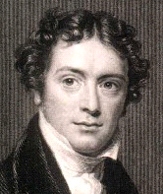
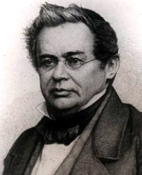
Topic 11: Electromagnetic induction 11.1 – Electromagnetic induction
Faraday’s law of induction and Lenz’s law
•_____________states that ______________________ ____________________________________________
•__________states that _________________________ ____________________________________________ _______________. Hence, the (-) sign in Faraday’s law.
Faraday’s law
**Ignore the (-) if direction is not needed.**
PRACTICE: Suppose the magnetic flux in the presence of a coil having 240 loops is changing at a rate of 0.25 Wbs⁻¹. What is the induced emf?
SOLUTION:
Notes:
© 2015 by Timothy K. Lund

Slide 21
Topic 11: Electromagnetic induction 11.1 – Electromagnetic induction
Faraday’s law of induction and Lenz’s law
EXAMPLE: Explain why when the switch is closed in the first circuit, the induced current produces a flux change that is opposite to the original flux change.
SOLUTION:
•Suppose the induced flux change were NOT opposite.
•Then the induced flux change would ADD to the original, thus inducing a runaway flux change leading to infinite induced current!
•Clearly this is NOT possible. It violates conservation of energy. Thus by reductio ad absurdum we see that ___ ____________________________________________.
A
Notes:
© 2015 by Timothy K. Lund

Slide 22
Topic 11: Electromagnetic induction - AHL 11.1 – Electromagnetic induction
Faraday’s law of induction and Lenz’s law
PRACTICE: Watch the experiment. The maximum voltage is about 18 V.
(a) What would be the effect, if any, of reversing the magnetic so that the south pole goes in first?
(b) What would be the effect of doubling the oscillation speed of the magnet?
SOLUTION:
ε = -N
ΔΦ
Δt
Notes:
© 2015 by Timothy K. Lund

Slide 23
Topic 11: Electromagnetic induction - AHL 11.1 – Electromagnetic induction
Faraday’s law of induction and Lenz’s law
PRACTICE: Watch the experiment. The maximum voltage is about 18 V.
(c) At the original oscillation rate, what would you predict the voltage induced in a single loop to be?
(d) If there were 150 loops, what would the voltage be?
SOLUTION:
1234567
ε = -N
ΔΦ
Δt
Notes:
© 2015 by Timothy K. Lund

Slide 24
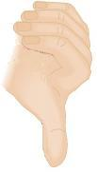
Topic 11: Electromagnetic induction - AHL 11.1 – Electromagnetic induction
Faraday’s law of induction and Lenz’s law
PRACTICE: Watch the experiment. The maximum voltage is about 18 V.
(d) Determine the direction of the induced current in the first loop of the coil while the magnet is moving right.
SOLUTION:
ε = -N
ΔΦ
Δt
I
Notes:
© 2015 by Timothy K. Lund

Slide 25
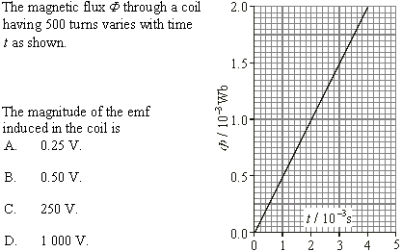
Topic 11: Electromagnetic induction - AHL 11.1 – Electromagnetic induction
Electromagnetic induction problems
Notes:
© 2015 by Timothy K. Lund

Slide 26
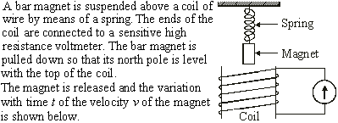
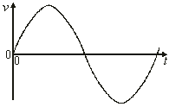
Topic 11: Electromagnetic induction - AHL 11.1 – Electromagnetic induction
•ε is maximum when change in flux is maximum.
Electromagnetic induction problems
Notes:
© 2015 by Timothy K. Lund

Slide 27
Topic 11: Electromagnetic induction - AHL 11.1 – Electromagnetic induction
•ε is zero when change in flux is zero.
Electromagnetic induction problems
Notes:
© 2015 by Timothy K. Lund

Slide 28
Topic 11: Electromagnetic induction - AHL 11.1 – Electromagnetic induction
Electromagnetic induction problems
Notes:
© 2015 by Timothy K. Lund

Slide 29
Topic 11: Electromagnetic induction - AHL 11.1 – Electromagnetic induction
Electromagnetic induction problems
FYI
•Beware of the IBO. They will try to catch you off of your guard. No, really.
•Don’t forget the identity cos( 90º – φ ) = sin φ.
Notes:
© 2015 by Timothy K. Lund

Slide 30
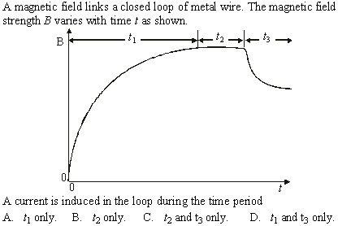
Topic 11: Electromagnetic induction - AHL 11.1 – Electromagnetic induction
Electromagnetic induction problems
Notes:
© 2015 by Timothy K. Lund

Slide 31
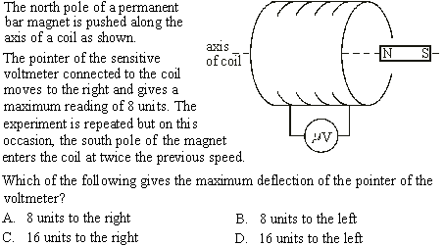
Topic 11: Electromagnetic induction - AHL 11.1 – Electromagnetic induction
Electromagnetic induction problems
Notes:
© 2015 by Timothy K. Lund

Slide 32
Topic 11: Electromagnetic induction - AHL 11.1 – Electromagnetic induction
Electromagnetic induction problems
FYI
•Only one choice is a RATE.
•Remember that flux linkage has the N in it whereas flux does not.
Notes:
© 2015 by Timothy K. Lund

Slide 33
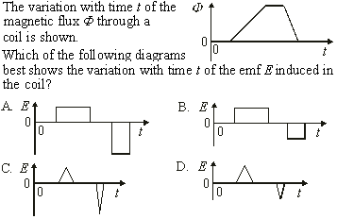
Topic 11: Electromagnetic induction - AHL 11.1 – Electromagnetic induction
Electromagnetic induction problems
Notes:
© 2015 by Timothy K. Lund

Slide 34
Topic 11: Electromagnetic induction - AHL 11.1 – Electromagnetic induction
Electromagnetic induction problems
Notes:
© 2015 by Timothy K. Lund

Slide 35
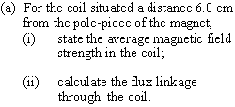
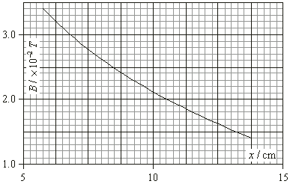
Topic 11: Electromagnetic induction - AHL 11.1 – Electromagnetic induction
Electromagnetic induction problems
Notes:
© 2015 by Timothy K. Lund

Slide 36
Topic 11: Electromagnetic induction - AHL 11.1 – Electromagnetic induction
Electromagnetic induction problems
Notes:
© 2015 by Timothy K. Lund

Slide 37
Topic 11: Electromagnetic induction - AHL 11.1 – Electromagnetic induction
Electromagnetic induction problems
Notes:
© 2015 by Timothy K. Lund

