Slide 1
Topic 10: Fields - AHL 10.1 – Describing fields
Topic 10.1 is an extension of Topics 5.1 and 6.2.
Essential idea: Electric charges and masses each influence the space around them and that influence can be represented through the concept of fields.
Nature of science: Paradigm shift: The move from direct, observable actions being responsible for influence on an object to acceptance of a field’s “action at a distance” required a paradigm shift in the world of science.
Notes:
© 2015 by Timothy K. Lund

Slide 2
Topic 10: Fields - AHL 10.1 – Describing fields
Understandings:
• Gravitational fields
• Electrostatic fields
• Electric potential and gravitational potential
• Field lines
• Equipotential surfaces
Applications and skills:
• Representing sources of mass and charge, lines of electric and gravitational force, and field patterns using an appropriate symbolism
• Mapping fields using potential
• Describing the connection between equipotential surfaces and field lines
Notes:
2
© 2015 by Timothy K. Lund

Slide 3
Topic 10: Fields - AHL 10.1 – Describing fields
Guidance:
• Electrostatic fields are restricted to the radial fields around point or spherical charges, the field between two point charges and the uniform fields between charged parallel plates
• Gravitational fields are restricted to the radial fields around point or spherical masses and the (assumed) uniform field close to the surface of massive celestial bodies and planetary bodies
• Students should recognize that no work is done in moving charge or mass on an equipotential surface
Data booklet reference:
• W = qΔV_{e}
• W = mΔV_{g}
Notes:
3
© 2015 by Timothy K. Lund

Slide 4
Topic 10: Fields - AHL 10.1 – Describing fields
Theory of knowledge:
• Although gravitational and electrostatic forces decrease with the square of distance and will only become zero at infinite separation, from a practical standpoint they become negligible at much smaller distances. How do scientists decide when an effect is so small that it can be ignored?
Utilization:
• Knowledge of vector analysis is useful for this sub-topic (see Physics sub-topic 1.3)
Aims:
• Aim 9: models developed for electric and gravitational fields using lines of forces allow predictions to be made but have limitations in terms of the finite width of a line
Notes:
4
© 2015 by Timothy K. Lund

Slide 5
Topic 10: Fields - AHL 10.1 – Describing fields
Conservative forces
•Recall the definition of work:
•Consider the movement of a baseball from the ground to the tabletop via displacements d₁ and d₂:
•Along the displacement d₁, gravity does work given by W₁ =______________________
•Along the displacement d₂, gravity does work given by W₂ = ______________________
•The total work done by gravity is thus
________________.
W = Fd cos θ
(θ is angle between F and d)
work definition
d₂
d₁
mg
Notes:
© 2015 by Timothy K. Lund

Slide 6
Topic 10: Fields - AHL 10.1 – Describing fields
Conservative forces
•Consider the movement of a ball from the ground to the tabletop via the 6 new displacements s:
•Along s₁, s₃ and s₅ gravity does total work given by
W_{T} = ______________________________________
•Along s₂, s₄ and s₆ gravity does no work. (Why?)
•Superimposing d₁ and d₂ from the previous path we see that W_{T} = ____________________________.
•This is exactly the same as we got before!
•We note that ________________ ____________________________ ____________________________.
d₂
s₆
s₄
s₅
d₁
s₂
s₃
s₁
mg
Notes:
© 2015 by Timothy K. Lund

Slide 7
Topic 10: Fields - AHL 10.1 – Describing fields
Conservative forces
•We call any force which does work independent of path a ________________________.
•Thus the __________________________________.
•Only _______________________________________ _____________________________________.
PRACTICE: Show that friction is not conservative.
SOLUTION: Suppose you slide a crate across the floor along paths 1 and 2:
•Clearly the distance along Path 2 is greater than on Path 1.
Path 2
A
Path 1
B
Notes:
© 2015 by Timothy K. Lund

Slide 8
Topic 10: Fields - AHL 10.1 – Describing fields
Conservative forces
•The electrostatic force and the gravitational force are both examples of conservative forces.
•Thus both forces have potential energy functions, which we will study in Topic 10.2.
Coulomb’s law
universal law of gravitation
FYI
Another conservative force that you have seen is the spring force, described by Hooke’s law $______________$. We already know that $_____________________________$for this force.
Notes:
© 2015 by Timothy K. Lund

Slide 9
Topic 10: Fields - AHL 10.1 – Describing fields
Force fields
•You have already been introduced to the concept of the ______________, in both Topic 5.1 and Topic 6.2.
•The force laws $F_{e}=\frac{kq_{1}q_{2}}{r^{2}}$ and $F_{g}=–\frac{Gm_{1}m_{2}}{r^{2}}$ were first developed as action-at-a-distance phenomena.
•Due to the finite speed ($v=c$) of the force signal required of the special theory of relativity, the ________ ________________________________________________________________________________________
•In the ___________, we imagine charges and masses as capable of _________________________________ due to their presence, and other charges and masses ___________________________________________, and not the actual source of that curvature.
Notes:
© 2015 by Timothy K. Lund

Slide 10
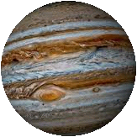
If you substitute a (+) charge for the sun and a (-) charge for the planets, you have an atom…
Topic 10: Fields - AHL 10.1 – Describing fields
Force fields
•This animation illustrates the concept of the sun’s gravitational field and the orbits of the planets.
•The curvature of the local space “surface” tells the orbiting planets how to respond without them communicating directly (at a distance) with the sun.
Notes:
© 2015 by Timothy K. Lund

Slide 11
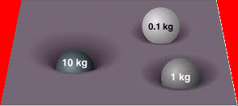
Topic 10: Fields - AHL 10.1 – Describing fields
Force fields
•We sketched fields with arrows surrounding the field source. The direction of the field arrows showed the direction of the force a test charge, or a test mass, would feel due to the local field.
Test masses and charges are small. Why?
PRACTICE: Which field is that of the…
(a) Largest negative charge?
(b) Largest positive charge?
(c) Smallest negative charge?
(d) Smallest positive charge?
(e) Largest mass?
(f) Smallest mass?
Why can’t the fields A, E and F be used for masses?
A
B
D
C
E
F
Notes:
© 2015 by Timothy K. Lund

Slide 12
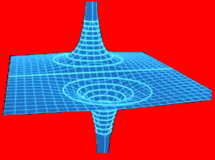
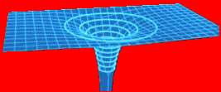
Topic 10: Fields - AHL 10.1 – Describing fields
Force fields
PRACTICE: Consider the fields shown below. Which field could be that of a…
(a) Positive charge?
(b) A negative charge?
(c) An electric dipole?
(d) A mass?
(e) A gravitational dipole?
A
B
C
Notes:
© 2015 by Timothy K. Lund

Slide 13
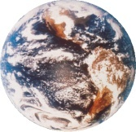
Topic 10: Fields - AHL 10.1 – Describing fields
Force fields - Review
PRACTICE: Sketch the gravitational field about Earth (a) as viewed from far away, and (b) as viewed “locally” (at the surface).
SOLUTION:
(a)
(b)
or
FYI
•Note that the closer to the surface we are, the more uniform the field concentration.
Notes:
© 2015 by Timothy K. Lund

Slide 14
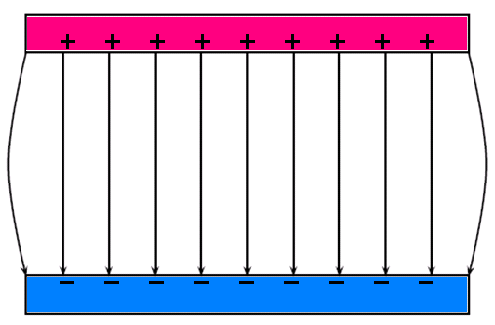
Topic 10: Fields - AHL 10.1 – Describing fields
Force fields - Review
PRACTICE: Justify the statement “the electric field strength is uniform between two parallel plates.”
SOLUTION:
•Sketch the electric field lines between two parallel plates.
•Now demonstrate that the electric field lines have equal density everywhere between the plates.
Notes:
© 2015 by Timothy K. Lund

Slide 15
Topic 10: Fields - AHL 10.1 – Describing fields
Potential difference – the electric force
•Because electric charges experience the electric force, when one charge is moved in the vicinity of another, work W is done (recall that work is a force times a displacement).
•We define the __________________ V_{e} between two points A and B as the amount of work W done per unit charge q in moving a point charge from A to B.
•Note that the units of $V_{e}$ are J C⁻¹ which are volts V.
Q
q
A
B
electrostatic potential difference
Notes:
© 2015 by Timothy K. Lund

Slide 16
Topic 10: Fields - AHL 10.1 – Describing fields
Potential difference – the electric force
PRACTICE: A charge of q = +15.0 μC is moved from point A, having a voltage (potential) of 25.0 V to point B, having a voltage (potential) of 18.0 V.
(a) What is the potential difference undergone by the charge?
(b) What is the work done in moving the charge from A to B?
SOLUTION:
A
B
q
Notes:
© 2015 by Timothy K. Lund

Slide 17
Topic 10: Fields - AHL 10.1 – Describing fields
Potential difference – the gravitational force
•Because masses experience the gravitational force, when one mass is moved in the vicinity of another, work W is done (recall that work is a force times a displacement).
•We define the __________________ V_{g} between two points A and B as the amount of work W done per unit mass m in moving a point mass from A to B.
•Note that the units of $V_{g}$ are J kg⁻¹.
M
m
A
B
gravitational potential difference
Notes:
© 2015 by Timothy K. Lund

Slide 18
Topic 10: Fields - AHL 10.1 – Describing fields
Potential difference – the gravitational force
PRACTICE: A mass of m = 500. kg is moved from point A, having a gravitational potential of 75.0 J kg⁻¹ to point B, having a gravitational potential of 25.0 J kg⁻¹.
(a) What is the potential difference undergone by the mass?
(b) What is the work done in moving the mass from A to B?
SOLUTION:
A
B
m
Notes:
© 2015 by Timothy K. Lund

Slide 19
Topic 10: Fields - AHL 10.1 – Describing fields
Potential difference – the gravitational force
PRACTICE: A mass m moves upward a distance Δh without accelerating.
(a) What is the change in potential energy of the mass-Earth system?
(b) What is the potential difference undergone by the mass?
SOLUTION: Use $ ∆E_{P}=W= Fdcos⁡$
d
mg
Notes:
© 2015 by Timothy K. Lund

Slide 20
Topic 10: Fields - AHL 10.1 – Describing fields
Potential difference – the gravitational force
PRACTICE: A mass m moves upward a distance Δh without accelerating.
(c) What is the gravitational field strength g in terms of V_{g} and Δh?
(d) What is the potential difference experienced by the mass in moving from h = 1.25 m to h = 3.75 m? Use g = -9.81 ms⁻².
SOLUTION: Use $∆V_{g}= –g∆h$.
Notes:
© 2015 by Timothy K. Lund

Slide 21
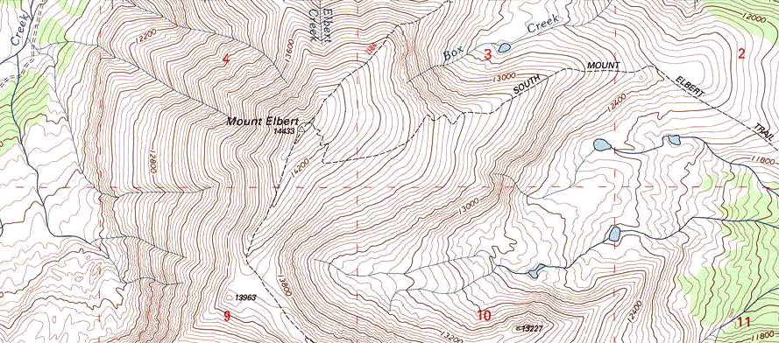
Topic 10: Fields - AHL 10.1 – Describing fields
Equipotential surfaces – the gravitational field
•Consider the contour map of Mt. Elbert, Colorado.
•From the previous slide we see that ____________ which tells us that if __________________________.
•Thus ______________________________________ ____________________________________________.
equipotential surface
Notes:
© 2015 by Timothy K. Lund

Slide 22
Topic 10: Fields - AHL 10.1 – Describing fields
Equipotential surfaces – the gravitational field
•The 2D equipotential planes define a 3D surface.
•Because $W=m∆V_{g}$, if a mass is moved along an equipotential surface, no work is done by the gravitational field. Why?
Notes:
© 2015 by Timothy K. Lund

Slide 23
Topic 10: Fields - AHL 10.1 – Describing fields
Equipotential surfaces – the gravitational field
•The 2D equipotential planes define a 3D surface.
14400
14360
14320
14280
14240
14200
Notes:
© 2015 by Timothy K. Lund

Slide 24
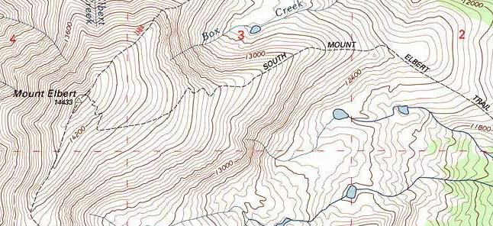
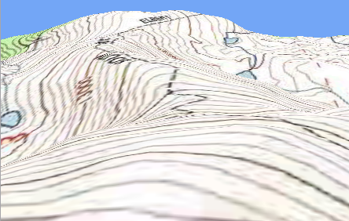
Topic 10: Fields - AHL 10.1 – Describing fields
Equipotential surfaces – the gravitational field
•The 2D equipotential planes define a 3D surface.
Notes:
© 2015 by Timothy K. Lund

Slide 25
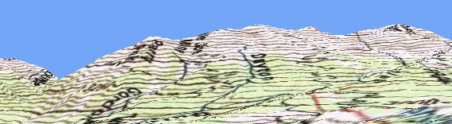
Topic 10: Fields - AHL 10.1 – Describing fields
Equipotential surfaces – the gravitational field
•Rotation, tilting, and stacking of these equipotential surfaces will produce a 3D image of Mount Elbert:
•If we sketch the gravitational field vectors into our sideways view, we note that _____________________ ____________________________________________.
FYI
•This relationship between equipotential surface and field is ____________________________________.
Notes:
© 2015 by Timothy K. Lund

Slide 26
Topic 10: Fields - AHL 10.1 – Describing fields
Equipotential surfaces – the gravitational field
•Of course, on the planetary scale the equipotential surfaces will be spherical, not flat.
•And the contour lines will look like this:
•The _______________________________________ ___________________________________________.
Notes:
© 2015 by Timothy K. Lund

Slide 27
Topic 10: Fields - AHL 10.1 – Describing fields
Equipotential surfaces – the electric field
•The negative point charge acts as a planet, setting up equipotential surfaces in the same way:
•And the contour lines about a negative point charge will look like this:
•The _______________________________________ ___________________________________________.
Notes:
© 2015 by Timothy K. Lund

Slide 28
Because E-field lines never cross, neither do equipotential surfaces.
Topic 10: Fields - AHL 10.1 – Describing fields
Equipotential surfaces – the electric field
EXAMPLE: Given the E-field lines of a dipole, sketch in the equipotential surfaces V_{e}.
SOLUTION: Just make sure your surfaces are perpendicular to the field lines.
+
-
Notes:
© 2015 by Timothy K. Lund

Slide 29
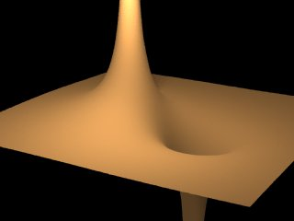
Topic 10: Fields - AHL 10.1 – Describing fields
Equipotential surfaces – the electric field
PRACTICE: Identify this equipotential surface.
SOLUTION:
•______________ __________.
•The positive charge is the peak and the negative charge is the pit.
•The test charge will “fall” from the peak to the pit. Why?
•What would a negative charge do if released in the pit?
Notes:
© 2015 by Timothy K. Lund

Slide 30
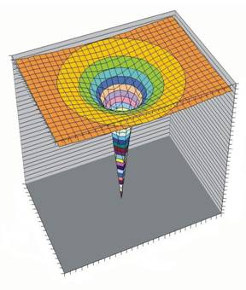
Topic 10: Fields - AHL 10.1 – Describing fields
Equipotential surfaces – the electric field
PRACTICE: Draw a 3D contour map of the equipotential surface surrounding a negative charge.
SOLUTION:
•If you think of the equipotential surface “stack” as a hill, a positive test charge placed on the hill will “roll” downhill.
FYI
•Just as is the case with the gravitational equipotential surface, if a charge is moved about on an electrostatic equipotential surface, no work is done by the electric field.
Notes:
© 2015 by Timothy K. Lund

Slide 31
Topic 10: Fields - AHL 10.1 – Describing fields
Equipotential surfaces – the electric field
PRACTICE: Explain how the 3D negative point charge picture would differ from that of the positive point charge.
SOLUTION:
Notes:
© 2015 by Timothy K. Lund

Slide 32
Topic 10: Fields - AHL 10.1 – Describing fields
Equipotential surfaces – the electric field
PRACTICE: Sketch the equipotential surfaces and the E-field surrounding a line of positive charge.
SOLUTION:
Notes:
© 2015 by Timothy K. Lund

Slide 33
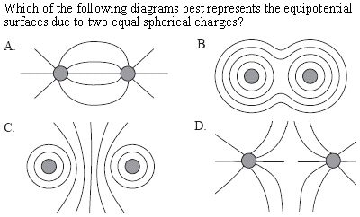
Topic 10: Fields - AHL 10.1 – Describing fields
Equipotential surfaces – the electric field
Notes:
© 2015 by Timothy K. Lund

Slide 34
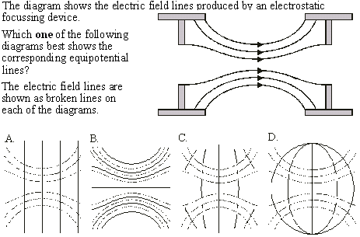
Topic 10: Fields - AHL 10.1 – Describing fields
Equipotential surfaces – the electric field
Notes:
© 2015 by Timothy K. Lund

Slide 35
Topic 10: Fields - AHL 10.1 – Describing fields
Equipotential surfaces – the electric field
Notes:
© 2015 by Timothy K. Lund

