Slide 1
Cosmology

Slide 2
Understandings
The Big Bang model
Cosmic microwave background (CMB) radiation
Hubble’s law
The accelerating universe and redshift (z)
The cosmic scale factor (R)

Slide 3
Applications and Skills
Describing both space and time as originating with the Big Bang
Describing the characteristics of the CMB radiation
Explaining how the CMB radiation is evidence for a Hot Big Bang
Solving problems involving z, R and Hubble’s law
Estimating the age of the universe by assuming a constant expansion rate

Slide 4
Guidance
CMB radiation will be considered to be isotropic with T ≈ 2.76K
For CMB radiation a simple explanation in terms of the universe cooling down or distances (and hence wavelengths) being stretched out is all that is required
A qualitative description of the role of type Ia supernovae as providing evidence for an accelerating universe is required
Data booklet reference:
$z =\frac{∆λ}{λ0} ≈\frac{v}{c}$
$z =\frac{R}{R0} − 1$
$v = H0d$
$T ≈\frac{1}{H0}$

Slide 5
Newton’s Model of the Universe
Sir Isaac Newton thought that the universe was infinite in space and time, uniform and static (otherwise it would collapse under its own gravitational force)
The implications here are that the universe is infinitely large with infinite stars and also that it is unchanging with the passage of time

Slide 6
But wait, Mr. Newton…
In the early 1800s a German astronomer named Heinrich Olbers described a paradox inherent in Newton’s model
If the model was correct, then at night you would see a star in any direction that you looked… in fact you should see many stars!
In a uniform universe, each star would be of equal luminosity related to its brightness and distance

Slide 7
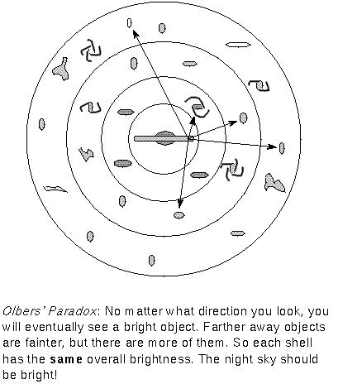
Olbers’ Paradox
As seen here, moving an equal thickness outward for each layer will result in more objects in that layer
The math works in such a way that each layer has the same overall brightness based on how many stars can fit in the extra area gained for each layer

Slide 8
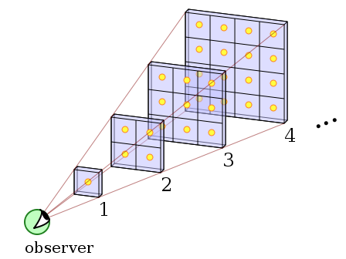
Olbers’ Paradox
For an infinite number of shells, we would multiply the energy output for a single shell times infinity and find a night sky that was infinitely bright!
https://upload.wikimedia.org/wikipedia/commons/c/cd/Olbers%27_Paradox.svg

Slide 9
Doppler Shift
Recall that the Doppler Effect suggests that a sound source moving away from an observer would be picked up by the observer as a lower pitch
This is directly related to the lower frequency due to the longer wavelength
This same phenomenon works for light as well as for sound

Slide 10
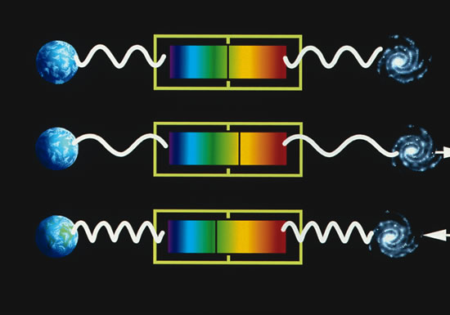
Red-Shift
Edwin Hubble observed many galaxies and saw that the light from them was all red shifted, since redder light is of a longer wavelength

Slide 11
Hubble’s Law
Hubble recognized this consistent red shift and showed that the further away the galaxy was, the greater the amount of red shift
Using Cepheid variables, he estimated a relationship between the recession velocity (how fast the object is moving away) and the distance from Earth. This is now known as Hubble’s Law
$$v=H_{0}d$$
$H_{0}$ is called the Hubble constant. He estimated it to be about $500 kms^{−1}{Mpc}^{−1}$, but with more reliable data that we have today, it appears to be closer to $70 kms^{−1}{Mpc}^{−1}$.

Slide 12
Red-Shift = Expansion
These findings support Hubble’s theory that the universe is expanding
All galaxies are moving away from each other
As you will see the reality is not relative motion, but the expansion of space
If we were in another galaxy and made the same measurements we would see the same effect

Slide 13
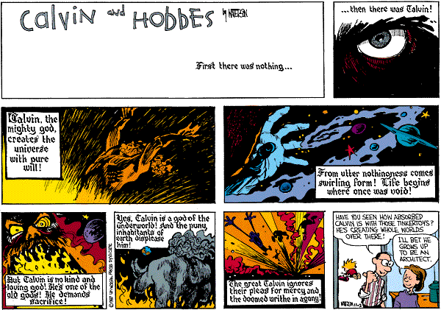

Slide 14
Before there was a before…
It is important to understand that even using the phrase “before the Big Bang” is contradictory
Similarly, we cannot ask, “What is beyond the universe?”
Also, it is incorrect to think of the Big Bang as some sort of explosion, as you will see it is not like some massive grenade but rather a creation of space

Slide 15
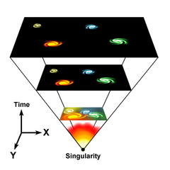
The Big Bang and the birth of Space-Time
The effect of expansion as we see it in the universe can be likened to marking a balloon and then blowing in air.
The points are not really moving away from one another but rather the space between them is expanding

Slide 16
More Big Bang
All of the universe was concentrated into a point of infinite density and temperature called a singularity
The Big Bang occurred roughly 13.7 billion years ago
This cosmological red shift is due to
this expansion

Slide 17
Hubble’s Law and the Age of the Universe
The light from a galaxy at the very edge of the observable universe must be travelling away at slightly under the speed of light
This means that the distance it has moved away from us since the Big Bang (when everything was pretty close) is $≈cT$, where T is the age of the universe.
If we assume $H_{0}=70 kms^{−1}{Mpc}^{−1}$, we can now calculate the age of the universe!

Slide 18
Hubble’s Law and the Age of the Universe
$$v= H_{0}d$$
Now we need to convert $H_{0}$ into fundamental units.
$$1 ly=9.46 ×{10}^{15} m \\ 1 pc=3.26 ly \\ 1 Mpc= {10}^{6} ×\left(\text{9.46}×{10}^{15}\right) ×3.26$$ $1 Mpc ≈3.1× {10}^{22} m$
$$c≈H_{0}cT$$
$$1≈H_{0}T$$
$$T= \frac{1}{H_{0}}$$

Slide 19
Hubble’s Law and the Age of the Universe
$$T= \frac{1}{H_{0}}$$
$$T= \frac{(1s)(3.1× {10}^{22} m)}{70×{10}^{3} m}$$
$$T=4.4×{10}^{17}s$$
$$T ≈1.4×{10}^{10} years$$
(14 billion years)

Slide 20
Cosmic Microwave Background (CMB) Radiation
In 1965 Penzias and Wilson were attempting to build a radio receiver and wanted to identify the source of “noise” in their signal. They inadvertently discovered the CMB remnant of the Big Bang
It is known that some 24% of the universe is helium, however calculations show that fusion within stars alone cannot account for this large amount of helium
This suggests that there must have been conditions early on in the universe suitable for fusion to produce the excess helium we see

Slide 21
CMB
This would also result in many high energy photons
These photons would have a “black-body” spectrum consistent with the temperature of the universe at that time
As the universe expands and cools, Wien’s Law would dictate a change in the maximum wavelength seen
Presently, we see a wavelength consistent with about 2.726K in these photons

Slide 22
CMB and the Big Bang
Penzias and Wilson saw that no matter what direction they pointed a microwave detector in space they got the same consistent result regarding the radiation
This provides rather concrete evidence of the Big Bang happened because the radiation is coming from everywhere, equally.
The radiation is a sort of echo of the event

Slide 23
Big Bang and Olbers’ Paradox
The Big Bang model resolves Olbers’ paradox because with the expansion of the space between galaxies and stars there is a red-shift occurring
This results in visible light for those distant sources being shifted into the infrared region, thus allowing for a “dark” night sky… at least from a visible light perspective
Indeed space is neither static nor uniform

Slide 24
Redshift Equation and Cosmic Scale Factor
Although the redshift in the universe is caused by the stretching of space, the Doppler equation still holds true. The redshift ratio in astrophysics is denoted by z and is determined by:
$$z= \frac{∆λ}{λ_{0}} ≈ \frac{v}{c}$$
$∆λ$ is the change in wavelength
$λ_{0}$ is the original wavelength at the source
$v$ is the speed at which the object is moving

Slide 25
Redshift Equation and Cosmic Scale Factor
As the universe expands, all distances stretch out by a factor of R. This is called the cosmic scale factor. What this means is that there is a direct relationship between the change in wavelength and the change in cosmic scale.
So if a wavelength changed from $λ_{0}$ to $λ$ (giving a change of $∆λ$), in the same time the cosmic scale factor would have change from $R_{0}$ to $R$(giving a change of $∆R$). This leads us our redshift ratio’s relationship to the cosmic scale factor:
$$z= \frac{∆λ}{λ_{0}}= \frac{∆R}{R_{0}}= \frac{R −R_{0}}{R_{0}}=\frac{R }{R_{0}} −1$$
The relationship $\frac{R }{R_{0}}$ tells us how big the universe is now, compared to how big it was.

