Slide 1
Cosmology

Slide 2
Understandings
The Big Bang model
Cosmic microwave background (CMB) radiation
Hubble’s law
The accelerating universe and redshift (z)
The cosmic scale factor (R)

Slide 3
Applications and Skills
Describing both space and time as originating with the Big Bang
Describing the characteristics of the CMB radiation
Explaining how the CMB radiation is evidence for a Hot Big Bang
Solving problems involving z, R and Hubble’s law
Estimating the age of the universe by assuming a constant expansion rate

Slide 4
Guidance
CMB radiation will be considered to be isotropic with T ≈ 2.76K
For CMB radiation a simple explanation in terms of the universe cooling down or distances (and hence wavelengths) being stretched out is all that is required
A qualitative description of the role of type Ia supernovae as providing evidence for an accelerating universe is required
Data booklet reference:
z = Δλ/λ₀ ≈ v/c
z = R/R₀ − 1
v = H₀d
T ≈ 1/H₀

Slide 5
Newton’s Model of the Universe
Sir Isaac Newton thought that the universe was _________________ _____________, ______________ and __________ (otherwise it would collapse under its own gravitational force)
The implications here are that the universe is infinitely large with infinite stars and also that it is unchanging with the passage of time

Slide 6
But wait, Mr. Newton…
In the early 1800s a German astronomer named Heinrich Olbers described a paradox inherent in Newton’s model
If the model was correct, then _______________________________ _____________________________________… in fact you should see many stars!
In a uniform universe, ________would be of ____________________ _____________________________________.

Slide 7
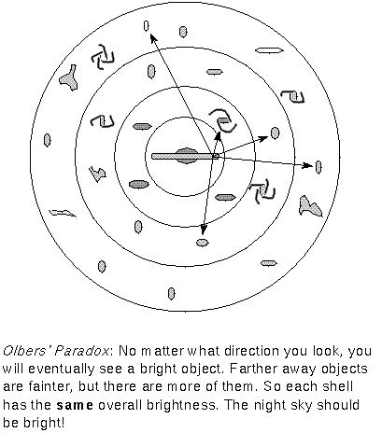
Olbers’ Paradox
As seen here, moving an equal thickness outward for each layer will result in more objects in that layer
The math works in such a way that _____________________________________________________________________________________________________________________________________________________.

Slide 8
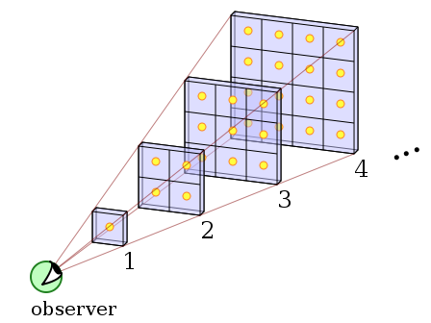
Olbers’ Paradox
For an infinite number of shells, we would multiply the energy output for a single shell times infinity and find a night sky that was infinitely bright!
https://upload.wikimedia.org/wikipedia/commons/c/cd/Olbers%27_Paradox.svg

Slide 9
Doppler Shift
Recall that the Doppler Effect suggests that a ____________________ ______________ from an observer would be picked up by the observer as a ______________.
This is directly related to the _____________________ due to the _____________________________.
This same phenomenon works for light as well as for sound

Slide 10
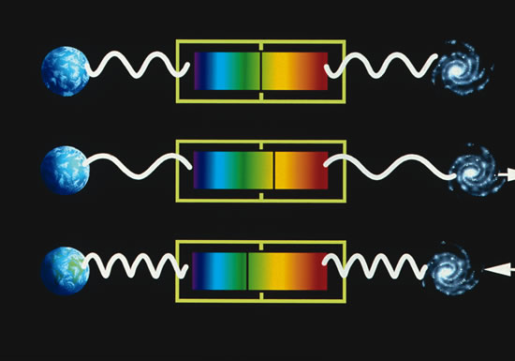
Red-Shift
Edwin Hubble observed many galaxies and saw that the light from them was all _____________, since redder light is of a ____________ ____________.

Slide 11
Hubble’s Law
Hubble recognized this consistent red shift and showed that _______ ________________________________________________________.
Using Cepheid variables, he estimated a ____________________ the ___________________(how fast the object is moving away) and the ________________________. This is now known as Hubble’s Law
$$v=H_{0}d$$
$H_{0}$ is called the _____________________. He estimated it to be about $500 kms^{−1}{Mpc}^{−1}$, but with more reliable data that we have today, it appears to be closer to $_____________________________$.

Slide 12
Red-Shift = Expansion
These findings support Hubble’s theory that the ________________ _______________
All galaxies are moving away from each other
As you will see the reality is _______________________, but the _________________________
If we were in another galaxy and made the same measurements we would see the same effect

Slide 13
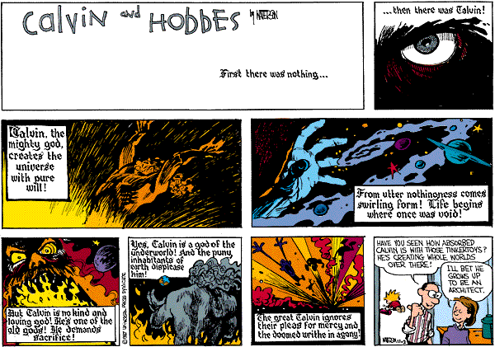

Slide 14
Before there was a before…
It is important to understand that even using the phrase “before the Big Bang” is contradictory
Similarly, we cannot ask, “What is beyond the universe?”
Also, it is ________________________________________________ _________________, as you will see it is not like some massive grenade but rather ____________________________.

Slide 15
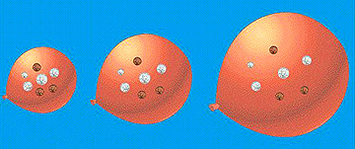
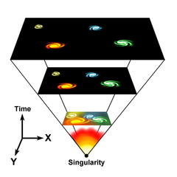
The Big Bang and the birth of Space-Time
The effect of expansion as we see it in the universe can be likened to marking a balloon and then blowing in air.
The points are not really moving away from one another but rather the space between them is expanding

Slide 16
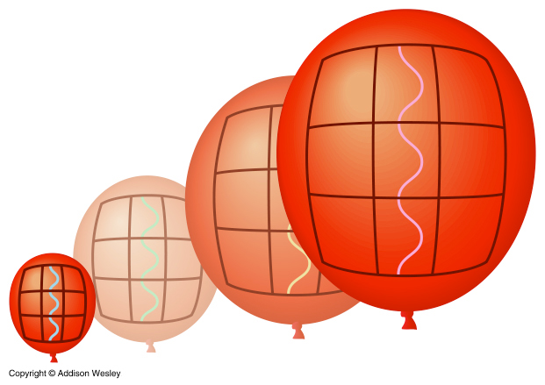
More Big Bang
All of the universe was concentrated into a point of ___________________________ called a ____________
The Big Bang ______________________________ ago
This cosmological red shift is due to
this expansion

Slide 17
Hubble’s Law and the Age of the Universe
The light from a ___________________________________________ must be travelling away at slightly under the speed of light
This means that the ________________________________ since the Big Bang (when everything was pretty close) is $________$, where T is the ________________________.
If we assume $H_{0}=70 kms^{−1}{Mpc}^{−1}$, we can now calculate the age of the universe!

Slide 18
Hubble’s Law and the Age of the Universe
$v= H_{0}d$
Now we need to convert $H_{0}$ into fundamental units.
$$1 ly=9.46 ×{10}^{15} m \\ 1 pc=3.26 ly \\ 1 Mpc= {10}^{6} ×\left(\text{9.46}×{10}^{15}\right) ×3.26$$ $1 Mpc ≈3.1× {10}^{22} m$

Slide 19
Hubble’s Law and the Age of the Universe
$$T= \frac{1}{H_{0}}$$

Slide 20
Cosmic Microwave Background (CMB) Radiation
In 1965 _______ and ______ were ____________________________ and wanted to identify the source of “noise” in their signal. They inadvertently discovered the ________________________________
It is known that some ___________________________, however calculations show that _____________________________________ ______________________________________.
This suggests that there must have been _______________________ ________________________________________________________.

Slide 21
CMB
This would also result in ______________________________.
These ________ would have a ________________________ with the ____________________________________________.
As the ___________________________, Wien’s Law would dictate a _________________________________________.
_______________, we see a ___________________________ about ____________________________.

Slide 22
CMB and the Big Bang
Penzias and Wilson saw that _______________________________ _______________________________________ they got the _______ _______________________regarding the radiation
This provides rather ________________________________________ because the _____________________________________________.
The radiation is a sort of echo of the event

Slide 23
Big Bang and Olbers’ Paradox
The Big Bang model resolves Olbers’ paradox because with the expansion of the space between galaxies and stars there is a red-shift occurring
This results in _____________for those distant sources being ______ into the ____________, thus allowing for a “dark” night sky… at least from a visible light perspective
Indeed _________________________________

Slide 24
Redshift Equation and Cosmic Scale Factor
Although the redshift in the universe is caused by the stretching of space, the Doppler equation still holds true. The _______________ in astrophysics is denoted by __ and is determined by:
$∆λ$ is the change in wavelength
$λ_{0}$ is the original wavelength at the source
$v$ is the speed at which the object is moving

Slide 25
Redshift Equation and Cosmic Scale Factor
As the universe expands, ______________________________. This is called the ______________________. What this means is that there is a ________ ____________________________________________________________.
So if a ____________________________(giving a change of $∆λ$), in the same time the ___________________________________(giving a change of $∆R$). This leads us our redshift ratio’s relationship to the cosmic scale factor:
The relationship $\frac{R }{R_{0}}$ tells us _____________________________, compared to ____________________.

