Slide 1
Stellar Characteristics and Stellar Evolution

Slide 2
Understandings
Stellar spectra
Hertzsprung–Russell (HR) diagram
Mass–luminosity relation for main sequence stars
Cepheid variables
Stellar evolution on HR diagrams
Red giants, white dwarfs, neutron stars and black holes
Chandrasekhar and Oppenheimer–Volkoff limits

Slide 3
Applications and Skills
Explaining how surface temperature may be obtained from a star’s spectrum
Explaining how the chemical composition of a star may be determined from the star’s spectrum
Sketching and interpreting HR diagrams
Identifying the main regions of the HR diagram and describing the main properties of stars in these regions
Applying the mass–luminosity relation
Describing the reason for the variation of Cepheid variables
Determining distance using data on Cepheid variables
Sketching and interpreting evolutionary paths of stars on an HR diagram
Describing the evolution of stars off the main sequence
Describing the role of mass in stellar evolution

Slide 4
Guidance
Regions of the HR diagram are restricted to the main sequence, white dwarfs, red giants, super giants and the instability strip (variable stars), as well as lines of constant radius
HR diagrams will be labelled with luminosity on the vertical axis and temperature on the horizontal axis
Only one specific exponent (3.5) will be used in the mass–luminosity relation
References to electron and neutron degeneracy pressures need to be made
Data booklet reference:
λ_{max}T = 2.9×10⁻³m K
L ∝ M^{3.5}

Slide 5
Atomic Spectra and You!
Passing a sufficiently high potential through a tube of a specific gas will cause it to glow, as we see in the fluorescent lights in the classroom
Different elements produce different discrete spectra, unlike an incandescent light source which produces a continuous range of colors

Slide 6
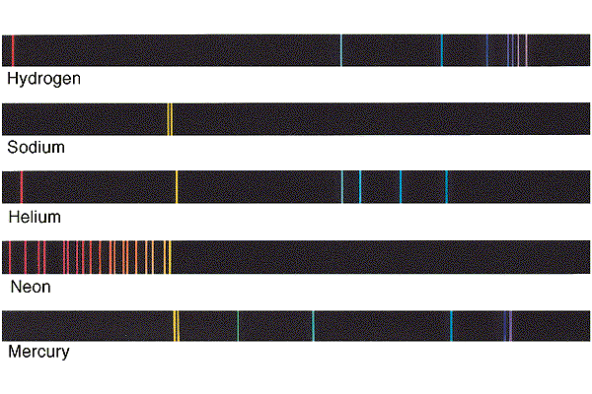
Emission/Absorption
If we shine light from an incandescent source through a tube made of a particular gas, only the wavelengths that would be emitted by that gas are absorbed

Slide 7
Absorption Spectra
Thus, we can determine the surface elements of a star based on the absorption spectrum that we see when we look at that star

Slide 8
Spectral Classification
Stars with similar spectra are grouped together into spectral classes, which relates directly to their surface temperatures.
Temperature influences a star’s ability to ionize or excite the atoms of its surface elements, thus impacting the spectrum we see
Regardless of class, all stars are essentially 74% H, 25% He, and 1% other

Slide 9
OBAFGKM!
Spectral Class | Solar Masses | Solar Diameters | Approx. Temp. Range (K) | Color | Main Absorption Lines | Example
O | 20 - 100 | 12 - 25 | 30000 – 50000 | Bluest | Ionized Helium | Mintaka
B | 4 - 20 | 4 – 12 | 10000 – 30000 | bluish | Neutral Helium | Rigel
A | 2 - 4 | 1.5 – 4 | 7500 – 10000 | Blue-white | Hydrogen | Sirius A
F | 1.05 - 2 | 1.1 – 1.5 | 6000 – 7500 | White | Ionized Metals | Canopus
G | 0.8 – 1.05 | 0.85 – 1.1 | 5000 – 6000 | Yellow-white | Ionized Calcium | Sun
K | 0.5 – 0.8 | 0.6 – 0.85 | 3500 – 5000 | Orange | Neutral metals | Aldebaran
M | 0.08 – 0.5 | 0.1 – 0.6 | 2500 – 3500 | Red | Titanium Oxide | Betelgeuse

Slide 10
Wien’s Displacement Law
Wien discovered an empirical relationship between the maximum value of the wavelength emitted by a black body and its temperature which can be stated as:
$λ_{max}= \frac{b}{T}$ where b = 2.3 x 10 ⁻³ m·K

Slide 11
Wien’s Law
This law applies to the spectra of stars as well, which means that we can use Wien’s Law to find the temperature of a star based on the spectra of radiation that it emits
Given that we can measure find a star’s luminosity as well, we can actually use the S-B Law for the more practical purpose of determining the radius of a star.

Slide 12
Types of Stars
Main Sequence Stars – ordinary stars, similar to our sun, make up 90% of all stars
Red Giants – very large, cooler temp than our sun
White Dwarfs – much smaller than the sun (earth size) but much hotter

Slide 13
The Fate of Stars
Neutron stars – have undergone gravitational collapse and are now mostly neutrons at their core. These will generally remain neutron stars after a supernova when the mass of the collapsed star is between 1.5 and 3 solar masses.
Supernovae – when a neutron star’s core cannot collapse further, the outer layers get reflected back outward causing a huge shock wave, blowing the outer layers of the star away.
FYI: In a supernova, the star will tear apart (mostly) and send out a shock wave. This can cause a flash of brightness over 100x greater than the whole universe!

Slide 14
The Fate of Stars
Black Holes – the mass of the core of the dying star is so great that the gravitational force is strong enough to overcome the neutron degeneracy pressure, causing it to collapse, entirely. Their gravity is sufficiently massive to prevent even EM radiation from leaving the surface

Slide 15
Types of Stars
Binary Stars – almost half of the stars we can see are in fact two stars orbiting about a common center. Can be of different types.
Cepheid Variable – stars that have a luminosity that varies regularly over time, usually within a period of a few days.
The internal structure of the star actually causes it to vary in size and thus in L

Slide 16
The Cepheid Variable
As we have previously discussed, the Cepheid Variable is a type of star that has a luminosity that varies over time
Recall that this is due to the outer layers of the star undergoing a periodic expansion and contraction, causing a variation in the surface temperature and surface area.
The S-B law states:
$$L=4πR^{2}σT^{4}$$

Slide 17
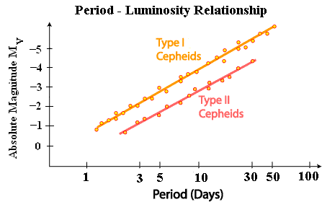
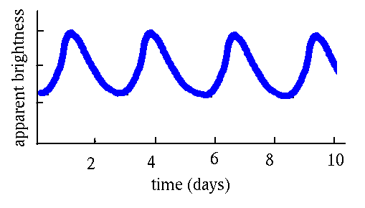
Period and Absolute Magnitude
We have discovered that a relationship exists between the period of a Cepheid Variable’s brightness and the luminosity of the star
Cepheid Variables are quite bright (about 10000x the luminosity of the sun) and so are easy to locate

Slide 18
The Standard Candle
The ability to know the magnitude of the star based on its period means we can also determine the distance even if it is beyond the 10Mpc limits we usually encounter
It also means that we can use that star as a reference or standard candle to compare the other stars in, say, another galaxy or to determine the distance to that galaxy
This method is limited to 60Mpc

Slide 19
A Cepheid Variable Distance Example
A Cepheid δ is known to be 300pc from Earth. Another Cepheid variable, Z, is seen in a different galaxy with the same period but with an apparent brightness of 10⁻⁹ of δ. How far is the other galaxy from Earth?
$$L_{Z}= L_{δ}$$
$$4πd_{Z}^{2}b_{Z}= 4πd_{δ}^{2}b_{δ}$$
$$\frac{d_{Z}}{d_{δ}}=\sqrt{\frac{b_{δ}}{b_{Z}}}$$
$$d_{Z}=d_{δ}\sqrt{\frac{b_{δ}}{b_{Z}}}$$
$$d_{Z}=300pc\sqrt{\frac{1}{{10}^{−9}}}$$
$d_{Z}=9.5 × {10}^{6}pc$ or $9.5 Mpc$

Slide 20
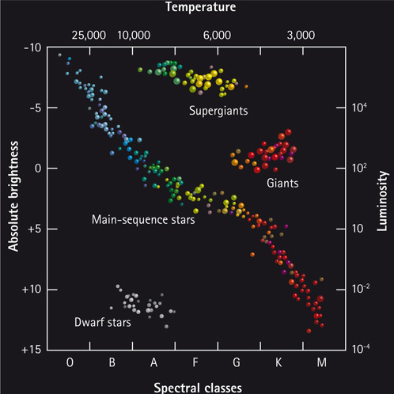
The Hertzsprung-Russell (HR) Diagram
A plot dealing with Spectral Class, Luminosity, Temperature, and Absolute Magnitude, and star type…or at least a few of these at a time

Slide 21
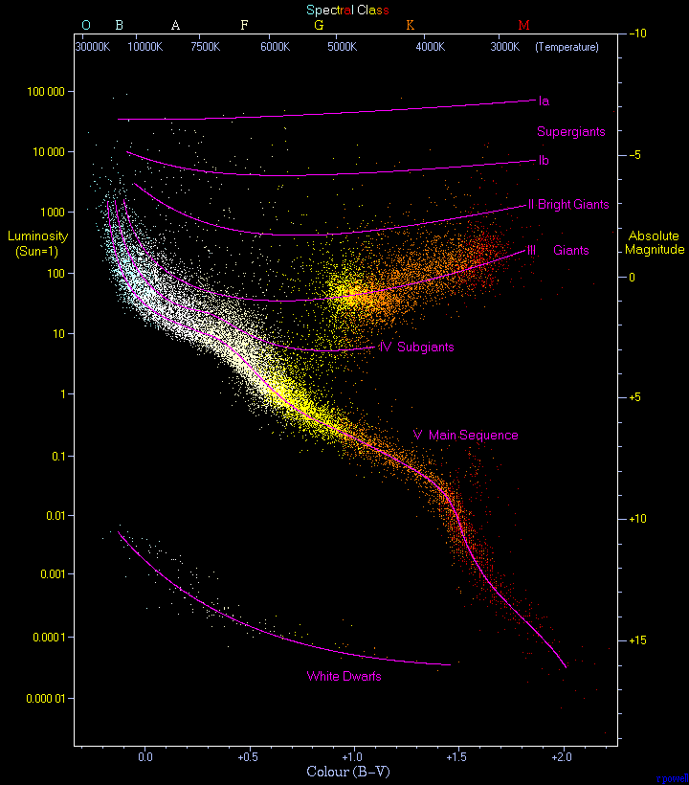
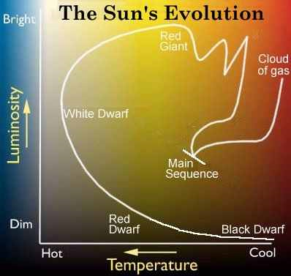
Notice that the Scales on the axes are non-linear and that temperature is plotted from high to low

Slide 22
Estimating Luminosity
For the stars beyond the distance at which parallax is useful, we can use the measureable brightness and the spectral type of the star to estimate luminosity using Wien’s Law and the HR diagram

Slide 23
The Mass-Luminosity Relation
There exists a mathematical relationship between the Mass of a main sequence star and the luminosity of it.
The exponent in this relationship is in fact an average value and so values are often greater than 4 or less than 3.
The relationship, stated in terms of Solar Units (based on our Sun) is: L $∝$ M^{3.5}

Slide 24
Start Me Up
A nebula is made of Hydrogen (74%), Helium (24%), and Dust (1%) which is made of many different elements.
These nebulae are very dense and also low temperature which allows for gravitation to pull particles together. If a nebula is very hot and/or not dense, it is unlikely to become a star because the gravitational potential energy won’t be enough to overcome the kinetic energy.

Slide 25
Start Me Up
The process of moving together causes these particles to lose gravitational potential energy and instead gain kinetic energy... thus we see the temperature increase.
This yields an increase in ionization amongst the particles and as they ionize the nebula gains its own luminosity. This is called a protostar.
Protostars are considerably larger than stars. To have one with the same mass as our Sun would yield a protostar with 5000x the surface area and 100x the luminosity.

Slide 26
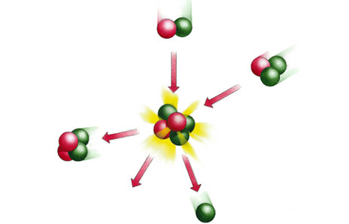
Fusion
As gravitational contraction continues the temperature at the core of the protostar rises until such a point that all of the electrons are stripped from their atoms.
Now that the core is a plasma, fusion of hydrogen nuclei begins.
This officially makes a new star which will be placed in the main sequence of the H-R diagram based on its initial mass.
Greater mass yields higher surface temperature and thus higher luminosity.

Slide 27
Gestation Period
A protostar of higher mass will become a star much quicker than those of lower mass.
This will also have an impact on temperature and luminosity as the star contracts.
Recall that there are lower and upper limits placed on the mass of a protostar that will result in a star forming (0.8 M_{Sun} – 100 M_{Sun})

Slide 28
It’s Better to Burn Out than to Fade Away
The mass of a star also has a great impact on how long its fuel source (the hydrogen in the core) will last.
Our Sun has been burning for roughly 5 Billion years and will continue to burn for another 5 Billion years.
A star of 25 M_{Sun} would exhaust its supply of hydrogen in just about 1 Million years. This is because the higher mass results in the core temperature being hotter and so more fusion can occur.

Slide 29
Our Sun Can’t Live Forever
Our Sun represents a typical main sequence star that is destined to become a red giant star.
This is a multi-phase process that occurs at different layers within the star.
Our Sun will one day exhaust the supply of Hydrogen at its core. However, throughout its life it radiates energy into its outer layers.
As such, when hydrogen fusion ceases in the core, it can continue in the surrounding material.

Slide 30
Core Values
Without fusion in the core, gravitational forces do not encounter resistance and so the core will contract.
This will raise the core temperature and in turn increase the energy flow to the outer layers.
This will mean that the core will contract but the outer layers will expand.
At this point, the surface will cool and the luminosity will go up (2000x its present value).
The Sun’s new size will cause it to engulf the orbits of Mercury and Venus.

Slide 31
It’s Not Over Yet
Fusion of Hydrogen in the outer layers will produce Helium which in turn increases the mass of the core, causing further contraction.
This will yield a temperature sufficient enough to fuse Helium and create products like Carbon-12 and Oxygen-16, which is where most living tissue on Earth gets its Carbon from.
Helium burning at the core will eventually cease and the energy radiated by the next core contraction will allow for Helium fusion in the outer layers, thus further expanding the Sun.

Slide 32
Just Die Already...
This second red giant phase will engulf the Earth’s orbit and produce a luminosty 10000x greater than the Sun had presently.
This phase is also associated with periodic burst of luminosity in which the outer layers of the Sun are ejected into space leaving an exposed core with a temperature of 100,000 K

Slide 33
Just Die Already...
The exposed core, which is now the size of the Earth, will have no fusion occurring and thus will simply cool down. It will no longer contract because the gravitational force is not enough to exceed the outward electron degeneracy pressure (electron repulsion because they can’t be in the same quantum state)
This White Dwarf star will eventually just fade from sight.

Slide 34
Limits
A star like our Sun will not have a core that contracts forever. At some point, the electrons won’t be able to be packed any closer.
A White Dwarf has an upper limit for mass at which point any greater mass than this limit will mean there is too much gravity for the electron degeneracy pressure to be enough to keep it from collapsing.
This limit, which is 1.4 M_{Sun} is known as the Chandrasekhar Limit.

Slide 35
Other Limits
Generally speaking, stars of mass 8 M_{Sun} or less end up as white dwarf stars.
Stars with mass between 4 M_{Sun} and 8 M_{Sun} are able to fuse carbon and thus produce heavier elements like neon, sodium, magnesium, and oxygen during their red giant phase.
Neutron stars have a special upper limit to their mass, just as White Dwarves do. This is known as the Oppenheimer-Volkoff Limit. We will come to this soon.

Slide 36
Giant vs. Supergiant
Stars of 8 Solar Masses or more are able to fuse even heavier elements and thus yield elements all the way up Iron.
This fusion happens in layers within the star just as we saw in our own Sun with each layer representing another red giant phase.
Fusion ceases with Iron because to fuse iron actually absorbs more energy than it produces due to the massive coulomb forces that must be overcome.

Slide 37
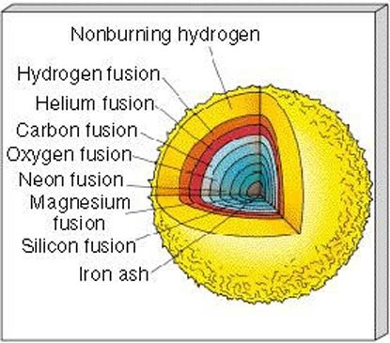
Like an Ogre, It has Layers

Slide 38
What’s Next For Our Giant Stars?
When the fusion at the core has ceased, the core contracts very rapidly. This high temperature releases gamma-photons which collide with the iron nuclei and break them into alpha particles.
Almost instantly, there is so much density in the core that the electrons begin to combine with protons to make neutrons and neutrinos.
This results in a mass release of energy from the core but also a dramatic contraction.

Slide 39
Regular Novas are Lame by Comparison
Here we see a huge pressure wave going outward while the stellar material of the outer layers is trying to collapse inward. The pressure wave wins and accelerates outward ripping the star to pieces, resulting in a Supernova!
The energy release is sufficient enough to allow for the fusion of other elements and thus we see that all elements heavier than iron are in fact generated in supernova explosions.

Slide 40
What’s Left Over?
The core of the star is now made up entirely of neutrons and is packed together as tightly as in a nucleus. (a cubic cm of a neutron star would have a mass of roughly 300 - 400 billion kilograms!)
The force that keeps the neutron star from collapsing even further is the neutron degeneracy pressure. If the mass of the neutron star is less than the Oppenheimer – Volkoff limit (currently estimated to be 1.5 – 3 solar masses) then it will remain a neutron star.
If the mass exceeds the Oppenheimer – Volkoff limit, the gravitational force will overcome the neutron degeneracy pressure, further collapsing into itself and becoming a black hole.

Slide 41
The Evolution of a Star

