Slide 1
Stellar Quantities
D.1

Slide 2
Stellar Quantities
Understandings:
Objects in the universe
The nature of stars
Astronomical distances
Stellar parallax and its limitations
Luminosity and apparent brightness

Slide 3
Stellar Quantities
Applications and skills:
Identifying objects in the universe
Qualitatively describing the equilibrium between pressure and gravitation in stars
Using the astronomical unit (AU), light year (ly) and parsec (pc)
Describing the method to determine distance to stars through stellar parallax
Solving problems involving luminosity, apparent brightness and distance

Slide 4
Stellar Quantities
Guidance:
For this course, objects in the universe include planets, comets, stars (single and binary), planetary systems, constellations, stellar clusters (open and globular), nebulae, galaxies, clusters of galaxies and super clusters of galaxies
Students are expected to have an awareness of the vast changes in distance scale from planetary systems through to super clusters of galaxies and the universe as a whole
Data booklet reference:
$d\left(parsec\right)=\frac{1}{p (arc−second)}$
L = σAT⁴
$b=\frac{L}{4{πd}^{2}}$

Slide 5
Our Solar System
The Solar system consists of numerous objects in orbit of the Sun.
Types of objects include, but are not limited to:
Planets
Dwarf Planets
Moons
Asteroids
Comets
Other dust and icy bodies

Slide 6
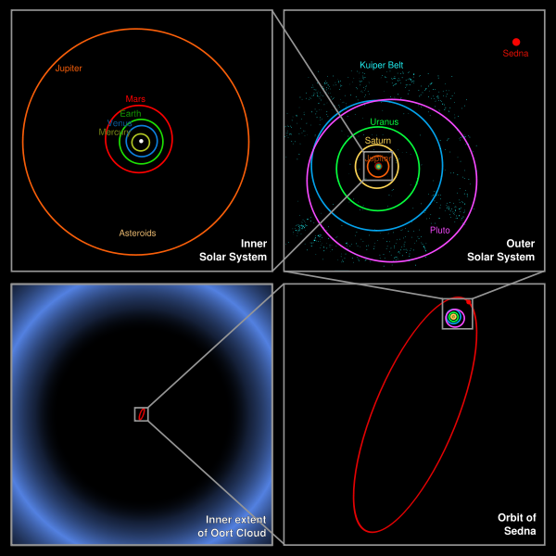
Our Solar System

Slide 7
Inside → Outside

Slide 8
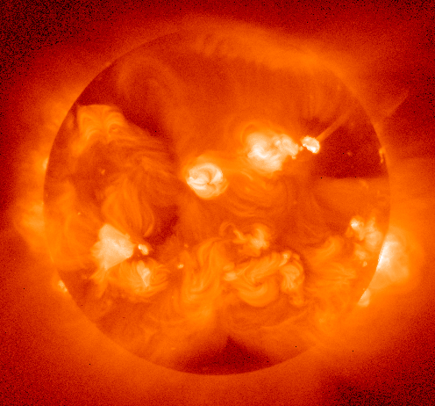
The Sun
The Sun, a small and relatively insignificant star, classified as a G2V
The Sun sits at one of the foci of the elliptical orbits of the objects moving around it.
332900 x the mass of Earth
108 x the diameter of Earth

Slide 9
Nuclear Fusion in Stars
As we have seen in topic 7, the combination of two lighter elements to form a heavier element causes a liberation of energy (Nuclear Fusion)
In stars, we see the conversion of hydrogen into helium. Later in the development of the star, helium and other atoms are fused into heavier elements.
Fusion requires extremely high temperatures on the order of 10⁷K

Slide 10
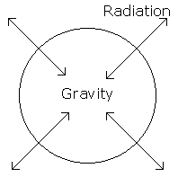
Balance is Key
The fusion will produce radiation, gamma photons and neutrinos, that will in turn collide with surrounding protons and electrons, thus transferring energy.
This radiation pressure acts to stabilize the Sun against gravitational collapse, creating a kind of equilibrium.

Slide 11
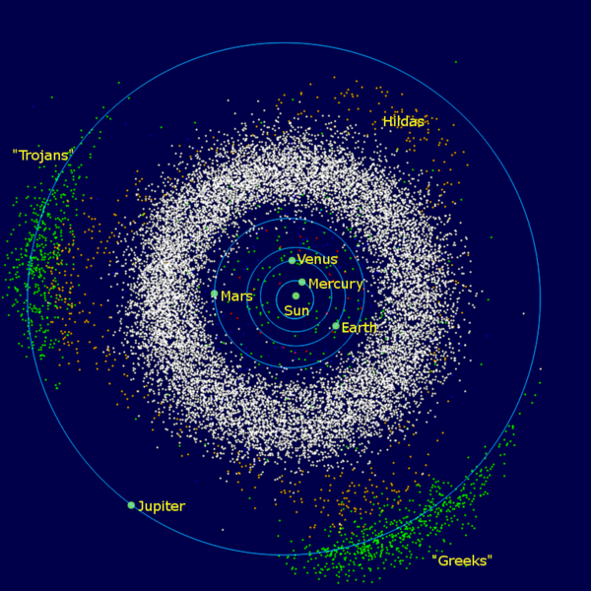
Asteroid Belt
Millions of small rocky objects between Mars and Jupiter
Jupiter’s gravity is thought to have interfered with these objects coalescing into a planet in this space.
The largest among the asteroids is a Dwarf Planet called Ceres

Slide 12
The Kuiper Belt
A ring of debris beyond Neptune that is similar to the asteroid belt except that most objects are primarily ice.
Please note that the ice in these distant bodies is not, in most cases, solid water but rather solidified forms of things like Methane
The Kuiper Belt is part of the so-called Trans-Neptunian region (though the name is misleading)

Slide 13
Pluto and Friends
As you may be aware, Pluto is no longer considered to be a “planet” but rather a Dwarf Planet
It is said to have three moons though the largest of these, Charon, actually forms more of a binary system with Pluto

Slide 14
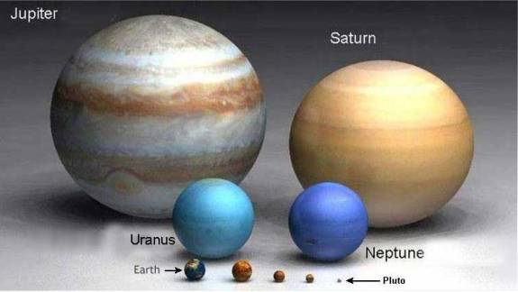
So what is a Planet?
The term is actually rather antiquated given that it derives from a Greek word describing those objects that wander in the sky relative to the “stationary” stars.

Slide 15
Planets and Dwarves
The IAU have declared that a planet must:
Orbit the Sun, not some other object
Have sufficient mass to form itself into a spherical shape
Have a small enough mass to not cause thermonuclear fusion
Clean out the region in which it orbits
A Dwarf Planet meets the first three criteria but not the fourth
This meant that while Pluto was changed “down” to a dwarf planet other objects were moved “up”

Slide 16
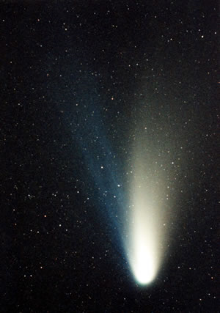
Comets
Comets are small Solar System bodies, typically only a few kilometers across, composed largely of volatile ices. They have highly eccentric orbits, generally a perihelion within the orbits of the inner planets and an aphelion far beyond Pluto. When a comet enters the inner Solar System, its proximity to the Sun causes its icy surface to sublimate and ionize, creating a coma: a long tail of gas and dust often visible to the naked eye.
Comet orbit periods can vary from decades to millenia

Slide 17
Planetary Information
Round Object | Mass Relative to Earth | Mass (x 10²³ kg) | Mean distance from the Sun (AU) | Mean Distance from the Sun (x10⁶ km) | Equatorial Diameter (x 10³ km) | Radius Relative to Earth | Number of Moons | Length of a Year (in Earth Days)
Mercury | 0.06 | 3.3 | 0.39 | 57.9 | 4.9 | 0.38 | 0 | ~88
Venus | 0.81 | 49 | 0.72 | 108 | 12.0 | 0.97 | 0 | ~225
Earth | 1.00 | 60 | 1.00 | 150 | 12.8 | 1.00 | 1 | ~365
Mars | 0.11 | 6.4 | 1.52 | 228 | 6.8 | 0.53 | 2 | ~ 687
Jupiter | 318 | 19000 | 5.20 | 778 | 143.0 | 11.2 | At least 63 | ~4332
Saturn | 92.0 | 5700 | 9.54 | 1430 | 120.5 | 9.50 | At least 62 | ~10759
Uranus | 14.5 | 866 | 19.2 | 2900 | 51.2 | 3.70 | At least 27 | ~30799
Neptune | 17.1 | 103 | 30.0 | 4500 | 49.5 | 3.50 | At least 13 | ~60190
Pluto | .002 | 0.13 | 39.47 | 5920 | 2.3 | .18 | 3 | ~90613

Slide 18
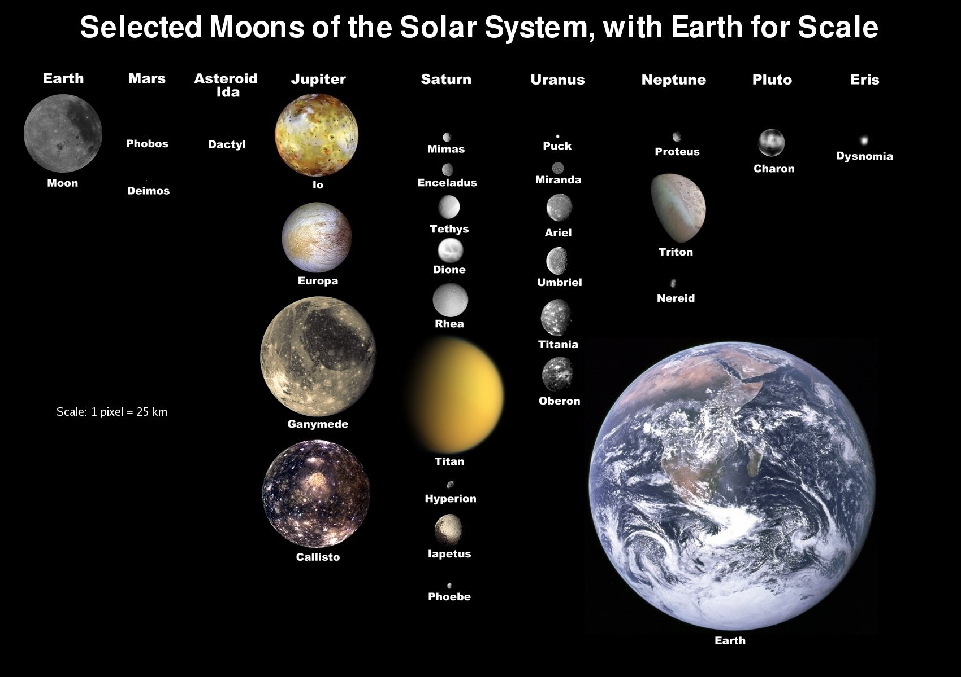
Moons

Slide 19
Beyond Our Solar System
Stellar Cluster (aka globular cluster)
A group of stars that are physically close to each other in space
These are created by the collapse of the same gas cloud
The stars are held close by gravitational attraction
Can contain thousands or possibly millions of stars

Slide 20
Other Stuff in the Universe
Galaxies – vast collections of billions of stars
The core of most galaxies is thought to be a supermassive black hole
A cluster of galaxies can contain thousands of galaxies, though ours contains very few
Nebulae – large amounts of gas and dust that are thought to be the birthplaces and/or remnants of stars

Slide 21
Did you know…
The only object that naturally orbits the Earth is our single moon… despite the way things look in the sky?
Indeed, the Sun appears to orbit us because the Earth rotates
This is also why the stars in the night sky seem to move

Slide 22
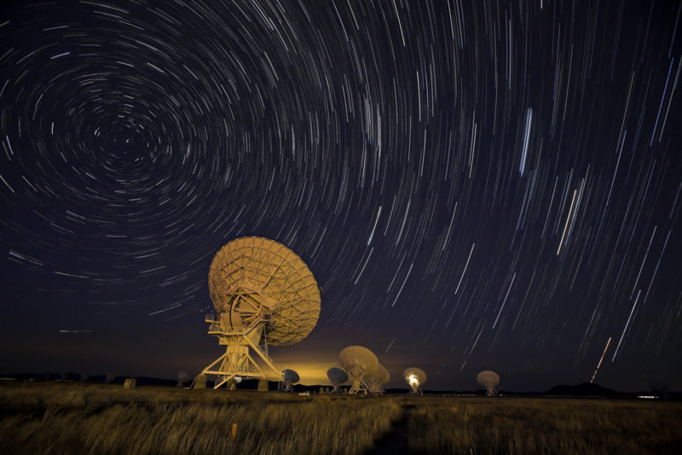
Time Lapse!

Slide 23
Stuff We See
The length of the “day” changes based on our axial tilt and position relative to the Sun
Certain “planets” seem to move relative to the fixed stars behind them. Some even experience “retrograde motion” because they orbit the sun as we do but at a different rate.
The moon, Venus, and Mercury all experience phases because of their position relative to the Sun and to Earth

Slide 24
The Light Year (ly)
A measure of distance, not of time
Defined as the distance that light travels in one year (~3.2 x 10⁷ seconds) at a speed of ~3.0 x 10⁸ m/s
This translates to about 9.46 x 10¹⁵m
This is the unit that is most often used when dealing with interstellar distances

Slide 25
Wow, that’s far…
Light takes only 328 minutes (.0006 ly) to reach the Kuiper Belt area from the Sun
Light takes 4.2 ly to reach the closest star to our Sun
Generally, the separation between stars in our galaxy is on the order of 10¹⁷m
The separation between galaxies in a cluster is on the order of 10²³m
The separation between clusters is on the order of 10²⁴m
Despite only changing the exponent by a small number it is important to note that this translates to a huge increase in distance!

Slide 26
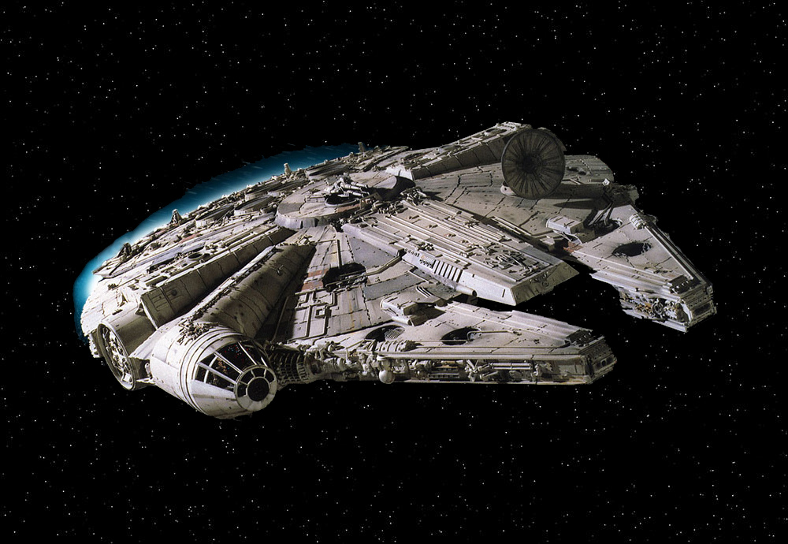
It’s the ship that made the Kessel Run in less than 12 parsecs

Slide 27
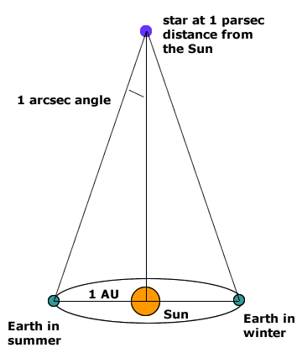
What is a Parsec? (pc)
A unit of distance that we use for determining the distance of stars
It is calculated using the diagram here
It is defined as the length of the adjacent side of an imaginary right triangle in space.
The two dimensions that specify this triangle are the parallax angle (defined as 1 arcsecond) and the opposite side (which is defined as 1 astronomical unit (AU), the distance from the Earth to the Sun).
Given these two measurements, along with the rules of trigonometry, the length of the adjacent side (the parsec) can be found.

Slide 28
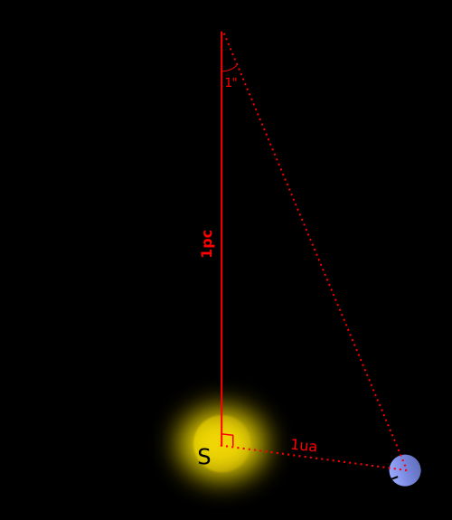
Parsec and Friends
Unit | Equals
1 AU | 1.46 x 10¹¹m
1 ly | 9.46 x 10¹⁵m
1 ly | 63240 AU
1 pc | 3.086 x 10¹⁶m
1pc | 3.26 ly
1 pc | 206265 AU

Slide 29
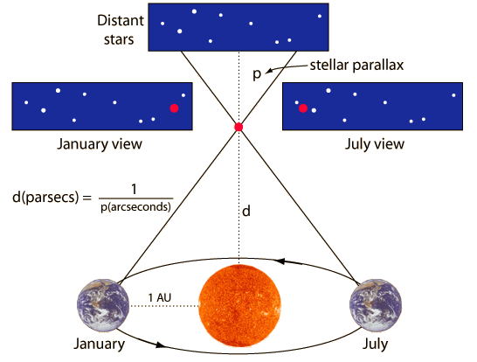
Stellar Parallax
The apparent shifting of a distant object against a stationary background when viewed from two different perspectives
Think about looking out of a window with a plant on the sill. As you walk past the window the object will appear to move relative to the background outside.
http://hyperphysics.phy-astr.gsu.edu/hbase/astro/imgast/stelpar.gif

Slide 30
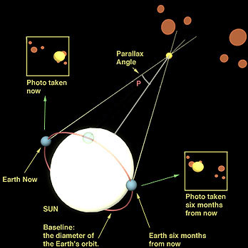
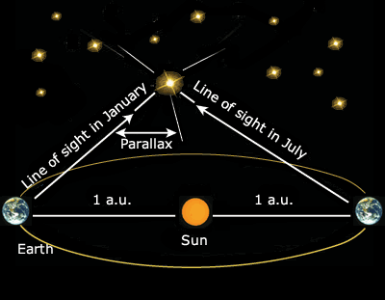
Parallax
The shift is very slight relative to the “fixed” stars behind the observed star but sufficient for distant stars… but not too distant (100pc or less)
Formula: d = $\frac{1}{p}$, where d is the distance to the star and $p$ is the parallax angle

Slide 31
Limitations of the Parallax method
Stars that are too far away will not show enough parallax to calculate their distance
Viewing stars from a space-based position helps to eliminate some of the error and increase the range, but at some point the error in the system equals or exceeds the angle being measured
Beyond that, other methods can be used

Slide 32
Luminosity
The energy radiated by a star is emitted uniformly in all directions, just as we would see with a light bulb
The total energy emitted by the star per unit time (i.e. the power) is called the luminosity of the star, L
Our Sun has a luminosity of 3.90 x 10²⁶W
We can measure brightness and determine distance to learn the luminosity of a star. (as you will see)
L is based on radius of a star and temperature of the star.
If r is equal, then higher temp = higher L
If temp is equal, then higher r = higher L

Slide 33
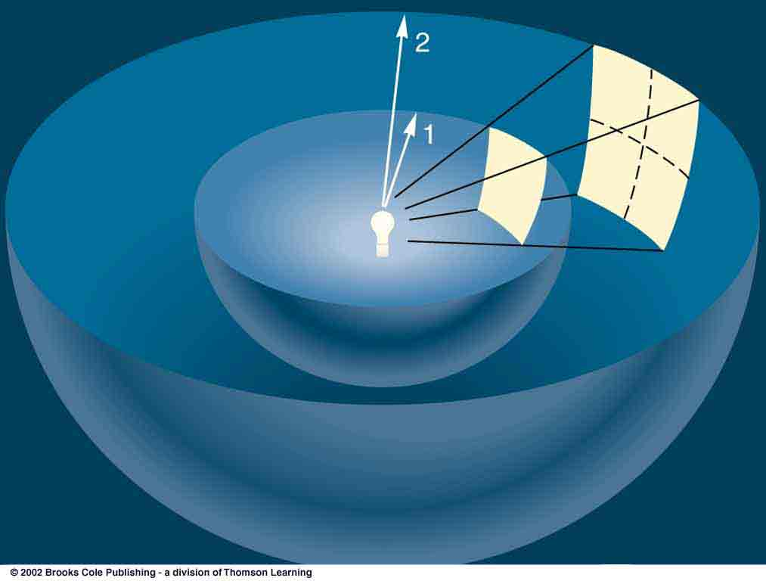
Apparent Brightness
By the time the energy released by a star arrives at Earth it will be spread out over a sphere of radius d. The energy received per unit time per unit area at the Earth is called the apparent brightness, b
$$b= \frac{L}{4πd^{2}}$$
L = luminosity
d = distance to the star

Slide 34
Apparent Brightness Formula
Assuming two stars of equal L, the closer star has a greater brightness
We would have to know the L of a star and its brightness to determine distance, but since all stars are not equally bright or luminous, we cannot use the formula in that way.

Slide 35
The Stefan-Boltzmann Law
$$L=σAT^{4}$$
$$L=4πR^{2}σT^{4}$$
Allows for a comparison of the Luminosities of different stars
A is the surface area of the star (SA of a sphere is $4πr^{2}$)
T is the surface temperature of the star
σ is the Stefan-Boltzmann Constant = 5.67 x 10⁻⁸Wm⁻²K⁻⁴
R is the radius of the Star
From this we can see that the luminosity of a start depends on it’s temperature and size!

Slide 36
Determining Stellar Distances
Now that we have the luminosity and brightness we can use an earlier formula to determine the distance to these far off stars
$$b= \frac{L}{4πd^{2}}$$

